Slide 1
What: Population Jelly Babies
Why: To revise how the structure of a population changes over time

Slide 2
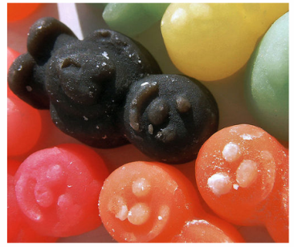
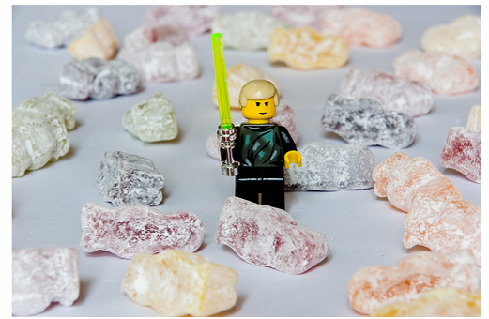
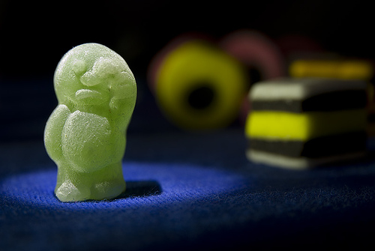
People in the population
Cohorts include:
Young people - also called
young dependents
Middle aged people –
the workers/ economically active
Older people - also
called elderly dependents
People are having to work for a lot longer, why?
What will this do to the number of elderly dependants?

Slide 3
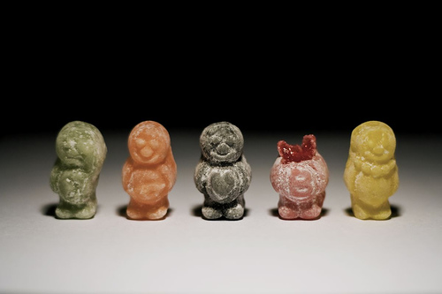
People are born…

Slide 4
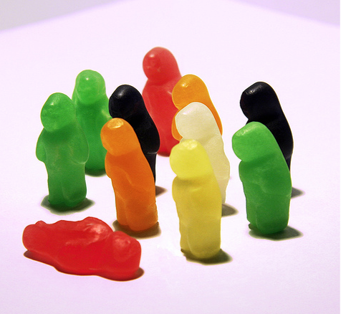
People die….

Slide 5
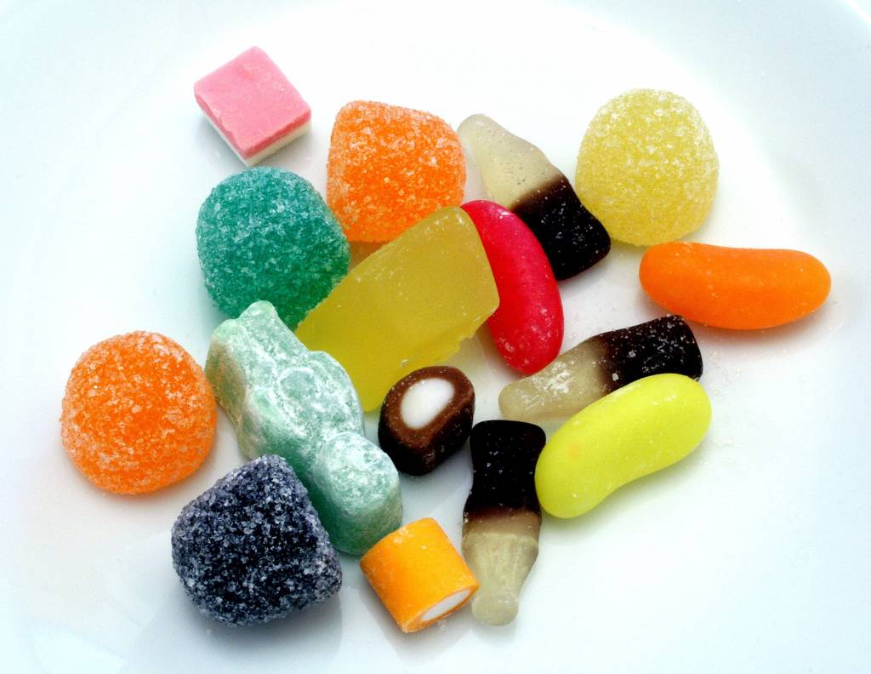
People move in…

Slide 6
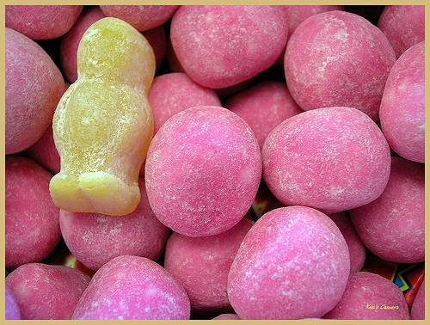
People move out…

Slide 7
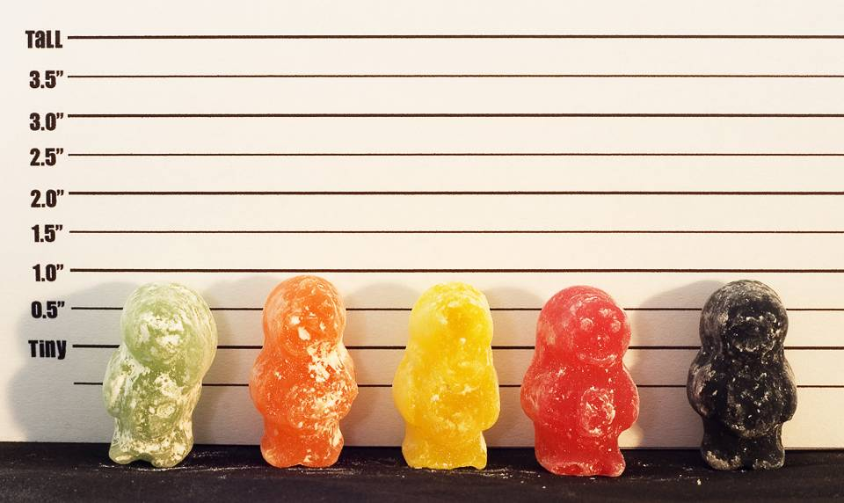
…and we all get older every day…

Slide 8
The game…
How will the population of your country change in response to a series of ‘chance’ events?
By the end of the game you should be able to answer this key question…
Why do some populations increase and others decrease?

Slide 10
M and M Geography …
Your jelly babies represent the people within that country. The colours of the m and ms represent different groups of people within the country.
Blue: Adult males
Red: Adult females
Yellow: Ageing population
Green: Immigrants
Orange: Female children
Brown: Male children
You will be given ‘chance cards’ which show scenarios which affect population growth/decline. At the end of the game you will explain the population structure of your country from the colour of your sweets.

Slide 11
