Slide 1
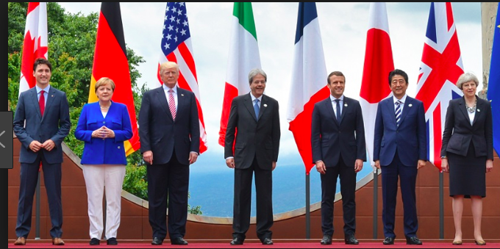
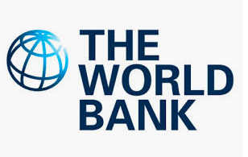
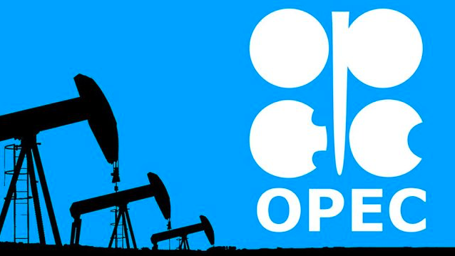
Powerful organizations and global groups
Powerful organizations and global groups:
G7/8, G20 and Organization for Economic Cooperation and Development (OECD) groups
Organization of the Petroleum Exporting Countries’ (OPEC) influence over energy policies
Global lending institutions, including the International Monetary Fund (IMF) and New Development Bank (NDB)

Slide 2
What: Powerful organizations and global groups:G7/8, G20 and Organization for Economic Cooperation and Development (OECD) groups
Organization of the Petroleum Exporting Countries’ (OPEC) influence over energy policies
global lending institutions, including the International Monetary Fund (IMF) and New Development Bank (NDB)
Why: To understand how global power and influence varies spatially​​
Learning objectives:
To be able to explain the role of several powerful organizations and global groups (G7, G20, OECD, OPEC, IMF and NDB).
To be able to briefly evaluate the influence of these powerful organizations and global groups.

Slide 4
Task 1 - Using the framework research grid below, use both the video and news story links, textbook and Kognity information plus your own research to find out and then share with you peers how powerful organizations and global groups exist at varying scales, and how membership is complex and subject to change. This information will be shared with the rest of the class so it needs to be detailed and well organized.

Slide 5
With your completed fact sheets answer these questions….
Evaluate the need for both the G7 and the G20.
How might OPEC influence the price of oil?
Explain the difference between the World Bank and the IMF.
Outline the key weaknesses of the ... (choose any of the six groups above).
What makes the World Development Bank different from the existing World Bank and IMF set up?

Slide 6
Summary
Which ‘powerful organization’ has the most influence over...
The USA
A low income nation seeking development assistance
The price you and your family pay for fuel
An upper-middle income country
The UK
The World

Slide 7
Example exam question
Using examples, explain how at least two powerful global organizations use their power. [12]

