Slide 1
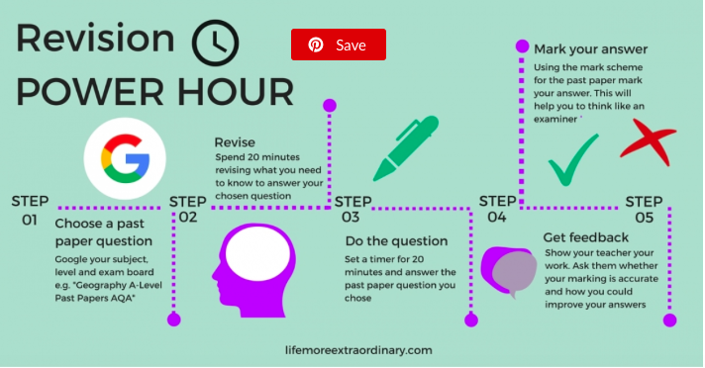
How to revise effectively

Slide 2
Examiners notes
make the choice of questions with care, ensuring that for each question they choose they have a named case study about which they can write in detail and with confidence.
● answer the three chosen questions in order, starting with the one with which they are the most confident, and finishing with the one with which they are least confident (in case they run out of time).
● read the entire question first before answering any part, in order to decide which section requires which information to avoid repetition of answers.
● highlight the command words and possibly other key words so that answers are always relevant to the question.
● use the mark allocations in brackets as a guide to the amount of detail or number of responses required, not devoting too much time to those questions worth few marks, but ensuring that those worth more marks are answered in sufficient detail.
● consider carefully their answers to the case studies and ensure that the focus of each response is correct, rather than including all facts about the chosen topic or area, developing each point fully rather than writing extensive lists of simple, basic points. It is better to fully develop three ideas rather than write extensive lists consisting of numerous simple points.
● study the resources such as maps, photographs, graphs, diagrams and extracts carefully, using appropriate facts and statistics derived from resources to back up an answer and interpreting them by making appropriate comments, rather than just copying parts of them.

Slide 3
Question: Explain how government policies can be used to increase rate of natural population growth (5)
This question was generally not well answered. Many answers contained simplistic statements such as ‘pay them to have children’, ‘ban contraceptives’, etc. rather than reflecting any real or plausible policies. A few good France and Singapore answers were seen although an example was not needed here, just the policies.

Slide 4
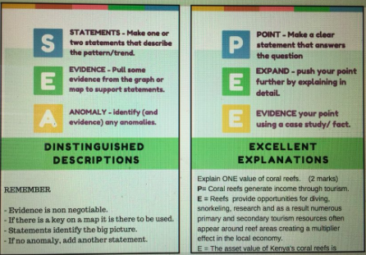

Slide 5
How to revise effectively: Use the shared drive
http://lifemoreextraordinary.com/revision/how-to-revise-effectively/?utm_source=twitter&utm_medium=social&utm_campaign=SocialWarfare

Slide 6
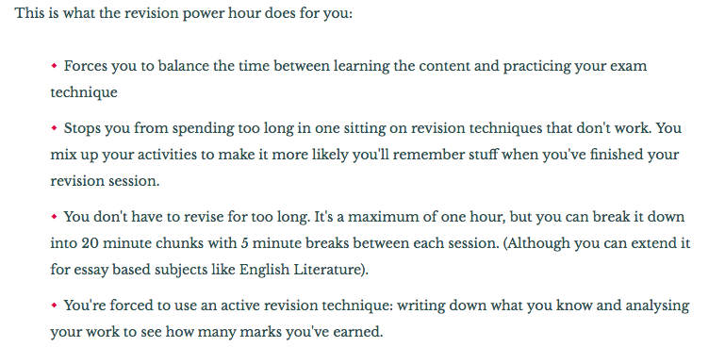

Slide 7
Access to exam papers
https://drive.google.com/drive/folders/1UxpILY8R1kqA-lQSkdYlRKXAAf1SFD4N
Or section at bottom of revision page on the weebly.

