Slide 1
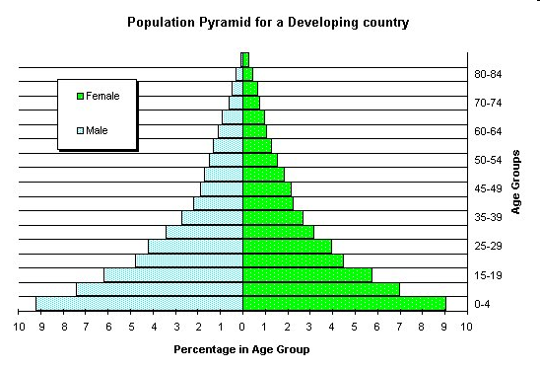
Can you explain this graph?
Think about these questions?
What does this graph show?
Which is the largest age group.
Which is the smallest age group
What percentage of males are aged between 35-39

Slide 2
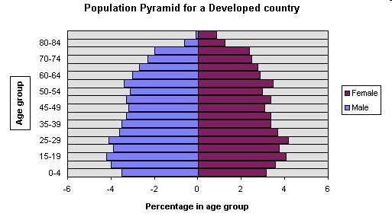
Population pyramids
What: To understand what population pyramids show
Why: To understand how we can use these to predict changes in the population
How: Learning about population pyramids for countries at different stages of development and considering what they may tell us about future populations
https://www.youtube.com/watch?v=RLmKfXwWQtE

Slide 3
Use the information on the sheet to annotate the 2 population pyramids

Slide 4
Identifying the key features of a population pyramid
Narrow at the top which shows that there is a small proportion of elderly people.
Wider in the middle which means that people are living longer, less infant mortality.
Wide at the top because there is longer life expectancy.
4% of the population is female aged 25-29.
Developing Country (LEDCs)
Developed Country (MEDCs)
Wide at the base which means there are a large proportion of young people in the country.
This pyramid is typical of a country such as Kenya or Vietnam.
This pyramid is typical of a country such as Italy and Japan.
Narrower at the base which means that birth rates are lower.
Stretch and challenge – Draw a sketch of a country that has an aging population
Notes:
Students stick the pictures into their book and copy down the information around it.

Slide 5
Using the mini white boards draw 4 population pyramids that represent each type of scenario below.
1. Seaside resort in the UK (ageing population)
2. Rural village in Zambia (lack of family planning)
3. Commuter town near London (Workers moving to suburbs)
4. Shanty town settlement on the outskirts of Rio de Janeiro (infant mortality high, low life exp)

Slide 6
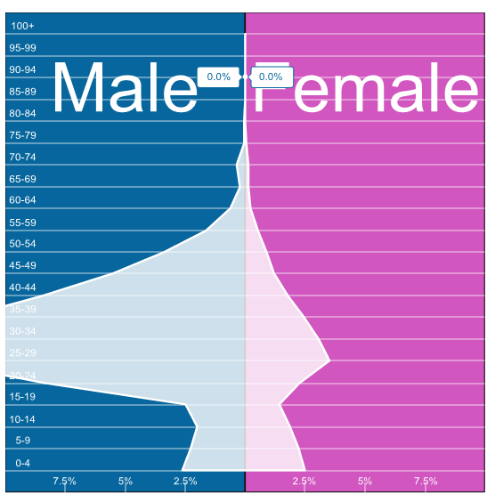
Exam Question
Qatar
Using the graph to the right, explain why Qatar population pyramid is so different to what you would expect.
(3 marks)

