Slide 1
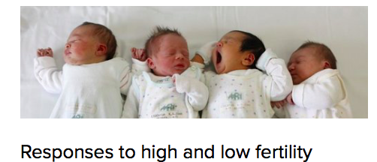
What: Population challenges and opportunities Why: Population possibilities and power over the decision-making process How: I can evaluate policies associated with managing population change, focusing on pro-natalist or anti-natalist policies

Slide 2
An introduction to population policies
TASK
Click and open the article …
Make a table of points to do with a pro-natalist policy and anti-natalist policy
-Summarise the main points in bullet point format
Include examples and data

Slide 3
Example of an exam question:
“Government attempts to control population growth are ineffective.” Discuss this statement. [15 Marks]

Slide 4
Task: Due next Tuesday
In groups of 3 you will be working on teaching a population policy: Singapore, China, or Kerala (India).
You will be preparing an infographic revision resource (using Piktochart) for the whole class and a 5 minute lesson (video, PPT, lecture…)
Roles within the groups: researcher, preparing the lesson, preparing the piktochart etc...
Things to include:
Why the policy was needed
How it was enforced
Was it successful
Any issues/ barriers
Case study detail
What is the situation today

Slide 5
Assessment
“Government attempts to control population growth are ineffective.” Discuss this statement. [10 Marks]

Slide 6
“Government attempts to control population growth are ineffective.” Discuss this statement. [10 Marks]
NOWLEDGE
ommand and content
C
K
Facts
Figures
Places
Concepts
Scale
time
Describe (no because)
Explain (use because)
Analyse (SITCOMSS)
Evaluate/extent (three o’s)
General theory
What are the possibilities for population control?
Who has the power?
What specific information will you use?
PLACES
CASE STUDIES
PLACE STUDIES
NAMED EXAMPLES
POLICIES
TREATIES
ETC
WHAT SPECIFICATION CONTENT IS REQUIRED FOR THIS QUESTION?
CONCLUSION
XAMPLES
PPLYING FOR AO2
E
A
Comparison between case studies- why may some be more successful than others?
How will you turn up the heat?
Which areas will you use?
What are the possibilities here? Who has the power?
EVALUATIVE
EXAMPLES
LINKS
DEPTH
APPLY
Finally, what’s your method?

