Slide 1
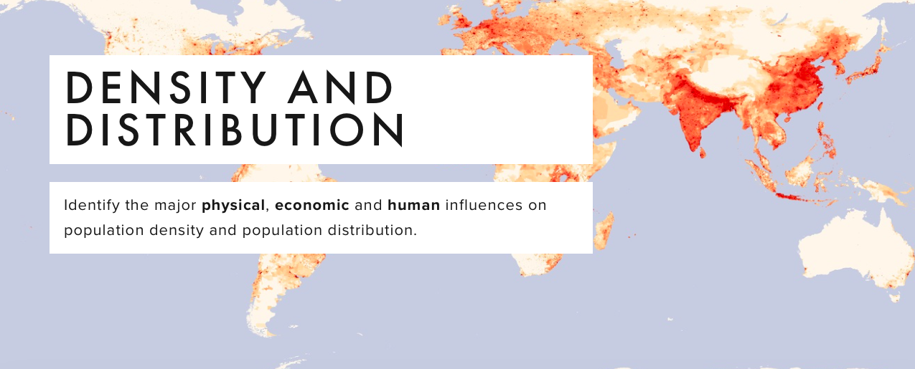

Slide 2
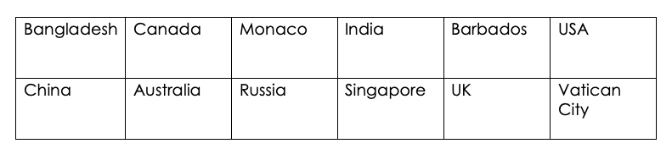
Population density continuum
Put these countries in the correct order….

Slide 3
Population density continuum answers (answers in people per Square KM)
1
Monaco- 18,960
Singapore 7,804
Vatican City 2273
Bangladesh 1161
Barbados 668
India 411
UK 274
China 145
USA 34
Russia 9
Canada 4
Australia 3

Slide 4
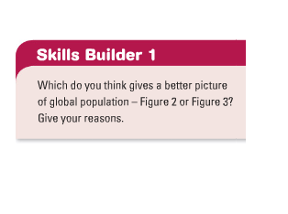
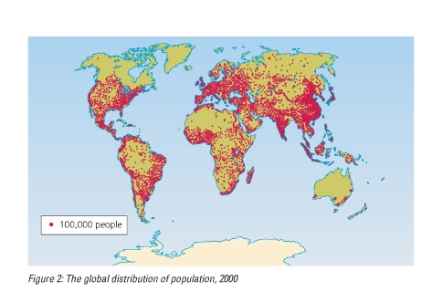
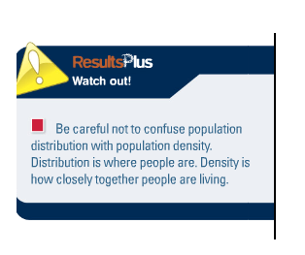
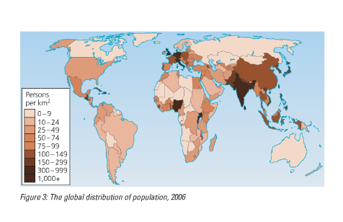

Slide 5
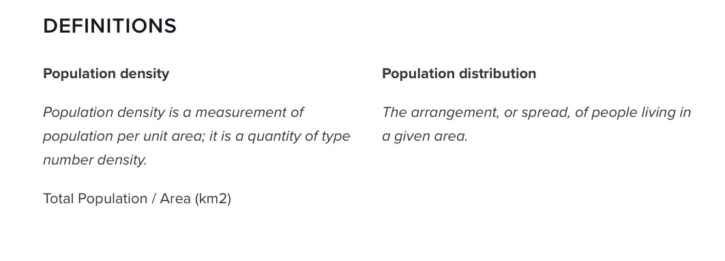

Slide 6
Sparse and densely populated areas.
Densely populated
Lots of people per Km².
Sparsely populated
Few people per Km².
2 per Km²
200 per Km²

Slide 7
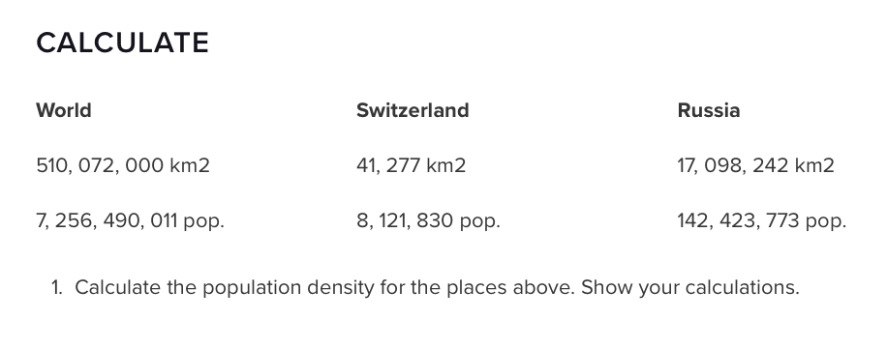
Population density is normally worked out using the following formula:
Total Population / Total Land Area = Total Population Per Square KM.

Slide 8
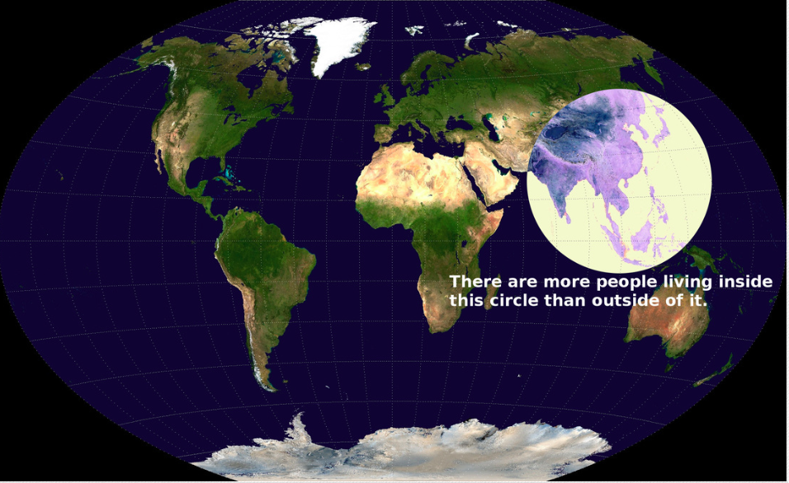
How would you describe this distribution?

Slide 9
Don't believe everything you see though. This is the visualization, but we have to check it out. The countries in the circle are .
China: 1,349,585,838 people India: 1,220,800,359
Indonesia: 251,160,124
Bangladesh: 163,654,860
Japan: 127,253,075
Philippines: 105,720,644
Vietnam: 92,477,857
Thailand: 67,448,120
Burma: 55,167,330
South Korea: 48,955,203
Nepal: 30,430,267
Malaysia: 29,628,392
North Korea: 24,720,407
Taiwan: 23,299,716
Sri Lanka: 21,675,648
Cambodia: 15,205,539
Laos: 6,695,166
Mongolia: 3,226,516
Bhutan: 725,296
… which adds up to a grand total of 3,637,830,357, or roughly 51.4 percent of the global population of 7,083,460,000 (May 2013)

Slide 10
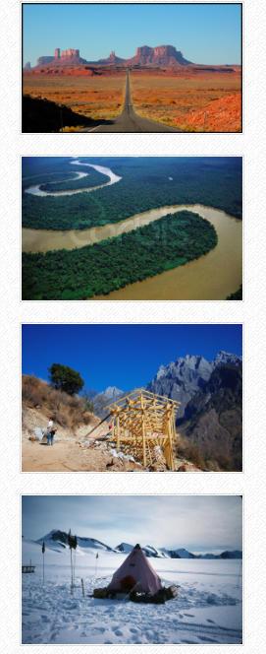
What factors will impact population density?

Slide 11
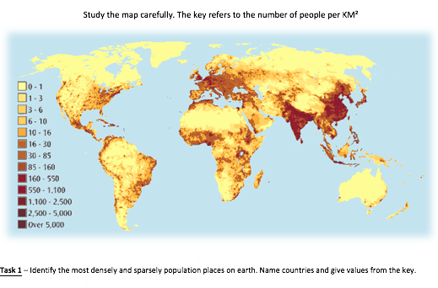
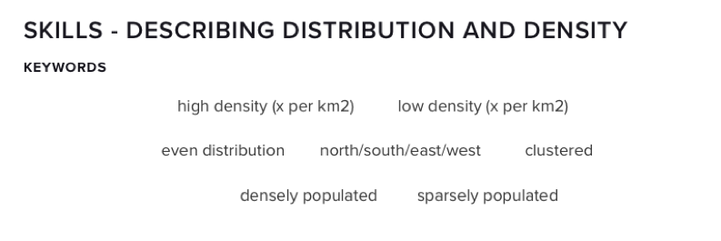
Describe the distribution of sparse and dense populations (4)
Extension
Explain why this pattern exists (6)

Slide 12
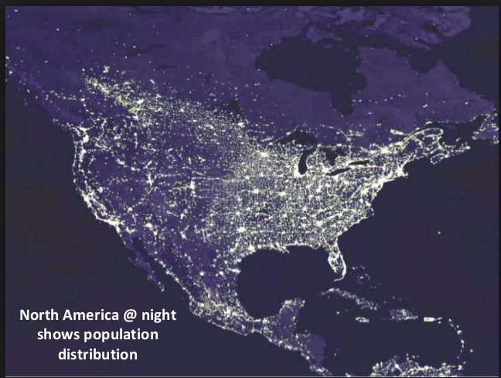
Case study: Population distribution in North America

Slide 13
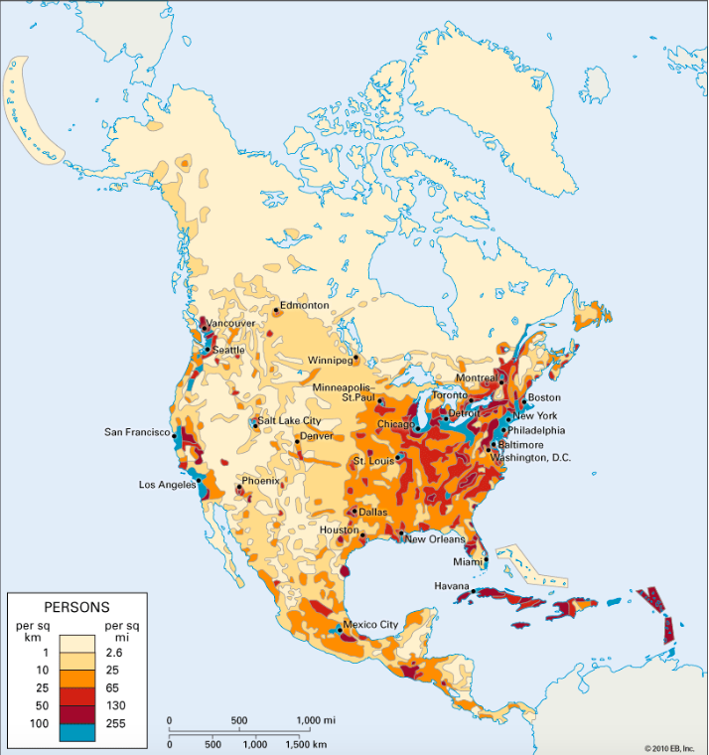
Task:
Describe the population distribution of the USA (4)
Success criteria:
Give overall pattern
Use geographical locations
Use the key
Identify any anomalies

Slide 14
The population distribution of North America
Annotate the map to explain the reasons why some areas have a high population density and some have a low population density
Success criteria:
Include place names
Include specific reasons (use the atlas and information from the textbook resources to help)
Use data from the key
Use different colours for high and low population density

Slide 15
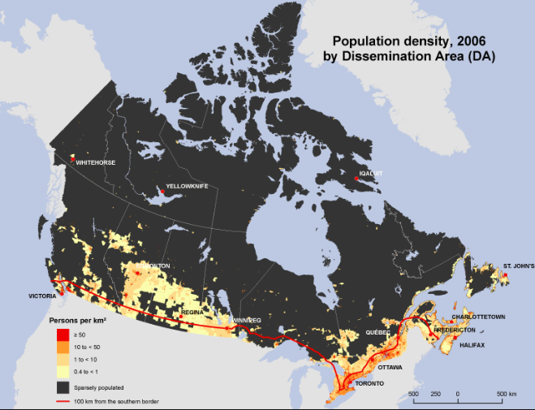
Population distribution in Canada
https://www.youtube.com/watch?v=TftLaHb1FvA

Slide 16
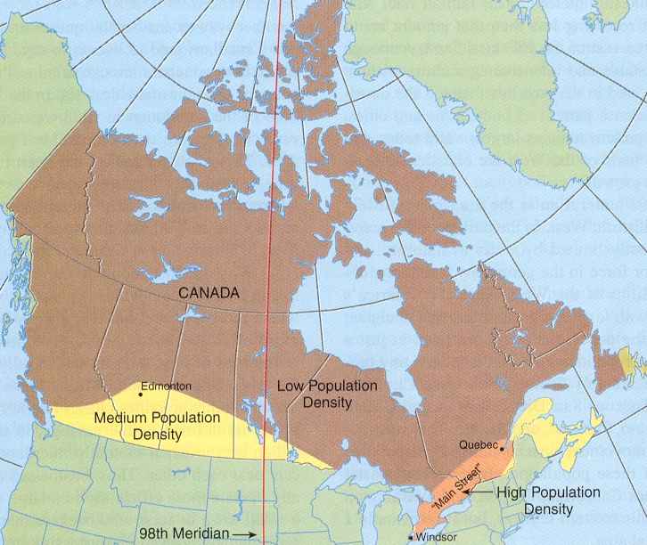
Population Distribution
The highest concentration of people lie within the corridor from Quebec City to Montreal, and Toronto to Windsor.

Slide 17
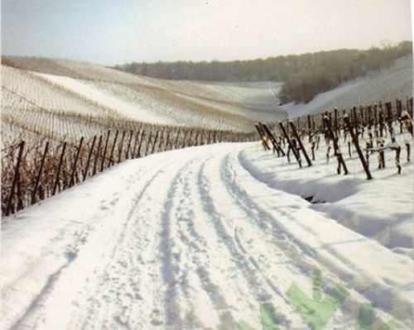
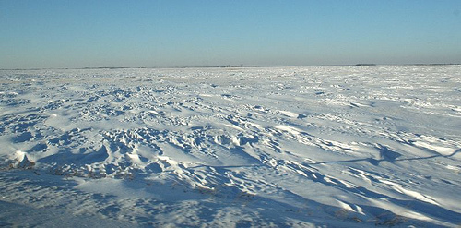
Population Distribution
Because climate conditions in Canada are hostile, most of Canada’s 72% population live in the warmer southern portions of the country.
This is within 150 miles of the United States Border.

Slide 18
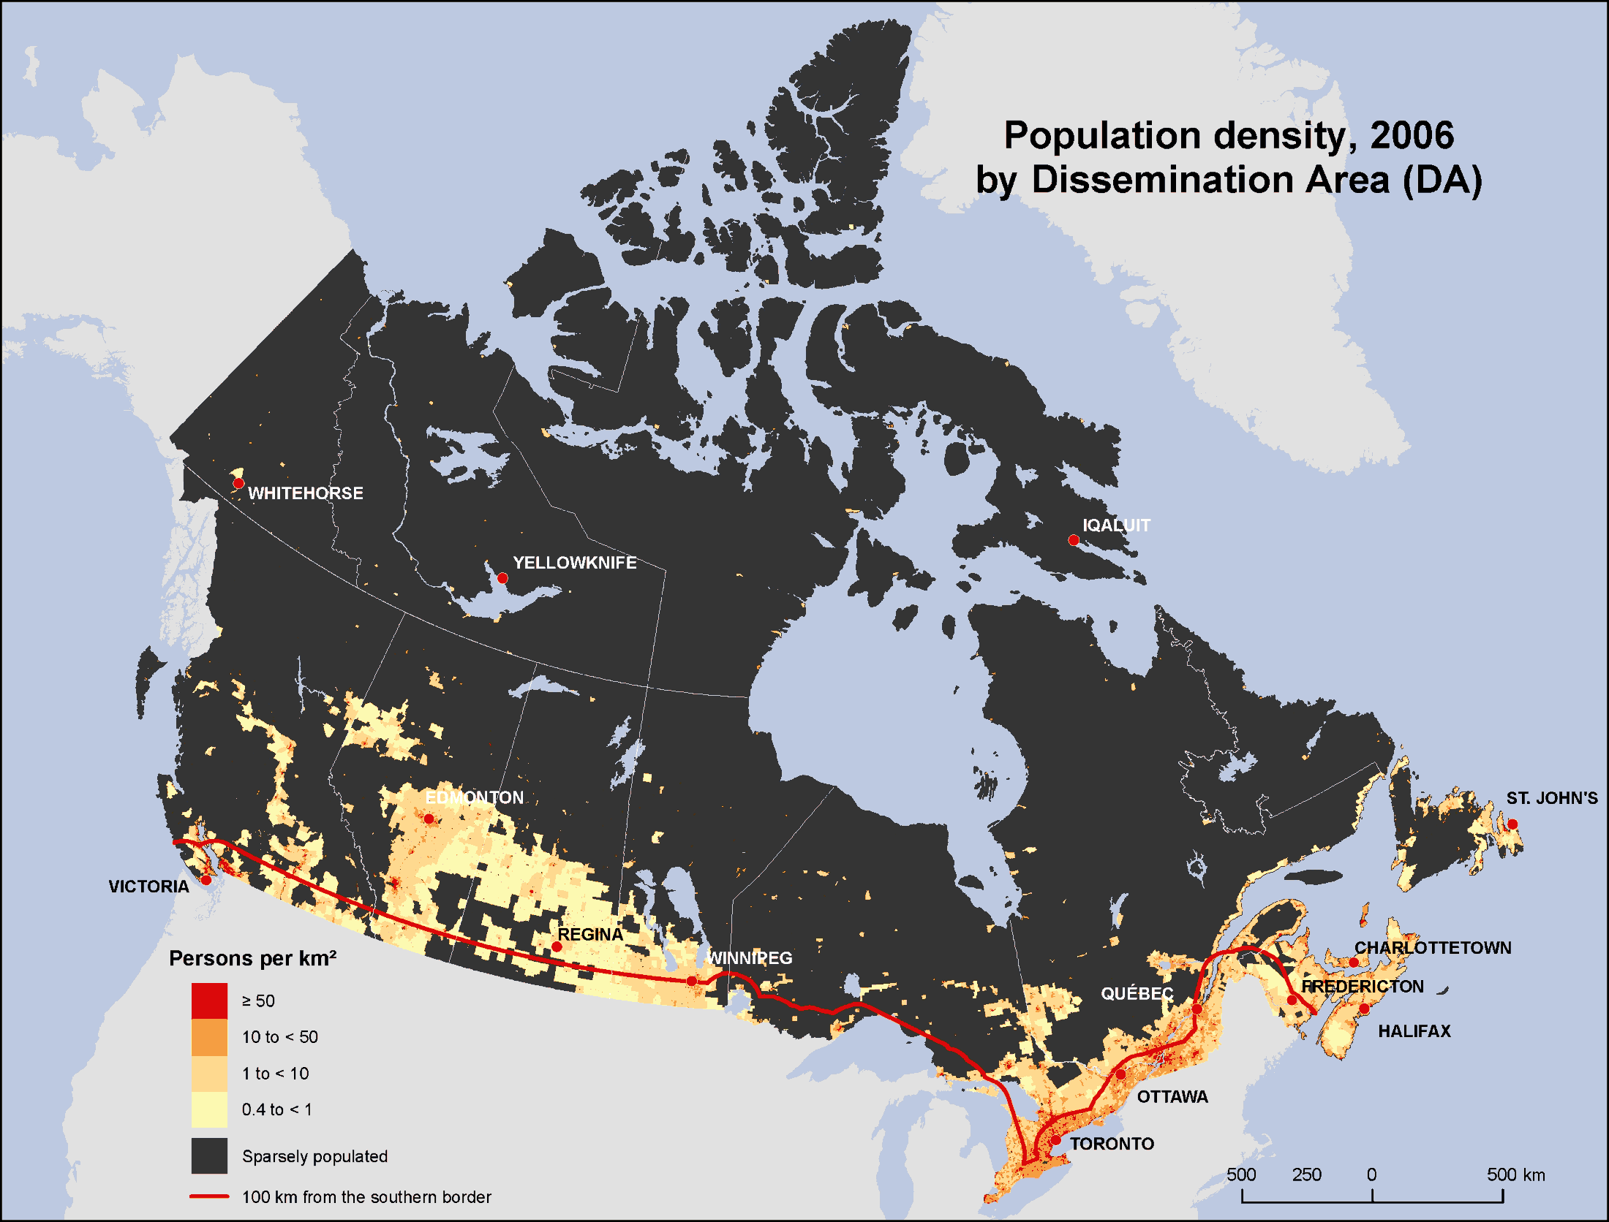

Slide 19
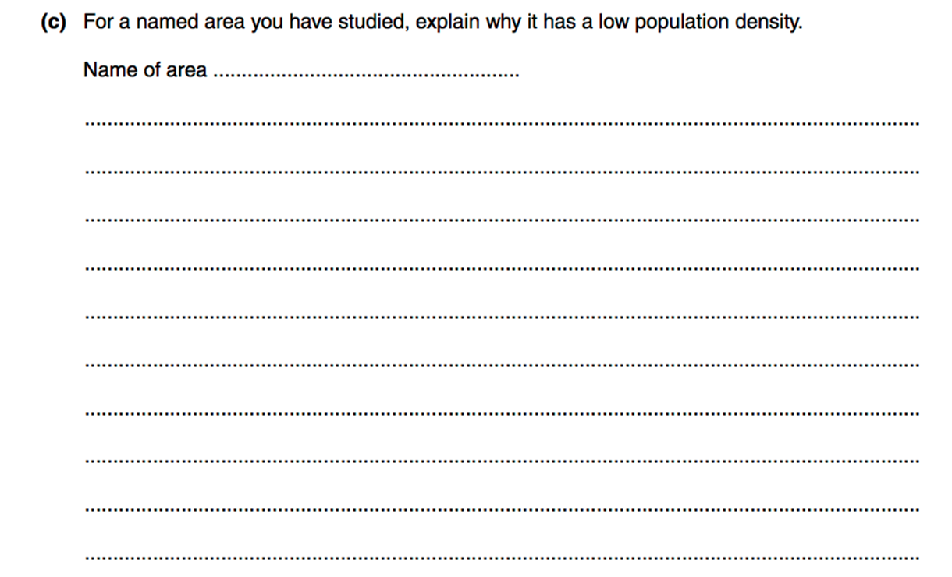
Example 7 mark question

Slide 20
