Slide 1
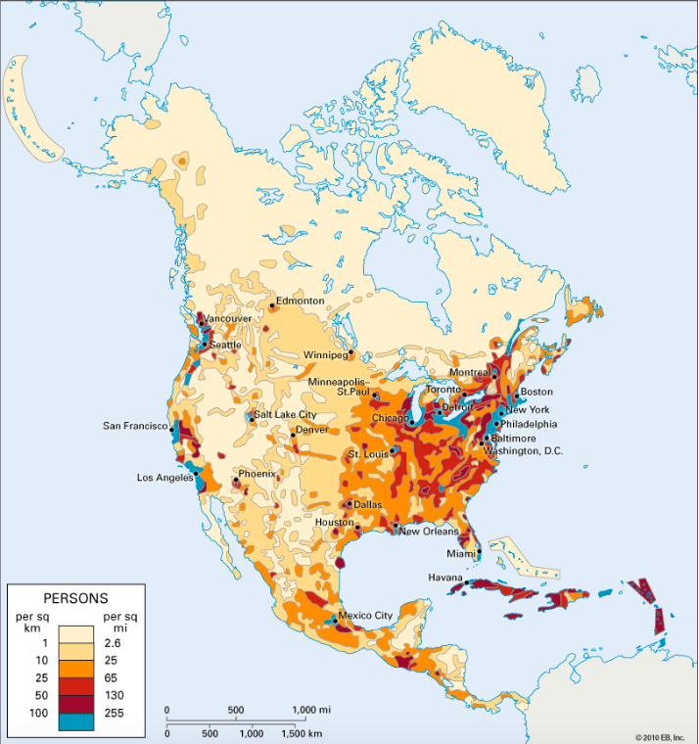
Population Density Patterns - The Case Studies
An example of one country or region that is densely populated and one country or region that is sparsely populated.

Slide 2
Exam questions to answer:
Homework
Complete the following 7 mark exam questions:
For a named area you have studied, explain why it has a low population density (7)
For a named area you have studied, explain why it has a high population density (7)
Success criteria
Name the region/country and correctly locate it (likely to be a region in North America)
Include a range of specific reasons (3-4 developed ideas)
Think about the influence of both human and physical factors
Use facts, figures, specific details and names of places
Answer the questions in your Geography book (if you type your answers, please print and attach in your book)

Slide 3
Sparsely populated area (few people per square kilometre): The Northlands of Canada

Slide 4
LOCATION
The Canadian Northlands are an area of North America that lie beyond 55 degrees north
The largest settlement in the Canadian Northlands is Yellowknife in the Northwest Territories, population 19,000
The area has a population density of less than 1 person per square kilometre
55N

Slide 5
Reasons for the Canadian Northlands being sparsely populated
A major reason why so few people live in this area is due to the climate.
Temperatures are extremely cold and inhospitable in winter, with the mean average January temperature being -20 degrees C.
Summers are short and the climate in much of the northlands is beyond the limits of agriculture.
The inability to grow food on the land is a key factor in explaining low population density.

Slide 6
Reasons for the Canadian Northlands being sparsely populated
Much of the Northlands are affected by permafrost. This means that the ground is permanently frozen for long periods of the year. When the ice does melt in some the land becomes waterlogged. This makes life in the region very difficult e.g. it makes it restricts building and crop growth.

Slide 7
Reasons for the Canadian Northlands being sparsely populated
The environmental conditions mean that there is great difficulties for human development in the region.
For example, transport and communications are hampered by the climatic conditions.
Railway and road routes are extremely limited and the use of water transport is dictated by the seasons.
For many communities, air transport is the only link they have to the outside world.

Slide 8
Densely populated area (many people per square kilometre): The North-East USA

Slide 9
Location
The greatest concentration of population in the USA is in the North-East.
The region stretches from Inland from Boston and Washington to Chicago and St Louis.
The area from Boston to Washington is known as BOWASH. This continuous urban area is known as a megalopolis, it also includes the cities of New York and Philadelphia.

Slide 10
Reasons for the North-East USA being densely populated
New York City is a global city because it is one of the great financial cities of the world. It is the most densely populated city in the USA.
The global importance of New York means that there are a wealth of job opportunities in the area – leading to population growth.

Slide 11
Reasons for the North-East USA being densely populated
The north-eastern states are along the Atlantic Coast, this enables trade which provides job opportunities and boosts population growth. Port of New York is the busiest port in the United States of America.

Slide 12
Reasons for the North-East USA being densely populated
The north-east has the most highly developed transport networks In North America, this enables people to move around easily making it more appealing for businesses to develop and for people to settle in the area.

Slide 13
Reasons for the North-East USA being densely populated
The climate and soils in the north-eastern USA are generally fertile. This enables the development of agriculture to support human populations.

