Slide 1
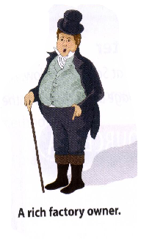
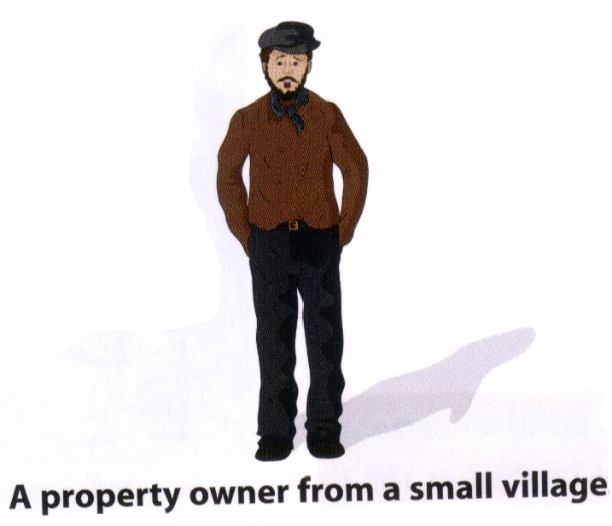
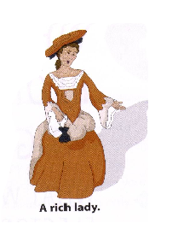
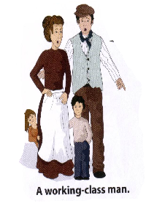
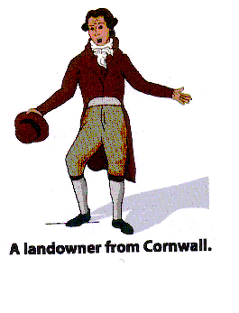
Starter:
Two of the following people are the odd ones out.
Who are they?
Why?

Slide 2
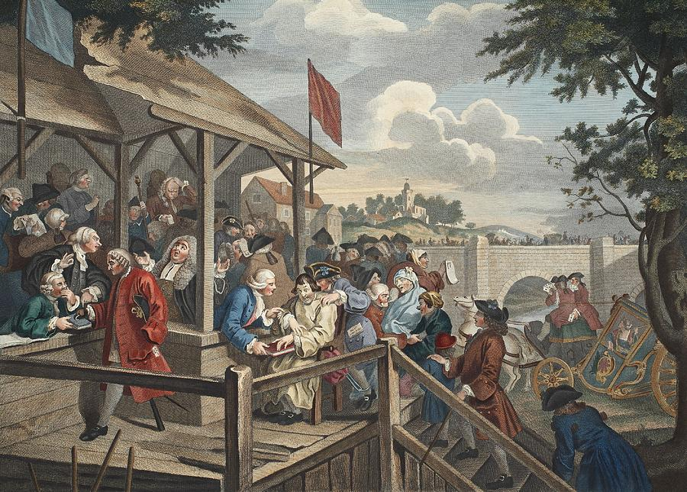
Hogarth’s “the Election” about 1754 election in Oxfordshire
What was wrong with the voting system in Britain in 1830?

Slide 3

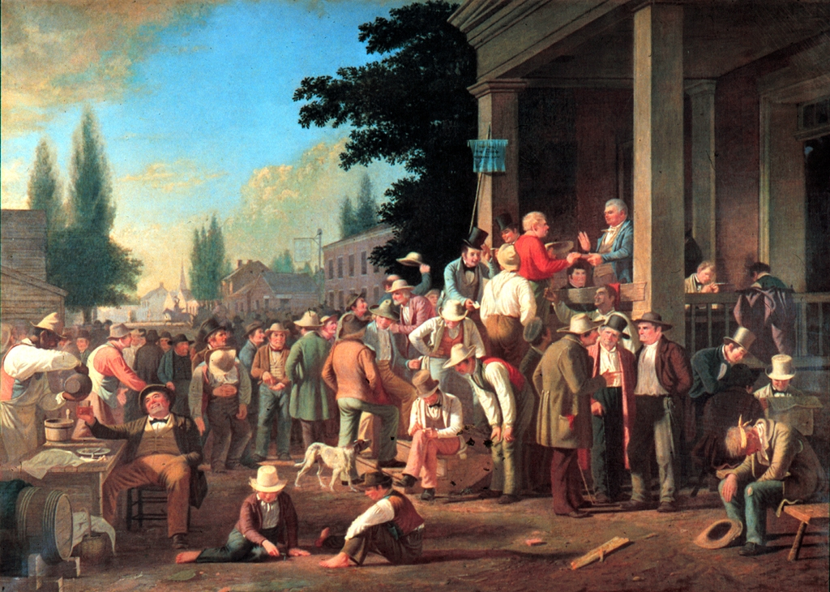
Threats
Voters could be threatened with violence, loss of jobs or houses if they didn’t vote as told to.
Bribery
Voters could be given money as a bribe to vote for a particular candidate.
Treating
Candidates bought voters drinks and meals in return for their vote.
Public Voting
Voters had to shout out who they were voting for. This was then written down.

Slide 4

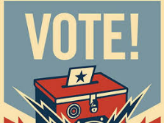
Why were people unhappy about voting rights in the 19th century?
In the early 19th century, the king and those who owned land and titles were the people who controlled the country. They made decisions about how the country should be run and what should happen to everyone else in society. This became a problem when the population increased during the Industrial Revolution. Many factory owners became very wealthy – but they, and their workers, had no political power. Only 1 in 10 men could vote.
PROBLEM #1:
One of the main complaints was about the so-called rotten boroughs. These were areas that sent to Members of Parliament (MPs) to parliament even though no one lived there. In one case there was a mound of grass called Old Sarum, where a village used to be: still, two MPs went to parliament to represent it! Birmingham, on the other hand, was one of the largest and fastest growing towns, yet it had no MPs to represent its people in parliament.
PROBLEM #3
When people did go to vote there was no secret ballot. This meant that people had to say in public who they were voting for. Therefore, they could be easily bribed, and in some cases people were sacked if they did not vote for the ‘right’ candidate. This was not true representation, as the same corrupt people continued to hold power.
PROBLEM #4
Unfairly, some people were allowed to vote purely because they had a fireplace and a locked door! These were called potwalloper boroughs because in order to prove their assets, the men would rattle their keys in a large cooking pot. On top of all this, women did not have the vote. Despite how much money, how many fireplaces, and how many locked doors they had!
PROBLEM #2
Pocket boroughs were also an issue. These were boroughs that were controlled by rich individuals who did not represent the needs of everyone
Key Questions:
Who could vote in the 19th century?
What reasons could be used to support voting reform in the 19th century?

Slide 5
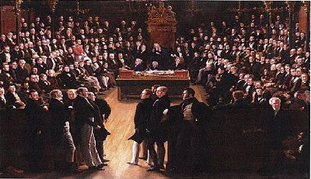
Enquiry Question: How was electoral reform achieved?

Slide 6

Pause For Thought
Radical Protest
In Britain, both rich and poor alike noted the effect of the French Revolution, an event in which the ordinary people of France rebelled violently against the ruling class.
This coincided with the end of the Battle of Waterloo, when many soldiers returning home needed work.
The introduction of the Corn Laws and a poor harvest meant people were starving.
People were now no longer in a position to wait for change – they needed representation in parliament, and radical speakers started to demand it.

Slide 7
Pause For Thought
Great Reform Act (1832)
On the third attempt Earl Grey went to the king and requested new Lords be appointed who were sympathetic to reform.
The existing Lords were horrified – they would lose their power and influence to Lords from another political party.
As they did not want this, they agreed to finally pass the reform act.
It had been such a battle it is called the “Great Reform Act”.

Slide 8
Fear of a revolution
Terms of the Act
The 1832 Reform Act
1832 Crisis
Limitations
of the Act
Public Response

Slide 9
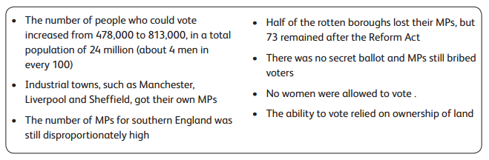
How “great” was the Great Reform Act?
YOUR TASK: Read p132-3
Explain how the Great Reform Act impacted the middle class.
Explain how the Great Reform Act impacted the working class.

Slide 10

Key Question:
How did Britain become more democratic?
YOUR TASK:
On your sheet you have descriptions of electoral reform in Britain from 1800 to 2011.
EASY = Place them in chronological order and stick them in your exercise book.
MEDIUM = Explain what aspects of democracy have been reformed (i.e. what has changed)?
HARD = Explain the continuity of aspects of democracy (i.e. what has stayed the same)?

Slide 11
How satisfied were these people with the Reform Acts?

Slide 12
1800
1900

Slide 13
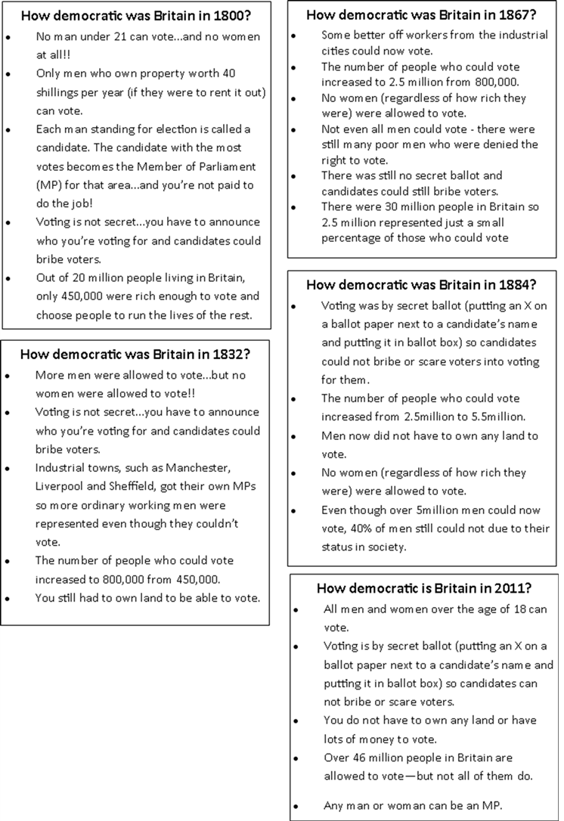

Slide 14
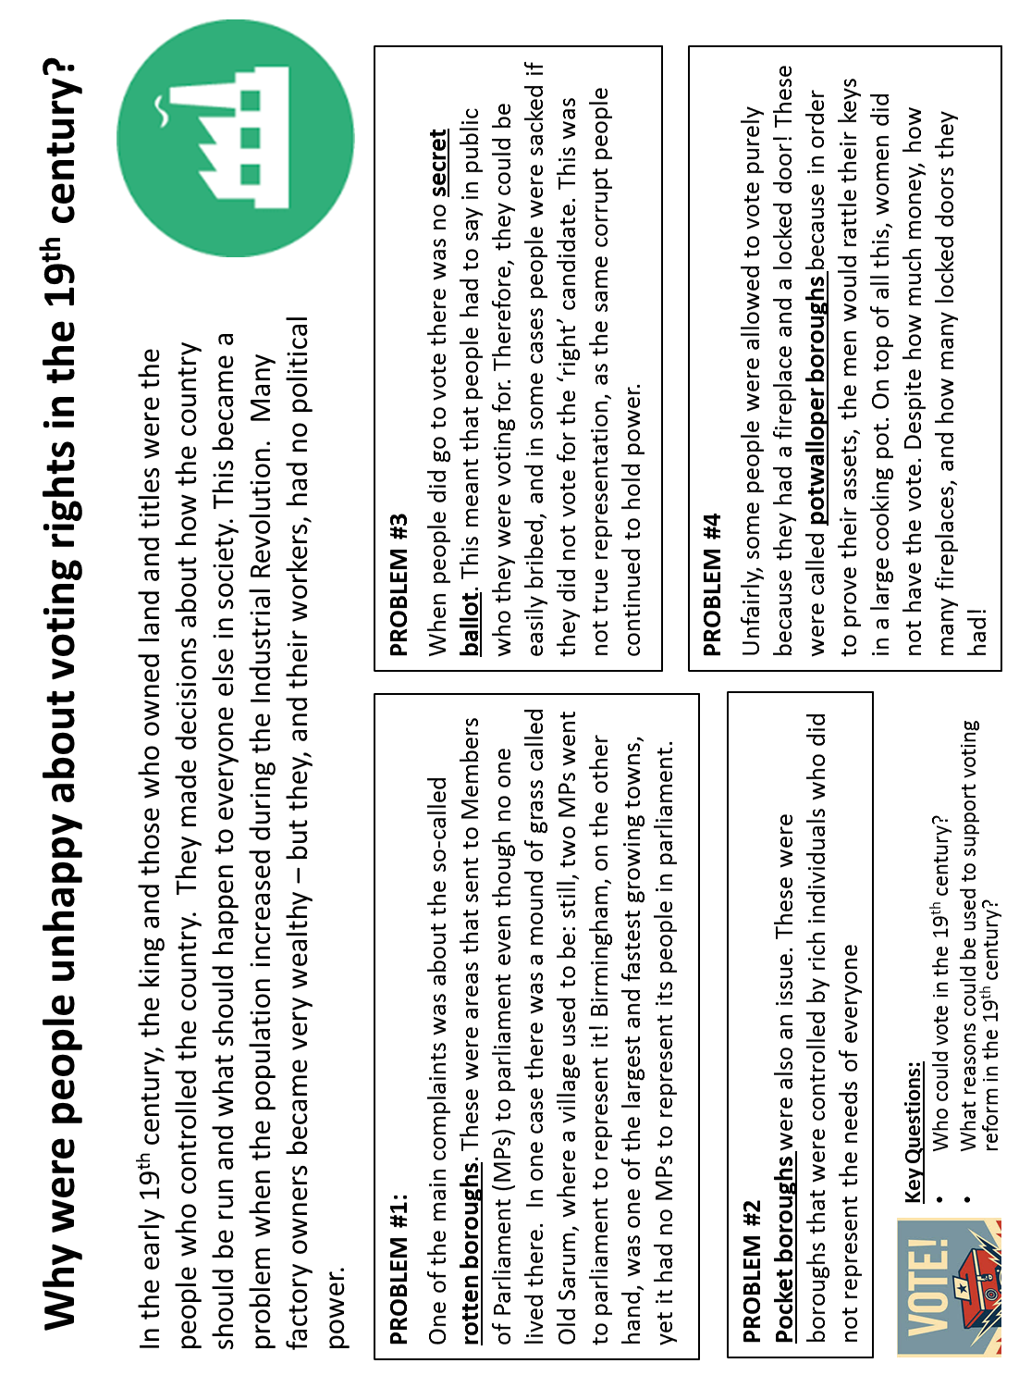

Slide 15
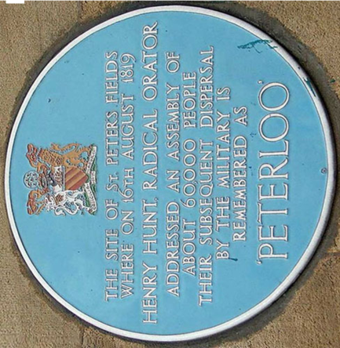
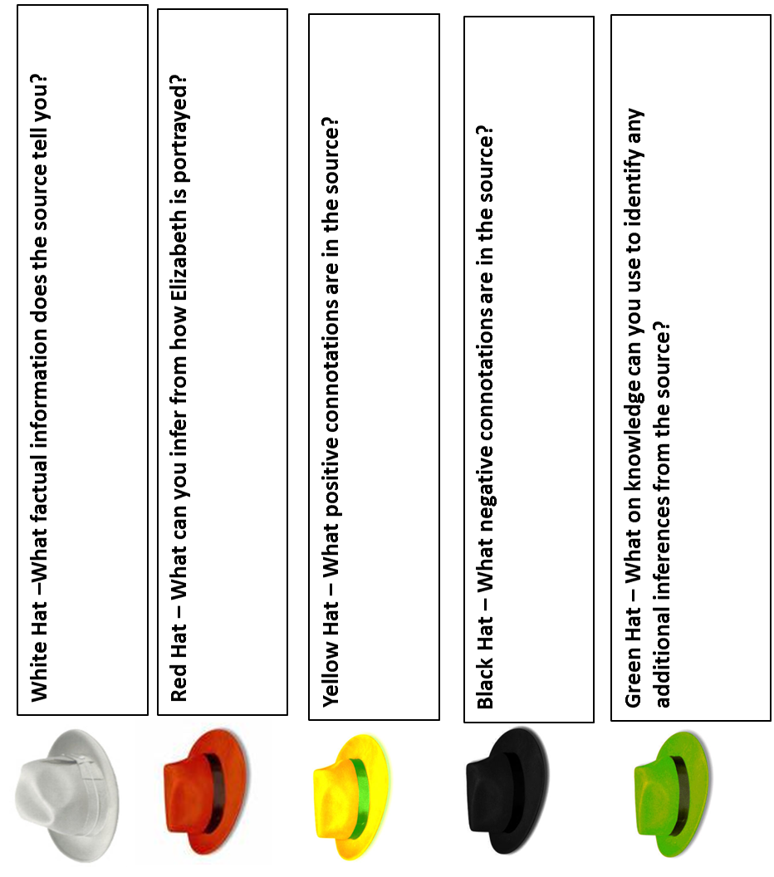
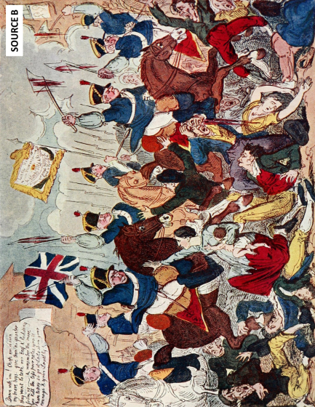
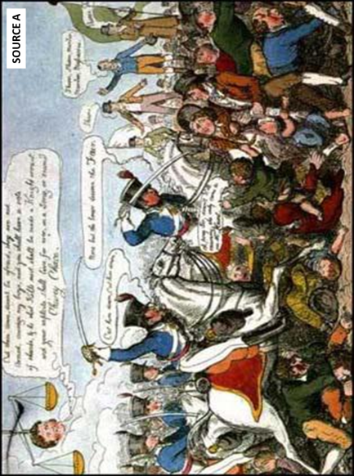
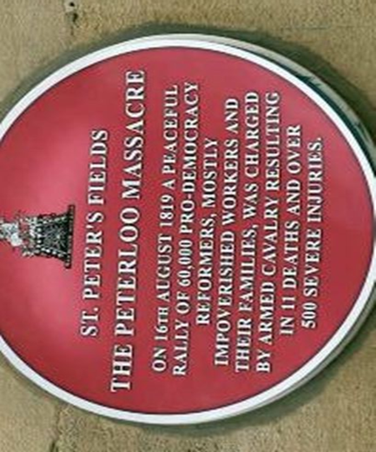
Definitions:
BALLOT
MASSACRE
MP
SOURCE E
“In 1819, there was a gathering in St Peter’s Field in Manchester, of people who were demanding the vote. This was a peaceful protest where the 60,000 protestors listened to speeches by radicals such as Henry Hunt. Hunt inspired the crowds with his speech that called for the reform of parliament.
The local magistrate panicked when he heard how many people had gathered, and called for the local militia. It is reported that they were drunk, and so events escalated quickly. Within 10 minutes, 600 people had been wounded and 15 had been killed. These figures include women and children. Working-class people making clear demands had scared the authorities into responding with violence.
After the event, which became known as the Peterloo Massacre, the government introduce the Six Acts. These stated that any meeting of more than 50 people for radical reform was an act of treason. Anyone doing this was now breaking the law.”
– Aaron Wilkes (History textbook)
What can the Peterloo Massacre teach us about voting rights?

Slide 16
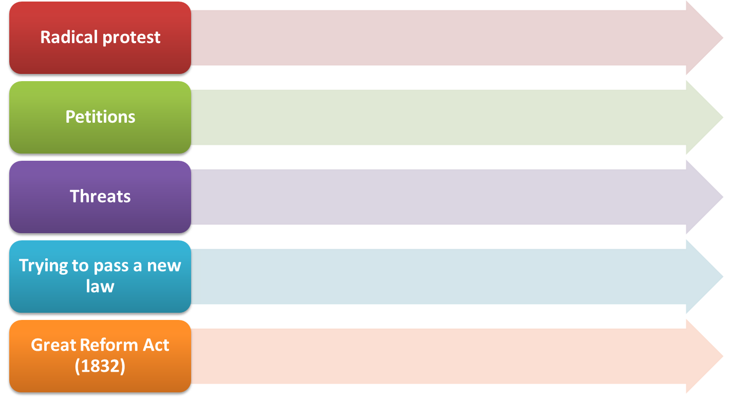

How was the Great Reform Act passed?

Slide 17
LARGE PICTURES
(Use for Thinking Hats Group Work)

Slide 18
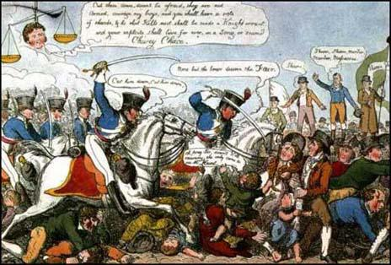
SOURCE A

Slide 19
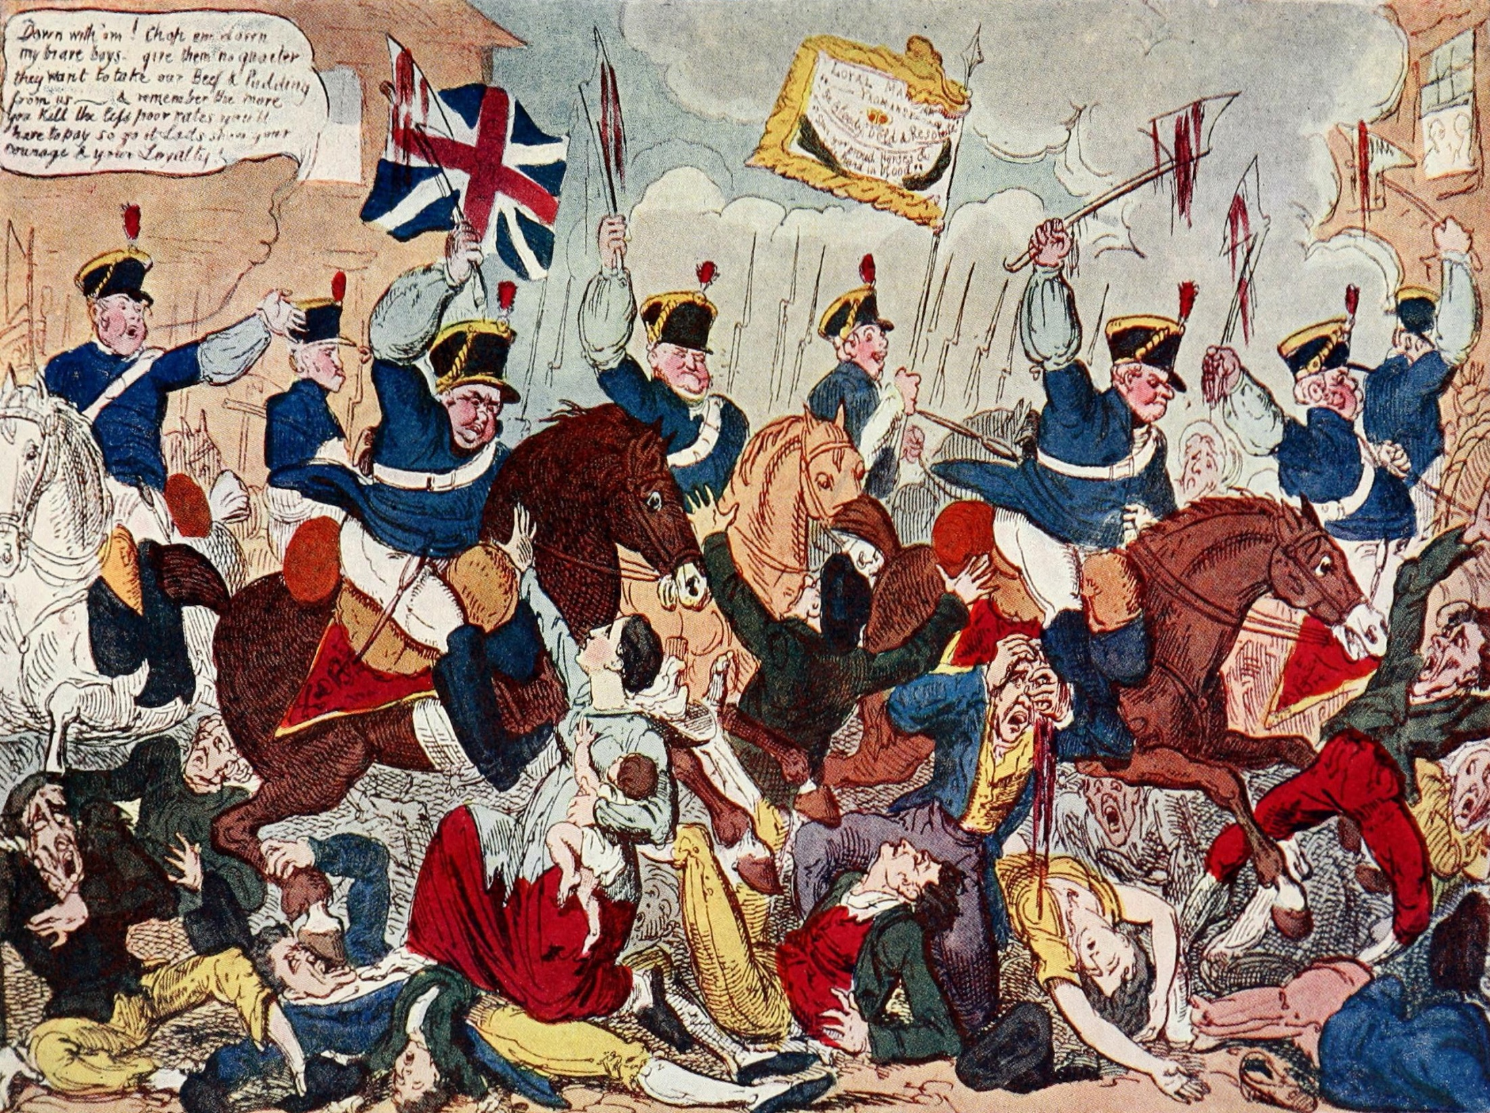
SOURCE B

Slide 20
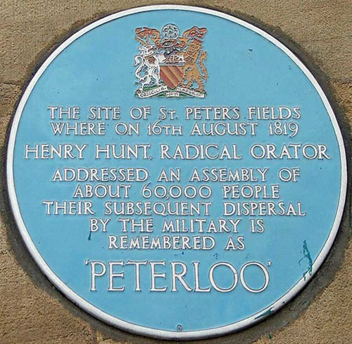
SOURCE C

Slide 21

SOURCE D

Slide 22
SOURCE E
“In 1819, there was a gathering in St Peter’s Field in Manchester, of people who were demanding the vote. This was a peaceful protest where the 60,000 protestors listened to speeches by radicals such as Henry Hunt. Hunt inspired the crowds with his speech that called for the reform of parliament.
The local magistrate panicked when he heard how many people had gathered, and called for the local militia. It is reported that they were drunk, and so events escalated quickly. Within 10 minutes, 600 people had been wounded and 15 had been killed. These figures include women and children. Working-class people making clear demands had scared the authorities into responding with violence.
After the event, which became known as the Peterloo Massacre, the government introduce the Six Acts. These stated that any meeting of more than 50 people for radical reform was an act of treason. Anyone doing this was now breaking the law.”
– Aaron Wilkes (History textbook)

Slide 23
By the end of the lesson YOU will:
Know the key features of the 19th century Reform Acts.
Understand that the Reform Acts did not address all of the problems with the political system.
Have assessed the Reform Acts by producing a living graph.

Slide 24
Who did the Reform Acts satisfy?
Great Reform Act, 1832
Middle class men given the vote.
56 Rotten Boroughs abolished.
Voters in industrial towns able to elect 142 MPs.
One in five men could vote.

Slide 25
Who did the Reform Acts satisfy?
Second Reform Act, 1867
All male property owners were given the vote.
45 extra MPs elected from industrial towns.
Over one million more people could now vote.

Slide 26
Who did the Reform Acts satisfy?
Secret Ballot Act, 1872.
Landlords and employers could no longer intimidate or bribe workers to vote for a certain person.
Elections had to be carried out in private.

Slide 27
Who did the Reform Acts satisfy?
Third Reform Act, 1884-5
In most areas, all men could now vote.
Voters increased by two million.
Women still could not vote.

Slide 28
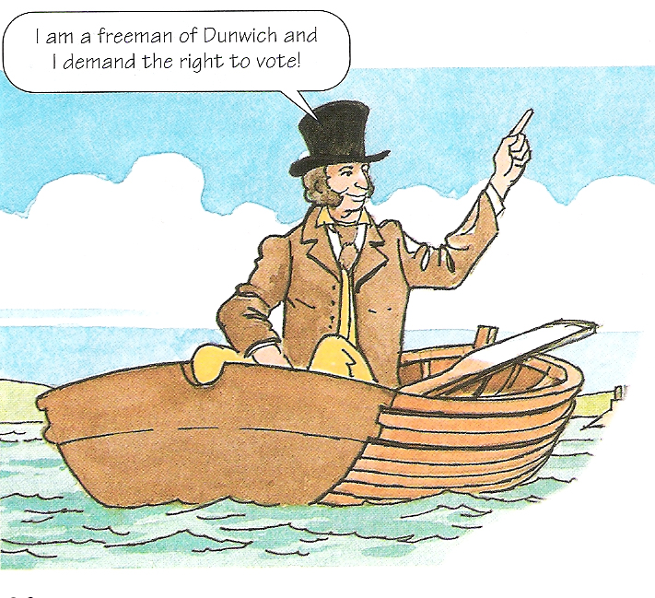

Terms of the Act
(what it changed)
It gave Middle class men the right to vote.
Voters increased to 2 in every 10 men.
No more rotten boroughs.
One new qualification throughout the country.
Anyone occupying a house worth at least £10 per year could vote.
Some seats in parliament were redistributed so some northern towns gained an MP while others lost.
Scotland and Ireland were given extra seats in Parliament.

Slide 29


Limitations of the Act
(what it didn’t do!)
Elections were still held in public so threats and bribery could still take place.
Property in the North wasn’t worth as much as in the South so many still couldn’t vote.
M.P’s were still not paid so many were still from the upper classes.
Working class men were not given the right to vote.
Constituencies were still not of an equal size.
The Upper Classes gave away just enough power to the Middle Class to stop the threat of a Revolution.

Slide 30
Fear of a Revolution
The Upper Classes were worried that the revolution which had happened in France could happen here in Britain.
They were concerned that the lower classes might take control of the country.
There had been many protests over recent years: Swing Riots, Luddites and the Peterloo Massacre.
The Middle and Working Classes had been protesting together for the right to vote.

Slide 31
Public Response
The working class were angry that the middle class had received the vote and they had not.
This was because the two groups had protested together to gain the vote.
There was only a small increase in the number of men who were able to vote.
The North was still under represented.
There were still now working class MP’s in Parliament as there were no salaries for MP’s.
The disappointment of the working classes led to the formation of another protest group called ‘The Chartists’.
The Chartists got their name because they made a list of 6 points that they wanted on a ‘People’s Charter’
MP’s should be paid
Everyman over 21 who was of sound mind and not a criminal should be able to vote.
No property qualification.
Secret ballots
Equal constituencies
Annual elections for Parliament.

Slide 32
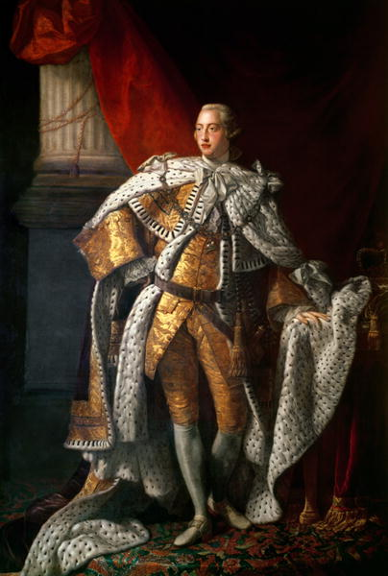
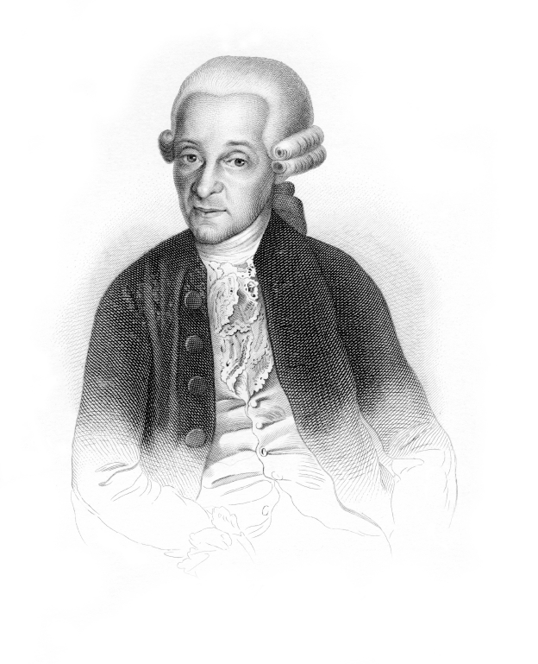

The Reform Riots 1831-32
In 1830 there was a new King, William IV.
There was a new Whig government who had promised reform in the voting system.
MP’s in the House of Commons put forward their ideas for a Reform Act but the House of Lords rejected it.
Most of the Lords were strong Tories and refused to pass reforms no matter what MP’s or voters wanted.

Slide 33
The Reform Riots 1831-32
People’s anger at the Lord’s blocking the Act turned to violence, especially as people were hungry due to bad harvests.
There were serious riots all over the country.

Slide 34
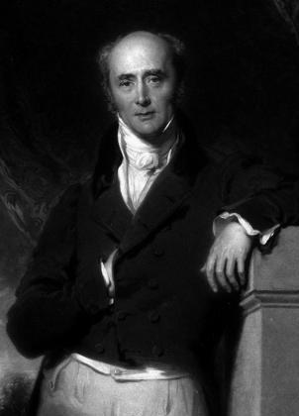
The Reform Riots 1831-32
In December 1832 the Whigs tried again to get a Reform Act through Parliament.
Once again the Lords blocked it.
This time the Whigs leader, Earl Grey, asked the King to make 50 new Whig Lords who would vote for the Reform Act but the King refused.
People were furious and there were rumours that soldiers were going to join the protestors.
Earl Grey

Slide 35
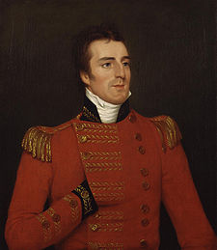
The Reform Riots 1831-32
William IV and the Lords were scared.
In the end the Lords could see that the Reform Act had to be passed.
It became law in 1832 and has been known ever since as the Great Reform Act.
Duke of Wellington
Prime minister
King George IV

