Slide 1
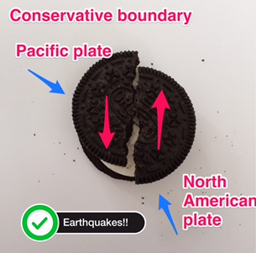
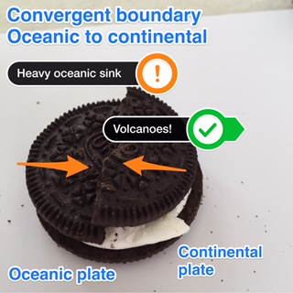
Homework- Oreo Style ♯OreoTectonics
Using the top of your Oreo, create three models of each plate boundary
Take a photo using Skitch
Annotate the photos showing the following:
Plate name
Plate movement
Landform created
Mrs Bennett’s for inspiration!

