Slide 1
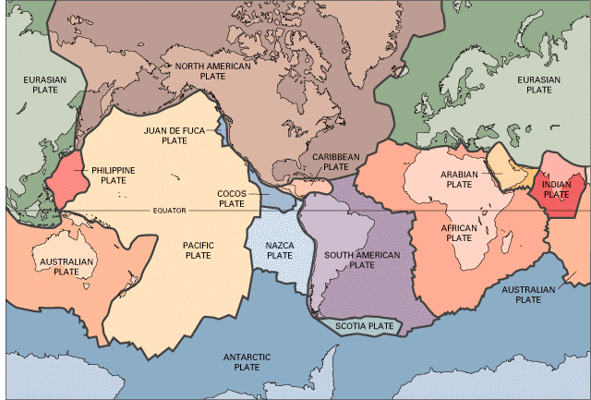
Plate boundaries
LO: to be able to explain what happens when plates meet

Slide 2
In what ways do the plates move?
3 types of plate movements we need to know:
Convergent: Plates move together. Can be split into destructive (oceanic and continental crust) and collision (continental and continental)
Divergent: Plates move apart from each other. Can also be called a constructive margin.
Conservative: Plates slide past each other.

Slide 3
What you need to know about each plate boundary:
1. What happens at that boundary
2. What activity (e.g. volcano or earthquake that causes)
3. Why that activity is caused
4. Examples of locations
5. Draw an annotated sketch.

Slide 4
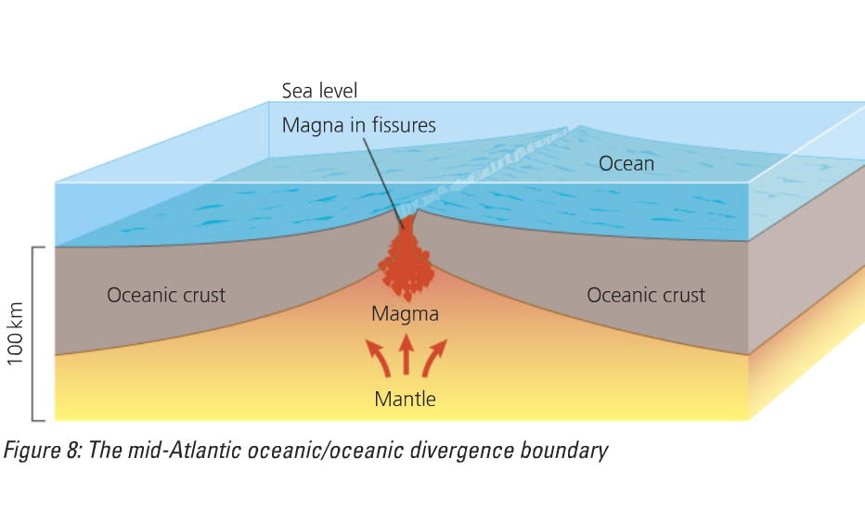
Divergent or constructive plate margin

Slide 5
How is it formed?
Convection currents cause the plates to move apart
As the plates move apart the magma wells up from the mantle to form new basaltic oceanic crust (new plate area is formed)
The Earth’s surface area increases due to the formation of new oceanic crust – sea floor spreading

Slide 6
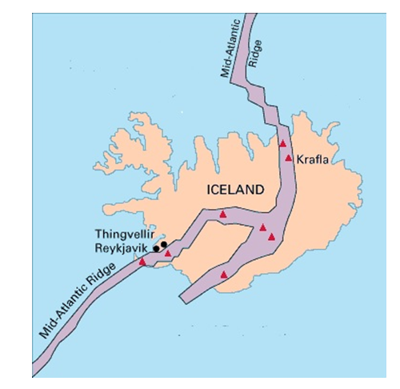
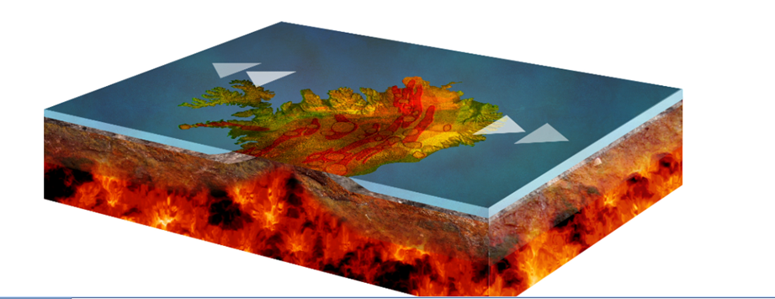
Divergent (constructive) plate margins in Iceland

Slide 7
Constructive plate margins: Using notes from the Tectonics DVD
What’s a ‘composite volcano’ and why is it so-called?
Why do volcanoes have different layers of different material?
What’s the difference between a volcano and a caldera?
Why are constructive plate margins also known as ‘divergent margins’?
Why does Iceland have as many as 30 different volcanic systems?
How and why does lava vary?
What’s different about a ‘fissure eruption’? Why are they safer for people to watch than most volcanic eruptions?
What’s the difference between a lava tube and a lava field?
What’s the difference between a geyser and a fumarole?
Why do many volcanic features have a limited life?
What’s a ‘rift valley’?
Why do volcanic eruptions become extremely hazardous where glaciers and ice are concerned?
Why did Eyjafjallajökull’s eruption in 2010 have great impacts at long distances away from Iceland? Why were many people inconvenienced?

Slide 8
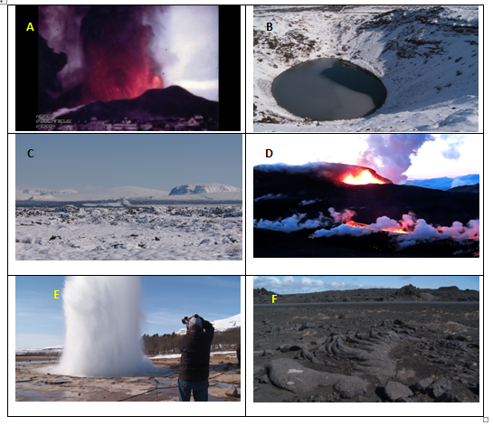
Characteristic features of a divergent plate margins

Slide 10
Mark scheme

Slide 12
Explain the processes that take place at divergent plate boundaries (4)
Divergent plate boundaries are when two plates move away from each other. The plates move due to convection currents in the mantle. The movement can cause a gap called a mid-oceanic ridge. Magma rises to fill the gap, thus creating new land. Where magma builds up above the surface of the ocean, volcanic islands form. If a constructive (divergent) margin is found on the land a rift valley will be formed.

Slide 14
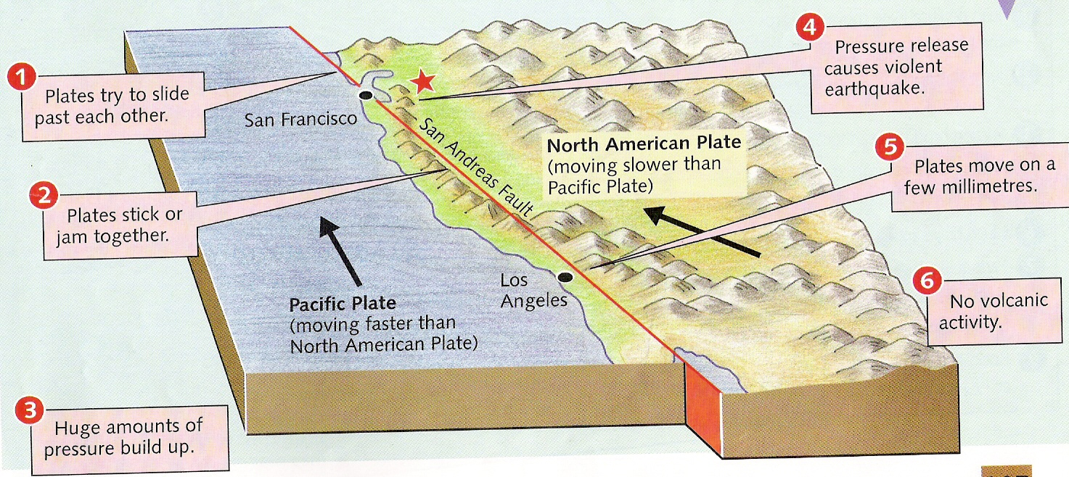
Conservative plate boundary

Slide 15
What happens at conservative margins?
As the plates slide horizontally past each other pressure builds up in the rocks either side of the fault
Fault surface often rough – friction creates large strains along the faults
An earthquake happens when the built up pressure and energy are released in a sudden, jerky movement

Slide 16
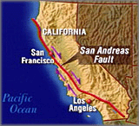
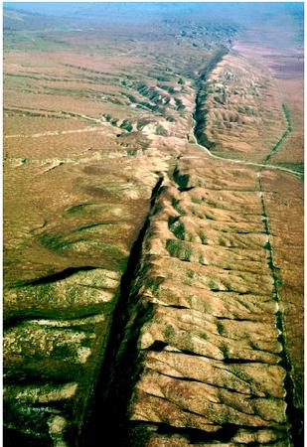
San Andreas Fault
The San Andreas Fault is the border between two tectonic plates — the North American Plate and Pacific (Nazca) Plate

Slide 17
Conservative plate margins: Notes from tectonics DVD
What made the Haiti earthquake in January 2010 ‘the biggest urban disaster ever’?
What were the reasons that so many people were a) killed, b) made homeless on Haiti?
Why is it as important to assess vulnerability to an earthquake as it is to know how big it is on the Richter Scale?
What makes the population of Haiti so vulnerable to earthquakes?
What human factors made the population of Haiti so vulnerable to an earthquake like that of 2010?

Slide 18
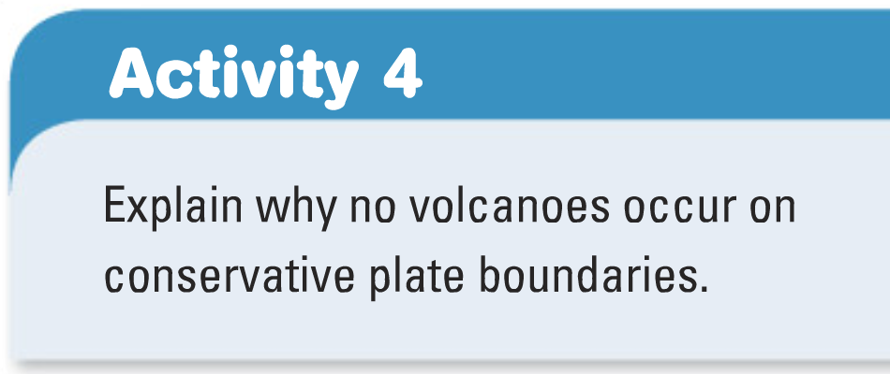

Slide 19
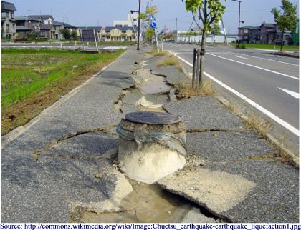
When the plates collide (or convergent plate boundaries)
LO: to be able to explain what happens when plate boundaries meet

Slide 20
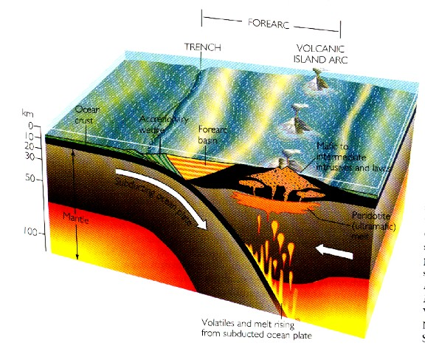
Key words we have learnt so far
Convergent
Divergent
Conservative
Oceanic
Constructive
Crust
Mantle
Ocean ridge
Plate
Core
Convection currents

Slide 21
Diagram for memory
Get into pairs
Label yourself 1 and 2

Slide 22
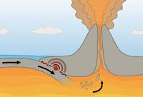
How did you do?

Slide 23
Destructive plate margin (where a continental plate meets an oceanic plate)- a form on convergent margin

Slide 24
Labels:
Neatly add these correct labels:
Generally explosive volcanic eruptions.
Magma rising to form volcanoes.
Plate being forced into the mantle
Deep, violent Earthquakes
One plate is denser than the other so sinks.
Plate melting.
Subduction zone
Oceanic plate
Continental plate
Ocean trench
Make sure you can explain how earthquakes and volcanoes occur at this plate boundary

Slide 25
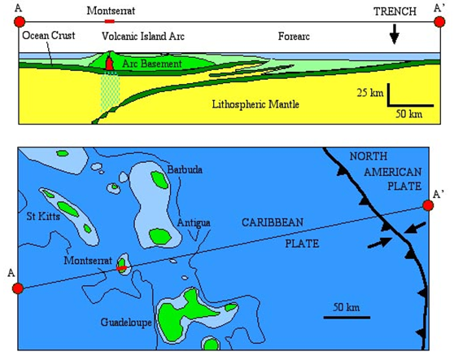
Montserrat: a destructive plate margin

Slide 26
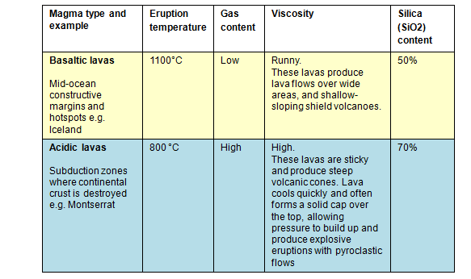
The difference in the lava produced… this will cause different types of volcanoes and eruptions

Slide 27
Destructive plate margins: notes from tectonics DVD
Explain why there are volcanoes and earthquakes on Montserrat.
Explain how lava on Montserrat is different from that on Iceland.
How and why are Montserrat’s volcanic eruptions different from those on Iceland?
Why do volcanic eruptions along destructive margins occur much less frequently than those on constructive margins?
Why is the volcano on Montserrat ‘incandescent’?
Why are volcanic domes found on Montserrat rather than volcanic shields?
Why does the volcano on Montserrat seem to have long periods of inactivity?
What’s so dangerous about pyroclastic flows?
Explain the difference between ash fall, pyroclastic flow and tephra.
What’s a composite volcano?
Explain why ocean trenches are associated with destructive plate margins.
How can plate margins produce the world’s biggest mountain ranges?
What’s the difference between a ‘collision margin’ and a ‘destructive margin’?
What do Fold Mountains have to do with plate margins?
Why do earthquakes in locations such as Christchurch often occur very many times?

Slide 28
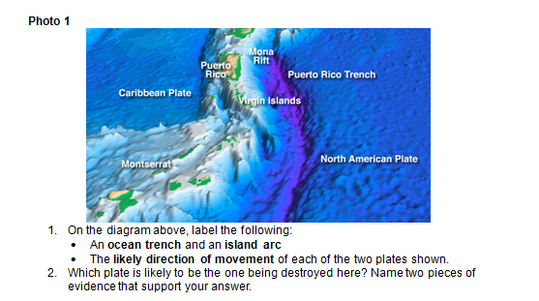
Characteristic features of a destructive (convergent) plate margin

Slide 30
Practice exam paper (June 2010)

Slide 31
Mark scheme

Slide 32
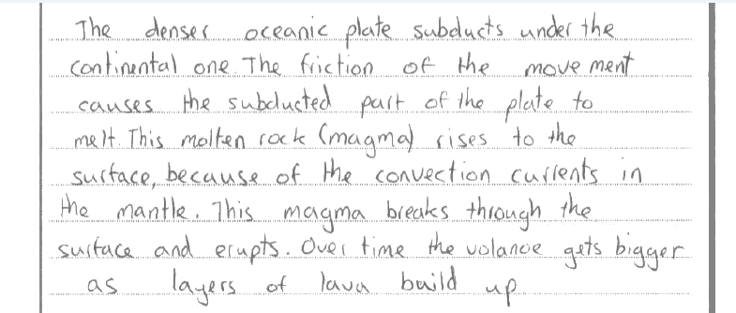
How did this person do?

Slide 35
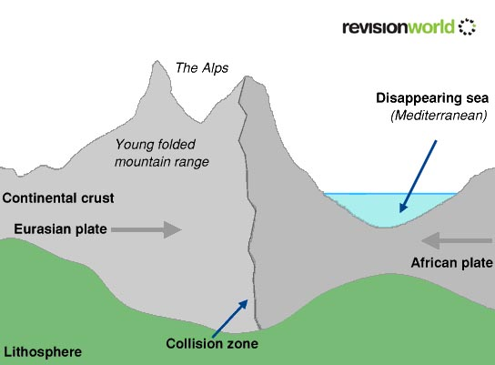
Collision margin Continental and continental

Slide 36
The Collision Zone
When continental plates collide head on with other continental plates, the result is upheaval!
Similar densities – neither plate is subducted
Gradual forward movement of each plate creates extreme pressures= earthquakes
Over time, the rock strata become folded, and rise to create mountain ranges

Slide 37
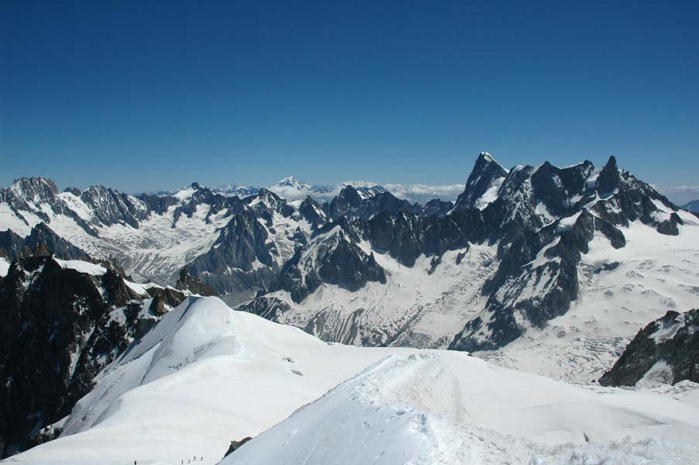
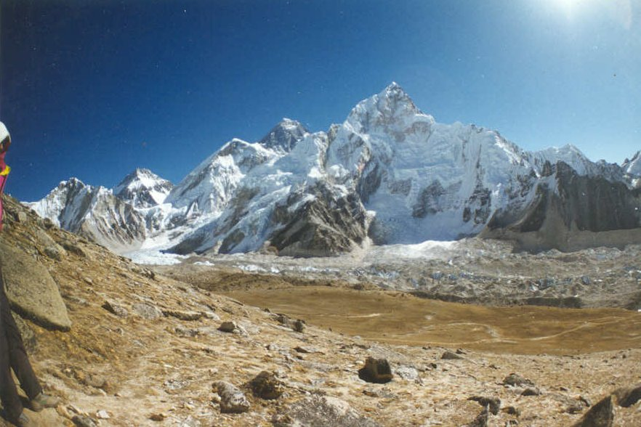
The Alps and the Himalayas
The Alps
The Himalayas

Slide 38
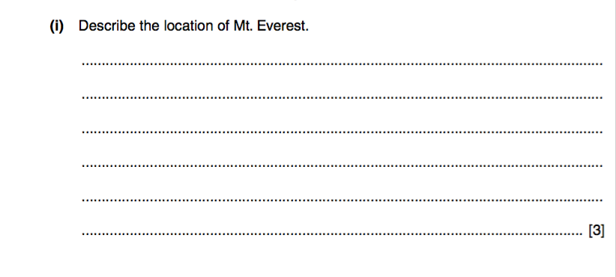
Exam questions

Slide 40
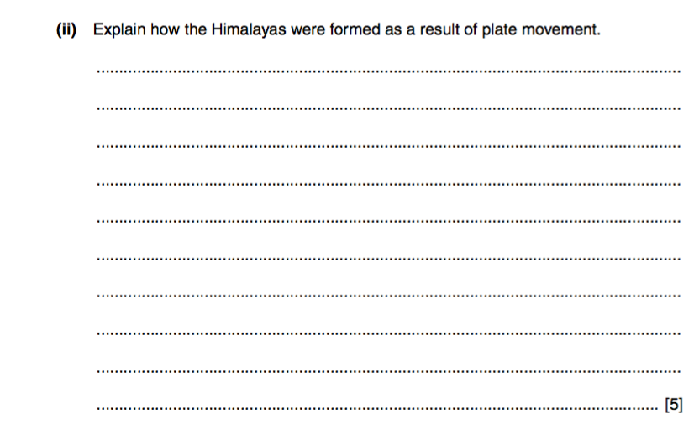
Exam questions

Slide 42
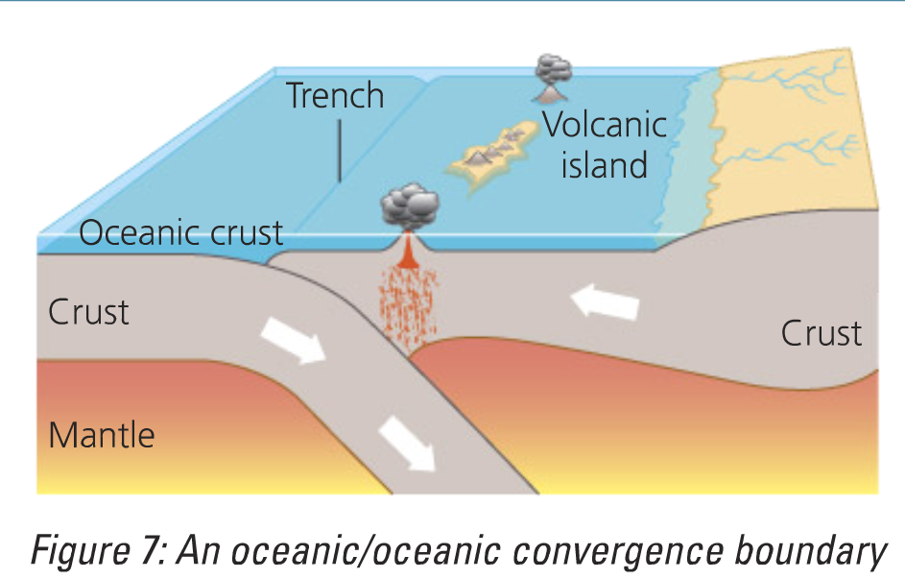
Oceanic/ oceanic boundary

Slide 44
convergent
Use page 102 in textbook to help!

Slide 45
Remembering details quiz; can you..
Remember the name of the three types of plate margin?
Name one example of each type of margin?
Remember the name of the person who thought of the theory of continental drift?
Name the original landmass that eventually split up into the continents we now know?
Name three currently active volcanoes?
Name two places where severe earthquakes have occurred since 2000?

