Slide 1
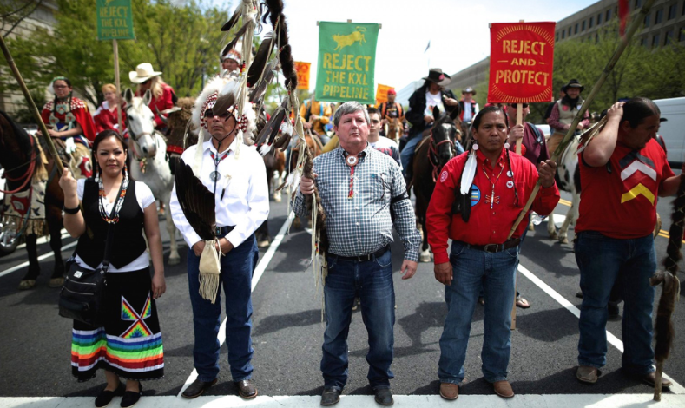
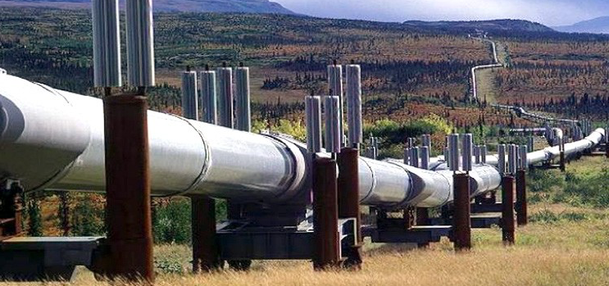
Geopolitical issues
Geopolitics: The study in the ways in which political decisions and processes affect the way space and resources are used. It is the relationship between geography, economics and politics.
Battle Over an Oil Pipeline
LO/ success criteria: To create a balanced argument using SEEP for and against the development of the Keystone oil pipeline

Slide 2
The situation
For several months, Native American tribes and their allies, led by the Standing Rock Sioux, have been protesting against the Dakota Access pipeline, a project that would transport oil from the Bakken oil fields in North Dakota and Montana across the Plains to Illinois. The protesters, numbering in the thousands and including members of hundreds of different tribes, argue that completing the pipeline would desecrate ancestral lands, threaten the water supply, and unfairly burden the Standing Rock Sioux tribe, which is unlikely to benefit from any economic development that accompanies the project. Energy Transfer Partners, the corporation behind the pipeline, suggests the project will lead to greater economic development and increased safety and efficiency compared to the trains that currently carry Bakken crude oil.

Slide 3
Location

Slide 4
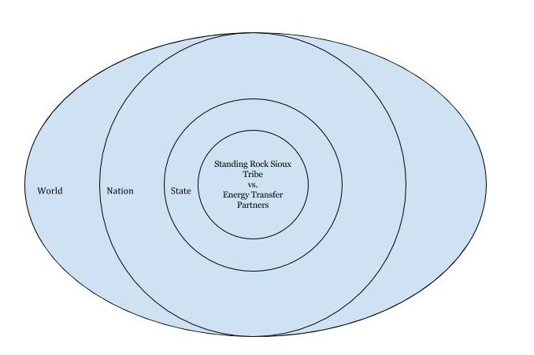
The situation
http://www.cnn.com/2016/09/07/us/dakota-access-pipeline-visual-guide/
The issue is often presented as a conflict between two sides: the Standing Rock Sioux tribe and Energy Transfer Partners.
Who else might be affected by the construction of the pipeline, in the state, the nation and beyond?
You could organize your ideas like this:

Slide 5
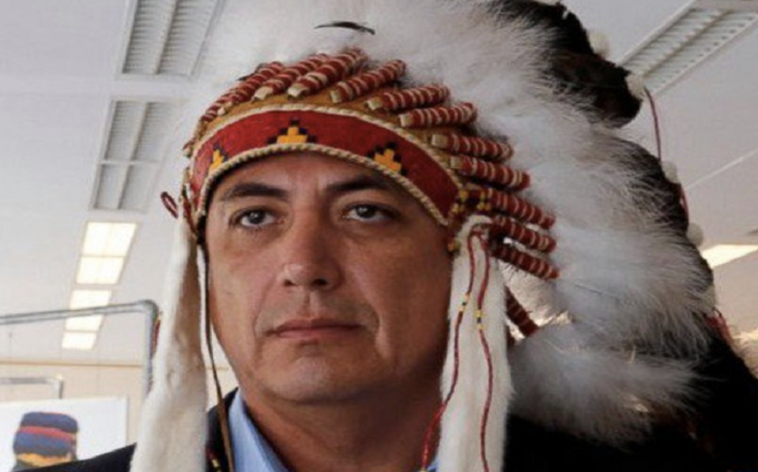
http://usuncut.com/news/standing-sioux-tribe-just-responded-trumps-dakota-pipeline-order/

Slide 6
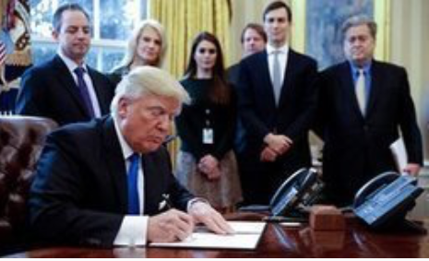
What is the current situation
https://www.theguardian.com/us-news/2017/jan/24/keystone-xl-dakota-access-pipelines-revived-trump-administration

Slide 7
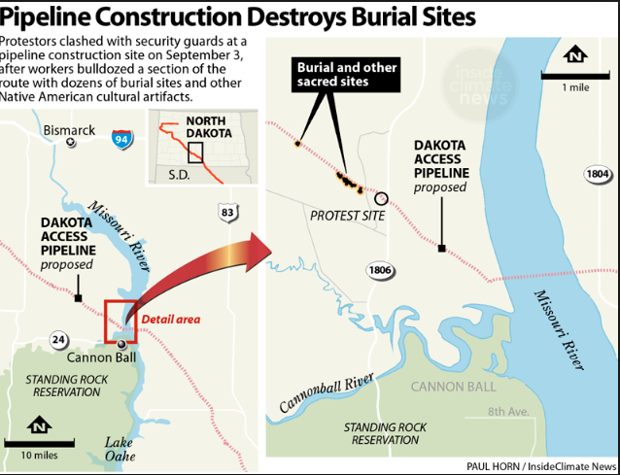
Cultural/social issues

Slide 8
Environmental issues with PIPE TRANSPORT
The Keystone Pipeline System is an oil pipeline system in Canada and the United States, commissioned since 2010.
It runs from the Western Canadian Sedimentary Basin in Alberta to refineries in Illinois and Texas, and also to oil tank farms and oil pipeline distribution centre in Cushing, Oklahoma.
The US is currently trying to pass an extension to the pipeline to increase transport of oil, called Keystone XL.
Different environmental groups, citizens, and politicians have raised concerns about the potential negative impacts of the Keystone XL project. The main issues are the risk of oil spills along the pipeline, which would traverse highly sensitive terrain, and 17% higher greenhouse gas emissions from the extraction of oil sands compared to extraction of conventional oil.
PIPELINE SPILLS IN NORTH DAKOTA, USA: https://www.youtube.com/watch?v=Jo-r4oXwnGg

Slide 9
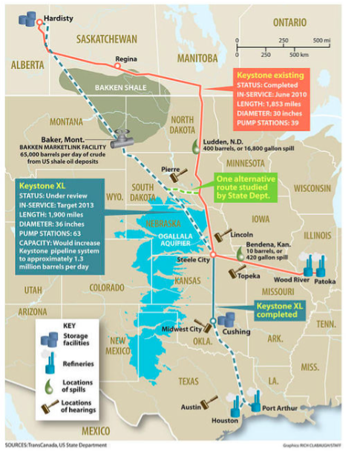

Slide 10
TASK
Create a detailed overview of the current situation of the pipeline including specific case study detail.
Consider the SEEP impacts (positive and negative)
Include specific case study figures
Consider the views of the different groups involved.

Slide 11
Resources:
BBC:Dakota Pipeline: What's behind the controversy?
http://www.bbc.com/news/world-us-canada-37863955
Guardian: Trump orders revival of Keystone XL and Dakota Access pipelines
https://www.theguardian.com/us-news/2017/jan/24/keystone-xl-dakota-access-pipelines-revived-trump-administration
CNN: Dakota Access Pipeline: What's at stake?
http://www.cnn.com/2016/09/07/us/dakota-access-pipeline-visual-guide/
NY times: North Dakota Oil Pipeline Battle: Who’s Fighting and Why
https://www.nytimes.com/2016/11/02/us/north-dakota-oil-pipeline-battle-whos-fighting-and-why.html

Slide 12
Conclusion
Should the pipeline construction continue?

