Slide 1
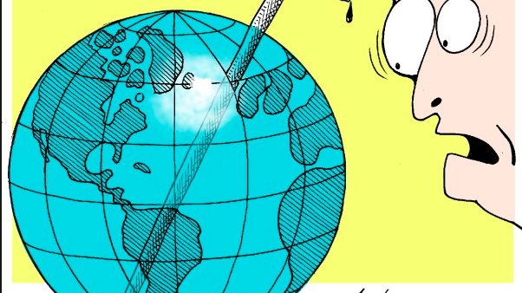
Core: Unit 3
Global Resource consumption and security

Slide 2
Objectives:
What: Global and regional/continental progress towards poverty reduction, including the growth of the “new global middle class”
Why: To understand that global economic development and the emergence of a new global middle class is leading to increases in resource consumption that will require careful management in the future.

Slide 3
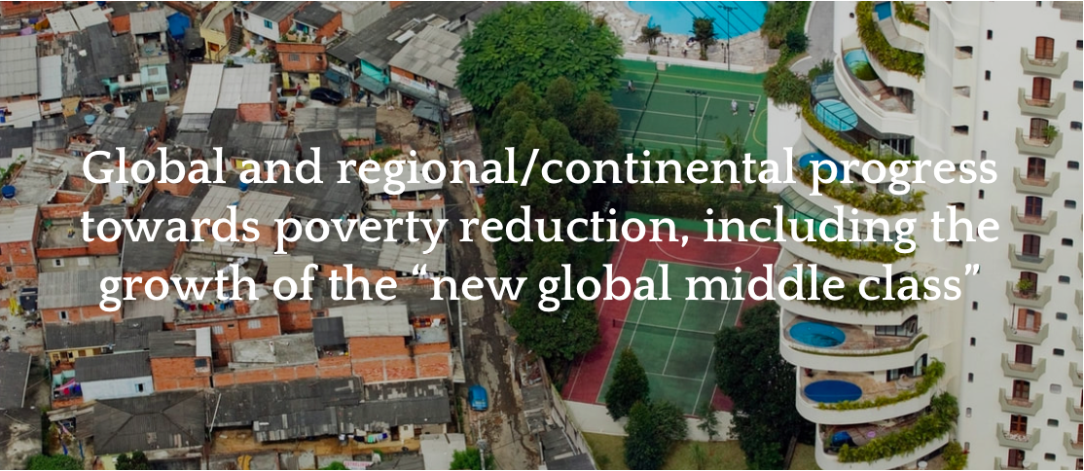
Section 1: Subject Guide learning objective:

Slide 4
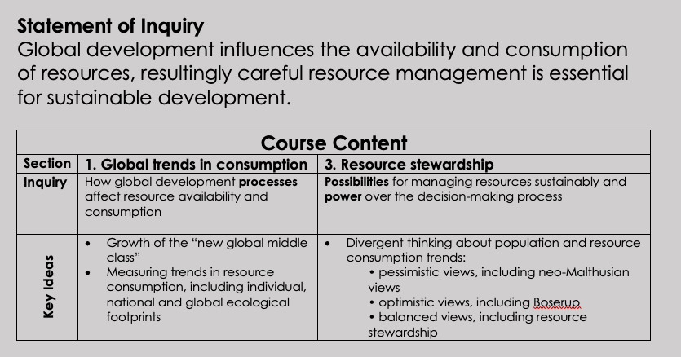

Slide 5
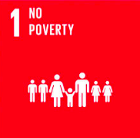
What is poverty?
​There are many different types of poverty; three important types are briefly explained below:
Situational poverty is caused by a sudden crisis or loss and is often temporary. Causes might include environmental disasters, divorce, or severe health problems.
Absolute poverty involves a lack of basic needs such as shelter, clean water, and food. People in absolute poverty will probably focus on day-to-day survival.
Relative poverty is where people's incomes fall significantly below the average for the place where they live. They may have access to basic needs and more but will be poorer than other people and families in the same place.

Slide 6
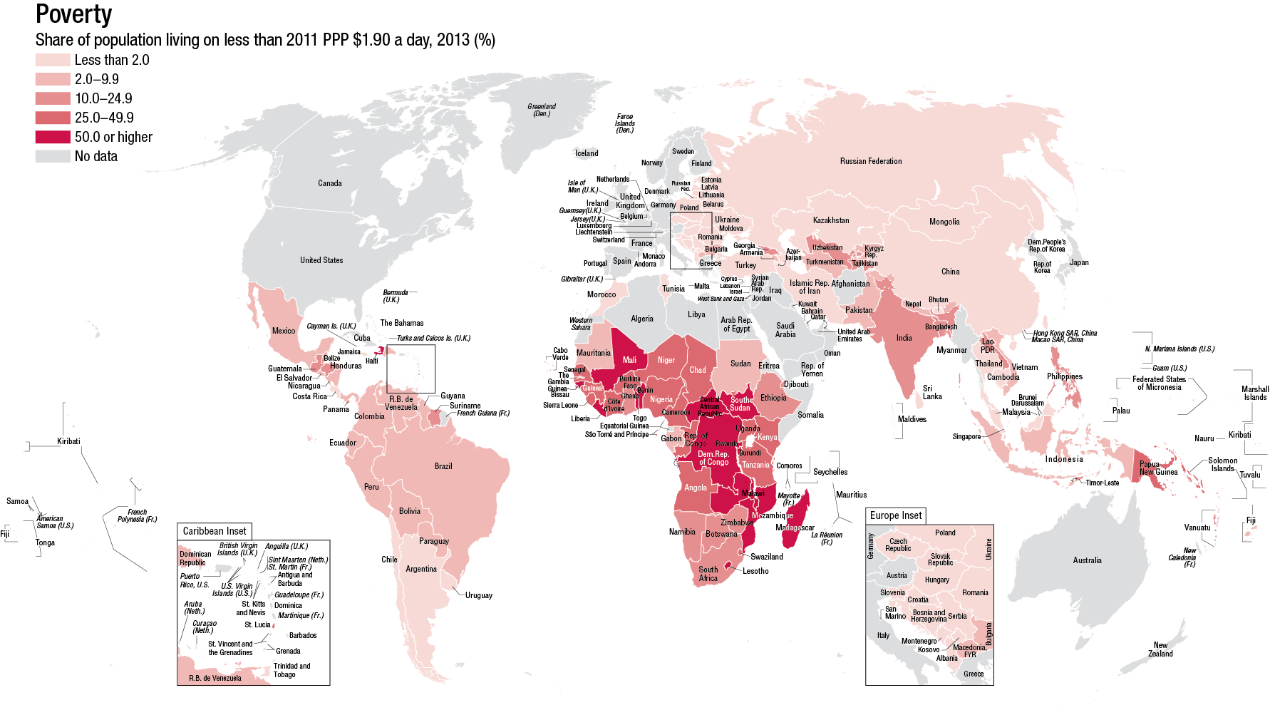

Slide 7
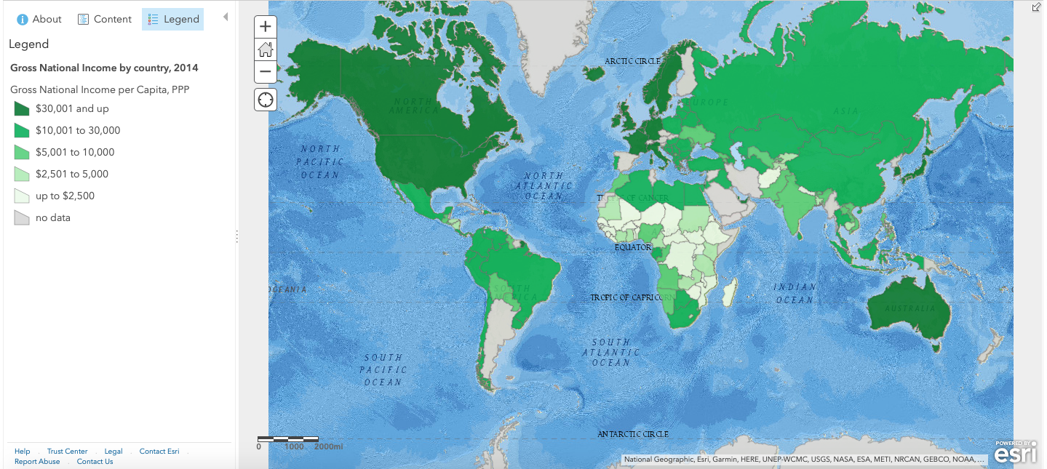
Task: Using a copy of the map , complete the inquiry questions on the attached sheet to consider the global patterns of wealth. Open up the map here: http://esriurl.com/enviroGeoinquiry13

Slide 8
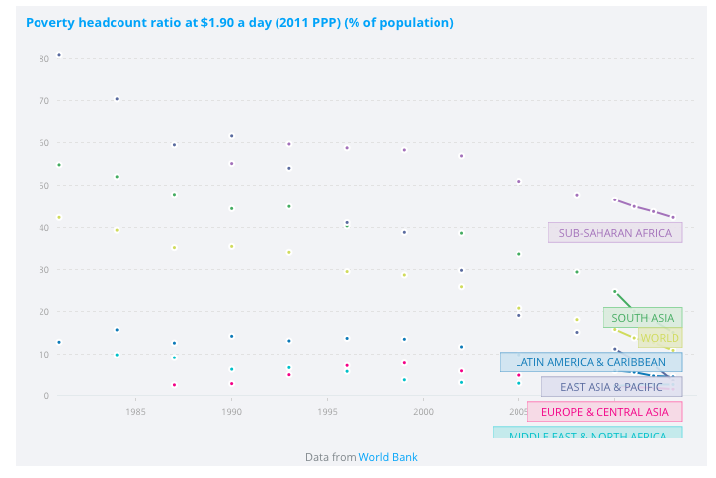
Patterns and trends in poverty reduction
Use the graph embedded on the Weebly (or hyperlinked here) to identify and describe changing patterns of poverty worldwide. You should consider:
​Overall trends - look at the global figures and describe the overall trends for each region.
Relative figures globally - in 1980 which regions had most and least poverty? How does this change between 1980 and the present day.
Which regions have seen the greatest reduction in poverty?
Which regions are reducing poverty most slowly?

Slide 9
Development and Resource Consumption
Question to ponder
How will the consumption of resources change as countries develop? Why?

Slide 10
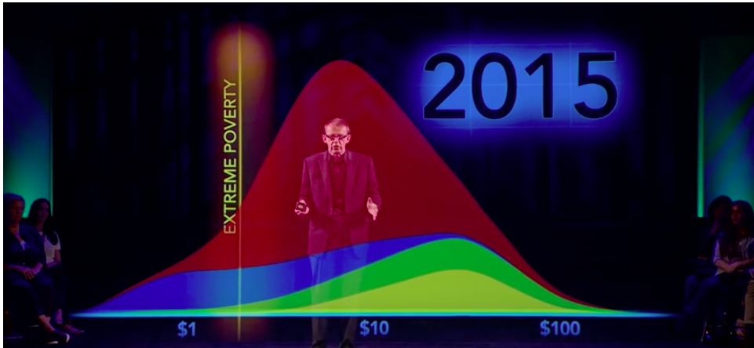
'How To End Poverty in 15 years' Hans Rosling - BBC News
Some extra sources to watch

Slide 11
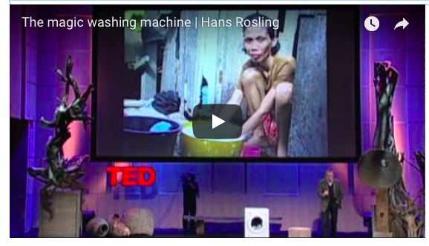
The Magic Washing Machine - Hans Rosling
Some extra sources to watch
Why does Rosling identify the washing machine as a significant indicator?
What does the video tell us about changing levels of global poverty/inequality?

