Slide 1
UNIT 1: Changing Population
Population and Economic Development Patterns

Slide 2
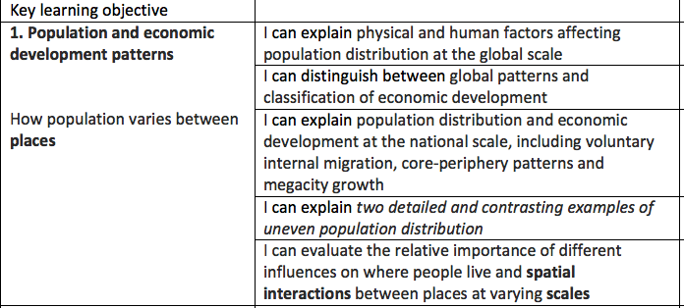

Slide 3
Enquiry question: Why does the population vary between places?
Why: so that I can understand the reasons for uneven population distribution in 2 contrasting countries
How:
Consider the human and physical factors that influence population density
GIS map analysis

Slide 4
1.1 Section A
Explain the physical and human factors affecting population distribution at the global scale.

Slide 5
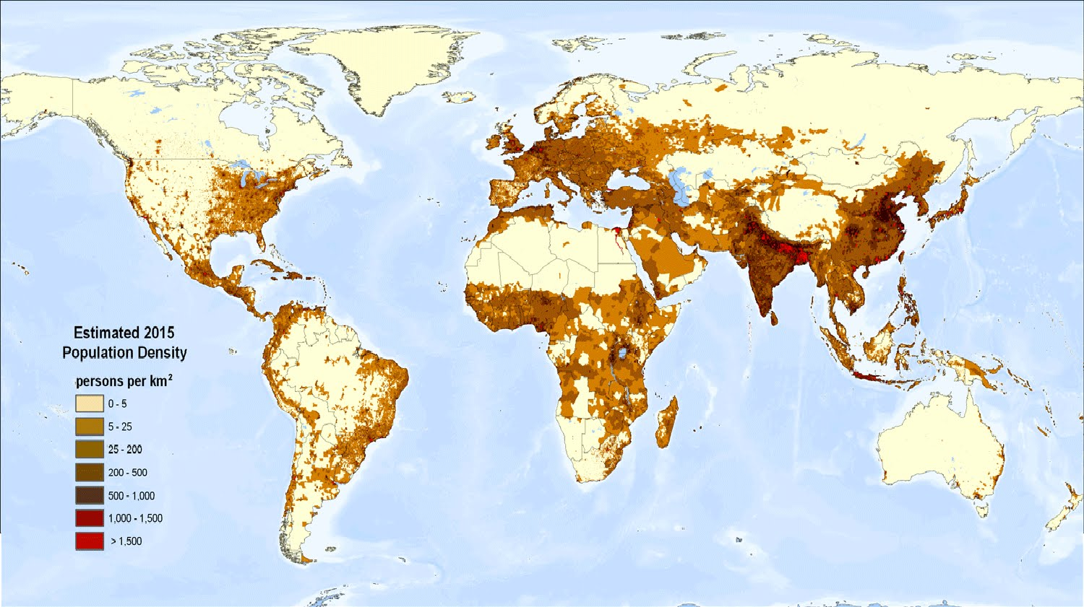
Population Distribution & Density: Choropleth Map
Source
Differentiate between the terms population distribution and population density.
Using the map above, describe the population distribution patterns at a global scale. (You should only use the information on the map, including quantification to answer this.)

Slide 6
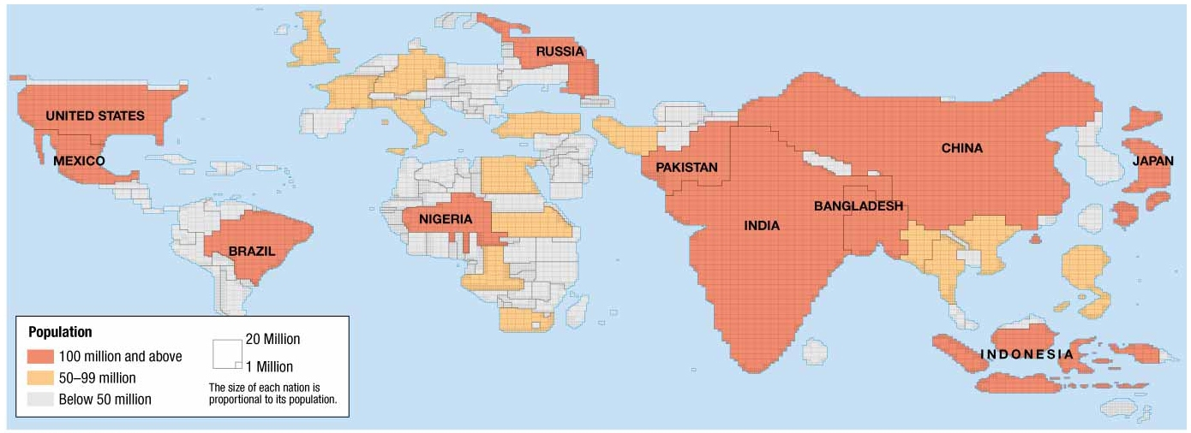
Population Distribution & Density: Cartogram Map
List 3 observations of the distribution of world population in this cartogram.

Slide 7
Key Terms
Key terms
Population distribution – The way in which people are spread out in an area.
Population density – The number of people living in an area (usually per square kilometre).

Slide 8
Population density continuum

Slide 9
Task: Interactive Mapping- World Population Densities
Review the interactive map: 'World Population Density‘ reading through the ‘map guide’ and ‘analysis’ tabs, and make ‘interactive stats’ available by clicking in the box at top left.
Enquiry questions:
What is the global pattern of population distribution?
How do population densities vary between region e.g. North/ South, HIC/LIC etc…
Skills:
Is the data reliable? Easy to understand?
Is this a good way of presenting the data? How else could it be presented?

Slide 10
Population distribution mapping
Task: On the big world map distinguish between human and physical factors that have effected the population distribution. Use a colour code to distinguish between the factors.
Source: P. 12-15 (Codrington) and compare / contrast the population density & distribution patterns based on physical and human geographic evidence.
From all of this information write a 350 summary to describe and explain the global pattern of population density making specific mention of areas of high and low population densities. In your answer mention the names of continents at least 5 different countries.

Slide 11
Where Is the World’s Population Distributed?
Population Concentrations
2/3 of the world’s inhabitants are clustered in four regions.
East Asia
South Asia
Southeast Asia
Europe
Site and Situation of Population Clusters
Low-lying areas with fertile soil and temperate climate
Near an ocean or near a river with easy access to an ocean.

Slide 12
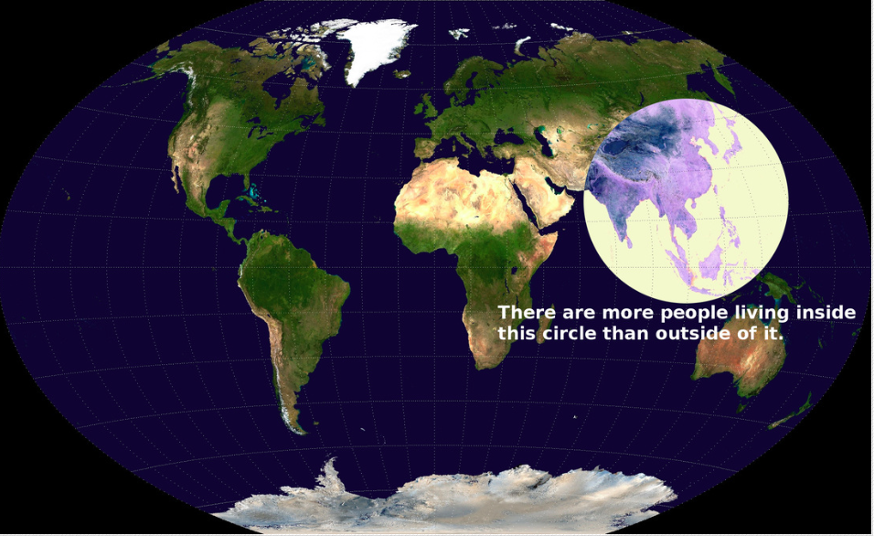
How would you describe this distribution?

Slide 13
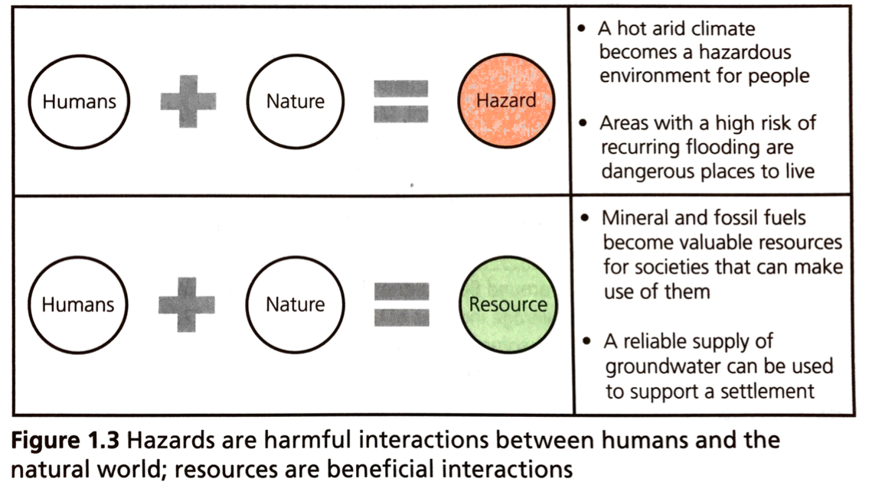
Debatable question: ‘People are most likely to live where resources are maximised and hazards are minimized’. Discuss
Read global change study guide p3 to add to your discussion ideas.

Slide 14
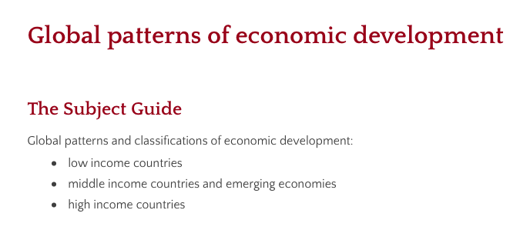
Global development patterns

Slide 15
https://www.independent.co.uk/travel/news-and-advice/richest-happiest-healthiest-countries-world-new-zealand-norway-finland-switzerland-canada-travel-a8206711.html

Slide 16
Global Patterns and Classification of Economic Development
What is meant by the term economic development?
It is used to describe a process – the process of development. It refers to the changes occurring in a country that are enabling it to advance. In general, a country is advancing / developing if the quality of life of the inhabitants is improving.
It is used to describe a potential state of being. A state of development is achieved when its people have attained the full quality of life that they desire. This ‘developed state’ is something countries strive towards but have not yet achieved.

Slide 17
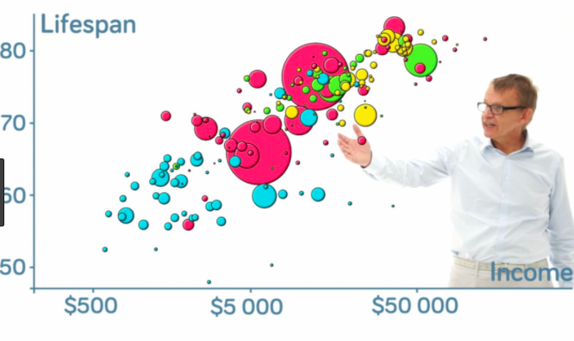
Global Patterns and Classification of Economic Development
View Hans Rosling’s 200 Years 200 Countries 4 Minutes
Summarize the Patterns & Trends in notes

Slide 18
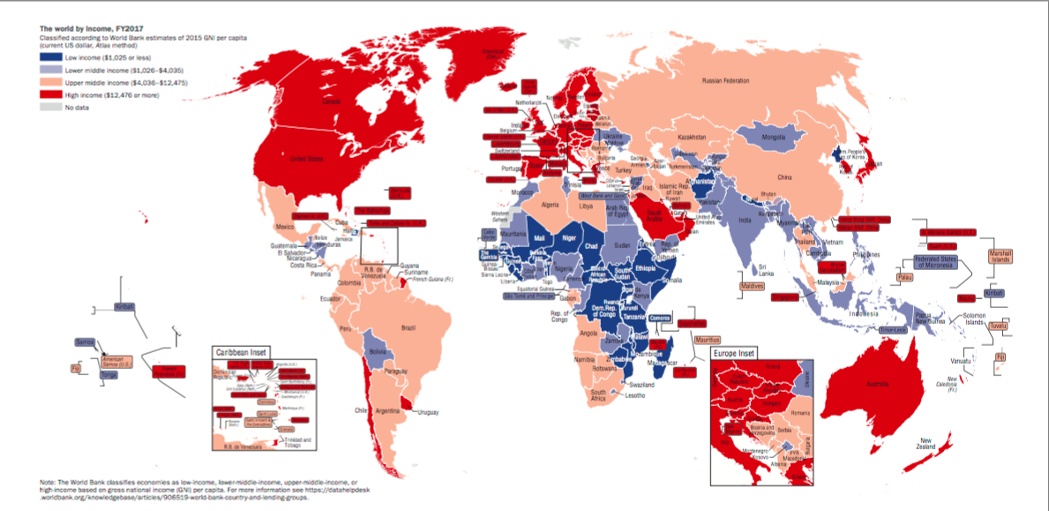
Global Patterns and Classification of Economic Development
1. Use the map and the World Bank website to produce a SIMPLIFIED and ANNOTATED sketch map to show the spatial distribution of the low, middle and high income countries. 2 . Write a paragraph describing the distribution: your paragraph should reference each continent. Remember to identify and explain anomalies as well as overall patterns and trends. Name countries and use specifics in your description. Does this link to patterns of population distribution? 3. Use the World Bank website to explain how each group of countries is defined by income.

Slide 19
Global Patterns and Classification of Economic Development
How many economic classifications of countries are you familiar with? Brainstorm.
Read Nagle p388-391
Read: The World Bank is eliminating the term 'developing country' from is data vocabulary
Summarize the reasoning for this change.

Slide 20
Emerging economies
1. Read the article on characteristics of NICs and watch the video on BRICS. 2. Create a spider diagram to show the key characteristics of NICS. 3. How do these emerging economies differ from other low or middle income countries? 4. How can you explain the importance of this group of countries?

Slide 21
1.1 Section C:
Describe the population distribution and economic development at the national scale, including voluntary internal migration, core-periphery patterns and consequences of megacity growth.
Two detailed and contrasting examples of uneven population distribution.

Slide 22
Internal Migration: Core / Periphery
Definition:
The concept of a developed core
surrounded by an undeveloped
periphery.
The concept can be applied at
various scales.
More on core-periphery

Slide 23
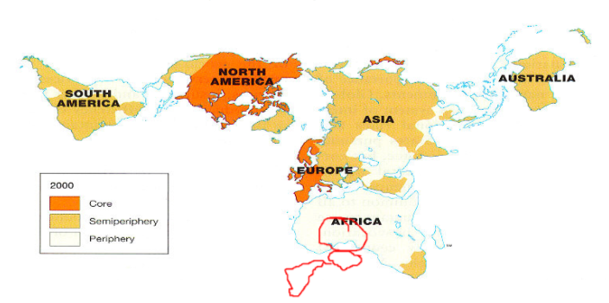
Core / Periphery
Immanuel Wallerstein proposed the World Systems Theory which promoted the Core-Periphery concept.
Unlike the term-developed and developing, the Core-Periphery Model does not imply that change will occur.

Slide 24
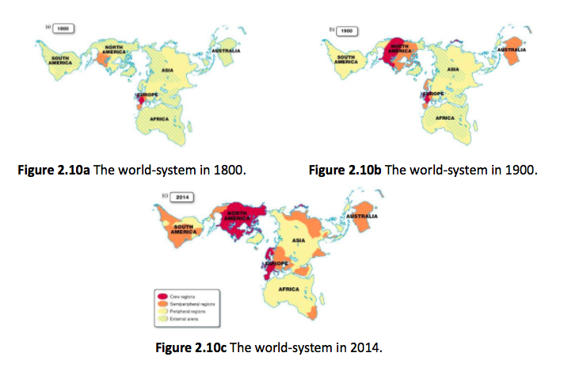
World systems analysis

Slide 25
Core / Periphery Countries
Notes:
https://www.thoughtco.com/core-and-periphery-1435410

Slide 26
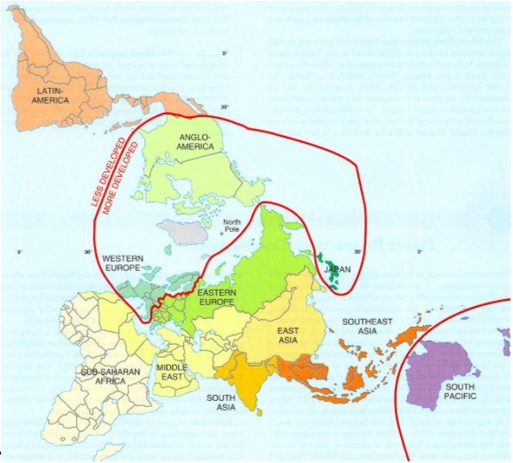

Slide 27
Gini coefficient
The Gini coefficient is a measure of the inequality of a distribution, comparing the ideal distribution of income with the Lorenz Curve (which plots the proportion of the total income of the population (y axis) that is cumulatively earned by the bottom x% of the population). A value of 0 expresses total equality and a value of 1 expresses maximal inequality.

Slide 28
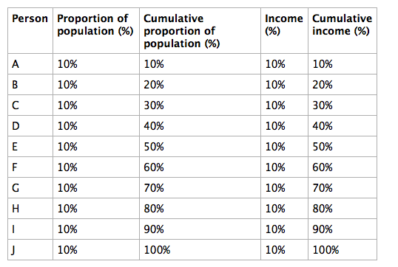
Even income distribution
For this society with perfectly-distributed income, we could draw a graph of the cumulative proportuion of population (on the horizontal axis) against the cumulative percentage of income (on the vertical axis) as follows.

Slide 29
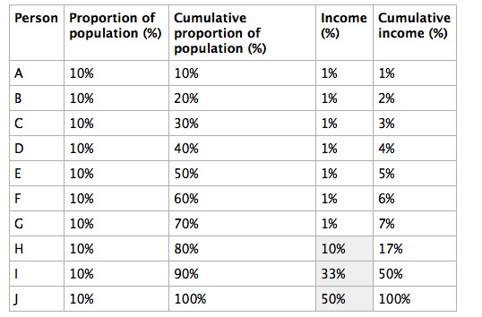
Lorenz Curve to show an uneven income distribution
Now we have a very uneven income distribution. The bottom 70% of the population earn only 7% of the income, while the top 30% earn 93% of the income.

Slide 30
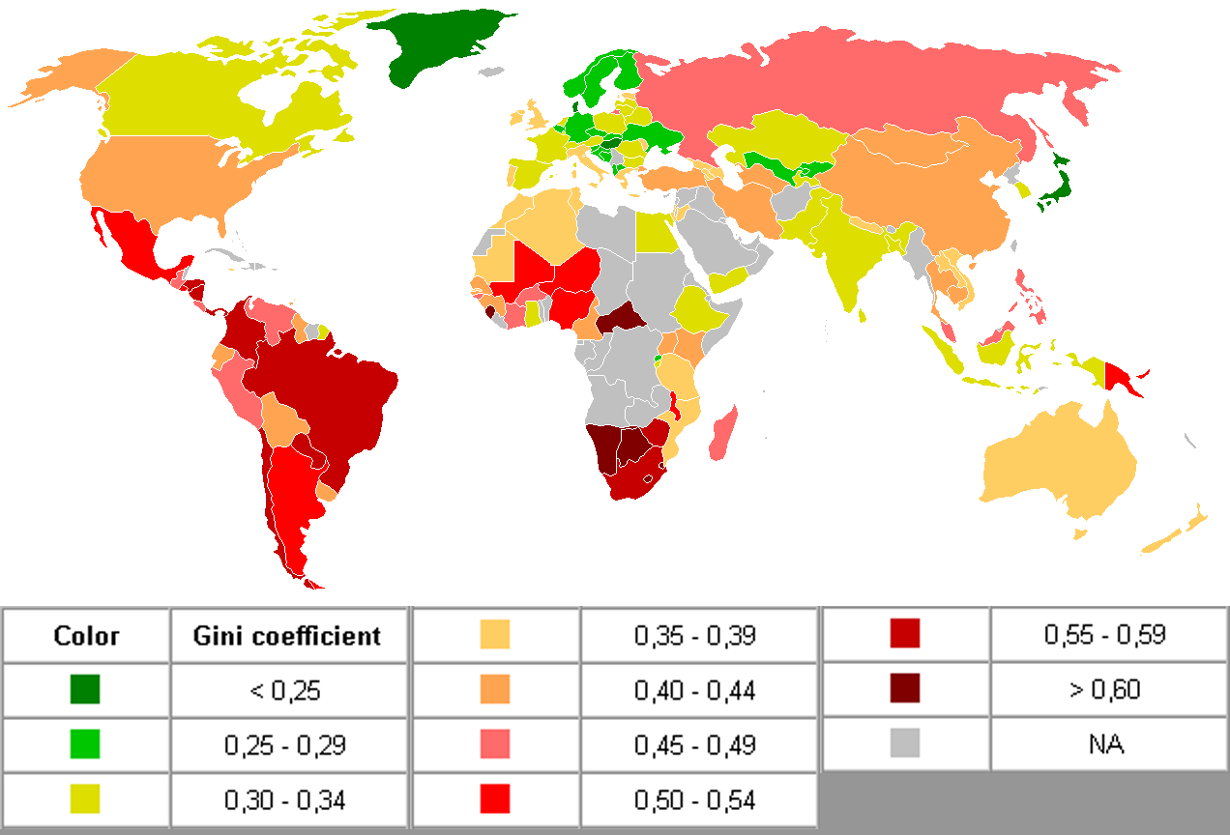

Slide 31
The wealth distribution in the USA
https://www.youtube.com/watch?v=QPKKQnijnsM

Slide 32
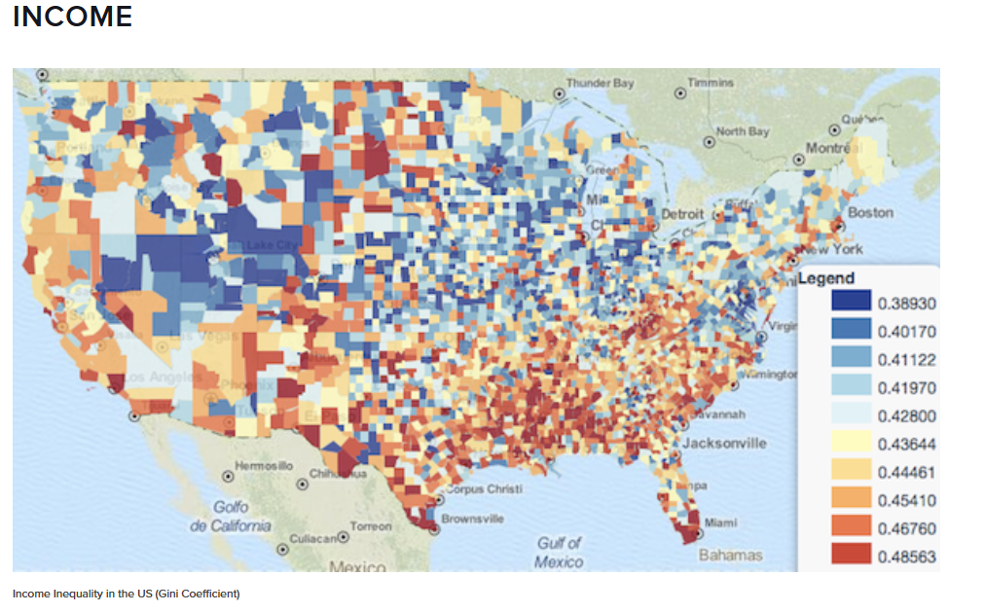
How income inequality in the USA varies spatially
More inequality

Slide 33
Population Distribution: National Scale
Forces affecting population distribution at a national scale differ from country to country according to unique combinations of:
Landforms
Climate
Soils
Vegetation
History
Politics

Slide 34
Population distribution, economic development and migration
A permanent move to a new location constitutes migration.
Emigration is migration from a location.
Immigration is migration to a location.
Place “A” can have individuals migrating away from and to it.
Emigrant: Place A → Place B
Immigrant: Place B → Place A
Difference between the number of immigrants and number emigrants is a place’s net migration.

Slide 35
Ravenstein: Theory of Migration
Ravenstein’s laws for the distance that migrants typically move:
Most migrants relocate a short distance and remain within the same country
Long-distance migrants to other countries head for major centers of economic activity.

Slide 36
Migration
Migration can be divided into two categories.
International Migration- permanent move from one country to another
Voluntary
Forced
Internal Migration- permanent move within the same country
Interregional
Intraregional

Slide 37
How can this image be linked to the issue of internal migration? International migration?

Slide 38
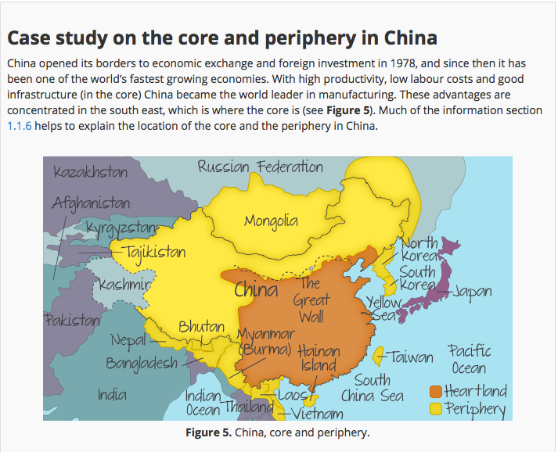
Core and Periphery in China
Source: Kognity

Slide 39
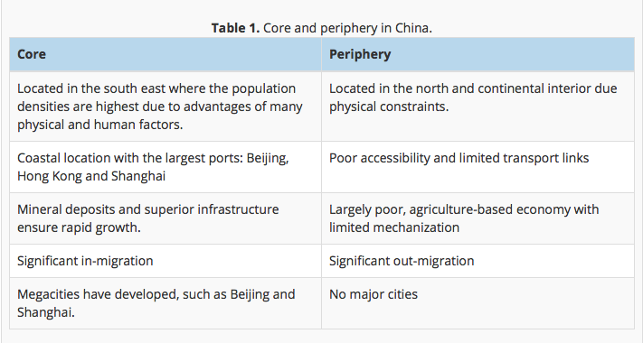

Slide 40
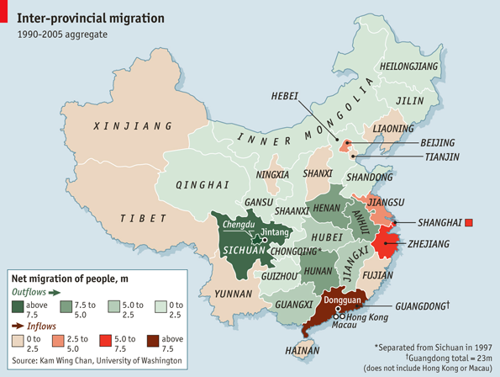
CASE STUDY: China, Internal Migration Text: p.391-393
Review the Economist Article / Videographic: The Impact of Chinese Migration
a. How many people have left rural areas to seek work?
b. Outline the reasons why people left.
c. In 1978, how much did farmers earn?
d. What are the negative aspects of migration?
e. What has happened to the wealth gap over time?
f. What changes has Shenzhen seen since 1978?
g. Outline the comparative GDP values of coastal regions compared to western countries.
h. What change is China seeing in terms of location of manufacturing industry?

Slide 41
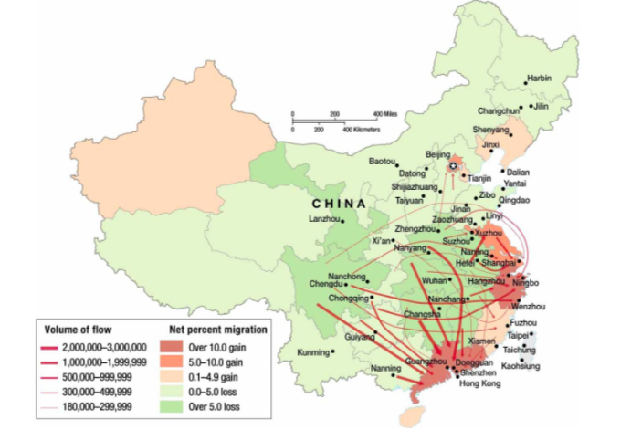
Describe the pattern of internal Chinese Migration (4)

Slide 42
The Hukou system
What is the hukou system? (Organization system for Chinese government)

Slide 43
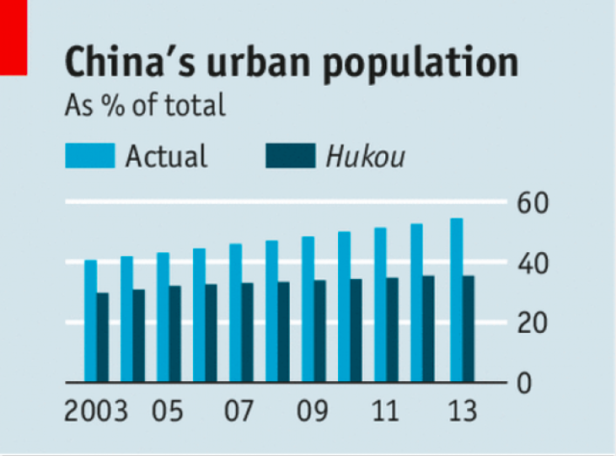

Slide 44
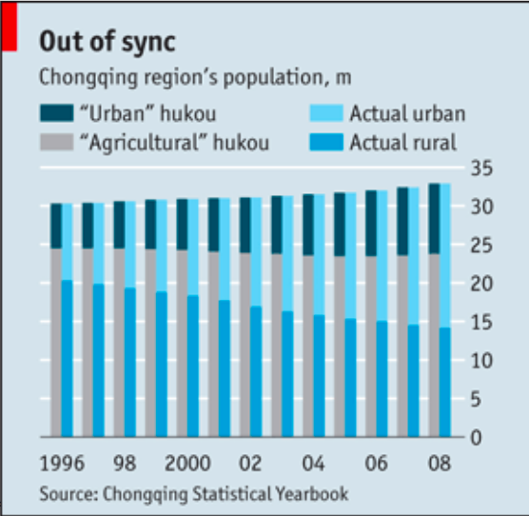

Slide 45
CASE STUDY: China, Internal Migration Text p.391-393
In jigsaw groups of three, take notes on the following in collaborative space:
View this video and
Read: The Guardian
3. Read: Megacities

Slide 46
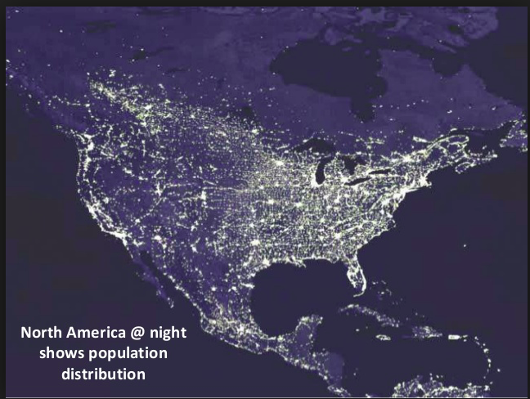
Case study: Population distribution in North America

Slide 47
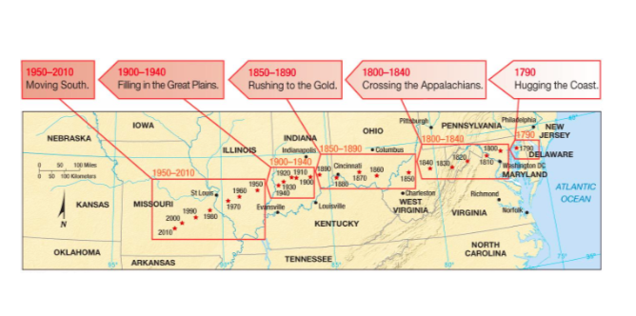

Slide 49
USA resources
Half the US population lives in just 9 states
US Population Distribution
Video/animation

Slide 50
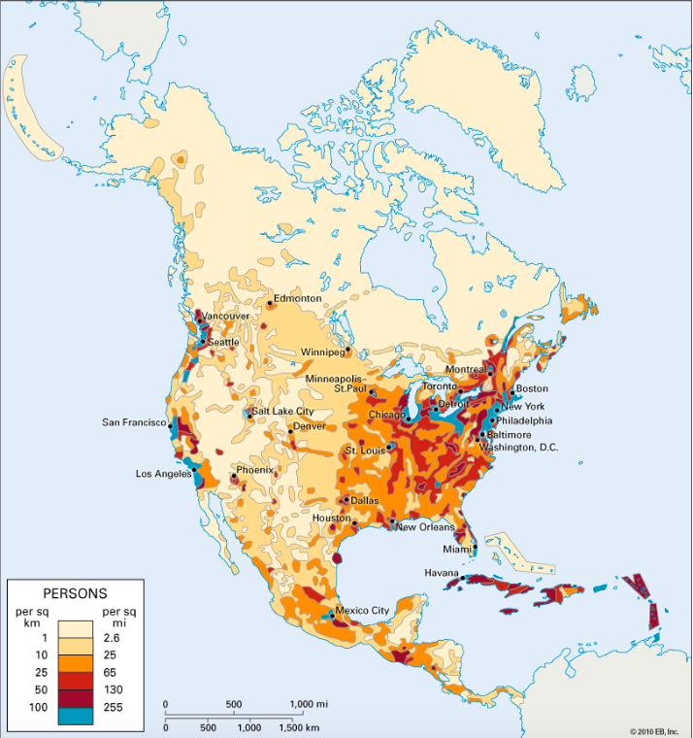
I can explain two detailed and contrasting examples of uneven population distribution

Slide 51
Application Task: create an infographic
Dealing with heavy content- geographical skill
Creating visual representations to encourage understanding and highlight key information. Graphics are visual elements often used to point readers and viewers to particular information. They are also used in an effort to aid readers in their understanding of a particular concept or maker the concept more clear or interesting.
Success criteria:
For either China or the USA:
Explain the pattern of economic development
Describe the population distribution (include an annotated map)
Explain the physical and human factors that influence patterns of population density
Explain the influence of core-periphery patterns, internal migration and megacity growth on population distribution
Resources:
Found on wiki, within PPT and China is on Kognity

Slide 52
Compare and contrast the population distribution of China and the USA
USA population distribution description
Similarities between both population distributions
China population distribution description

Slide 53
Essay task (10 marks)
“Physical factors have the greatest impact on population distribution.” Discuss this statement.

