Slide 2
Key term:
Participation rate: refers to the proportion of a population that takes part in a specific sporting activity.

Slide 3
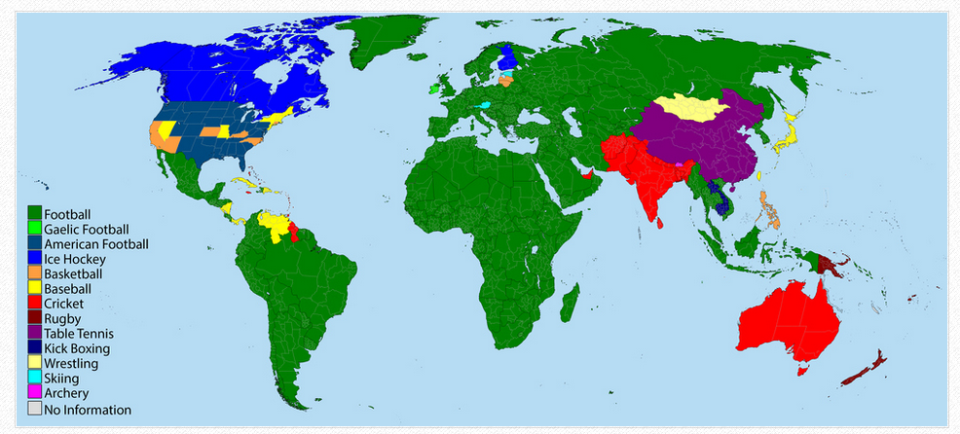
The most popular sport by nation

Slide 4
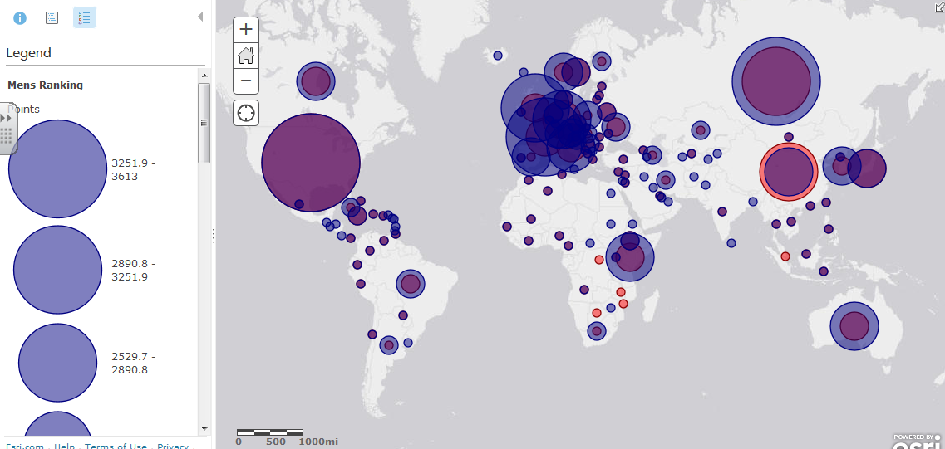
The greatest sporting nations: ARCGIS

Slide 5
Task: Using the maps on the previous 2 slides…
Take a screen shot of the ArcGis map and then comment on the spatial distribution and levels of success in sport around the world. Can you identify and areas of the world that would link with particular sports? Check out Asia and Australasia. What sports are popular in these places? Why is this?

Slide 6
Factors affecting participation
There are significant spatial variations in the participation of sports. The participation rate refers to the proportion of the population that takes part in a specific sporting activity.

Slide 7
What do you think are the factors that influence participation in sport?
Can you think in terms of…
Social e.g. people’s lifestyles
Economic e.g. people’s wealth
Political e.g. the role of the government
Cultural e.g. attitudes towards sport
Physical e.g. the physical geography of an area/the physical attributes of the human body

Slide 8
Read pages 222 of textbook
Select a sport and try to think of one idea for each of the factors below
Social e.g. people’s lifestyles
Economic e.g. people’s wealth
Political e.g. the role of the government
Cultural e.g. attitudes towards sport
Physical e.g. the physical geography of an area/the physical attributes of the human body

Slide 9
Factors affecting participation:
Physical: certain sports need certain physical facts e.g. skiing needs mountains and snow, coastal areas with large waves for surfing. It has also bee suggested that the increase in red blood cells concentration at high altitudes helps runners which is why there is a high concentration of runners from Ethiopia and Kenya
Make notes on the physical factors that impact sports on p220 of textbook

Slide 10
Factors affecting participation
Human (economic): most sports need facilities therefore there is a relationship between participation and economic factors. E.g. most gold courses in MEDCs and NICs (with the exception of golf courses made for tourism in LEDCS).
In LEDCs funding is limited (except in boarding schools)

Slide 11
Factors affecting participation
Human (political): geographical ‘models’ of national sports systems:
Eastern bloc uses sports to show how successful the communist bloc is
The emergent national model for SE Asian and Africa often uses organizations such as the police force and army to develop talent
The American model is bases on competition and rewarding success.

Slide 12
Factors affecting participation
Cultural: e.g. low participation in running and swimming by Muslim women. The convention for Muslim women to stay robed mean that certain Muslim athletes such as Moroccan middle distance runner Hasna Benhassi, receive criticism at home.

Slide 13
Factors affecting participation
Social: certain people cannot afford membership fees, to certain sports. Certain sports (e.g. golf) have high fees to keep the sport ‘exclusive’.

Slide 14
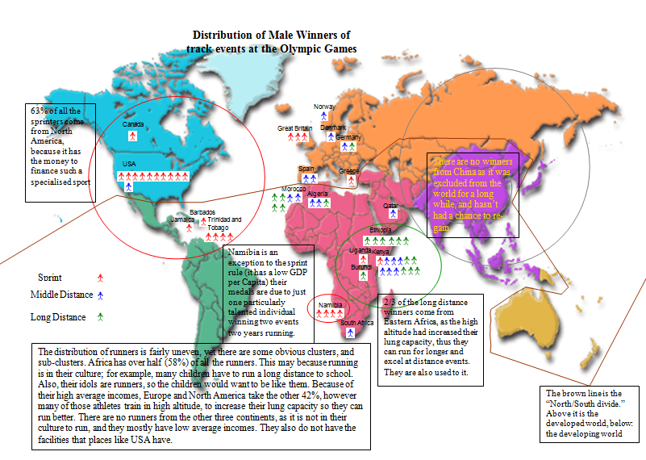

Slide 15
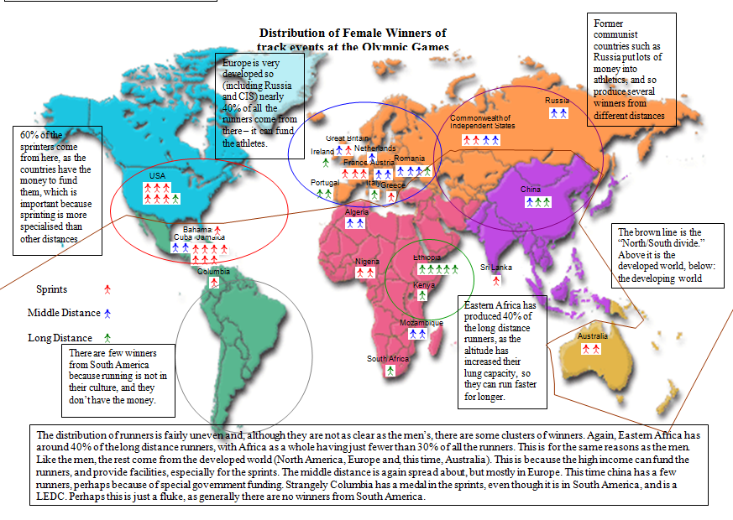

Slide 16
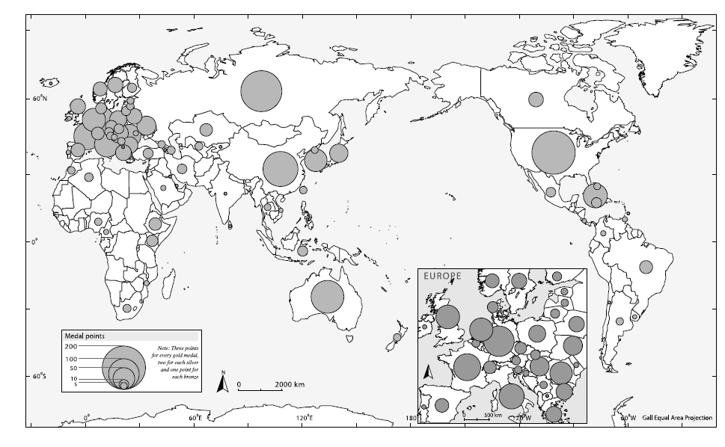
Map to show distribution of medal points in Olympic games

Slide 17
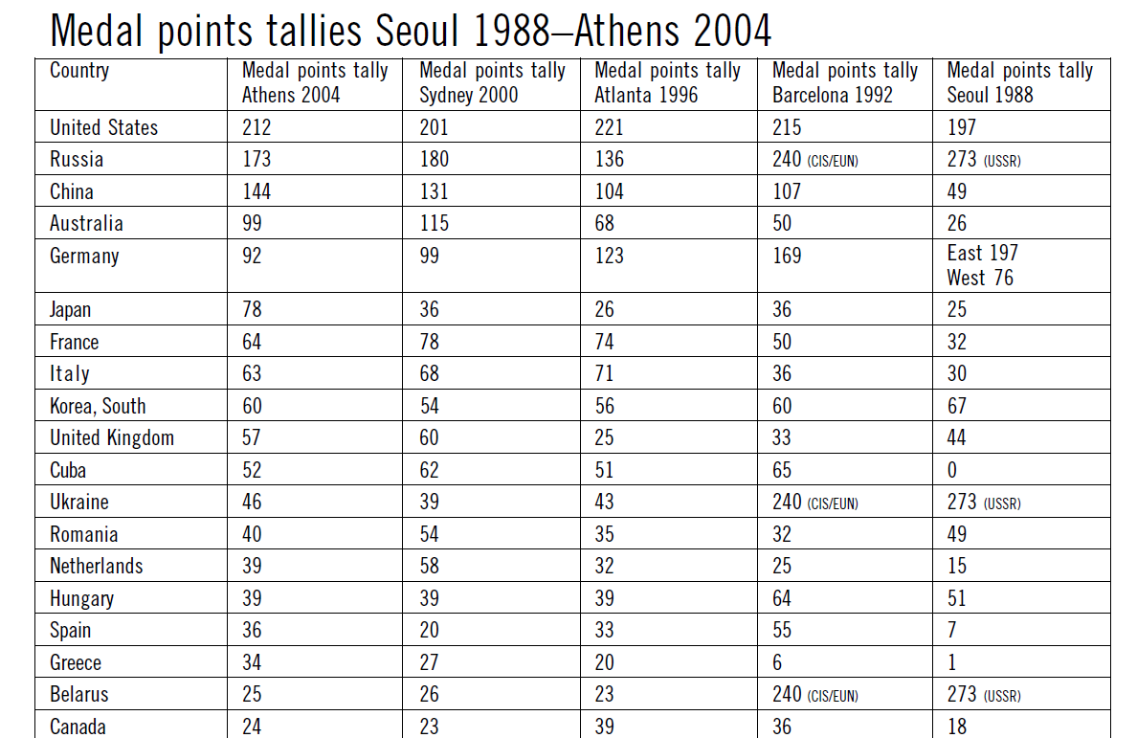

Slide 18
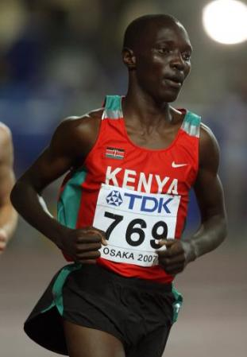
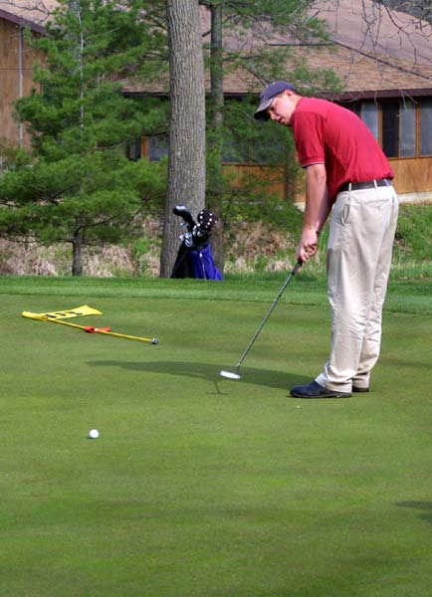
Cross country v golf
Describe the difference in participation in the two sports.
What factors will influence this participation?
Resources:
http://greenfieldgeography.wikispaces.com/International+participation+and+success
IB textbook p234-235

Slide 20
http://www.theguardian.com/lifeandstyle/the-running-blog/video/2013/jul/02/kenyans-best-distance-runners-video Video clip – the factor that affect participation and success in distance running (case study Kenya)

Slide 21
Exam question
Analyse three geographic factors, other than accessibility and affluence, that determine levels of participation in one named sport you have studied. [2 + 2 + 2]

Slide 22
Mark scheme
Participation may be on a local, national or international scale.
Candidates are expected to consider three distinct factors. 2 marks are available for each developed factor up to a maximum of 6 marks.
The range of answers is wide, but could include socio-economic factors, education levels, funding, investment in infrastructure, marketing, role of governing body, media exposure, or facility requirements.
The answer may focus on the numbers of nations participating in international sports or individuals participating in sports.
There may be other valid approaches, such as levels of spectator participation.

Slide 23
Example of an essay question:
Discuss the international variation in the level of participation in world sporting events (10)
Discuss the reasons why there is a variation in participation in at least 2 international sports
Think about why some areas have a lot of participation and why other areas have little participation.
Think about classifying the information into categories e.g. physical political, cultural, social, economic
You could be more evaluative and analytical by discussing in depth/ considering which factors are more important for participation/ a lack of participation in particular sports, pointing out anomalies etc
Make sure in your conclusion you answer the question – what is the variation/why is there a variation in participation?
Model example essay: here

