Slide 1
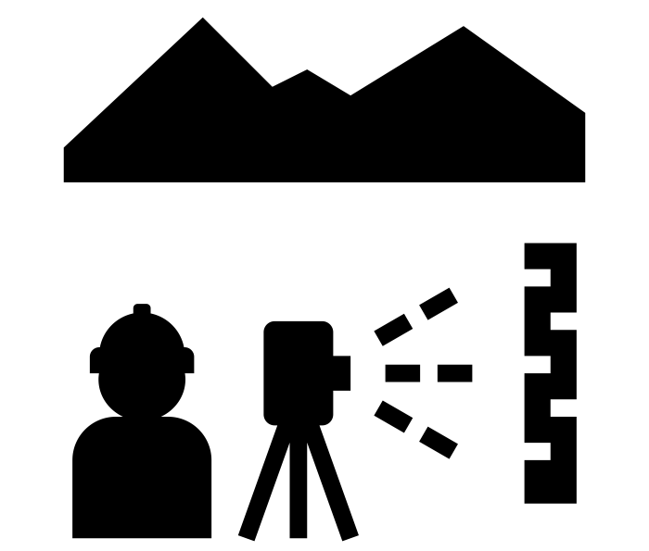
Paper 4 Skills
What’s in this booklet
Instructions
On how to complete the various types of investigations you might encounter in Paper 4.
Some investigations such as rivers, coasts and weather investigations require specific equipment and methods – these are explained.
Other investigations e.g. urbanisation and tourism can use the same techniques e.g. traffic counts – how does tourism influence levels of traffic or is congestion higher in the CBD or the suburbs?
You’ll find:
How to collect Geographical Data
General Techniques – Sampling
Investigating Rivers 1
Investigating Rivers 2
Investigating Coasts 1
Investigating Coasts 2
Investigating Weather
General Techniques 1
General Techniques 2
References
references
BBC Bitesize GCSE Revision – Fieldwork and Enquiry
Kelly D and Fretwell, M Complete Geography for Cambridge IGCSE, 2012: Chapter 13
Cambers, G and Sibley S Cambridge IGCSE Geography, 2010: Part C: the Alternative to Coursework – preparing for Paper 4
FSC Geography Fieldwork Guides – Sampling
Widdowson, J and Parkinson A, Fieldwork through Enquiry, 2013: Units 2, 4, 6, 7, 8 and 10
Royal Geographical Society Fieldwork for Schools website
Icons from Noun Project
Some images taken from CIE past paper 4’s.

Slide 2
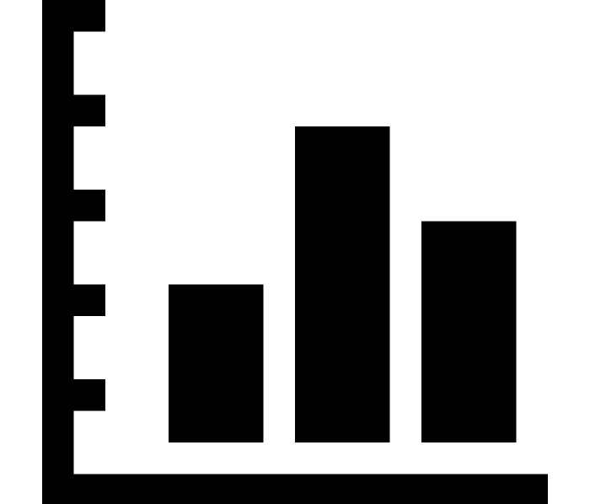
Paper 4 Skills
How to collect geographical data
Step 1: Health and Safety
It is important to check if the area to be studied is safe. For example, when investigating rivers and working on riverbanks:
Banks and rocks can be very slippery after rain
The depth and velocity of the river can change suddenly after heavy rain
At the coast, be aware of when high tides are due and reduce risk by working at low tide. Avoid areas at the foot of weak cliffs because of possible dangers of falling rocks or cliff collapse. Be aware of the tide timetables and the weather forecast.
In all areas:
Conduct questionnaires in pairs and choose safe times and locations
Take contact numbers for other group members, home and school
Be aware of traffic around busy junctions
Step 2: Pilot study
A pilot study is a test run, to make sure that all students are aware of the techniques to be used. In addition it is an opportunity to test questionnaire questions and other methods of investigation. If problems are found they can be fixed before the actual fieldwork takes place.
Step 3: Primary or Secondary data
Primary data – is collected in the field by a student or group of students completing an investigation.
Secondary data – is data already collected by someone else and researched online, in books, journals or magazines. Sources must always be referenced.
Step 5: Recording sheets
Recording sheets can be used for many data types and should be adapted to need.
All recording sheets should include dates, times, site number / name, description of weather conditions.
There should then be space to record the information.
Step 4: Types of data
Qualitative data – data showing opinions or judgements e.g. from interviews or questionnaires.
Quantitative data – data that is measured or counted and is numerical.
Continuous data – where all values between two measured values are passed through before the second is reached e.g. rise in temperature from 7-10 degrees passes through 8 and 9 degrees.
Discrete data – two values exist separately with no progression between them e.g. 7cm rainfall in January vs 10cm rainfall in April. Rainfall in February and March will not necessarily have been 8 and 9cm.
Step 6: Recording data
Data can be counted using recording sheets and following methods carefully.

Slide 3
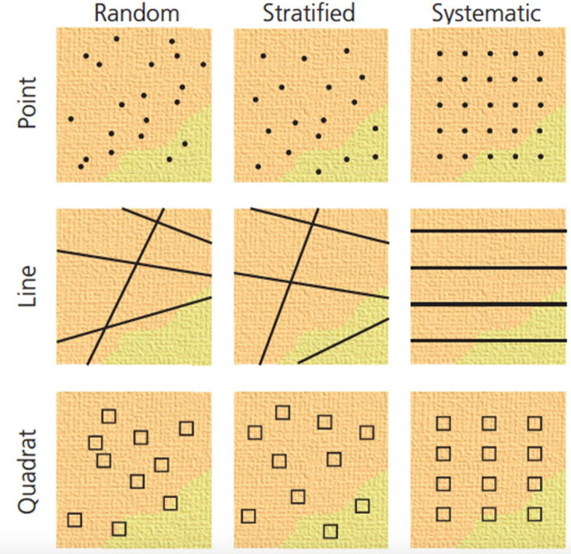
Paper 4 Skills
General Techniques - Sampling
What is sampling?
A sample is a group selected from a larger population (whatever is being sampled e.g. rocks on the river bed, people, congestion).
It’s not possible to sample every single item in a river, beach, city or farm so samples must be taken. The aim of taking a sample is to be representative and avoid bias.
the larger the sample, the more representative your research will be. A minimum sample of 30 is needed to create reliable results.
How to choose a fieldwork site
The way to decide sample points (fieldwork sites) using a map or in the field is through:
Point sampling – choosing a specific point on the map e.g. a road junction for a pedestrian count or a meander on a river.
Area sampling – using a quadrat to assess vegetation cover or littering.
Line sampling – to investigate changes in the depth of a river from bank to bank, taking measurements at intervals along the line.
Type of sample
Now you have your fieldwork sites you can now sample your ‘population’
Random sampling - selecting a person to interview or site to measure, at random. Random sampling is unbiased as particular people or places are not specifically selected.
Systematic sampling - collecting data in an ordered or regular way, eg every 5 metres or every fifth person.
Stratified sampling - dividing sampling into groups, eg three sites from each section of coastline, or five people from each age range. It is possible to combine stratified sampling with random and systematic sampling.
Stratified random sampling - random samples are taken from within certain categories.
Stratified systematic sampling - regular samples are taken from within certain categories.
Possible exam questions:
Name and describe a sampling method to choose people to complete their questionnaire. (3)
To investigate Hypothesis 2: Beach material is larger at beaches formed by constructive waves, the students then obtained a sample of pebbles from both beaches. Describe a method they could use to get reliable samples in order to compare them. (3)
Think…:
Which methods of sampling would be most appropriate for measuring a river?
Which methods of sampling would be most appropriate for investigating tourism?

Slide 4
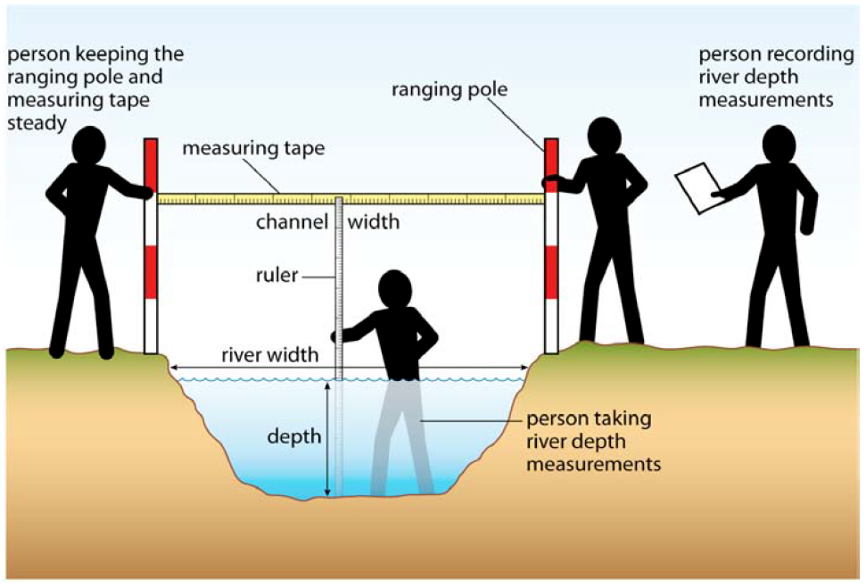
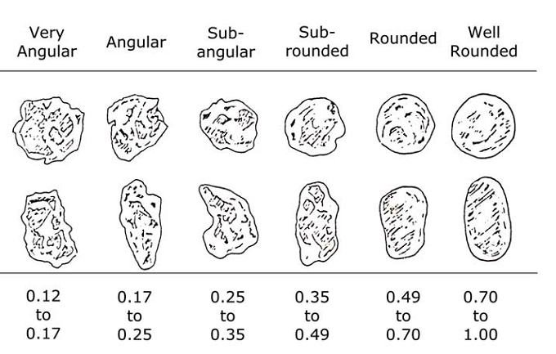
Paper 4 Skills
Investigating rivers 1
Possible investigations
Does the river channel increase in width and depth as the river moves downstream away from its source?
The bedload of a river will be smaller and rounder as it moves away from its source.
The river does not increase its speed as it moves downstream towards its mouth
How does the shape of the valley change as the river moves downstream from its source
Does the riverbed gradient decrease as the river moves downstream from the source to its mouth?
People have changed some parts of the river and its valley.
Equipment:
Ranging poles
Tape measure (30 metres)
Metre rulers
30cm rulers
Powers’ shape index
Clinometer
Measuring channel width
Hold the tape measure on one bank.
Stretch the tape measure tight across the river channel to the other bank, just above the water level.
Record the channel width.
Measuring bedload characteristics
Pick ten stones (at random) from the river bottom at each place you place the metre rule – any that you dislodge with your boots will do.
Compare each pebble to the Power’s Shape Index (above)
Record the length of the pebble along the longest axis.
Measuring channel depth
At each measurement site put a metre rule into the water on the right bank until it touches bottom, hold it against the tape measure.
Read and record the depth from the bottom to the surface of the water.
Repeat every 25cm across the channel width and also at the left bank.
Measuring channel velocity
At five sites along the course of the river you are to measure and record the velocity of the river flow. Use a biodegradable object that will float but that you will not need to retain (e.g. an orange).
Decide on the length of the stretches (reach) you will measure, e.g. 10m, 25m. Make sure the reach is relatively straight and free from obstructions.
Drop the dog biscuit in and use a stopwatch to accurately time how long it takes to travel the reach. Repeat four times for each reach and average the results.
Equipment: tape measure, stop watch, floats.

Slide 5
Paper 4 Skills
Investigating rivers 2
Measuring channel gradient
Using the tape, measure out 3m in a straight line upstream from where you took your survey recordings.
Place your ranging poles at either end of the tape measure.
Stand next to the nearest ranging pole and line up the arm of the clinometer with the bottom/top of a red or white band on the pole (hold on to the trigger).
Look along the sight to the distant pole and angle the clinometer so the sight notch at the end is in line with the corresponding band on the far pole.
Let go of the trigger so that the clinometer swings, keep your hand steady.
Once it has stopped swinging, press the trigger again and record the angle
Cross sectional area and discharge
Measuring the width and depth of the channel allows you to calculate cross sectional area:
CSA – average channel depth x width.
Now you can multiply the CSA with velocity to get the discharge in cumecs (cubic metres per second)
Calculating velocity:
Average your 3 time readings
Complete the following to calculate the velocity in m/s (metres per second)
$$Velocity= \frac{distance (m)}{average time (s)}×0.85$$

Slide 6
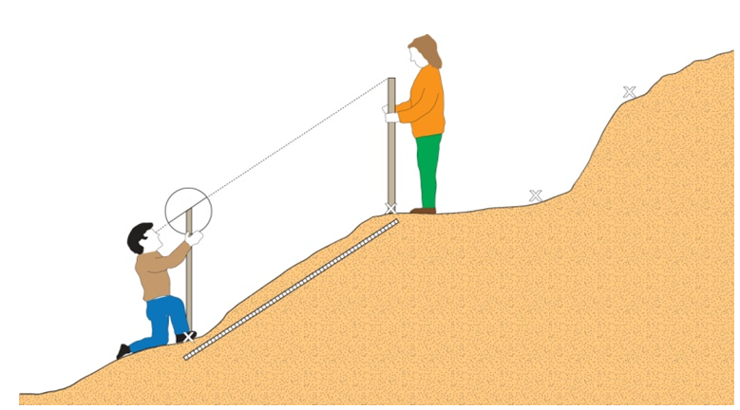
Paper 4 Skills
Investigating Coasts 1
Possible investigations
How do beach profiles change in response to wave energy?
The size and shape of pebbles will change along a coastline
Investigate whether longshore drift takes place
Do coastal management techniques have an overall positive impact on the coast?
Equipment:
Ranging poles
Tape measure (30 metres)
Metre rulers
30cm rulers
Clinometer
Recording sheet
Stop watch
Measuring a beach profile
Measure the profile of the beach from the low-tide mark upwards
At the first site, look for points where the angle of the beach.
Use these to divide your profile into sections – mark them as points A, B, C etc on your map. (If the slope is uniform, use changes in sediment or pebble size instead.)
One student stands at point A - as close to the low-tide mark as it is safe – with a ranging pole and one end of the tape measure.
The second student takes the other end of the measuring tape and a ranging pole and walks up to point B.
The third group member records the distance in metres between point A and point B.
To measure the slope angle between point A and B using a clinometer:
Stand next to the ranging pole, line up the arm of the clinometer with the top of a red or white band (hold on to the trigger).
Look along the sight to the distant pole and angle the clinometer so the sight notch at the end is in line with the same band on the other pole.
Let go of the trigger so that the clinometer swings. Keep your hand steady.
Once it has stopped swinging, press the trigger again and record the angle
Repeat this process for each section up the beach.
Longshore drift
Take a bucket of brightly painted pebbles / corks to make them easily visible.
Place them at the break zone – where waves break up the beach. Mark the location with a ranging pole. Time 15 minutes.
The movement of the material after 15 minutes should be clear and be consistent with wind and wave direction.
Groyne analysis
Using the compass, identify and record the aspect of each side of the groyne, for example the western and eastern side of each groyne
Use the meter ruler to measure from the top of the groyne to the surface of the sediment on each side
Repeat for each groyne, or identify and use a suitable sampling strategy if there are too many groynes to sample them all
Groyne
LSD Direction
West side of groyne
East side of groyne

Slide 7
Paper 4 Skills
Investigating Coasts 2
Beach Sediment Analysis
Similar methodology to a river pebble analysis
Select 10 pebbles from the sample site
Measure the long axis of each pebble
Compare shape on Powers shape index (see rivers)
Note it’s characteristics / geology.
Impact of coastal defences:
A range of techniques can be used to determine attitudes of local people. See the ‘general techniques’ section for more guidance.
Bi-polar survey of coastal management techniques e.g. gabions, groynes, sea walls.
Questionnaire of local people / tourists to gauge their views in range of open and closed questions.
See the general techniques section for more on these techniques.
Wave frequency
Count waves for three 1 minute intervals then work out an average for each site.
In addition use a stopwatch to record the time between the wave crests breaking.
Make a note of wind direction and speed.
Destructive waves cause erosion – you would expect 13 or more waves per minute.
Constructive waves deposit material. Expect fewer than 13 waves per minute.

Slide 8
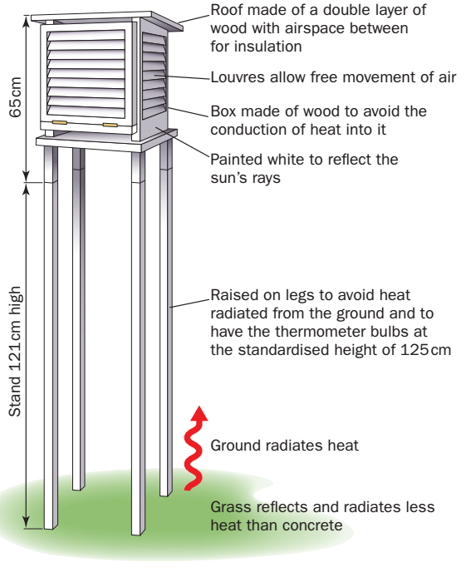
Paper 4 Skills
Investigating weather. How do i…
…measure precipitation
The rain gauge must be in an open space
It must be read at the same time each day.
Any snow or frost must be melted first.
To measure, pour the water from the collecting jar into a measuring cylinder on a flat surface.
The water level should be read at eye level
Any amount too small to measure should be recorded as a trace. This is probably the result of drizzle.
Recordings can be totalled to give monthly and annual rainfalls.
…use a Stephenson Screen
A Stephenson Screen can be used for measuring air temperature and humidity.
Instruments inside could include:
Maximum-minimum thermometer
Six’s thermometer
Wet – Dry bulb thermometer
Barometer
Siting factors shown on the diagram below.
Care should be taken to ensure they are located in open areas, not influenced by buildings or trees.
…measure wind speed and direction
Wind speed is measured using an anemometer. They can be handheld or fixed as part of a weather station.
Wind speed is measured in m/s, km/h and the Beaufort Scale.
Wind direction is measured using a wind vane which points at compass directions.
Wind direct is measured as the direction the wind is coming from.
…investigate weather conditions
Collect data over a period of time (a week, a month, a year) and interpret patterns this shows e.g. atmospheric pressure vs rainfall or amount of rain vs wind direction.
Investigate the influence of buildings, trees or other factors on temperature, wind speed, direction etc. around a school site (called a microclimate).
…measure atmospheric pressure
Using a barometer (gives readings in millibars).
Can be placed in a Stephenson Screen as they should be kept away from wind, direct sun and heat sources.
Indicates high or low atmospheric pressure which can influence weather conditions.

Slide 9
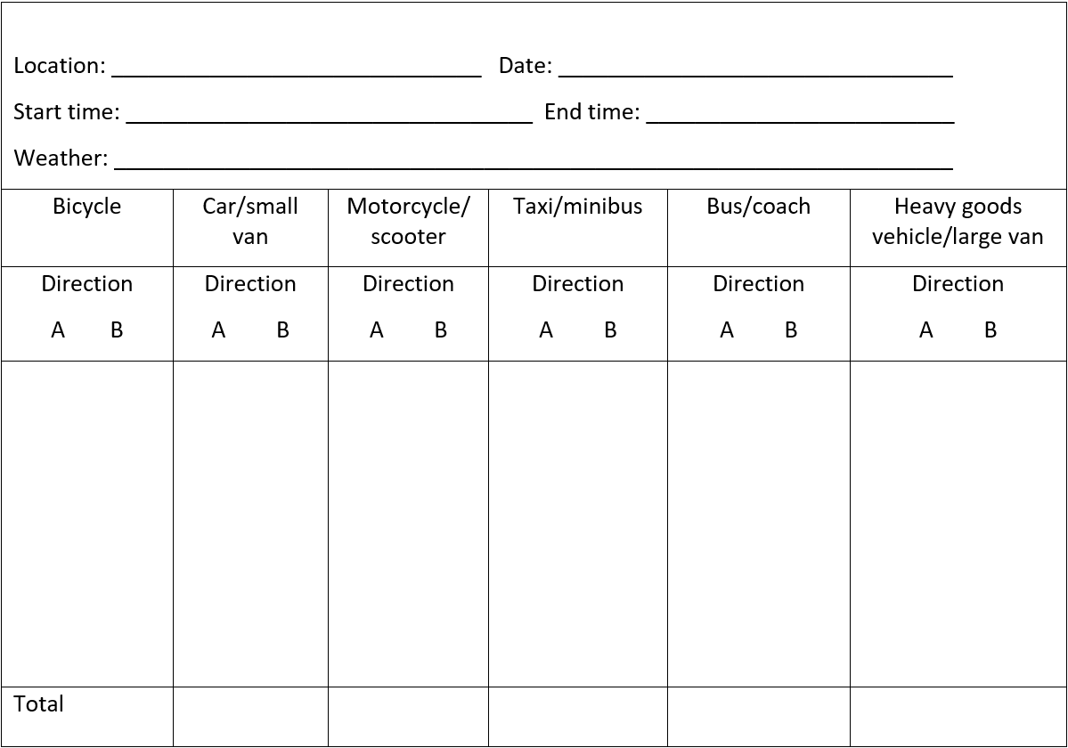
Paper 4 Skills
General Techniques
Fieldwork toolkit
These are a range of techniques that can be applied to a range of different investigations and may come up in questions from different aspects of the course.
Questionnaires
Land use surveys
Traffic counts
Bipolar surveys
Quadrats
Questionnaires
Always explain who you are and why you’re asking questions – be polite!
When you need to find out people’s opinions about an issue, or their behaviour, it is important to plan a carefully designed questionnaire.
The questions should be essential for the enquiry – short, simply worded, unambiguous, and numbered.
Include closed questions – those which lead to a definite answer. These include age ranges or yes / no type questions.
Start the questionnaire with closed questions which build to open questions – those which allow people to give their opinions.
You could use likert scale questions to gauge opinions (strongly disagree > strongly agree)
Traffic counts
At your chosen location, record the number of vehicles in each category for one session.
These should be marked under the directions you previously agreed in class (e.g. A may be for traffic flowing west, and B for traffic flowing east, or A traffic travelling into town and B out of town).
At the end of each session, tally up your marks and record the total.
To get the most reliable results carry out the survey more than once in each location.
Don’t forget to include time of day and the weather; they may affect your results.
This can then be repeated at each identified fieldwork site.
Pedestrian counts
Same principle as traffic counts above but:
decide on the kind of groups to record. For example, children, teenagers, adults, family group, elderly people.

Slide 10
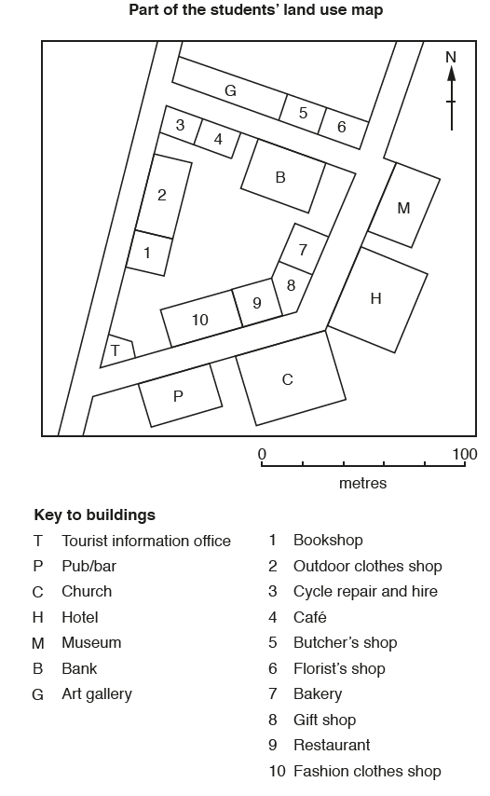
Paper 4 Skills
General Techniques
Bi-polar surveys:
These can be used to assess the environmental impact of different aspects e.g. the urban environment, tourism or sea defences.
Using a table, record your impressions of the factor on a bi-polar scale from -3 (extremely negative factor) to +3 (very positive factor), with 0 being the ‘average’ factor.
Scales used vary, and can be from -5 to +5 or -2 to +2 (like the example below).
Work out a total score for each type of defence.
Each student in the group should complete this, and results averaged to consider any bias.
Land use surveys
These can be used in various places:
Urban areas for building use e.g. retail, café’s, residential
Tourism to highlight services for tourists and locals
Farming for field types, crops grown, animals reared etc.
Draw a large-scale plan of the area on which separate buildings or fields are shown.
Decide whether it is possible to record all buildings, or whether systematic sampling should be used.
Decide the land use categories e.g. convenience stores, comparison, high order – low order, or wheat, barley, hop fields.
Mark the uses on the base map. If you are using the categories in
Devise shadings for each category and plot the land uses on another copy of the map. Remember to add a key for the shading used.
Quadrats
These can be used to count percentages of coverage on the ground. This could be:
Litter on the ground in an urban area
Type of beach material
Vegetation on a beach, sand dune, foot path etc.
At regular intervals, e.g. every 10 metres, place the quadrat at the side of a tape measure and count the number of different vegetation species and/or the percentage vegetation cover.
Record the results on the recording sheet.
Move the start of the measuring tape to the second ranging pole and repeat the process until the end of the transect line.

Slide 11
Paper 4 Skills
references
BBC Bitesize GCSE Revision – Fieldwork and Enquiry
Kelly D and Fretwell, M Complete Geography for Cambridge IGCSE, 2012: Chapter 13
Cambers, G and Sibley S Cambridge IGCSE Geography, 2010: Part C: the Alternative to Coursework – preparing for Paper 4
FSC Geography Fieldwork Guides – Sampling
Widdowson, J and Parkinson A, Fieldwork through Enquiry, 2013: Units 2, 4, 6, 7, 8 and 10
Royal Geographical Society Fieldwork for Schools website
Icons from Noun Project
Some images taken from CIE past paper 4’s.

