Slide 4
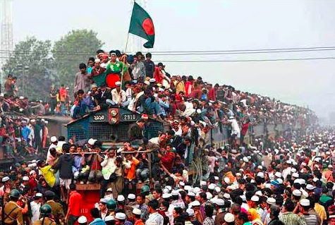
Overpopulation
is when there is not enough resources for the inhabitants in an area. Inevitably this leads to famine, water and electricity shortages, increased unemployment.
Bangladesh, Ethiopia, and parts of China, Brazil and India are said to overpopulated as they have insufficient food, minerals and energy resources to sustain their populations
All suffer from localised famines, natural hazards (drought/flood) and are characterised by low incomes, poverty, poor living conditions & high levels of emigration

Slide 5
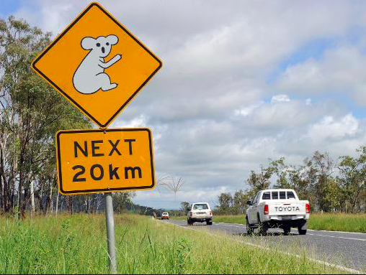
Underpopulation
is when there is more resources than inhabitants in an area. Surplus in food and water results in wastes. Societal systems such as schools and hospitals will then not have enough demand to run at a sustainable level. So the cost per capita for the service will increase. Additionally, there will be less "working population" this has a negative impact on a countries economy and will lead to an increase in taxation.
Canada and Australia are good examples of countries that are underpopulated. Both have surplus amounts of food, energy and mineral resources that are exported. Their populations have high incomes, good living conditions, high levels of technology and immigration.
Standards of living would probably rise further if populations increased, as greater volumes of resources would be produced and exploited!

Slide 6
Optimum population
is when there is enough resources for the number of inhabitants (population demand for goods is equal to the supply). The optimum population will also be influenced by developments in technology, demographic structure changes, as trade opportunities develop/falter, and as new raw materials are discovered to replace old ones which are exhausted or whose values change over time

Slide 7
Most likely to be associated with over-population or under-population?
Poverty
Not enough housing
Lack of employment
Lack of government income
Not enough health care and education
Water and air pollution
Shortage of workers
Resources underused
Low level of production
Small market for goods and services
High taxes
High crime rates
Shortage of food and water
Low value of exports

Slide 8
Check your answers

Slide 9
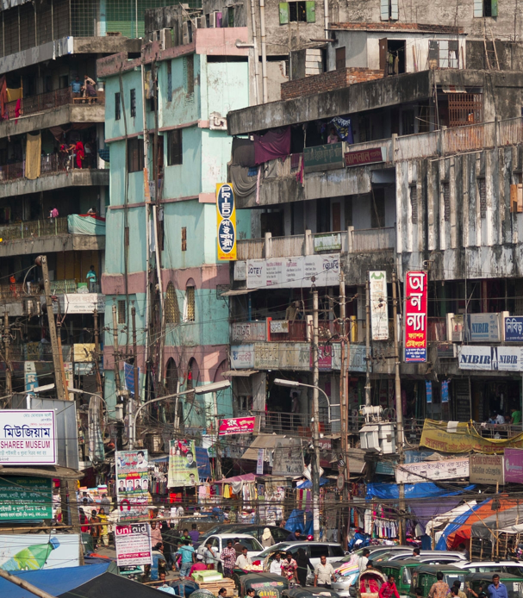
What evidence is there on these images that Canada is underpopulated and Bangladesh in overpopulated?

Slide 10
Information race….. Use the information on the tables outside to answer the following questions:
Name 5 natural resources in found in Canada……
What % of the land is arable….
What has happened to the average incomes and employment levels…
What is one of the most underpopulated parts of Canada? ….
What proportion of the land do the NW territories take? ……
How large is the population of the NW territories?…
What resources are found in the NW territories? ….
What are the problems of extracting resources in the NW territories?
What % of the land in the NW territories is more than 100km from the nearest road? …
What other types of transport do they need to use?
What are other problems in extracting resources in the NW area?

Slide 11
Information race answers
Name 5 natural resources in found in Canada: Fish, timber, minerals, natural gas and oil and HEP
What % of the land is arable 5%
What has happened to the average incomes and employment levels…fallen
What is one of the most underpopulated parts of Canada? NW territories
What proportion of the land do the NW territories take? 1/3
How large is the population of the NW territories? 55,000
What resources are found in the NW territories? Zinc, gold, tin, gold, lead, oil and gas
What are the problems of extracting resources in the NW territories? Environmental difficulties and a lot of the population follow a traditional indigenous way of life.
What % of the land in the NW territories is more than 100km from the nearest road? 90%
What other types of transport do they need to use? Air and river
What are other problems in extracting resources in the NW area? Hard to get at, expensive to develop and subject to world market fluctuations.

Slide 12
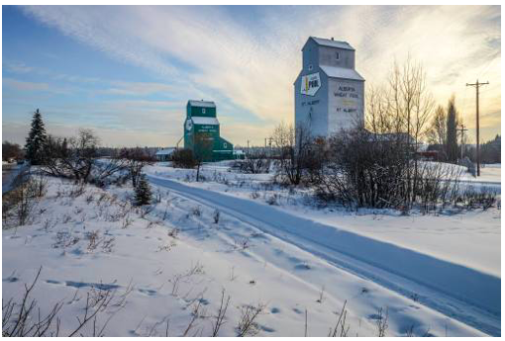
Underpopulation in Canada
Canada is regarded as an underpopulated country as the carrying capacity is much higher than the current population. The 35 million people in Canada can not fully exploit the available resources and technology.

Slide 13
Problems of underpopulation in Canada:
Labour shortage: 32% of Canadian employers are encountering difficulties in hiring workers due to a lack of applicants
Services (e.g. schools, hospitals and transport) close down as there are not enough customers.
Less innovation and development (less brain power)
Difficulties in defending the country
Solutions:
Canada has tried to promote immigration to maintain the fairly high standard of living, but in the previous decades less people are migrating to Canada, than during the 1950’s and 1960’s.
relaxing immigrant policies and visa requirements to encourage migration
Pro-natal goverment support to increase the birth rate eg. subsidies and parental leave programmes
allow pensioners to continue working

Slide 14
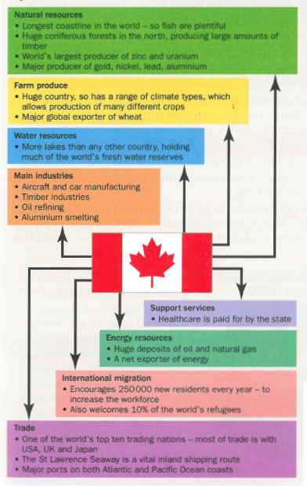
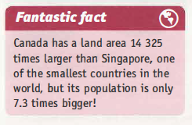
Underpopulation in Canada
Use the evidence on this slide to prove that Canada is underpopulated.
Explain the reasons you have given

Slide 15
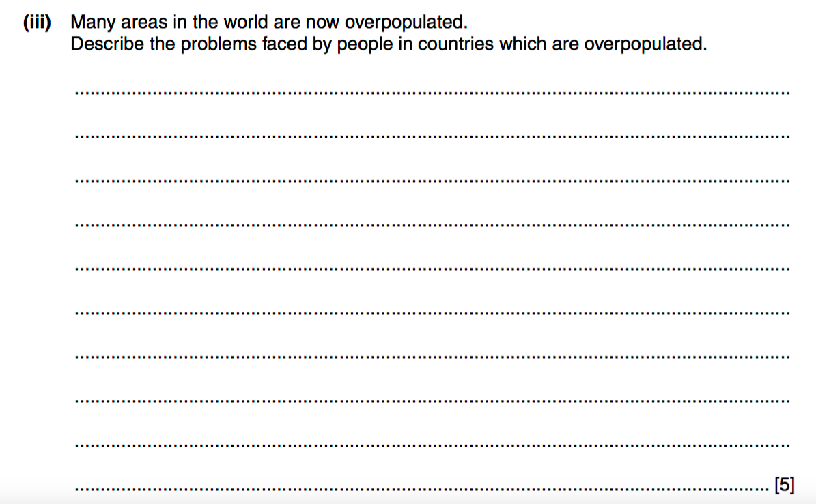

Slide 16
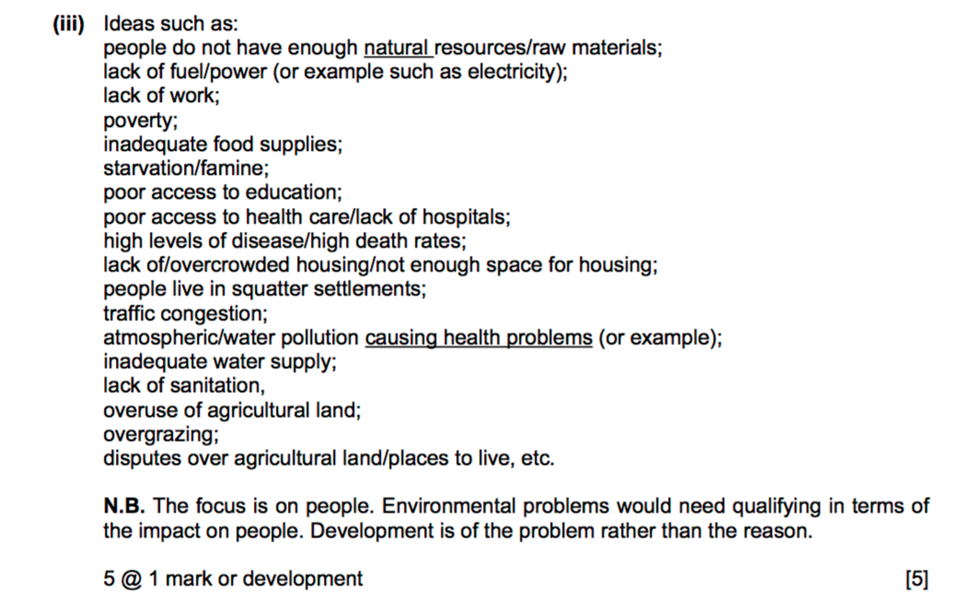

Slide 17
Describe problems created by underpopulation (5)

