Slide 1
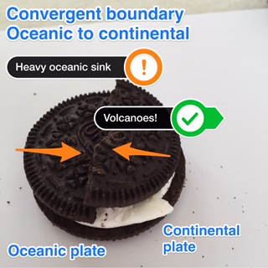
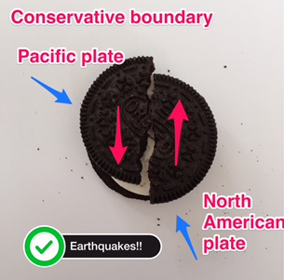
Oreo Style ♯OreoTectonics
Using the top of your Oreo, create models of each plate boundary
Take a photo using Skitch
Annotate the photos showing the following:
Plate name
Plate movement
Landform created

