Slide 3
Think!
How can we let the government know when we disagree with their policies or ideas?
Can you think of any recent examples of people challenging the government because they don’t agree with their policies or ideas?
What can be the consequences of challenging the government about their policies or ideas?

Slide 4
Role Play
You have been given a character.
You now live in the new dictatorship under Comrade Morgan.
As she makes new laws and new policies you should act as your card dictates.

Slide 5
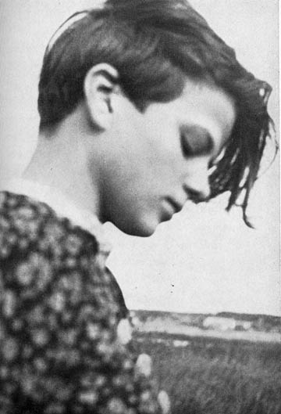
How did your character react?
Nonconformity Acceptance Resistance Participation Enthusiasm Protest Commitment
On your white board write these out in a line, with the most hostile attitude towards the regime on the left, moving towards the most positive on the right.
Which forms of opposition are easiest to deal with? Which are the most difficult?

Slide 6
How would you explain what a totalitarian regime is?

Slide 7
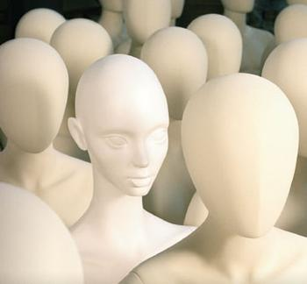
Totalitarianism
(or totalitarian rule) is a political system where the state recognizes no limits to its authority and strives to regulate every aspect of public and private life wherever feasible.
Totalitarian regimes stay in political power through propaganda, disseminated through the state-controlled mass media, a single party that is often marked by personality cultism, control over the economy, regulation and restriction of speech,mass surveillance, and widespread use of terror.

Slide 8
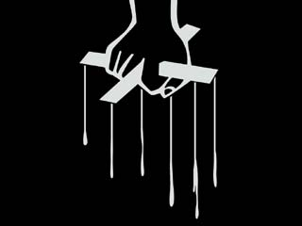
What methods would you use to control the “people”?

Slide 9
Key Quote
“Terror is the best political weapon for nothing drives people harder than a fear of sudden death.”

Slide 10
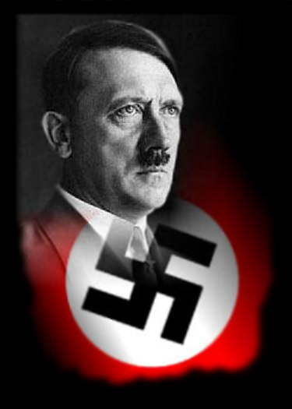
Following Hindenburg's death, Hitler merged the presidency with the office of Chancellor under the title of Leader and Chancellor making himself Germany's Head of State and Head of government. This action effectively removed the last remedy by which Hitler could be legally removed from office—and with it, all institutional checks and balances on his power.
What has Hitler succeeded in creating?

Slide 11
Hitler had a plebiscite held on 19 August 1934, in which the German people were asked if they approved of Hitler merging the two offices. The Ja vote amounted to 90% of the vote.
Dictatorship

Slide 12
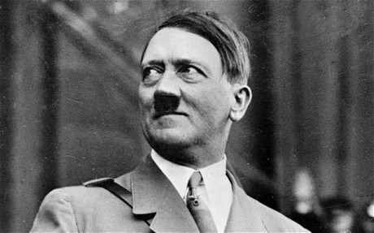
“I will render unconditional obedience to the Fuhrer of the German Reich and people, Adolf Hitler, the supreme commander of the armed forces, and will be ready as a brave soldier to stake my life at any time for this oath.”

Slide 13
What do we need to know?
What was the nature of opposition?
What was the extent of opposition?
How was opposition dealt with?

Slide 14
Who opposed Hitler?

Slide 15
What can we learn from our secret file about opposition in Germany?
Feedback to the rest of the class

Slide 16
Case Studies
Why did these people oppose the Nazis?
What did they oppose?
How did they oppose the Nazis ?
What was the impact of their actions?
Why did most opposition fail?
What do these cases tell us about ordinary Germans’ knowledge of Nazi crimes?
How far did opponents of Nazism oppose the persecution and murder of the Jews?

Slide 17
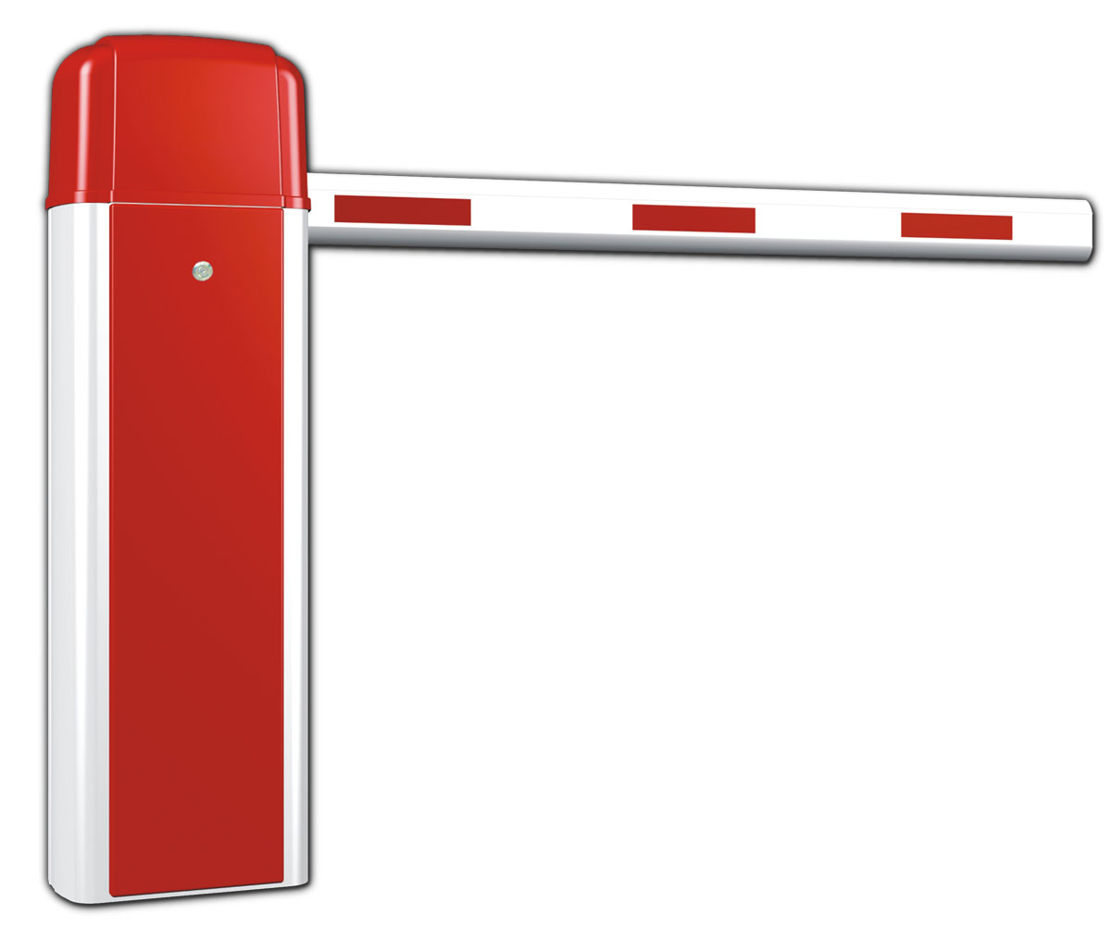
Who opposed Hitler?
How could they show their opposition?

Slide 18
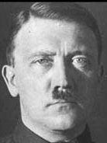
CHURCH
WORKERS
RELIGION
UNIONS
CHILDREN
FAMILIES
PEOPLE
SCHOOLS

Slide 19
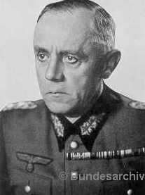
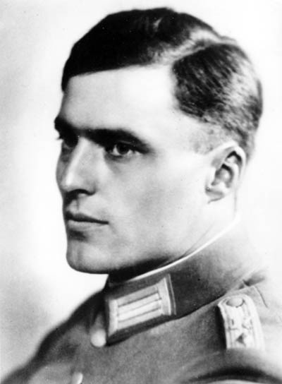
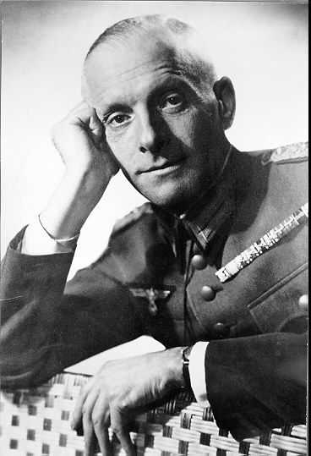
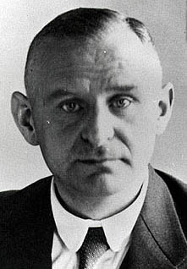
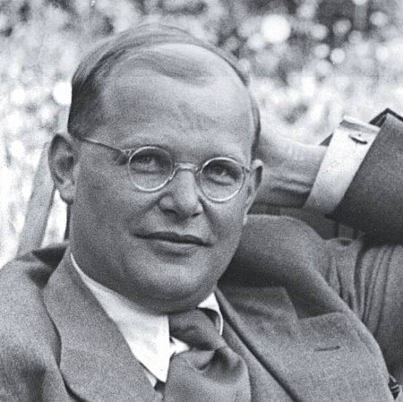
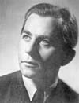
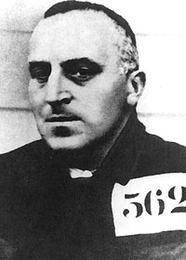
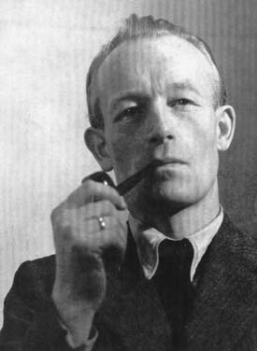
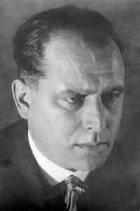
Groups providing some opposition
The Churches
Youth
The army
Government and the Civil service
Judiciary
The workers
Opposition parties
Traditional elites

Slide 20
Why did groups resist?
 | Why did they oppose? | What did they do?
Churches: | Defend church against interference, criticized sterilization, euthanasia | Spoke out in sermons, Confessional Church split from Reich Church
Youth | Inspired by Galen’s sermon (White Rose movement), Swing Movement – Nazi restrictions in culture, Edelweiss Pirates: Hitler Youth | Leaflets – details about euthanasia & atrocities on Eastern Europe
Army | Suspicious of Hitler’s foreign policy. Concerned of how radical it was becoming. | Beck planned to arrest Hitler in 1938. Bomb Plot in 1944. Abwehr helped Jews leave.
Government and civil service | Greater freedom, anti-semitic violence, | Planned alternate government, maintained contact with opponents
Judiciary | Interference in justice system | Tried to maintain proper standards of justice Sometimes defied government’s wishes
Workers | Trade unions destroyed Ex-SPD or KPD supporters | Strikes (400 between 33-35) Links with illegal political parties ‘No-go’ areas for Nazis in WC districts
Opposition groups | Banned in 1933 Ideologically opposed | SOPADE – distributing leaflets KPD – underground cells Red Orchestra: Sent info to USSR
Traditional elites | Government regulations and restrictions Oppossed ending of basic freedoms and subversion of justice | Plotted to replace Hitler (involved in 1944 Bomb plot)

Slide 21
What was the extent of opposition?

Slide 22
How much opposition was there to the Nazi regime?
“ What we have written and said is in the minds of all of you, but you lack the courage to say it aloud”
Sophie Scholl during her trial before a People’s Court in 1943.
Executed for distributing anti-government pamphlets
How true is her statement?

Slide 23
How much opposition was there to the Nazi regime?
Her statement raises a number of issues…
- Were most Germans privately critical of the Nazi regime or did public acceptance reflect genuine support?
- Was the limited amount of opposition a reflection of courage or of the problems potential opponents faced?

Slide 24
How much opposition was there to the Nazi regime?
General impression is of little opposition
Much evidence of Hitler’s genuine popularity
Third Reich not overthrown by its people
Internal opposition had little effect on the course of events
So did Germans lack courage?

Slide 25
How much opposition was there to the Nazi regime?
Germans gained greatly from Hitler’s domestic policies
Foreign policy successes until 1941
Fierce repressive machinery
Opposition could cost you your job, freedom or life
Would you have opposed Nazism?

Slide 26
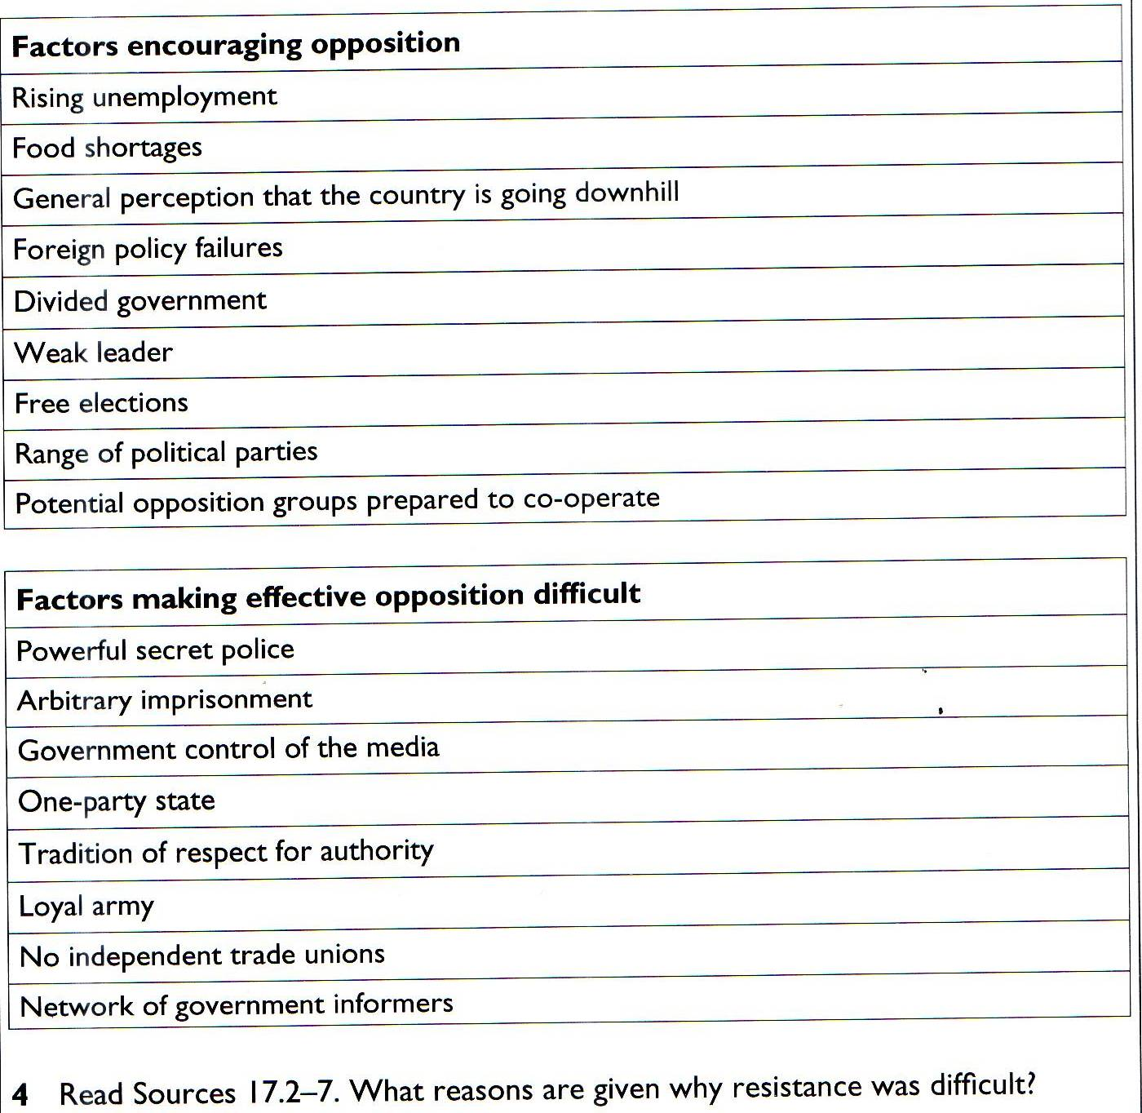

Slide 27
How much opposition was there to the Nazi regime?
Read sources 17.2-7. What reasons are given why resistance was difficult?

Slide 28
Types of opposition
Nonconformity Acceptance Resistance Participation Enthusiasm Protest Commitment
Rate the various forms of opposition that have been recorded in the Third Reich

Slide 29
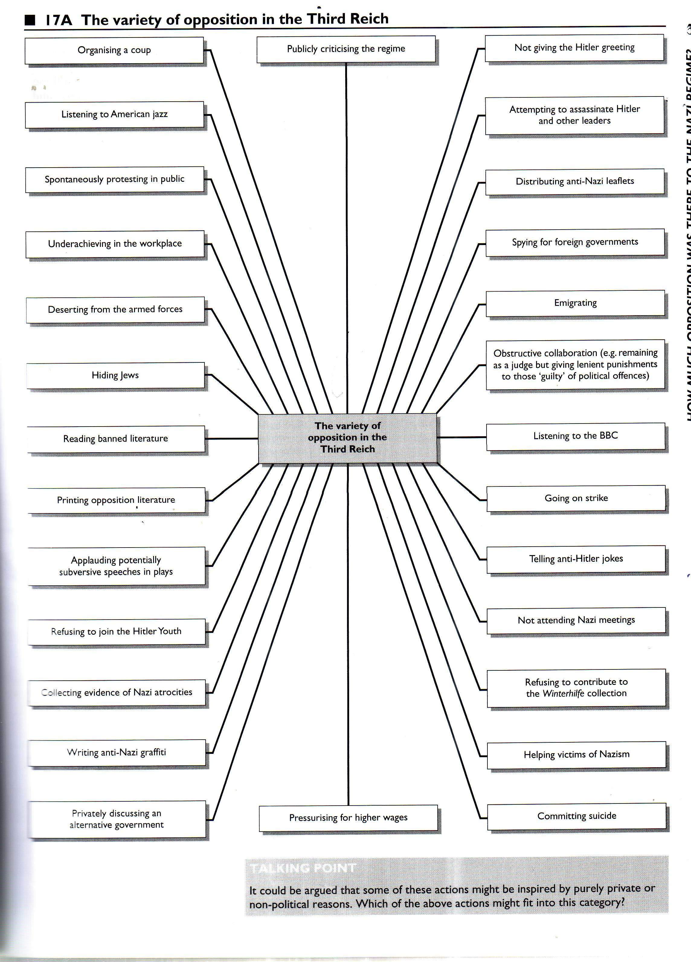

Slide 30
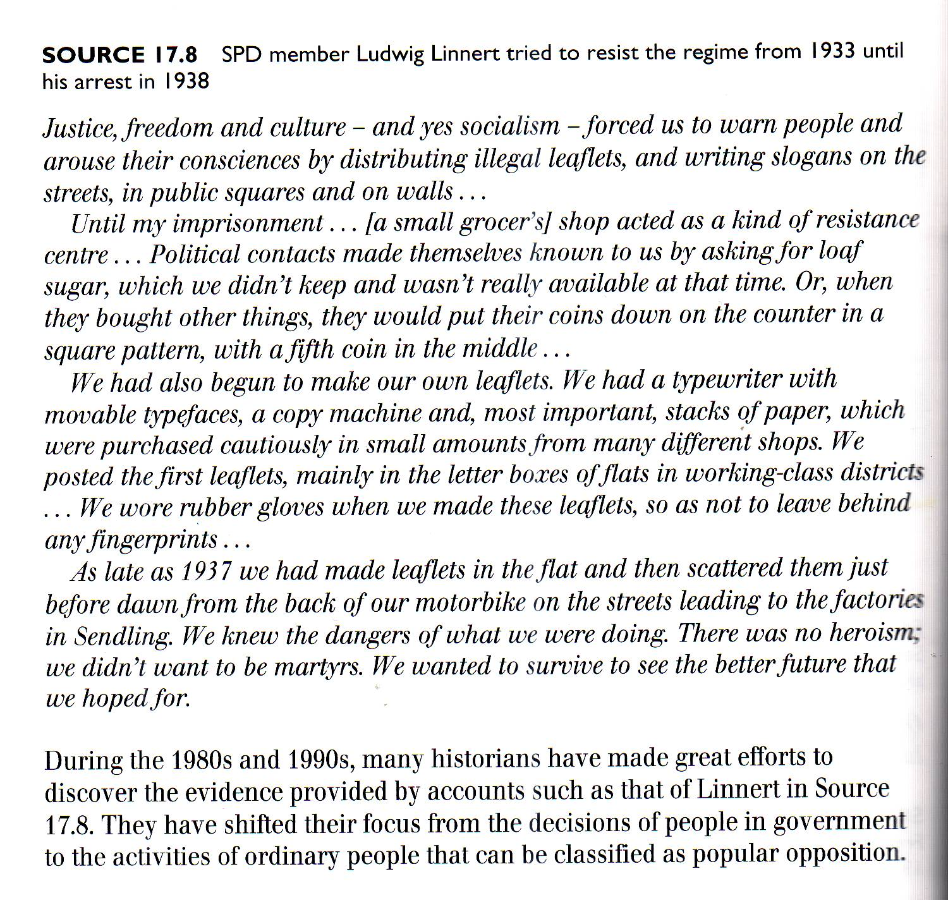

Slide 31
Opposition, resistance and nonconformity
Until recently historians focused on public criticism/open opposition.
Bishop Galen
Assassination attempts
July Bomb Plot 1944
Since 1980s – focus shifted
Study behaviour of ordinary people – broad range of opposition – major and minor
Minor - Grumbling at lack of butter
Major – challenging whole regime
Minor in private – major in public
Minor – people with little power
Major – powerful leaders

Slide 32
Assassination attempts
Most dramatic attempts – could have led to collapse of whole regime
Numerous individual plans
Some very close
Some are listed here…
Look at the dates
Look at the sorts of people

Slide 33
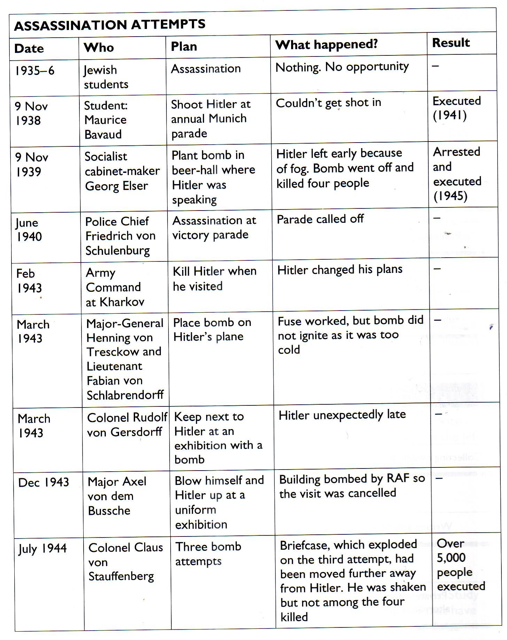

Slide 34
When was the best chance to remove Hitler?
At the beginning
Hindenburg – until Aug 1934
Opposition parties
General strike
However…
Unemployment high
Opposition divided
People did not expect Hitler to last long
Hitler appointed legally
Army appeased – Night of Long Knives
Widespread hope

Slide 35
What were the problems of removing him after 1934?
After 1934 no legal way to remove him
Opposition activity banned
Critics had to be secret – co-ordination impossible
No strong reasons…
Massive support for government – plebiscites
Early victims unpopular
Nothing too radical
Policies successful
Propaganda
Repression

Slide 36
How serious was the opposition?
Some plans to overthrow government
- army
Generally opposition took form of Non-cooperation
Number of resisters = small
Hundred subgroups
Thousands of individuals
Institutions – churches and army

Slide 37
How serious was the opposition?
Local archives reveal a variety of forms of dissent
Mason
working class non-conformism
absenteeism
Strikes
Industrial sabotage
Kershaw
Highlighted large scale grumbling
Peukert
- Cologne & Hamburg – young people

Slide 38
Who were the resisters?
There was opposition – one sign is…
1.3 million Germans sent to concentration camps
300,000 left Germany between 1933 & 1939

Slide 39
Account for the ineffectiveness of internal opposition to the Nazi regime

Slide 40
Why was it ineffective?
Regime controlled instruments of power e.g. propaganda
1000s relied on regime for livelihood
Leaders were ruthless
High risk of being captured
Reasons to oppose were trivial, selfish and narrow minded
Organisationally weak – numbers small often to avoid detection
Groups were not unified – e.g. ideologically
Not prepared to fight seriously – unclear on aims
People kept grumblings private
Things had improved – not wanting to go back to Weimar years
Gestapo could track leaflets – very well-informed of opposition activities

Slide 41
Futile
F ear
U ncoordinated
Dic T ator or totalitarian
I mprovements
L uck
m E dia

Slide 42
Methods used to control opposition

Slide 43
The People
The SS
The Nazi
Police State
The Gestapo
Concentration
Camps

Slide 44
SS were responsible for running the concentration camps.
Secret police would spy on and arrest enemies of the state.
The People
The SS
The Nazi
Police State
The Gestapo
Concentration
Camps
Everyone was scared of being arrested by the Gestapo and being put in a concentration camp.

Slide 45
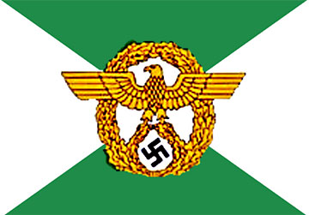
The Gestapo
Geheime Staatspolizei

Slide 46
The SS
Schutzstaffel

Slide 47
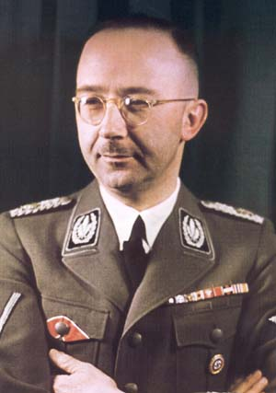
The Police State
Both the Gestapo and the SS were run by Heinrich Himmler.

Slide 48
The Police State
The Gestapo employed an army of spies who would inform on people.
They tapped phones, intercepted mail and received denunciations from informers.
Had strong local structure – Gauleiters responsible for “Gau”, divided into towns, streets & blocks.
Activists were ‘eyes & ears’ of Party.
Reports compiled on any form of opposition – telling anti-Hitler jokes, refusing to give Hitler salute, not flying Nazi flag.

Slide 49
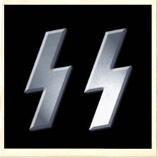
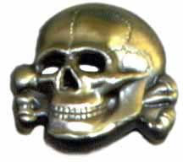
The Police State
The SS grew from a personal protection force for Hitler into a huge organisation in charge of the concentration camps, spying, army regiments and foreign soldiers.

Slide 50
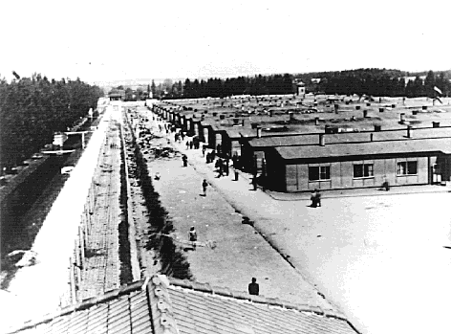
What were concentration camps?
Began as temporary prisons in disused warehouse or temporary enclosures for Nazi opposition.
Political opponents & ‘asocials’ imprisoned.
Slave labour used to manufacture weapons or work on public works schemes.
The number of camps quadrupled between 1939 and 1942 to 300+, as slave-labourers from across Europe; Jews, political prisoners, criminals, homosexuals, gypsies, the mentally ill and others were incarcerated.
Some became “death” camps as part of the Final Solution.

Slide 51
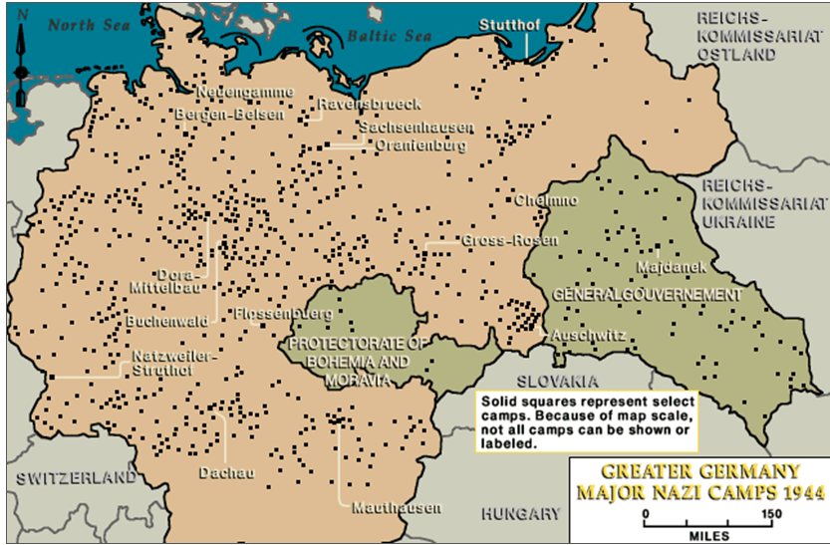
Nazi Camps in Greater Germany 1944

Slide 52
The SS

Slide 53
The Geheime Staatspolizei (German for Secret State Police, abbreviated “Gestapo”) was formally organised after the Nazis seized power in 1933. Effectively a secret police who spied on Germans.
Hermann Goring became the commander of this new force on 26th April, 1933. At the same time that Goring was organising the Gestapo, Heinrich Himmler was directing the SS Hitler’s elite paramilitary corps.
In April 1936, Himmler was given command of the Gestapo as well, integrating all of Germany’s police units under Himmler.
The Gestapo

Slide 54
How did the Police State work?
You are imprisoned for up to six months doing hard physical labour.
When you are released you tell everybody what has happened to you
Gestapo Spies inform on you
Fear
You are woken up by the Gestapo at 1 am in the morning and told that you have 5 minutes to pack your bags.
You are handed over to the SS who run the concentration camps.
By signing this form you are giving your consent to be put into a concentration camp.
Days or maybe weeks later you are interviewed and asked to sign form D11
You are arrested and thrown into a cell at the police station

Slide 55
A list of German women who were still purchasing goods from Jewish shops.
Printed to scare or terrorise other people into not buying from the Jews.

Slide 56
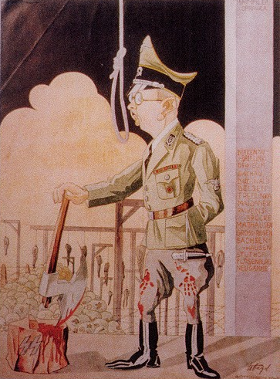
Nazi Law
Existing police forces, courts, laws remained in force.
Police put under command of Himmler & the SS.
Judges swore oath of loyalty or were replaced by Nazi supporters.
People’s Court & Special Court tried political opponents & traitors.
These abolished the right of trial before imprisonment.
By 1939, 162,000 Germans imprisoned without trial, 500 sentenced to death.

Slide 57
What is the message of this cartoon?

Slide 58
How effective was the Police State?
Everyone knew someone who knew someone else who had been in a concentration camp.
Favourite joke amongst Germans at this time: A man goes to the Dentist. The Dentist says: ‘Open Wide.’ The man sits up and says: ‘Not in front of a stranger.’
Favourite Saying amongst Germans: ‘Speak through a Flower.’
800,000 Germans were imprisoned from 1933 – 1945 as ‘Enemies of the State.’
500,000 were executed by being shot in the neck.
Notes:
There is a great BBC Video on this topic

Slide 59
Learning Objective
To understand how the Nazi’s worked to control workers.

Slide 60
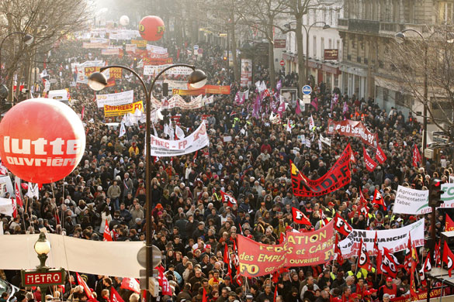

Slide 61
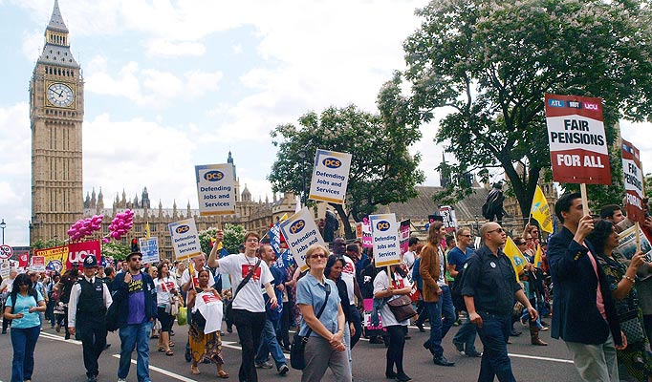
Who organises strike action?

Slide 62
Trade Unions

Slide 63
Trade Unions
Thinking;
How would workers benefit from trade unions?
Why might Trade Unions be seen as a threat?

Slide 64
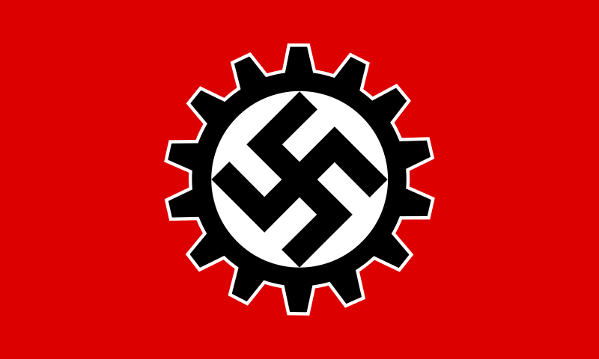

Slide 65
Deutsche Arbeitsfront
What does this mean?

Slide 66
German Labour Front
Or the DAF.
Theoretically, the DAF existed to act as a medium through which workers and owners could mutually represent their interests.

Slide 67
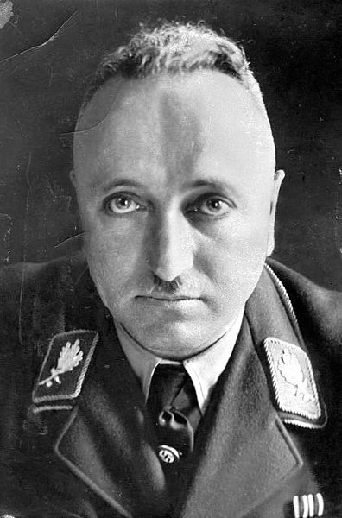
DAF
Robert Ley
Head of the DAF from its creation in April 1933.

Slide 68
Trade Unions
Evaluating the DAF
POSITIVES
NEGATIVES
To ‘protect’ those in work, the German Labour Front was set up.
The DAF took the role of trade unions..
Workers could not be sacked on the spot.
Government labour exchanges could arrange for a new job if someone did leave his employment.
The average factory worker was earning 10 times more than those on dole money.
All other Trade unions had been banned.
A worker could not leave his job without the government’s permission.
Only government labour exchanges could arrange for a new job.
The DAF increased the number of hours worked from 60 to 72 per week (including overtime) by 1939.
Strikes were outlawed.
Any complaining was potentially dangerous. Remember what happened to the Work shy!

Slide 69
Learning Objective
To understand how the Nazi’s worked to control the church.

Slide 70
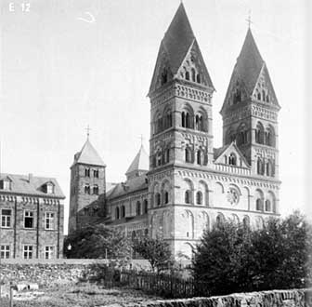
The Church
Why would the church pose a threat to the Nazi regime?

Slide 71
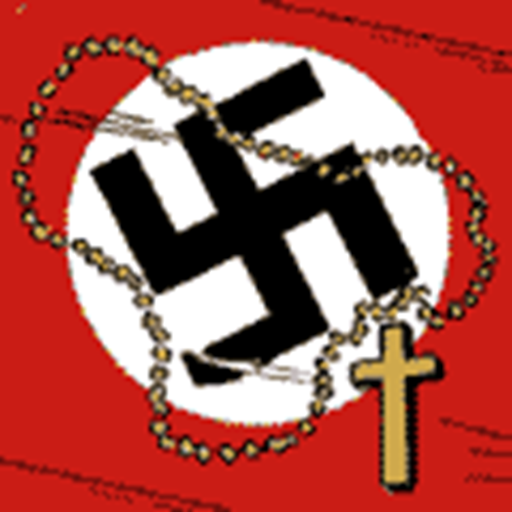
What does this suggest is the solution sought by the Nazi’s?

Slide 72
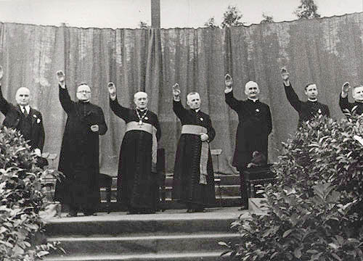
A Nazi Church?

Slide 73
The Church
Many leading Nazis were anti-Christian but unwilling to provoke conflict with Church.
In June 1933, Catholic Church signed ‘Concordat’ (an understanding).
The Protestant Churches combined into a pro-Nazi Reich Church, ‘The swastika on our breast and the cross in our hearts”.
Those churches who remained independent were called “Confessing Churches” but were subject to persecution and harassment.

Slide 74
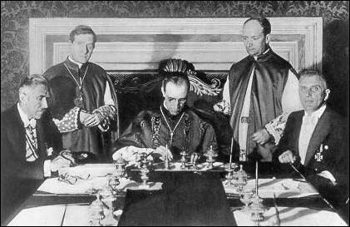
What was the Concordat?
The Pope signed a Concordat with Hitler. He agreed not to interfere in Nazi politics if the Church was left alone.

Slide 75
The “Reich Church”
In 1936, the Reich Church was created. This did not have the Christian cross as its symbol but the swastika. The Bible was replaced by "Mein Kampf" which was placed on the altar. By it was a sword. Only invited Nazis were allowed to give sermons in a Reich Church.

Slide 76
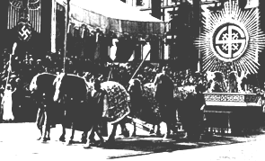
The “Reich Church”
Reich Church symbol

Slide 77
Did the Nazi’s isolate the Church?
In 1937, the pope, Pius XI, issued his "Mit brennender Sorge" statement ("With burning anxiety") over what was going on in Germany.
Martin Niemoller became a figure of resistance from the Protestant Church and was arrested in 1937.

Slide 78
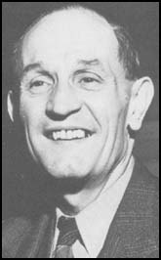
Martin Niemoller
First they came for the communists, and I didn't speak out because I wasn't a communist.
Then they came for the trade unionists, and I didn't speak out because I wasn't a trade unionist.
Then they came for the Jews, and I didn't speak out because I wasn't a Jew.
Then they came for me and there was no one left to speak out for me.
How useful to a Historian would this source be?

Slide 79
To Finish
Read pages 99 – 100 in your Todd book.
Make notes on the following questions;
Who opposed the Nazis (4 – 5 examples)?
What did they oppose?
How did they oppose the Nazis ?
What was the impact of their actions?
Why did most opposition fail?
What do these cases tell us about ordinary Germans’ opposition?
How did the Nazi’s control opposition?

