Slide 1
What country are we learning about?
As each clue appears think about which country might be the topic of today’s lesson.
Once you’ve written down your guess you can’t change it!
The winner is the person who guessed the earliest
1. It is located in Southeast Asia
2. It has over 18,000 km of coastline
4. It’s capital is over 7,000 miles from BISH
9. They celebrate their new year in February
7. They hosted the Olympics in 2008
6. It has the Worlds fourth
largest land mass in the world
3. It’s coastline runs along the Pacific Ocean
5. Paper, the compass and printing were all invented here.
8. It has the worlds largest population.

Slide 2
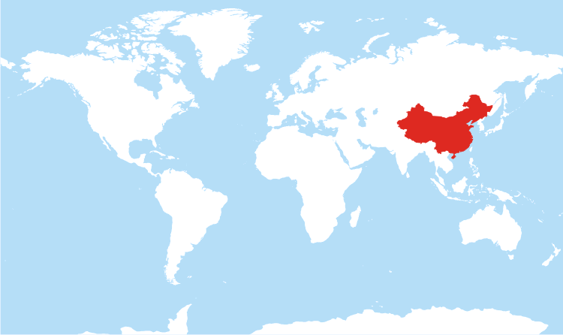
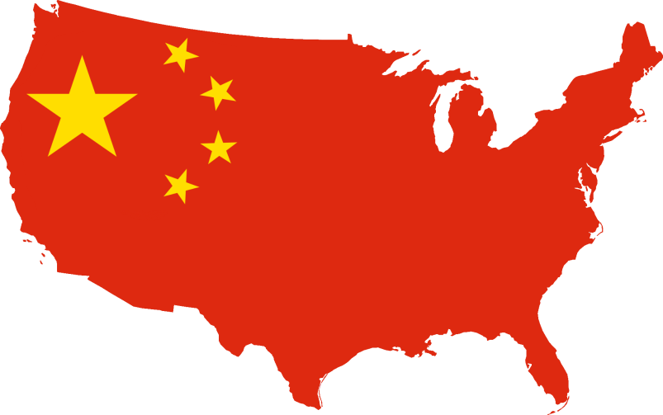
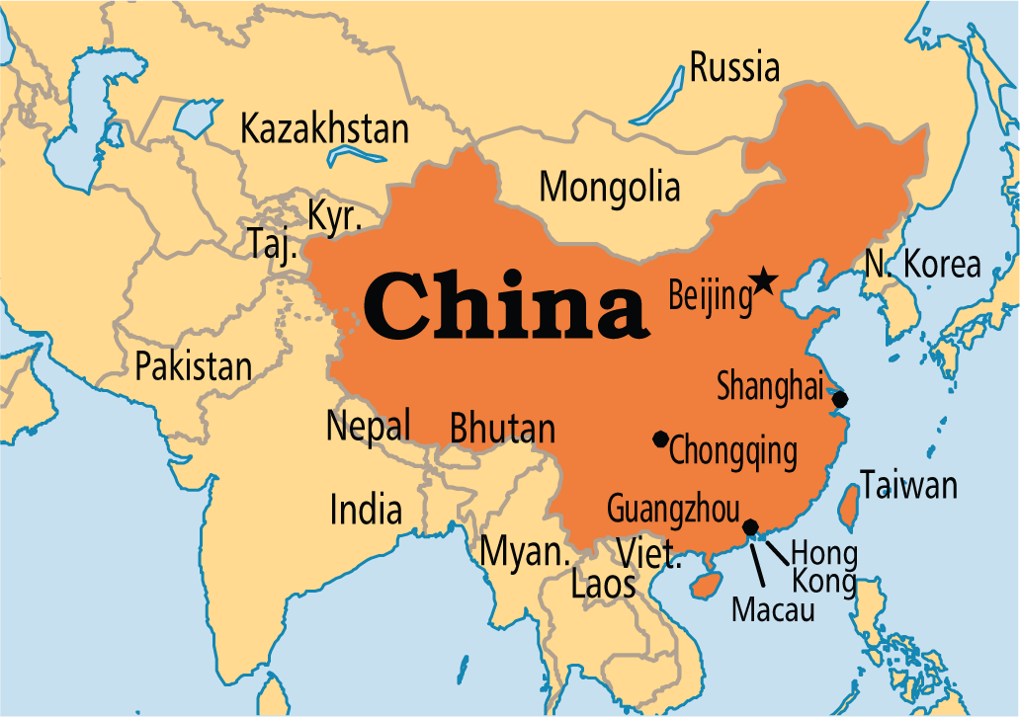
China!

Slide 3
1. Why are we looking at China?
Use the data from the table to complete the graph!
1. Why might China have such a large population?
2.Why do you think China are predicting the population will fall?
Year | Population (billions)
1960 | 0.667
1970 | 0.818
1980 | 0.981
1990 | 1.13
2000 | 1.20
2010 | 1.30
2020 | 1.35
2030 | 1.38
2040 | 1.34
2050 | 1.27

Slide 4
Learning Intentions
To understand the issue of population in China
To explain the One Child Policy and its impact on China
To analyse and evaluate the policy and offer possible solutions.
Key Words:
One Child Policy
China
Family
Responsibility

Slide 5
The One Child Policy
Comprehension and memory task!
This is China’s famous population policy, introduced to limit their rapid growth in population. It was introduced in 1979.
The majority of people in China can only have one child, or else they may face heavy fines or lose their jobs!
However, last year 52.9% of parents were allowed to have a second child if their first was a girl.
Memory and Comprehension
When was the policy introduced?
Why was it introduced?
What are the two possible punishments for not following this law?
When might you be allowed to have 2 children?

Slide 6
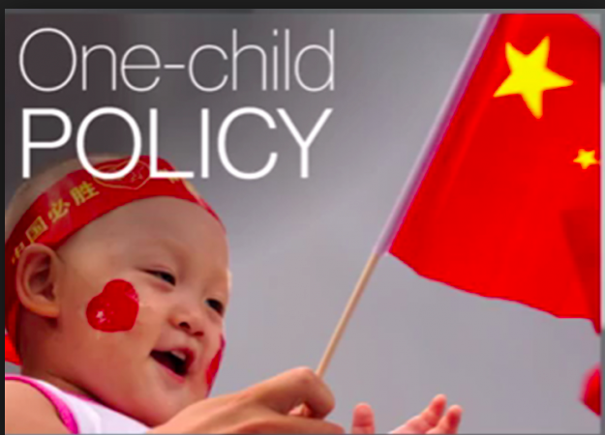
The consequences of China’s one child policy
https://www.youtube.com/watch?v=D0BPWFnL_jY
Complete the card sort:
How was the policy enforced?
What were the benefits?
What were the issues?

Slide 7
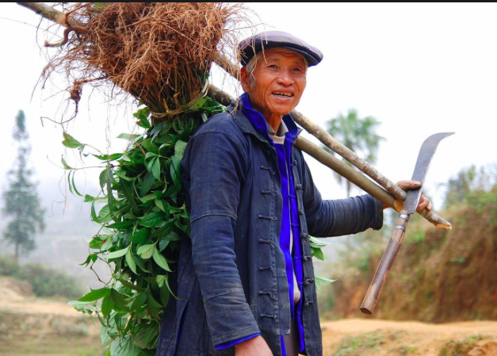
3: The Real Impact
Read the case studies and discuss the following questions with your partner:
Case study 1: Wei, an only child
Case study 2: Ju, a farmer
Answer the following questions:
Wei’s parents are keen for him to do well at school. Why is there so much pressure about this, in China?
How do you think Ju felt when the village committee spoke to her about being pregnant again?
How do you think Ju’s son feels as his parents future is in his hands?

Slide 8
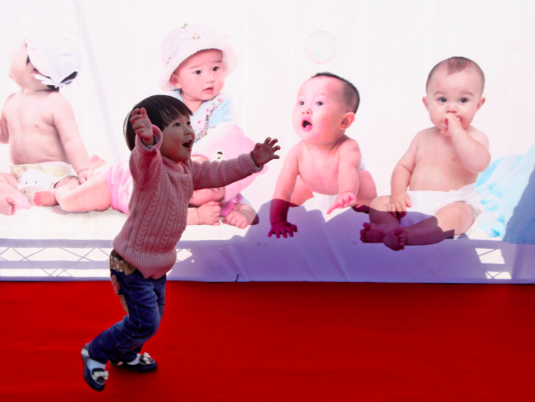
Why did they end the One Child Policy?
http://www.bbc.com/news/av/world-asia-china-34671371/end-of-china-s-one-child-policy-explained
https://www.theguardian.com/world/2015/oct/29/china-abandons-one-child-policy?CMP=share_btn_tw

Slide 9
Add to your notes:
Read:
http://www.bbc.com/news/world-asia-china-34667551
And page 21-22 of textbook

Slide 10
What do you think about China’s One Child Policy?
Do you agree or disagree with this policy?
Write your name and your reasons on your post-it note and stick it on the scale.
Dave
I’m not sure because....
Completely Agree
Completely Agree

Slide 11
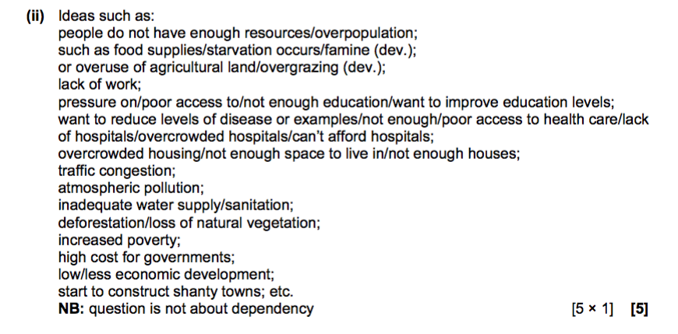

Slide 12
