Slide 1
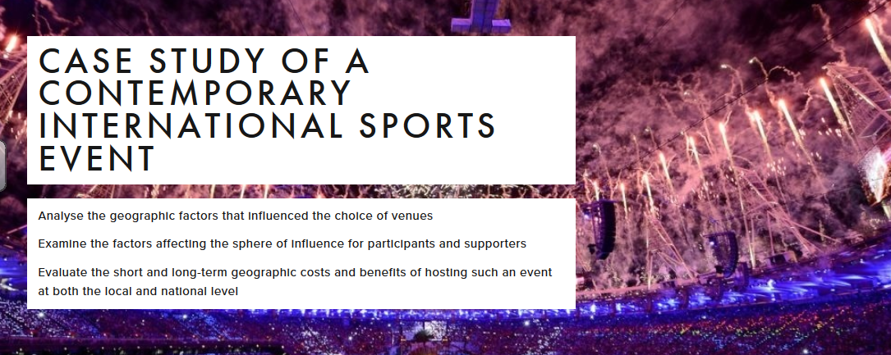
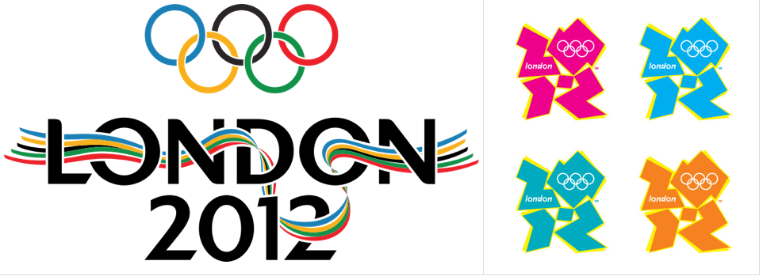
Leisure at the international scale: Sport

Slide 2
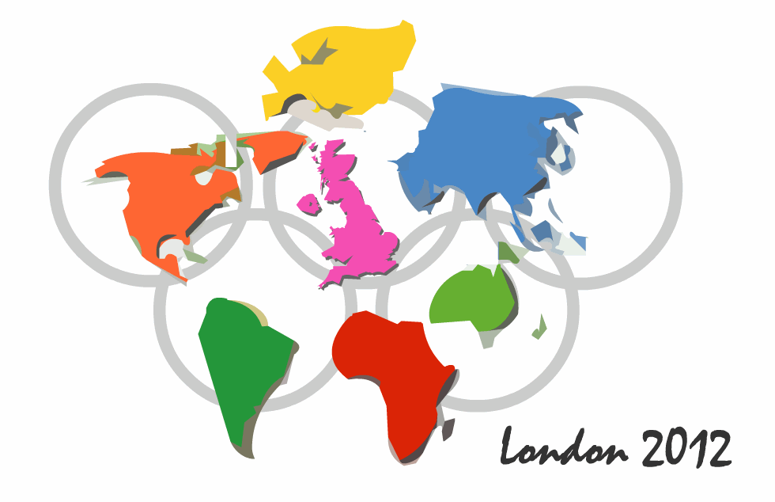
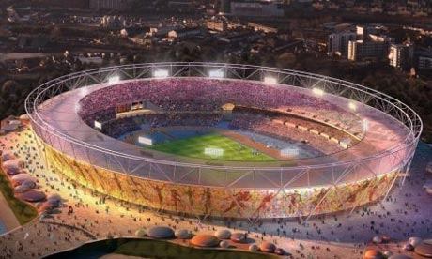
Objectives:
IB LO: I can explain the political, economic and cultural factors affecting the hosting of international sporting events, including Olympics and football World Cup events- with a case study of costs and benefits for one country hosting an international event What: A case study of an Olympic games Why: To develop the geographical skill of analysis- considering how impacts can be felt at a range of scales. How: Use a range of sources to consider the SEEP impacts of an olympic games and complete a 4 Ps analysis. Work in a group to effectively communicate ideas.

Slide 3
Task: Create a case study for either the London 2012 Olympics or the Rio 2016 Olympics
Success criteria: Include background information about the location- i.e. development, location, environmental factors etc
Include the economic impacts (both negative and positive)
Include the social impacts (both negative and positive)
Include the environmental impacts (both negative and positive)
Include the political impacts (both negative and positive)
What are the different views of holding the Olympic games?
Were the impacts felt locally, nationally, internationally?
​Include specific case study detail
Assessment essay: "The benefits of holding an international sporting event always outweigh the costs". Discuss this statement using appropriate examples (10)

Slide 4
Your overall analysis should try and link to the 4Ps PLACE: Give a specific relative location / comment on scale / describe the relevant physical & human characteristics PROCESSES: What are the human / physical mechanisms of change relevant to this case study? (think SPEED) Does a specific system apply? (linear, circular, complex, physical, human) Social (+/-): Political (+/-): Economic (+/-): Environmental (+/-): Demographic (+/-): POWER: Who is influencing and affecting change or equilibrium in this case? (citizens, governments, institutions, physical processes, other players?) POSSIBILITIES: What alternative events, futures, outcomes are possible? To what degree are human / environmental systems able to adapt or change? Consider the sources of information (links to TOK)
Consider how the work load will be distributed in your group (ATL)

Slide 5
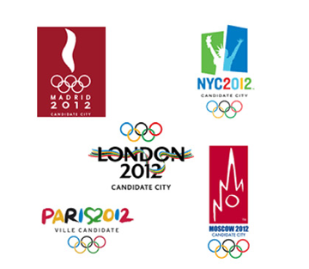
In 2012 London will host the 30th Modern Olympiad and become the first city to host the Olympics three times (1908, 1948 and 2012).
London was selected to host the games over eight other cities. In 2003, the nine competing cities were; Paris, New York, London, Moscow, Leipzig, Istanbul, Rio de Janeiro, Madrid and Havana.
After initial inspection reports the IOC reduced this number to five cities; Paris, New York, London, Moscow and Madrid. These five cities went head-to-head in a vote on 6th July 2005.
Despite Paris being a strong favourite, London beat Paris in the final round of voting by 54 votes to 50 votes.
http://www.youtube.com/watch?v=5Dt4jjS_dyA&feature=player_embedded

Slide 6
Focus on the London 2012 Olympics as a …Case study of a contemporary international sports event
We are going to look at:
Why London won the right to host the Olympic games
Where it was hosted (venues)
Who attended (athletes and supporters)
The impacts (positive and negative, short-term and long-term)

Slide 7
Host cities of the Summer Olympic games

Slide 9
Example question:
Explain the factors that need to be considered when choosing a city to host a world sporting event (6)

Slide 10
Objective 1
Analyse the geographic factors that influenced the choice of venue(s).
Use the links on this page and in slides 10-18: When we talk about geographic factors, we generally refer to social, economic, environmental and political (SEEP). Environmental (proximity & accessibility) Task 1 - Use this link from the Telegraph and the YouTube video: to explore each of the venues for the London 2012 games. Those that are found in Greater London need to be annotated onto the London map. Those that were hosted elsewhere in the UK need to be annotated on the UK map. Social & Economic Task 3 - Why choose London and in particular, Stratford in the east of the city? The video will also help you to get a feel for the area prior to 2012. Take notes on why this part of London was chosen to host the Games in 2012. Your notes should include reference to jobs, space, infrastructure. Task 4 Make links with urban environments unit: How does the Olympics case study show evidence of...
1. Gentrification 2. Urban Renewal 3. Urban Regeneration

Slide 11
Some of the reasons why London was chosen as the location for the 2012 Olympics

Slide 12
Focus on the London 2012 Olympics as a …Case study of a contemporary international sports event
We are going to look at:
Why London won the right to host the Olympic games
Where it was hosted (venues)
Who attended (athletes and supporters)
The impacts (positive and negative, short-term and long-term)

Slide 13
Explain the factors that need to be considered when choosing a city to host a world sporting event (6)
The factors should include: access to major international airports, minimal health risks, equable climate, educated workforce, political stability and cultural liberalism
Award up to [2 marks] for each factor that is fully explained, up to a maximum [6 marks]

Slide 14
2. Where was it hosted? The location of the 2012 Olympic venues
Describe the distribution of venues
Explain why they are distributed in this way

Slide 15
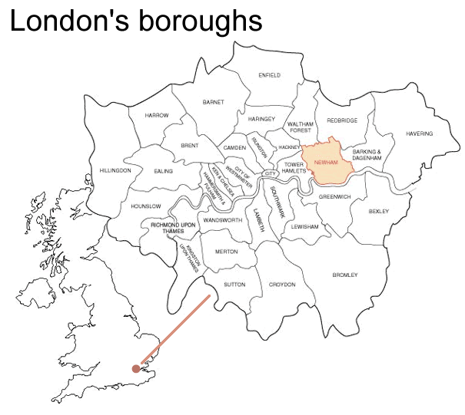
Where are the Olympics going to be?
Stratford

Slide 16
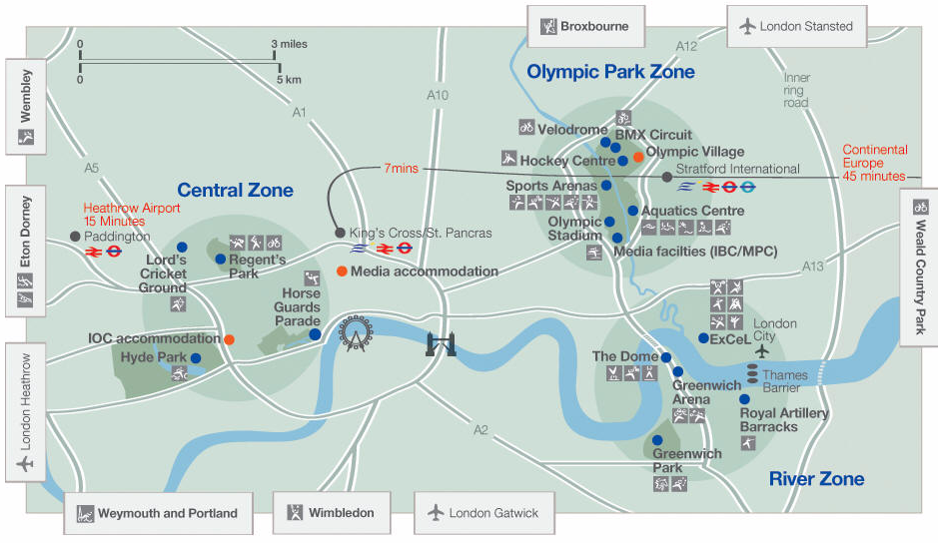
The location of Olympic Infrastructure within London

Slide 18
Location of Olympic sporting events within London and the UK
Although London was chosen as the host city for the 2012 Olympics, it is not possible for all events to take place in Central London.
Events like sailing need the sea, rowing a 2km straight course (the River Thames is too busy), shooting an area away from houses and football needs big stadiums. Therefore, some events were held outside London, including Glasgow and Cardiff.
Within London most events were concentrated in East London in the borough (district) of Newham.

Slide 19
Problems with London as a location?
As with most things the location of London is not perfect and there are some negative sides of it been selected.
London is already a developed city, so selecting London may have taken the opportunity of other cities like Istanbul or Havana to develop.
London is one of the world's most expensive cities to visit and live. Many potential spectators will be put off by the expense.
Some businesses had to be closed and relocated to make way for the Olympic village.
There were question marks whether London's transport network could cope with the influx of visitors.
There was a risk of a terrorist attack. The day after London won the Olympics, it experienced a major terrorist attack (the London bombings).

Slide 20
Political
Listen to what David Cameron (Prime Minister of the United Kingdom) says about the success of the Olympic Games in the YouTube video: https://www.youtube.com/watch?v=7AOfpYcVOyY. What does he mean about the "international charm offensive" right at the end of the video? Why is this important? How could it benefit Britain and affect the way in which the country is viewed internationally? Think about trade, tourism, the global recession, image, investment, partnerships, economic growth etc.

Slide 21
IB Question - Analyse the most important geographic (SEEP) factors that influenced the hosting of the London 2012 games (6 marks).

Slide 22
Who attended (athletes and supporters)?
Objective 2 - Examine the factors affecting the sphere of influence for participants and supporters.

Slide 23
Define: Sphere of Influence "London is the first host city in Olympic history to have a permanent resident from every single competing nation – all 204 of them" - Times 2012
Sphere of influence: The area people travel from to access a service, visit or attend an event.

Slide 24
Task
Find out how many participating teams there were in the 2012 Olympic Games and make a note of it
Study the images on the next 2 slides. Write a commentary underneath analysing the patterns outlined. Make reference to specific continents and countries and link to rates of success.
We all know that USA won the most medals, with China in close second place and the UK in third position, but what happens when you re-organise the medal table to show the number of medals won to the total population and level of development of a country? Read this
TOK Point - Should tables reflect population sizes and GDP? Surely, those countries with wealth and large populations will always outperform smaller poorer nations.

Slide 25
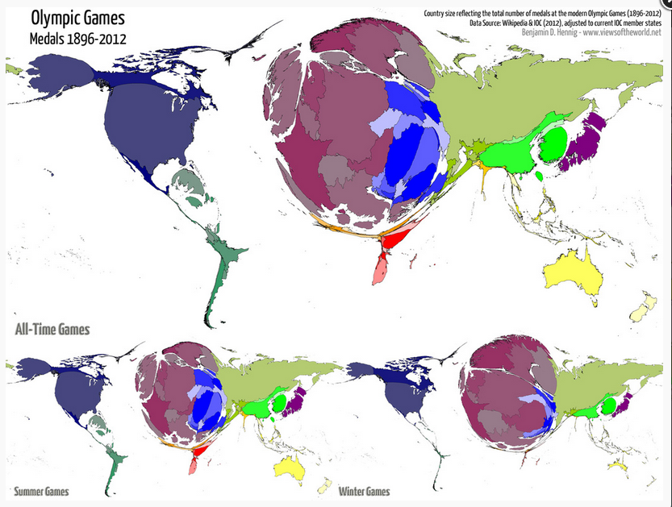

Slide 26
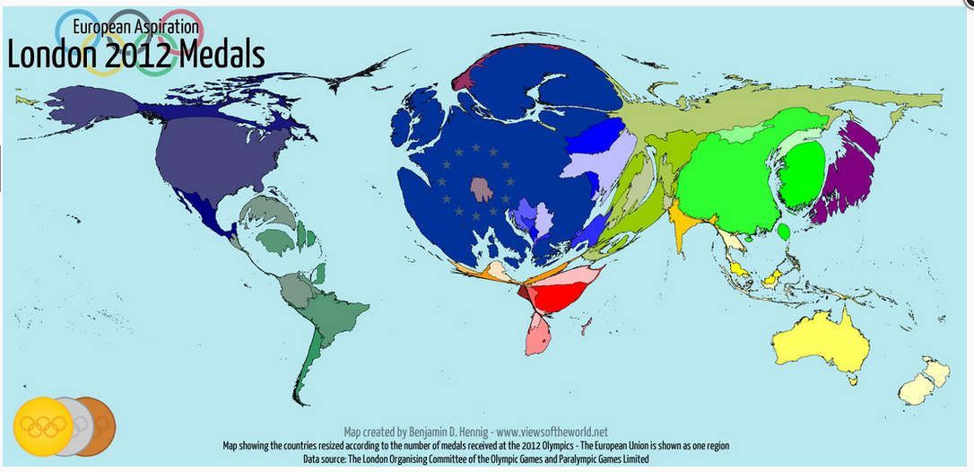

Slide 27
Athletes and Spectators and Tickets
Athletes: Over 10,500 athletes competed in the Olympics from all 205 member countries of the IOC. Because, the Olympics is a truly global event then the sphere of influence is the whole world.
Spectators: Nearly 9.6 million tickets went on sale for the Olympics and Paralympics. A lot of these however, were given to businesses who sometimes didn't turn up, which resulted in empty seats and people complaining. 2.1 million people attended the first 3 days of the Olympics, with an estimated 4 million people attending in total. Spectators travelled from all over the world, but the majority will came from the UK, Europe and North America. Traveling to the UK as well as finding accommodation and buying a ticket was costly so most spectators came from MEDCs.
Ticketing: There were 9.6 million tickets for sale - 8 million for the Olympics and 1.6 million for the Paralympics. 75% of all tickets cost less than £50 and offered free travel on London transport.
A sell-out rate of 82% for the Olympic Games and 63% for the Paralympics was estimated
What actually happened:
The opening ceremony sold-out TEN times over More than half of the 650 sessions were oversubscribed 95% of applications came from the UK Tickets for the athletics started at £15 and there were 20,000 £10 tickets for the Olympic Park to watch events on big screens
http://www.dailymail.co.uk/news/article-1381223/London-2012-Olympics-20m-tickets-sold-actually-see.html

Slide 28
4. The impacts (positive and negative, short-term and long-term)
Evaluate the short and long-term geographic costs and benefits of hosting such an event at both the local and national level.

Slide 29
Who benefits from hosting an international sporting event?
Objective: Evaluate the short and long-term geographic costs and benefits of hosting such an event at both the local and national level.
Command term: ‘Evaluate’ - to make an appraisal by weighing up the strengths and limitations.
How to evaluate:
Consider the meaning of "benefit" in its broadest context, to include the type of benefit, its extent, and the beneficiaries.
The means considering:
• Benefit Type - which might be economic, environmental or social
• Extent - The area affected, which might be the country, region, city or local area
• The People - Those who stand to lose and gain from the development.
• Time - These benefits may be short, medium or long term.

Slide 30
The impacts (positive and negative, short-term and long-term)
Watch the two videos below and make a note of the local costs and benefits associated with bringing the Olympics to this part of London.
London 2012: Legacy
Counting the Cost - The cost of the London Olympics

Slide 31
The London 2012 Sustainability Plan
The 2012 Olympic Games aimed to be sustainable
The Sustainability Plan focuses on five key themes:
1. Climate change: minimising greenhouse gas emissions and ensuring legacy facilities are able to cope with the impacts of climate change.
2. Waste: minimising waste at every stage of the project, ensuring no waste is sent to landfill during Games-time, and encouraging the development of new waste processing infrastructure in East London.
3. Biodiversity: minimising the impact of the Games on wildlife and their habitats in and around Games venues, leaving a legacy of enhanced habitats where we can e.g. the Olympic Park.
4. Inclusion: Promoting access for all and celebrating the diversity of London and the UK, creating new employment, training and business opportunities.
5. Healthy living: Inspiring people across the country to take up sport and develop active, healthy and sustainable lifestyles.

Slide 32
Newham: The area that will be regenerated
Newham was selected because it gave the borough a chance to be regenerated and had a large area of available land.
Newham was a very important location for industry 100 years ago. However, as ships became bigger and the River Thames less useful and as manufacturing moves overseas Newham went into decline.
Factories became derelict and unemployment went up. Now though with the arrival of the Olympics areas of brownfield land have been cleaned and built on and residents are finding jobs in construction and Olympic preparation.

Slide 33
Newham

Slide 34
Regeneration
Several Olympic bids now have been used to regenerate urban areas. Barcelona began the process in the mid-1980s, and now London’s vision for 2012 is the regeneration of one of the poorest parts of the UK.
Developments like this are –
Usually large-scale
Developed centrally by governments with a mix of private
capital and government investment.
Presented as projects for environmental remediation
(e.g. Sydney 2000) or socio-economic regeneration
(e.g. London 2012).
But are such ‘urban flagship’ developments sustainable?
http://www.youtube.com/watch?v=JTS1FAgc7Vo

Slide 35
This is what the IOC say …..
their criteria for sustainable development
The Olympics should provide …
“sustainable environmental legacies, such as
rehabilitated and revitalized sites,
increased environmental awareness,
improved environmental policies and practices,
further encouragement and facilitation of strong
environmental actions, technology and product
development in a city, country and beyond, through the
educational value of good example.”
Source IOC website (2005) Mission Statement

Slide 36
Key terms: link to urban environments
Regeneration: In geographical terms it means improving an area that has been experiencing a period of decline. In the east end of London the decline was bought about be de-industrialisation.
Renewal or Redevelopment: When areas are rebuilt to improve the physical environment. Redevelopment might involve changing the main functions of areas. The east end of London used to be an industrial area. Since the process of de-industrialisation has taken place in the UK the area became very run-down. The recent redevelopment of the area has changed the function from industrial to more commercial, residential and sporting.

Slide 37
The Pro's
Click on this link to be take to a 2015 article by the Guardian that reflects on the three year time period since the Games and the progress made. Make notes on the expected benefits under the following categories: Socio - economic Environmental Political
Read this comprehensive PDF and take higher level notes on the expected SEE effects of the games.

Slide 38
The Cons
Complete some note taking regarding drawbacks of the London Games. Use the 3 videos beneath and most importantly, the BBC information to the right to draw up a SEEP grid that shows the disadvantages.
Videos: Extra Research - Costs of the Games 2012
Watch the videos underneath and take notes on the perceived SEEP costs of the 2012 Games.
London Olympics criticized over its impact on local communities
Surprising Impact of Olympics on London Tourism
Raw Video: Olympics Protested in London

Slide 39
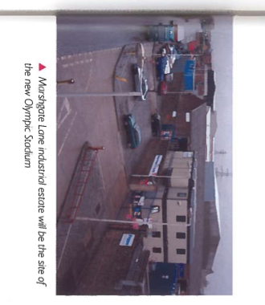

Slide 41
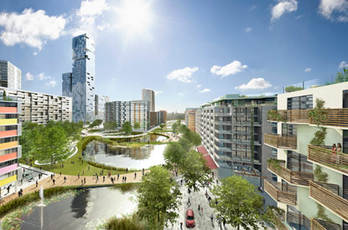
Olympic Village

Slide 42
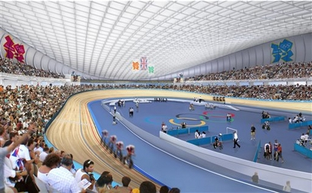
Olympic Velodrome

Slide 43
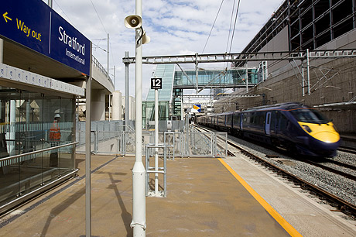
Stratford International

Slide 44
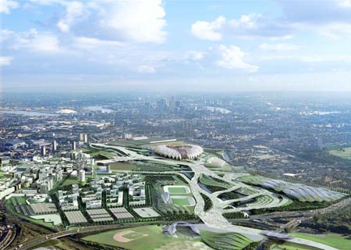

Slide 45
Transport: accessibility to the Games
London's transport did come in for some criticism during the bid process. However, since winning the right to host the games there have been significant improvements. About $17 billion has been spent on improving public transport over the five year period leading up to the games.
London Docklands's Light Railway: This a driverless system that covers a large area of East London. It will have direct links to the Olympic Village as well as London City airport, the North Greenwich Arena and ExCel arena.
Overground and Mainline: It is estimated that 80% of spectators will arrive by train. It is planned for a train to arrive in the Olympic Village area every 15 seconds. The main East London Line is currently going through a major upgrade and extension that will be ready for the Olympics. New trains have also been introduced to transport visitors from central London. The new trains will be known as Javelin trains and will take less than 10 minutes to travel from Central London.
Underground: Three underground lines; the District, Jubilee and Hammersmith and City travel out to East of London and will play a vital role in transporting spectators between venues.
Eurostar: There is a new Eurostar terminal that has been built in Stratford, right next to the Olympic Village. The Eurostar has direct connections to Paris and Brussels and makes connections to the European rail network.
Airports: London has five international airports; Stanstead, Luton, Gatwick, Heathrow and London City. London City is the closest airport to the Olympic Village and is actually connected by the Docklands Light Railway. London Heathrow is the world's busiest international airport so spectators and athletes will be able to travel to London from virtually any country in the world.
Roads: The aim is that no one will arrive at the Olympic Village by car. There will be park and ride schemes set up around London, where people can then transfer to trains and buses. It is estimated that about 15% of spectators will arrive using park and ride. The London congestion charge should also discourage people from wanting to drive into London during the games.
Walking and Bikes: People will be encouraged to walk in and around venues. There are walkways around the Olympic Village and a cable car is being constructed across the Thames to connect the village with other venues. The current mayor of London has also recently introduced a bike scheme in London where spectators can borrow bikes. It is estimated about 5% of spectators will walk or bike to the venues.

Slide 46
http://www.telegraph.co.uk/sport/olympics/8697749/London-2012-Olympics-Athletes-village-sold-to-investment-arm-of-Qatari-ruling-family.html

Slide 48
Transport Docklands Light Railway (DLR Network)

Slide 49
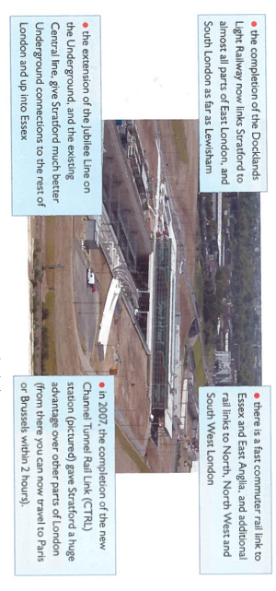
Transport impact on Stratford

Slide 51
Walking and Cycling
The London 2012 Games want to encourage people to walk and cycle to and from the games to ensure that when one travels they do so healthily and sustainably.
Ultimately, they want the environment to be kept clean, tidy and clear, and avoid the inevitable traffic and car park spaces needed. They have started to create a network of walking and cycling paths that link different parts of London to the Olympic Park and other venues. Thousands of spectators will come to the games and they believe that if this is encouraged, it will benefit them and be enjoyable and a useful travel option.

Slide 52
Problems
However, to construct these routes, it will be necessary to change the existing paths.
They plan to keep these closures to a minimum and will update people online.
Temple Mills Lane is one of the main paths for large construction vehicles traveling to the Olympic park and village and some areas of the Stratford City development, which has resulted in a road which is too narrow for pedestrians and cyclists to use safely. Therefore the London Boroughs of Newham and Waltham Forest have closed a section of Temple Mills Lane to the north of the Olympic Park to pedestrians and cyclists, and a detour via Leyton High Road and Ruckholt Road has been put in place. However, the alternate route adds about 400m to the journey.

Slide 53
Infrastructure
Energy Centre The Energy Centre, located in the west of the Olympic Park, will support London 2012’s commitment to use renewable and energy-efficient technology.
The Energy Centre will supply all the necessary power, heating and cooling across the Olympic Park for the 2012 Games but also for the new buildings and communities that will be developed in the area after 2012.The Energy Centre has a biomass boiler that uses woodchip as fuel to generate heat, and a natural gas powered Combined Cooling, Heat and Power plant (CCHP).
The Energy Centre is specifically designed to be sustainable and flexible, allowing future technologies to be used with the Centre.

Slide 54
We need a balanced argument. What are the negatives?…
Watch the following video:
http://www.youtube.com/watch?v=xyGqlEtWGlg&feature=player_embedded
Make notes on the impacts:
Economic
Social
Environmental
Cultural
Political

Slide 55
Legacy after the games - environmental
After the Games the Olympic Park will be transformed into one of the largest urban parks created in Europe for more than 150 years.
The new parks will be connected to the tidal Thames estuary to the south and the Hertforshire countryside to the north. The canals and the waterways of the River Lea will be widened and cleaned and the natural floodplains of the area will be restored, creating a new wetland habitat for the wildlife.
A park is going to planted with native species, this will allow for wildlife to have a home within the city..

Slide 56
Legacy after the games social and economic
The stadiums will be adapted for use by sports clubs and the local community. New playing fields will sit along side these facilities again these will be adapted for community use.
The Olympic village will be converted into homes, for key workers such as teachers and nurses. There will be further housing built with the Olympic Park site after the games. Riverside housing, shops and restaurants will provide new amenities for the local community.
The transport in the area will also be improved with an extension to the Docklands Light Railway, increasing the capacity on the jubilee line and the upgrade of the Stratford Regional Station. There will also be a wealth of benefits to the wider community, such as cross-city transport improvements in London, more training and job opportunities for the UK and the chance for a vast array of businesses to be involved. The Games will leave a key legacy of national benefits in culture, sport, volunteering, business and tourism.
Thousands of new jobs will be created and training opportunities will be created for local people.

Slide 57
Costs
On 15 March 2007 the government announced the budget for the Games had risen from £2.4bn to £9.35bn, although she said the cost of the Games would be £5.3bn.
New venues will cost £3.1bn. These include the Olympic Park at Stratford and the athletes' village.
There will be £1.7bn spent on regeneration and infrastructure.
£600m will be spent on extra security.
The government has set aside £2.7bn in a contingency fund in case costs rise further.
The Olympics will have to pay an £840m tax bill.
£390m will be spent on other costs, such as the Paralympics and community sport.
Income: The government will provide £6bn, with other funds coming from London council tax payers and the National Lottery. Further income will come from International Olympic Committee TV and marketing deals (£560m); sponsorship and official suppliers (£450m); ticket revenues (£300m); licensing (£60m); London Development Agency (£250m)

Slide 58
Tangible and intangible
Tangible costs: Things that cost money (e.g. building a stadium)
Intangible: Things that cannot be measure but are important ( i.e. things that cause a disruption such as building the stadium and closing roads etc

Slide 59
Impacts: Short term

Slide 60
Impacts: Long term

Slide 61
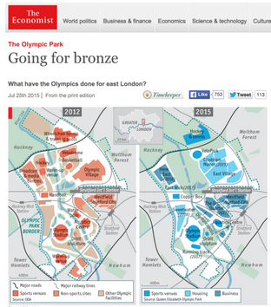
TASK
Read the document
Highlight costs and benefits using two different colours
Add information to your notes
Plan a response to the essay question:
“Local people do not benefit from hosting an international sporting event.” Discuss this statement. [10 marks]

Slide 62
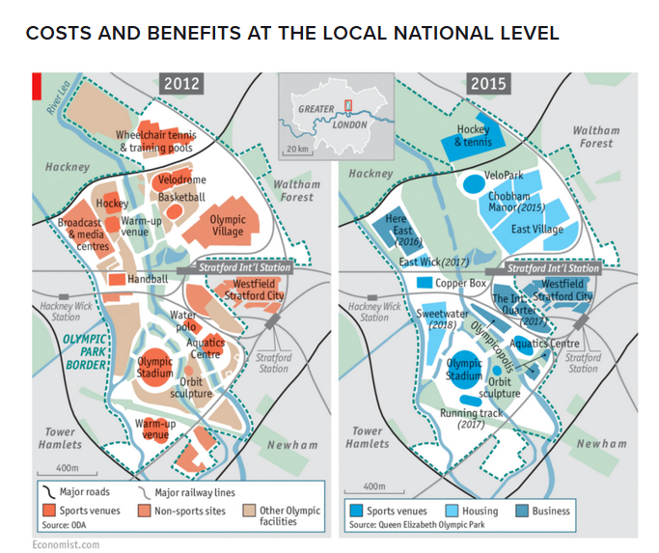
https://www.economist.com/britain/2015/07/23/going-for-bronze

Slide 63
Other resources
http://www.theguardian.com/society/davehillblog/2013/jul/29/east-london-regeneration-olympic-park

Slide 64
Task: Create a case study for either the London 2012 Olympics or the Rio 2016 Olympics
Success criteria: Include background information about the location- i.e. development, location, environmental factors etc
Include the economic impacts (both negative and positive)
Include the social impacts (both negative and positive)
Include the environmental impacts (both negative and positive)
Include the political impacts (both negative and positive)
What are the different views of holding the Olympic games?
Were the impacts felt locally, nationally, internationally?
​Include specific case study detail
Assessment essay: "The benefits of holding an international sporting event always outweigh the costs". Discuss this statement using appropriate examples (10)

Slide 65
Your overall analysis should try and link to the 4Ps PLACE: Give a specific relative location / comment on scale / describe the relevant physical & human characteristics PROCESSES: What are the human / physical mechanisms of change relevant to this case study? (think SPEED) Does a specific system apply? (linear, circular, complex, physical, human) Social (+/-): Political (+/-): Economic (+/-): Environmental (+/-): Demographic (+/-): POWER: Who is influencing and affecting change or equilibrium in this case? (citizens, governments, institutions, physical processes, other players?) POSSIBILITIES: What alternative events, futures, outcomes are possible? To what degree are human / environmental systems able to adapt or change? Consider the sources of information (links to TOK)
Consider how the work load will be distributed in your group (ATL)

Slide 66
Exam questions: Both 10 marks
Examine to what extent an international sporting event has brought about positive and negative changes to a named urban area.
Referring to examples explain the impacts for an area hosting a major sporting event.
You should consider the effects in terms of social, economic and environmental and long and short term.

