Slide 1
Oligopoly

Slide 2
Oligopoly
Oligopoly is a common market structure, features in each oligopolistic market will vary depending on circumstances…
Small number of large firms
Interdependence among firms, due to their small number the actions of each one affect all of the others
High barriers to entry
Homogenous or differentiated products (oil, cars)
Price rigidity
Non price competition
Economies of scale
Collusion?

Slide 3
The concentration ratio
A measurement used to determine the degree of competition in an industry, and the degree of monopoly power
Ex. A five firm concentration ratio of 45% means that the largest five firms produce 45% of industry output.
An industry that is held to be oligopolistic has a CR 4 of 40%

Slide 4
The incentive to compete or to collude?
Firms face the incentive to compete for the purpose of capturing part of their rivals firms’ market share.
An incentive to collude, to make an agreement to fix prices and share the market between themselves as to limit competition between them.

Slide 5
Analyzing the behavior of oligopolistic firms through the use of game theory
PLAYER 2 | OLIGOPOLISTIC PRICING DECISIONS | PLAYER 1
 |  | DECISION 1: HIGH PRICE | DECISION 2: LOW PRICE
 | DECISION 1: HIGH PRICE | HIGH Revenue HIGH Revenue | HIGH Revenue LOW Revenue
 | DECISION 2: LOW PRICE | LOW Revenue HIGH Revenue | LOW Revenue LOW Revenue
Observations:
Firms show strategic behavior as each bases its actions on what it guesses the other will do
Strategic interdependence= as each guesses what the other will do the actions of one affect the actions of the others
Conflicting incentives= compete(price competition) or collude (fix the price)
Both are worse off if they engage in price competition or cutting price to capture a part of their rivals market
Price competition strongly avoided as will result in price war

Slide 6
Prisoners Dilemna
Two members of a criminal gang are arrested and imprisoned. Each prisoner is in solitary confinement with no means of speaking to or exchanging messages with the other. The police admit they don't have enough evidence to convict the pair on the principal charge. They plan to sentence both to a year in prison on a lesser charge. Simultaneously, the police offer each prisoner a Faustian bargain. Each prisoner is given the opportunity either to betray the other, by testifying that the other committed the crime, or to cooperate with the other by remaining silent.
Here's how it goes:
If A and B both betray the other, each of them serves 2 years in prison
If A betrays B but B remains silent, A will be set free and B will serve 3 years in prison (and vice versa)
If A and B both remain silent, both of them will only serve 1 year in prison (on the lesser charge)

Slide 7
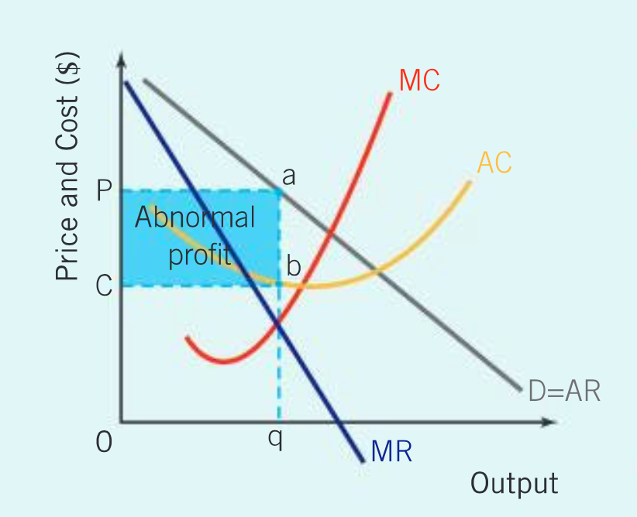
Collusive oligopoly:
Efficiency in oligopoly?

Slide 8
Why cartels are difficult to maintain
Incentive to cheat
Price wars and retaliatory price cuts
Differing costs of production lead to disagreements as higher cost firms want to set a higher price
Dominant firm in the cartel required to take on leadership role and settle dispute output and pricing decisions
Larger the number of firms the greater the potential for disagreement
During recessions firms have a greater incentive to cheat due to falling profits across the industry

Slide 9
Tacit collusion
Cooperation between firms in oligopoly to restrict competition and fix prices without a formal agreement.
Price leadership by a dominant firm
Limit pricing, setting price below the profit maximizing point to limit entry by new firms into the industry.

Slide 10
Benefits/Advantages
Economies of scale
Price stability
Choice

