Slide 1
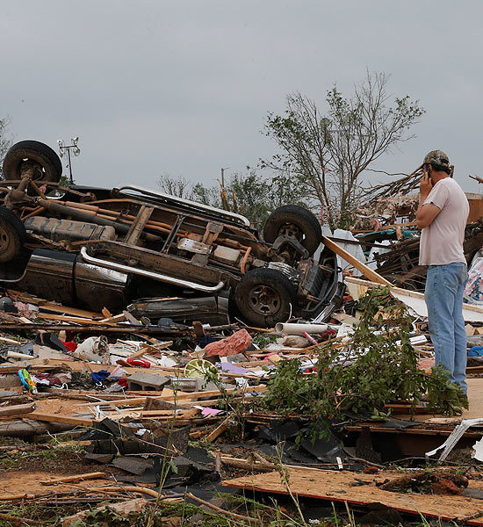
What? Where? When? Why?
Oklahoma, USA on Monday 20th May, where a tornado struck. It was 2 miles wide and was on the ground for 45 minutes!

Slide 2
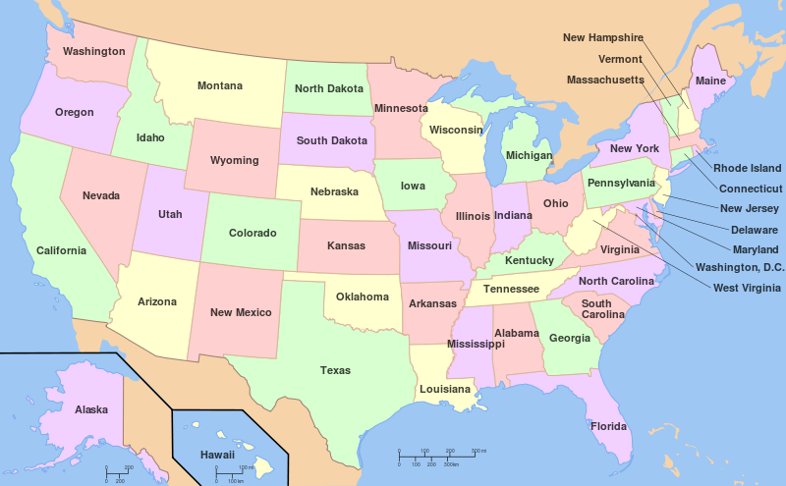
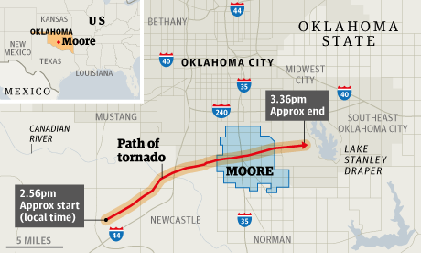
Where is Oklahoma?

Slide 3
LO To understand what the effects of the tornado in Oklahoma were
Tornado in Oklahoma
You can describe simply
You can describe using facts and figures
You can explain how people and the environment were effected
You can make sensible suggestions about how the damage could be reduced in the future and how the area needs to recover

Slide 4
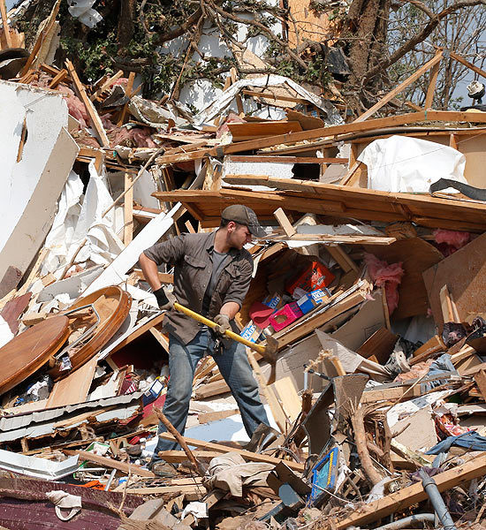
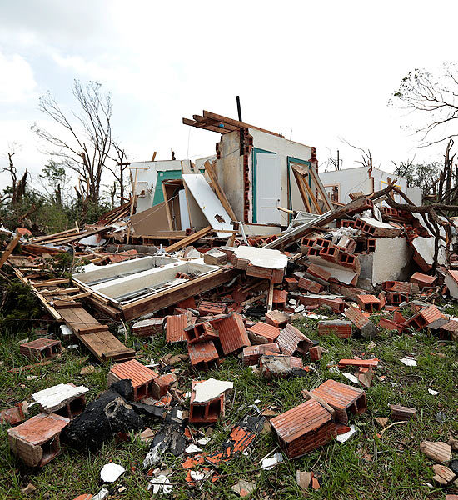
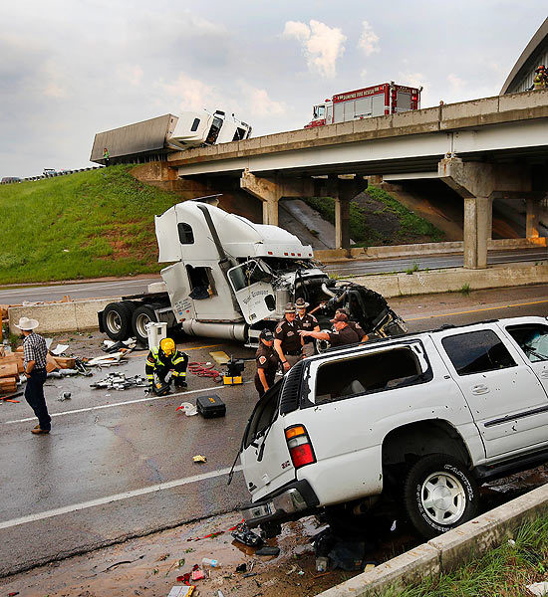
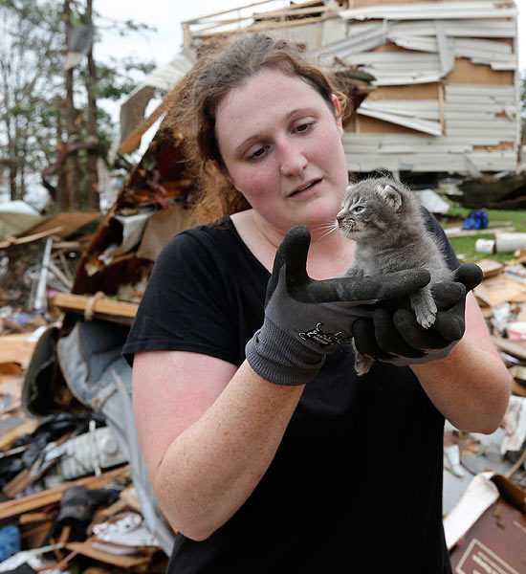

Slide 5
Tasks
Read the article and colour the answers to the questions.
Write what you have coloured into the correct boxes
What do you think can be done to reduce the damage?
Extension; imagine you were in Oklahoma on Monday, write a diary about what you saw and how you felt after the tornado.

Slide 6
LO To understand what the effects of the tornado in Oklahoma were
Tornado in Oklahoma
You can describe simply
You can describe using facts and figures
You can explain how people and the environment were effected
You can make sensible suggestions about how the damage could be reduced in the future and how the area needs to recover

