Slide 1
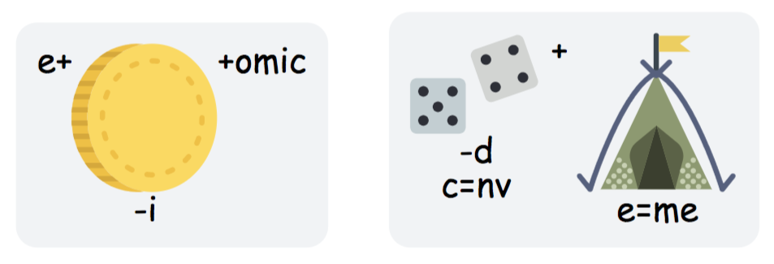
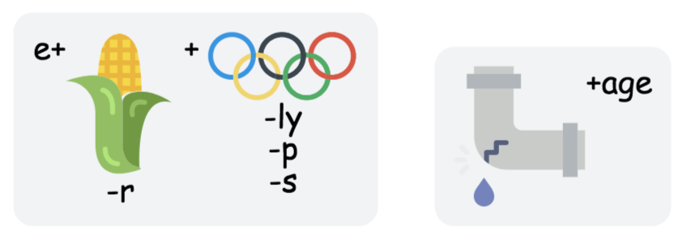
Can you work out the dingbats and find out the key words for today’s lesson. HINT: The lesson is on the impact of TNCs.
Starter
DING
1
2
Economic investment
Transnational company
3
4
Economic leakage
Economic development
Lesson title: What impact have TNCs had on Nigeria?

Slide 2
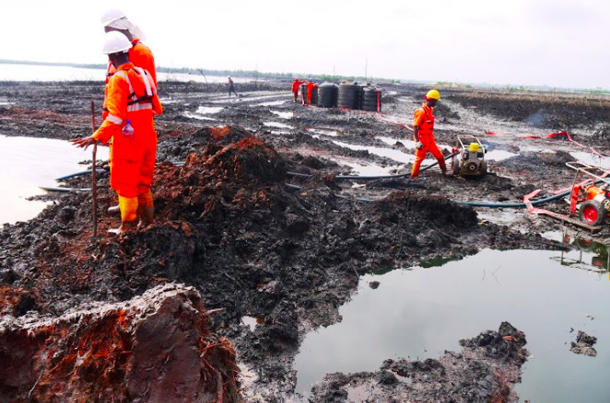
Case study: Shell
What impact have TNCs had on Nigeria?
What: What impact have TNCs had on Nigeria?
How: Describe the distribution of shell across the world.
Using case study detail to be able to evaluate the extent to which TNCs such as shell are important for the development of countries like Nigeria.
To assess the environmental damage (especially water pollution) that oil spills have created
Why: To understand that economic development has varying impacts

Slide 4
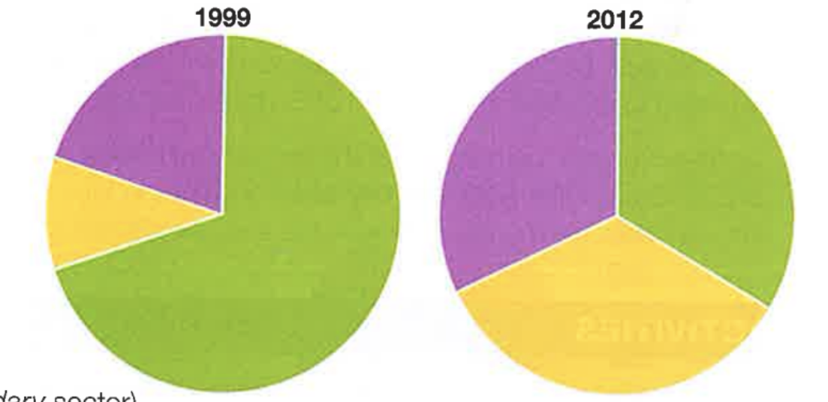
Link to previous learning
Using what you have learnt about the changes in economic structure as a country develops answer one of the levelled questions below. Bullet point your answer.
Easy (Grades 1-3)
Describe how Nigeria’s economy has changed using figure 1.
(2 marks)
Medium (Grades 4-6)
Explain how the changes have helped Nigeria’s economic development. (4 marks)
Hard (Grades 7-9)
Explain the impact of Nigeria’s economic development on the quality of life of the people. (6 marks)
Figure 1- Nigeria’s employment structure 1999- 2012
Agriculture
Industry
Services

Slide 5
Initial ideas
Where do you stand in relation to the statement? Be prepared to justify?
Yes
Maybe
“TNCs are the solution to the economic development of LICs”
No
Yes!
Maybe?
No!
Why are they the best way?
Why are they the solution?
What are the most influential reasons?
What is making you unsure?
What would it take for you to make a decision?
What are both sides of the argument?
Why not?
What is a better way?
Which negatives particularly outweigh the positives?
What is a TNC (transnational corporation)?
What are the advantages of TNCs for LICs?
What are the disadvantages of TNCs for LICs/NEEs?
What other ways could LICs develop economically if TNCs were not involved?
What is a TNC (transnational corporation)?
A TNC is is a company that has operations (factories, offices, research and development, shops) in more than one country. Many TNCs are large and have well‐known brands. Often TNCs have their headquarters and areas of research, development and product innovation in the country they start in, and manufacturing and factories in other countries (often poorer ones to take advantage of cheaper labour and environmental costs).
How can you decide?

Slide 6
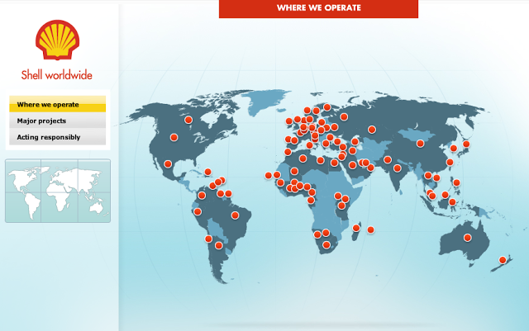
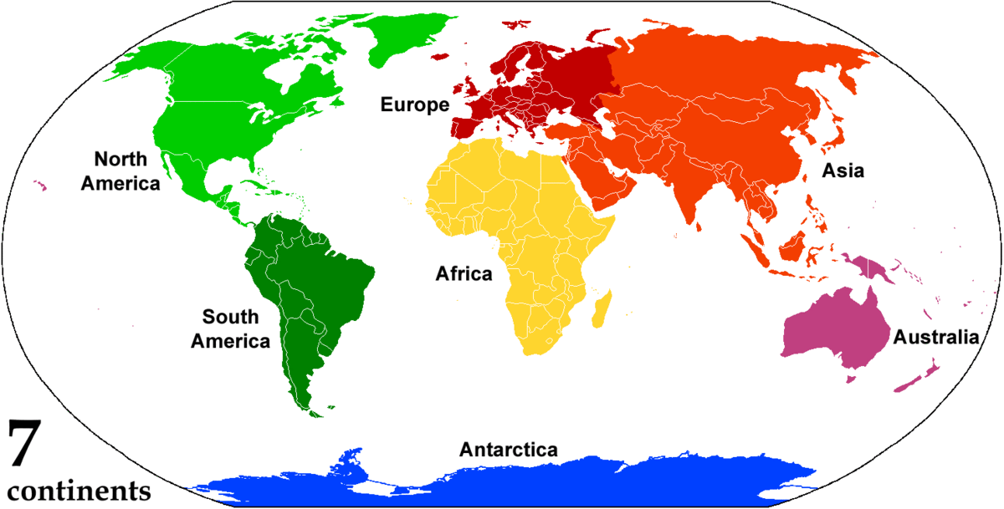
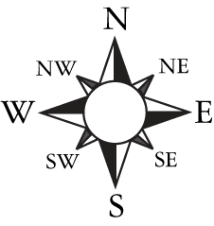
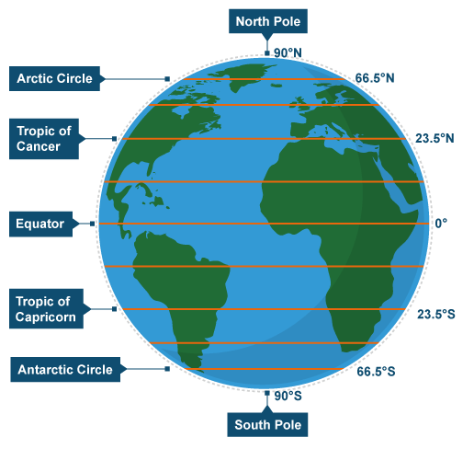
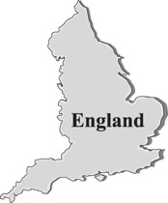
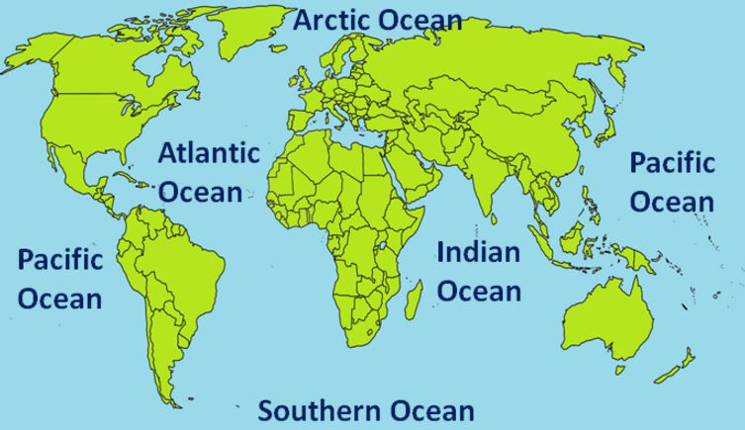
What is the distribution of shell globally and in Nigeria?
Describe the distribution of where shell operates shown in figure 2. (4 marks)
Figure 2- Countries that shell operates in
Continent
Compass Rose
Lines of latitude
Country
Oceans & Seas
Literacy
CLOCC your description to ensure that you include all the geographical aspects to the distribution.
Can you use these key terms:
Cluster
Spread
Density
Densely
Sparsely
North
South
East
West
Grades Below C
You can identify the areas where shell operates across the globe. You focus on the dense and spare clusters that can be found across the world.
Grades B-C
You can use geographical skills to clearly describe the distribution of where shell operates across the world. You use the skill of direction to be specific.
Grades A-A*
You can link your description to development, such as referring to countries at different stages of development and or the north south divide line.

Slide 7
What is the distribution of shell globally and in Nigeria?
Describe the distribution of where shell operates shown in figure 2. (4 marks)
Figure 2- Countries that shell operates in
Continent
Compass Rose
Lines of latitude
Country
Oceans & Seas
________________________________________________________________________________________________________________________________________________________________________________________________________________________________________________________________________________________________________________________________________________________________________________________________________________________________________________________________________________________________________________________________________________________________________________________________________________________________

Slide 8
What are the advantages and disadvantages of TNCs?
Key terms:
Multiplier Effect: the 'snowballing' of economic activity. e.g. If new jobs are created, people who take them have money to spend in the shops, which means that more shop workers are needed. The shop workers pay their taxes and spend their new-found money, creating yet more jobs in industries as diverse as transport and education.
Economic leakage: The way in which revenue generated by tourism is lost to other countries' economies.

Slide 9
What are the advantages and disadvantages of TNCs?
Colour code the statements to show the advantages and disadvantages of the TNCs. Indicate whether they are social, economic or environmental.
Literacy
A. | Large companies provide employment and training of skills. | E. | Modern technology is introduced and funded by the TNCs.
B. | TNCs can exploit the low wage economy and avoid paying local taxes. | F. | Local companies may benefit by supplying the TNCs.
C. | Working conditions may be poor with fewer rules and regulations than exist in richer countries. | G. | Environmental damage may be caused as it is easier for the TNCs to dump waste in LICs/NEEs.
D. | Most of the profit goes abroad rather than benefiting the host country. This is called economic leakage. | H. | TNCs have many international business links, helping industry to thrive.
I | Companies often invest in the local area, improving services (e.g. roads and electricity) and social amenities- Multiplier effect | J | Incentives used to attract TNCs could have been spent supporting the host countries home grown companies.
K | The government benefits from export taxes, providing money that can be spent on improving education, health care and services. | L | Higher paid management jobs are often held by foreign nationals.
M | The LIC can become dependent on TNCs for economic growth- this is a risk as TNCs can cease to operate at any time. | N | Local companies may find it hard to complete with TNCs as they have large research and development sections.
Can you use these key terms:
Pollution
Economic investment
TNC
Employment opportunities
Taxes
International
Services
Infrastructure
Technology
Incentives
Exports
Imports
Multiplier effect:
Economic leakage
Exam question
Can you answer the following question:
To what extent are TNC’s beneficial for LICs? 7 marks

Slide 10
What are the advantages and disadvantages of TNCs?
A. | Large companies provide employment and training of skills. | E. | Modern technology is introduced and funded by the TNCs.
B. | TNCs can exploit the low wage economy and avoid paying local taxes. | F. | Local companies may benefit by supplying the TNCs.
C. | Working conditions may be poor with fewer rules and regulations than exist in richer countries. | G. | Environmental damage may be caused as it is easier for the TNCs to dump waste in LICs.
D. | Most of the profit goes abroad rather than benefiting the host country. This is called economic leakage. | H. | TNCs have many international business links, helping industry to thrive.
I | Companies often invest in the local area, improving services (e.g. roads and electricity) and social amenities. | J | Incentives used to attract TNCs could have been spent supporting the host countries home grown companies.
K | The government benefits from export taxes, providing money that can be spent on improving education, health care and services.- Multiplier effect | L | Higher paid management jobs are often held by foreign nationals.
M | The LIC can become dependent on TNCs for economic growth- this is a risk as TNCs can cease to operate at any time. | N | Local companies may find it hard to complete with TNCs as they have large research and development sections.
Exam question
Can you answer the following question:
To what extent are TNC’s beneficial for LICs? (7 marks)
________________________________________________________________________________________________________________________________________________
________________________________________________________________________________________________________________________________________________________________________________________________________________________________________________________________________________________________________________________________________________________________________________________________________________________________________________________________________________________________________________________________________________________________________________________________________________________________

Slide 11
The development of Nigeria
Figure 1- A fact file comparing Nigeria and the UK
Easy (Grades 1-3)
Describe one political, social, environmental and cultural feature of Nigeria.
(2 marks)
Medium (Grades 4-6)
Describe how the political, social features of Nigeria have encouraged and slowed economic growth/ (4 marks)
Hard (Grades 7-9)
Explain using data why Nigeria is less developed than the UK using data from figure 1. (6 marks)
Fact | Nigeria | UK
Population growth rate (% per year) | 2.4 | 0.6
Birth rate (per 1000) | 38 | 12
Death rate (per 1000) | 13 | 9
Infant mortality rate (per 1000 live births) | 73 | 4
Life expectancy (years) | 52 | 81
Literacy rate (%) | 61 | 99
GNI per head (US$) | 2970 | 43430
Internet users (%) | 38 | 90
Percentage in poverty | 70 | 15
Gini Coefficient | 0.48 | 0.35

Slide 12
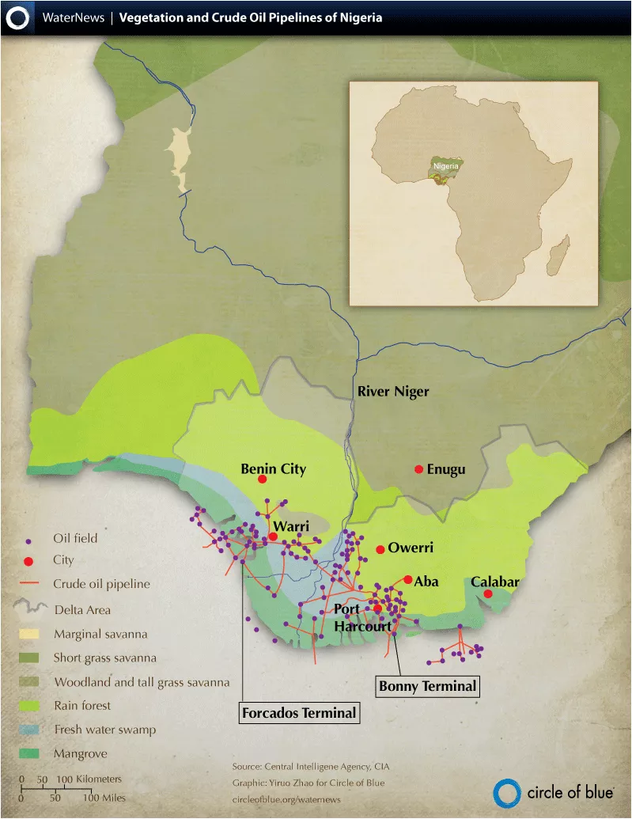
What are Nigeria’s sources of income?
Traditionally, primary products had been Nigeria’s main source of income. Agricultural products like cocoa, timber, oil palm, groundnuts and cotton were its main exports.
The discovery of oil in Niger Delta in the 1950s led to a big change in Nigeria’s economy. Today oil accounts for about 14 per cent of the country’s GDP and 98 per cent of its export earnings. Nigeria has the world’s 10th highest level of oil reserves. At present rate of production it has around 50 years supply left. Income from oil has helped Nigeria to make the transition from a low income country to newly emerging economy.
Key terms
Primary products- these are products are natural raw materials. For example crops and fish.
Exports- these are the products a country sells to other countries.
Niger Delta- the delta of the Nigeria river.
GDP- this is the money the country makes within its own boarders.
However, the country’s dependence on oil makes it vulnerable to changes in the world oil price. When oil prices fall, as they did in 2015, it damages the Nigerian economy.

Slide 13
Does Nigeria have a balanced economy?
The economy of a country is divided into sectors (such as retail, tourism, finance, public services). Since 1999 there have been major changes in Nigeria’s industrial structure.
Employment in agriculture (primary sector) has fallen, due to an increasing use of farm machinery and better pay and conditions in other sectors of the economy.
The growth of communications, retail and finance in the service (tertiary) sector.
These changes mean that Nigeria now has a more balanced economy, with a more even balance between the different sectors.
Agriculture
Industry
Services
Industrialisation and economic growth (secondary sector) under a stable government has increased employment in oil production, manufacturing and industries such as construction, motor manufacturing, sugar refining, paper and pharmaceuticals.

Slide 14
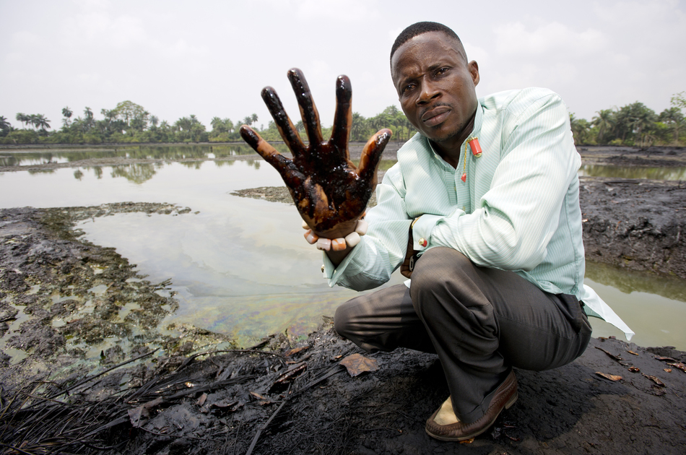
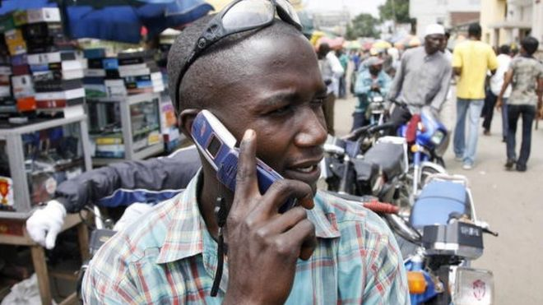
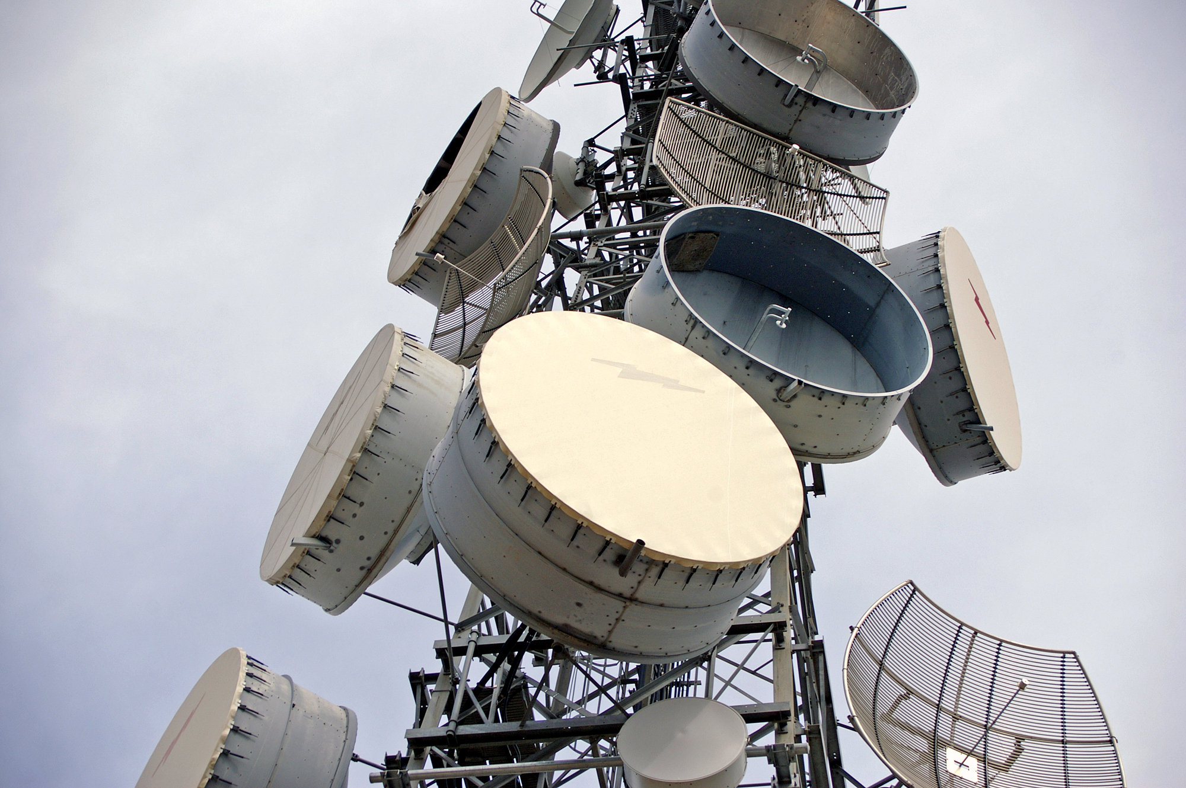
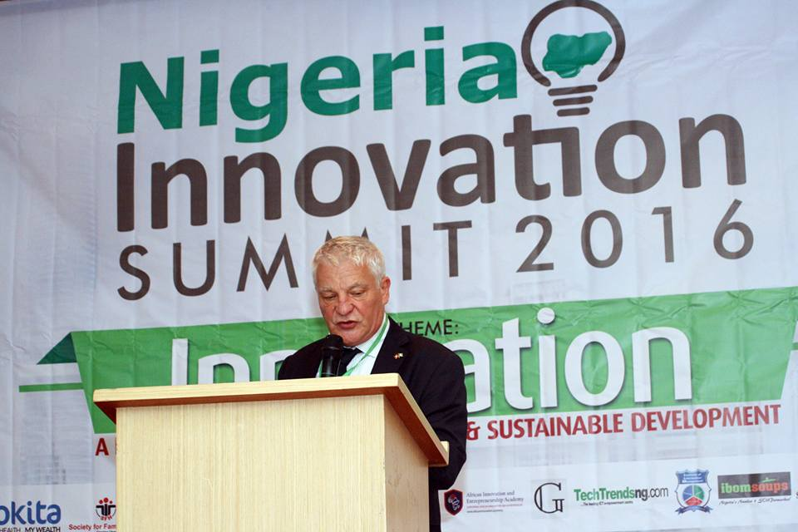
Why is Nigeria’s economy developing?
Increased use of telecommunications- Nigeria is able to benefit from global finance and trade
Greater concern for the environment
Why is Nigeria’s economy developing?
Information technology is beginning to drive the economy rather than oil
Rapid advances in technology
Investment in science and technology training – Nigeria’s huge population is seen as a potential asset for the country
Many people speak English, giving potential for growth in telecommunications
Key terms
Telecommunications- communication over a cable by phone or broadcasting
Asset- A useful or valuable thing or person

Slide 15
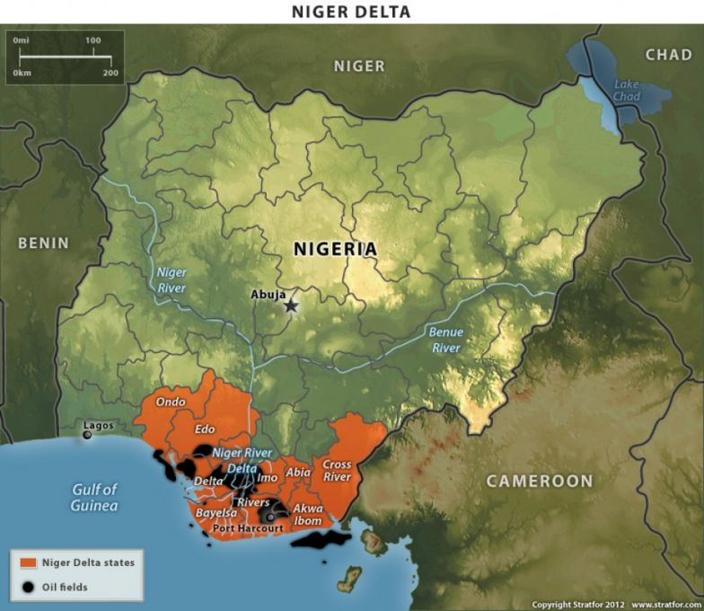
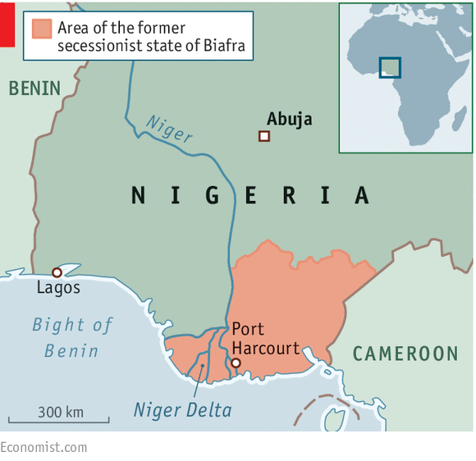
What impact have TNCs like Shell had on Nigeria?
Map from memory
Shell is one of the main companies to extract oil from the Niger Delta.
Grades Below C
You are able to describe the main positive and negative impacts that TNCs like shell have had on Nigeria.
Grades B-C
You are able to explain the advantages and disadvantages of TNCs for Nigeria.
Grades A-A*
You are able to evaluate whether TNCs such as Shell are beneficial for LICs such as Nigeria.
Notes:
https://www.theguardian.com/global-development/video/2013/oct/07/niger-delta-nigeria-oil-spill-cost-crude-video

Slide 16
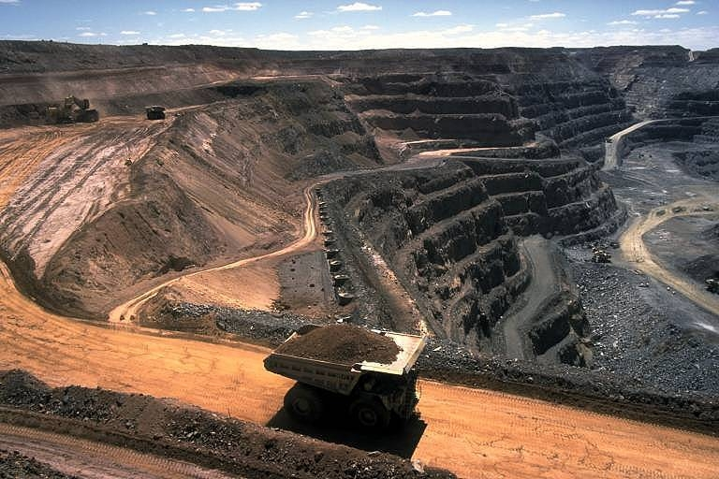
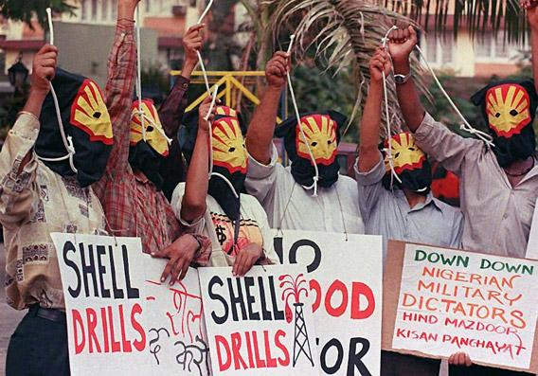
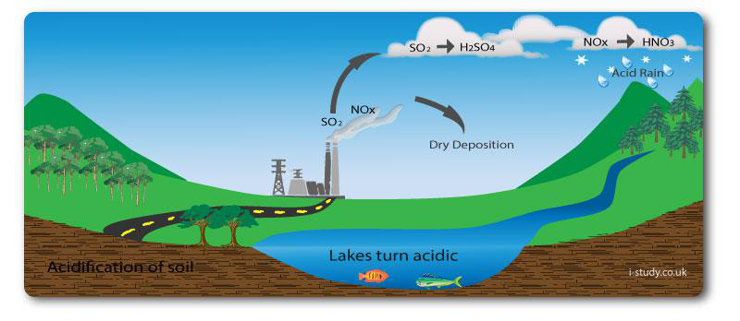
Mining and oil extraction
Mining and extraction of raw materials and precious metals- particularly oil- can lead to serious pollution. These can damage ecosystems and affect people’s jobs.
Some economic developments in the Niger Delta have caused violent conflicts with local people.
Tin mining led to soil erosion. Local water supplies were also polluted with toxic chemicals.
Nigerians protest about Shell
Mining in Nigeria
Many oil spills in the Niger Delta have had disastrous impacts on freshwater and marine ecosystems. Oils spills can cause fires, sending carbon dioxide and other harmful gases into the atmosphere. They cause acid rain, which harms plants and aquatic ecosystems.
Key words
Extraction- the process of taking resources from the ground.
Conflict- a disagreement between two or more stakeholders.
Soil erosion- when soil loses its fertility as a result of being left exposed.
Marine ecosystem- a water ecosystem.
The formation of acid rain

Slide 17
Water pollution and clean up
Case study: Bodo, a fishing community in the Niger Delta.
Livelihoods had been devastated by two oil spills in 2008-09 that had been caused by corroded Shell pipelines.
The UN Environment Programme (Unep) has announced that Shell and other oil firms systematically contaminated a 1,000 sq km area of Ogoniland, in the Niger delta, with disastrous consequences for human health and wildlife.
Heavy contamination of land and underground water courses, sometimes more than 40 years after oil was spilled.
Community drinking water with dangerous concentrations of benzene and other pollutants.
Soil contamination more than five metres deep in many areas studied.
• Water coated with hydrocarbons more than 1,000 times the level allowed by Nigerian drinking water standards.
Impacting primary industries (such as fishing and farming) for local communites. https://www.theguardian.com/environment/2011/aug/04/niger-delta-oil-spill-clean-up-un
What is being done to clean it up?
The UNEP calls for a clean-up fund of $1bn for spills in Ogoniland (where the Bodo community is), and says it will take 25-30 years to restore the environment. Much of the funding for the clean-up is expected to come from the oil companies.
http://www.aljazeera.com/news/2017/10/nigeria-oil-spills-shell-begins-clean-up-10-year-delay-171031113023508.html

Slide 18
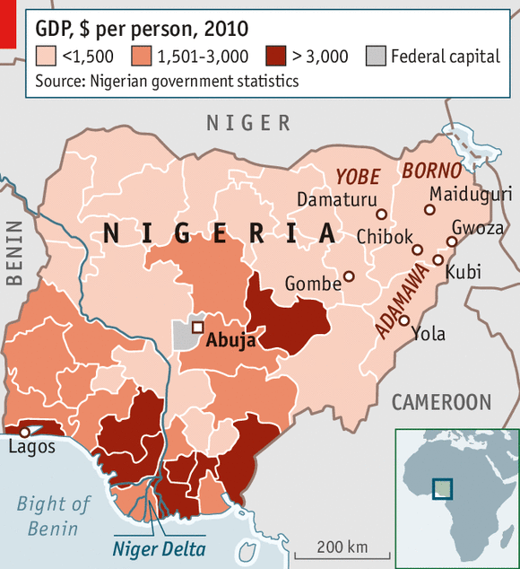
Which impacts are the most significant?
Figure 1- GDP by region in Nigeria
7
8
9
10
4
5
6
Increased
employment
Oil spills
Water
pollution
Increase in
taxes
3
Multiplier
effect
2
Extension
Theft and
sabotage
Improved
facilities
Using figure 1 explain how oil companies have affected the standard of living in NEEs.
Annotate the impact in terms of significance.
1
Dependence
on TNCs
Rise in
GNI
Grades below C
You can describe which impacts the most and least significant impact of Shell locating in Nigeria.
Literacy
Can you use these key terms:
Standard of living
Multiplier effect
Economic investment
Sabotage
Pollution
TNC
Economic leakage
Economic
leakage
Grades B-C
You can explain the most and least significant impact of Shell locating in Nigeria, using geographical vocabulary.
Grades A-A*
You make and explain the links between the different impacts of Shell locating in Nigeria using geographical vocabulary.

Slide 19
Which impacts are the most significant?
7
8
9
10
4
5
6
Increased
employment
Oil spills
Water
pollution
Increase in
taxes
3
Multiplier
effect
2
Theft and
sabotage
Improved
facilities
1
Dependence
on TNCs
Rise in
GNI
Economic
leakage

Slide 20
Review
Where do you stand in relation to the statement? Be prepared to justify?
Yes
Maybe
“TNCs are the solution to the economic development of LICs”
No
Yes!
Maybe?
No!
Why are they the best way?
Why are they the solution?
What are the most influential reasons?
What is making you unsure?
What would it take for you to make a decision?
What are both sides of the argument?
Why not?
What is a better way?
Which negatives particularly outweigh the positives?
What is a TNC (transnational corporation)?
What are the advantages of TNCs for LICs/NEEs?
What are the disadvantages of TNCs for LICs/NEEs?
What other ways could LICs/NEEs develop economically if TNCs were not involved?
What is a TNC (transnational corporation)?
A TNC is is a company that has operations (factories, offices, research and development, shops) in more than one country. Many TNCs are large and have well‐known brands. Often TNCs have their headquarters and areas of research, development and product innovation in the country they start in, and manufacturing and factories in other countries (often poorer ones to take advantage of cheaper labour and environmental costs).
How can you decide?
Notes:
To what extent are |TNC beneficial for the development of NEEs/LICs?

Slide 21
Exam question
Using the mark scheme. Improve/write your own response to the question.
‘TNCs only bring advantages to the host country.’
Do you agree with this statement?
Justify your decision. (7 marks)
Structure
Paragraph structure:
An introduction to TNCs that operate in Nigeria and whether you agree or disagree with the statement.
A detailed explanation of advantages that TNCs bring to countries such as Nigeria.
A detailed explanation of the disadvantages that TNCs bring to countries such as Nigeria.
A conclusion that reaches a judgement on whether TNCs only bring advantages.
Reasons for the judgement reached in the conclusion.
Literacy
Yes
No
Can you use these key terms:
Economic investment
Infrastructure
Local businesses
Dependent
Economic leakage
Employment
International links
Basic: Below C grade
Demonstrates limited knowledge of the characteristics of one or more TNCs. Answers may be largely generic.
Shows some geographical understanding of the advantages and disadvantages of TNCs for host countries.
May either include limited application of knowledge and understanding in making a judgement about the issues and/or reach a conclusion. Justification is limited to one or more simple points.
Clear : B-C grade
Demonstrates reasonable knowledge of the characteristics of one or more TNCs. Therefore uses some specific facts linked to a case study.
Shows clear geographical understanding of the advantages and disadvantages of TNCs for host countries.
Includes reasonable application of knowledge and understanding in making a judgement about the issues and reaching a conclusion. Justification is clear and well supported.
Detailed : A-A* grade
Demonstrates comprehensive and specific knowledge of the characteristics of one or more TNCs.
Shows thorough and accurate geographical understanding of the advantages and disadvantages of TNCs for host countries.
Demonstrates effective application of knowledge and understanding in making a judgement about the issues and reaching a substantiated conclusion. Justification is detailed and balanced.
Notes:
1= 5 marks
2= 9 marks

Slide 22
Exam question
Peer assess the example answer using the level criteria.
Basic: Below C grade
Demonstrates limited knowledge of the characteristics of one or more TNCs. Answers may be largely generic.
Shows some geographical understanding of the advantages and disadvantages of TNCs for host countries.
May either include limited application of knowledge and understanding in making a judgement about the issues and/or reach a conclusion. Justification is limited to one or more simple points.
1
‘TNC’s only bring advantages to the host country.’
Do you agree with this statement?
Justify your decision (9 marks)
Yes
No
Clear B-C grade
Demonstrates reasonable knowledge of the characteristics of one or more TNCs. Therefore uses some specific facts linked to a case study.
Shows clear geographical understanding of the advantages and disadvantages of TNCs for host countries.
Includes reasonable application of knowledge and understanding in making a judgement about the issues and reaching a conclusion. Justification is clear and well supported.
TNCs such as Shell or BP can bring many advantages to the host country, such as hiring locals and teaching them skills and bringing more money into an undeveloped area. However, they can often cause more harm than good. They can displace local people with large construction projects and can take materials, such as oil and gold from a country and the country not see anything back from it. In 1958, oil was discovered in the Nigeria Delta and Shell came to extract it. This was disadvantageous as oils spills damaged the surrounding environment.
Detailed A-A* grade
Demonstrates comprehensive and specific knowledge of the characteristics of one or more TNCs.
Shows thorough and accurate geographical understanding of the advantages and disadvantages of TNCs for host countries.
Demonstrates effective application of knowledge and understanding in making a judgement about the issues and reaching a substantiated conclusion. Justification is detailed and balanced.

Slide 23
Exam question
Peer assess the example answer using the level criteria.
Basic level : Below C grade
Demonstrates limited knowledge of the characteristics of one or more TNCs. Answers may be largely generic.
Shows some geographical understanding of the advantages and disadvantages of TNCs for host countries.
May either include limited application of knowledge and understanding in making a judgement about the issues and/or reach a conclusion. Justification is limited to one or more simple points.
1
‘TNC’s only bring advantages to the host country.’
Do you agree with this statement?
Justify your decision (9 marks)
Yes
No
Shell operates oil extraction in Nigeria. They have brought 65,000 permanent jobs 250,000 jobs in related industries. This has triggered the multiplier effect because all of these workers will have money to spend on services and in shops. Similarly, 91% of Shell’s oil contracts went to Nigerian companies.
On the other hand, Shell has brought environmental and social issues to Nigeria. Oil spills have ruined many fishing places. The increased unbalanced wealth has also increased corruption and the gap between rich and poor. Many gangs have stolen oil for themselves which doesn’t benefit normal hardworking Nigerians.
The host country isn't the only one to have benefited though, England and the Netherlands have also benefitted, which makes investing in Nigeria a more attractive prospect, such as Chinese investors in Abuja.
Clear level: B-C grade
Demonstrates reasonable knowledge of the characteristics of one or more TNCs. Therefore uses some specific facts linked to a case study.
Shows clear geographical understanding of the advantages and disadvantages of TNCs for host countries.
Includes reasonable application of knowledge and understanding in making a judgement about the issues and reaching a conclusion. Justification is clear and well supported.
Detailed: A-A* grade
Demonstrates comprehensive and specific knowledge of the characteristics of one or more TNCs.
Shows thorough and accurate geographical understanding of the advantages and disadvantages of TNCs for host countries.
Demonstrates effective application of knowledge and understanding in making a judgement about the issues and reaching a substantiated conclusion. Justification is detailed and balanced.

Slide 24
Exam question
Use your own knowledge of a place too.
For example in…..
This can also be supported by….
For an example of an economic activity in a named area you have studied, describe how the threats to the natural environment are being managed. [7]
Explain the threats on the natural environment
Because of the economic activity the impact on the environment is…..
This means that…..
Indicate how it is being managed .
To reduce the imapcts …..
This means that…..
Figure 2: Oil pollution in Nigeria.
Literacy
Can you use these key terms:
Oil extraction
Water pollution
Soil contamination
Industrial development
Export
Primary industries
Environmental degradation

Slide 25
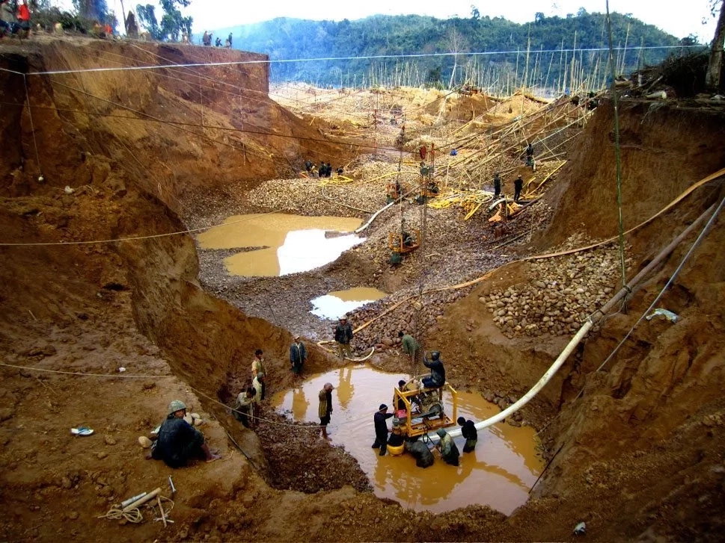
Exam question
Use your own knowledge of a place too.
For example in…..
This can also be supported by….
Refer to the figure.
Figure 2 shows that…
This an be supported by figure 2………
With the help of figure 2 and your own knowledge explain how economic growth can have harmful impacts on the environment of LICs. (6 marks)
Develop your points.
This harms the environment because…..
This means that…..
Link to your case study
This supports development because…..
This means that…..
Figure 2: Gold mining in Nigeria.
Refer to the figure.
Figure 2 shows that…
This an be supported by figure 2………
Literacy
Can you use these key terms:
Mining
Pollution
Tropical rainforest
Industrial development
Export
Environmental degradation
Using the mark scheme write your answer to the question below.
Detailed (5-6 marks)
Demonstrates comprehensive and specific knowledge of an LIC/NEE.
Shows thorough and accurate geographical understanding of how aid can support development.
Demonstrates effective application of figure 2.
Basic (1-2 marks)
Demonstrates limited knowledge an LIC/NEE. Answers may be largely generic.
Shows some geographical understanding of how aid can support development.
Makes limited use of figure 2 to support.
Clear (3-4 marks)
Demonstrates accurate knowledge of an LIC/NEE.
Shows clear geographical understanding of how aid can support development
Makes clear use of figure 2 to support.

