Slide 1
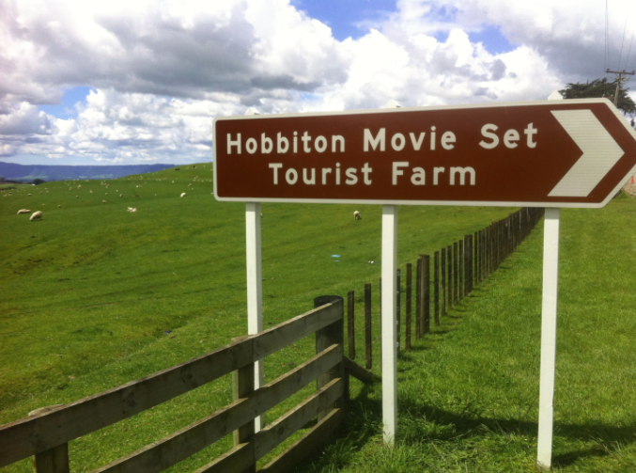
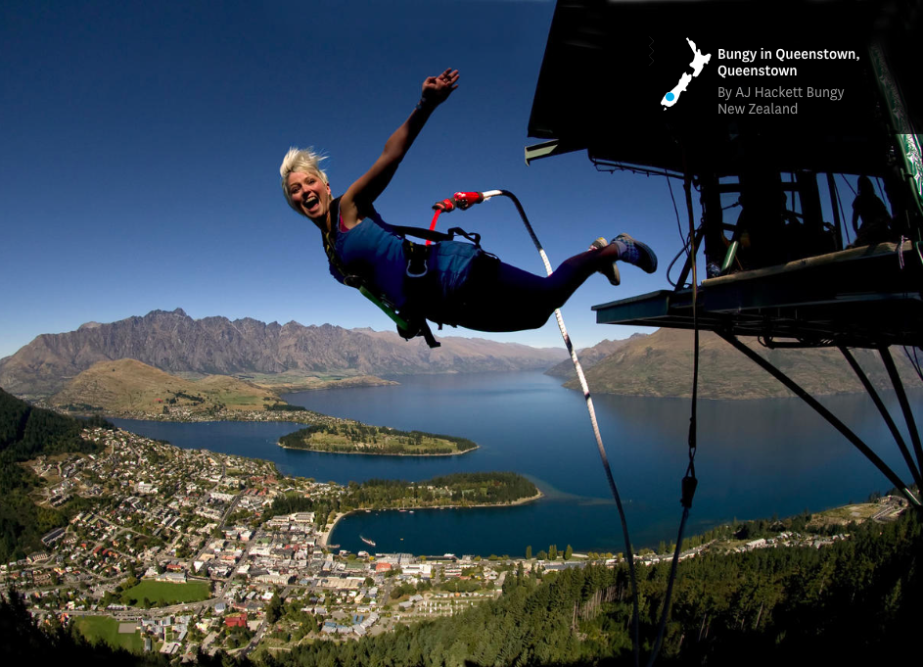
What: Niche national tourism strategies with a global sphere of influence, including adventure tourism, movie location tourism and heritage tourism
Conceptual understanding (why): The varying power of different countries to participate in global tourism and sport

Slide 2
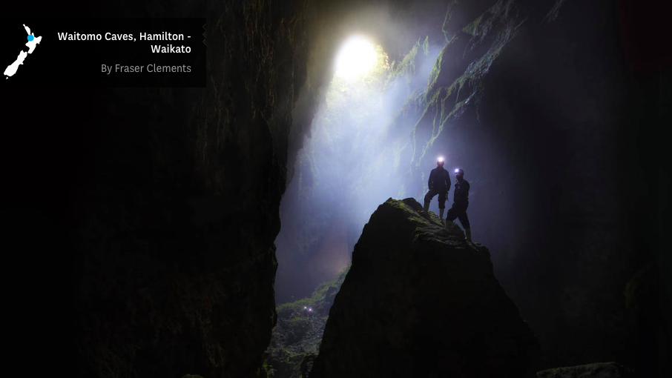
Niche tourism
Special interest tourism catering for a relatively small number of tourists

Slide 3
Movie location tourism
Which movie locations may be attractive to tourists

Slide 4
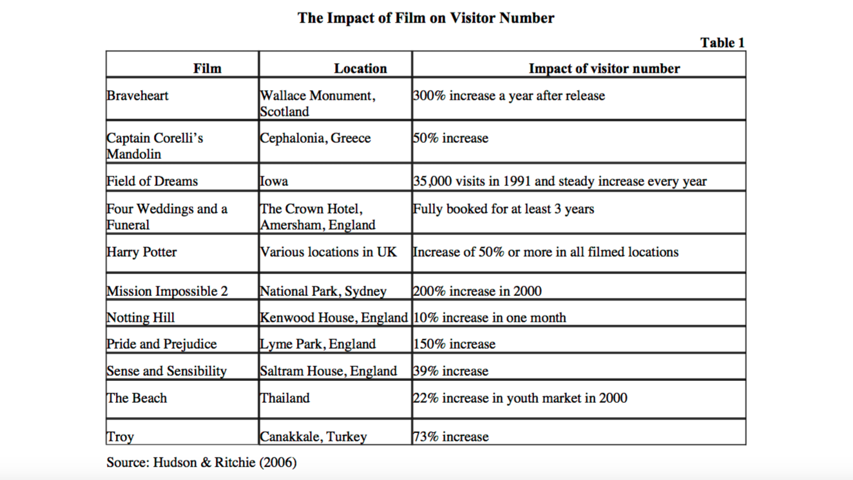

Slide 5
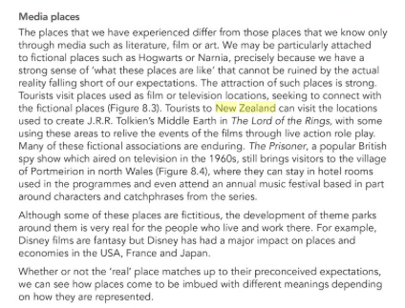
Also read- textbook page 239

Slide 6
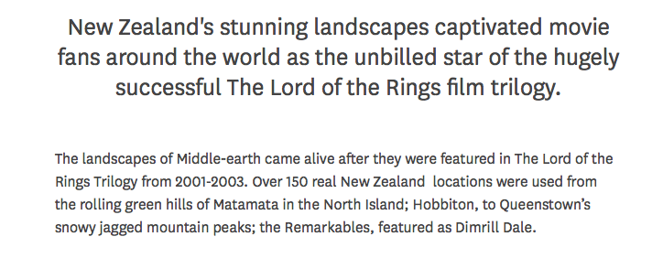
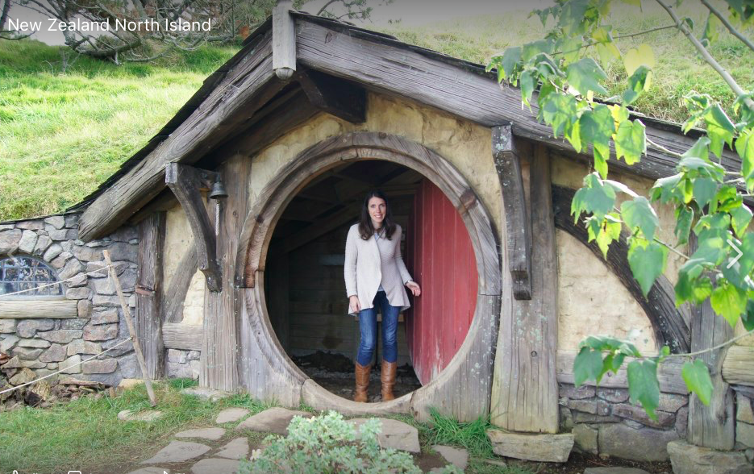
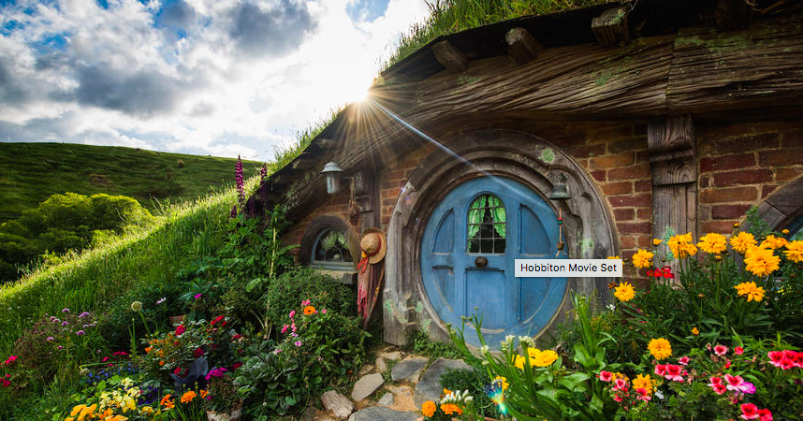
Location: Matamata,
Waikato, North Island
https://www.youtube.com/watch?v=mzYGlLonPRk
https://www.youtube.com/watch?v=ROxonCqDHcw
https://www.newzealand.com/us/feature/the-lord-of-the-rings-trilogy-experiences/

Slide 7
Impact of Hobbit tourism in New Zealand
Tourism has overtaken dairy as the nation's top earner of overseas dollars. And tourism officials say the success of the fantasy movie trilogy "The Hobbit" has helped.
The value of The Hobbit films to local tourism was anywhere between $50 million and $500 million per year.
It builds on the success of the three Lord of the Rings movies, which were credited with making New Zealand a world leader in "film tourism".
350,000 visitors visit Hobbiton each year- brings significant money to sheep farming area
The venture had hired 92 new staff in the past three months and now employs more than 200 workers. Alexander didn’t believe Hobbiton’s popularity would wane with time given the trilogy had run its course.

Slide 9
Adventure tourism
A form of niche tourism that involves travel to a remote area and some level of perceived (sometimes real) risk.

Slide 10
Benefits of adventure tourism
Attracts high value customers Supports local economies more than mass tourism- 66% stays in local destination
Encourages sustainable practices- involves local communities, supports local businesses, and promotes environmental protection
Extra reading: page 237-238

Slide 11
Target market

Slide 12
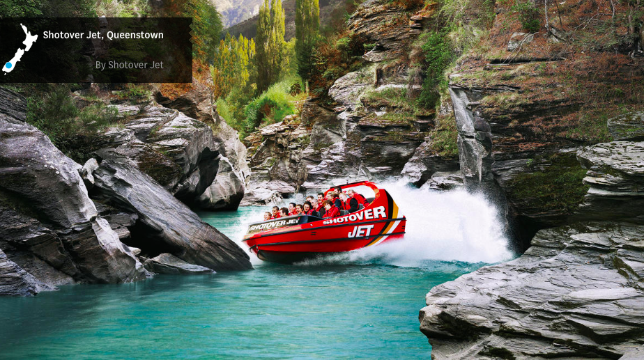
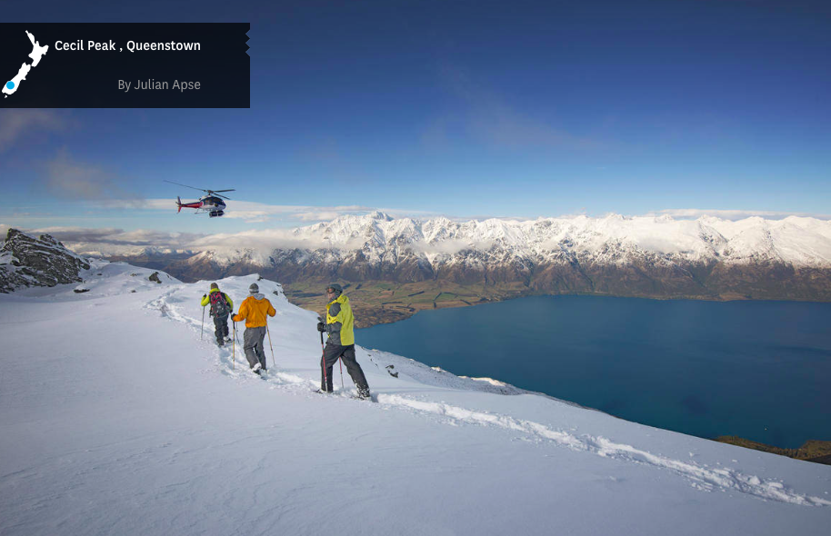
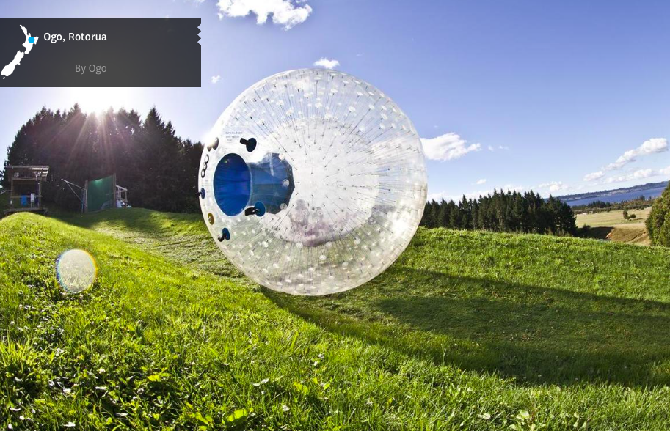
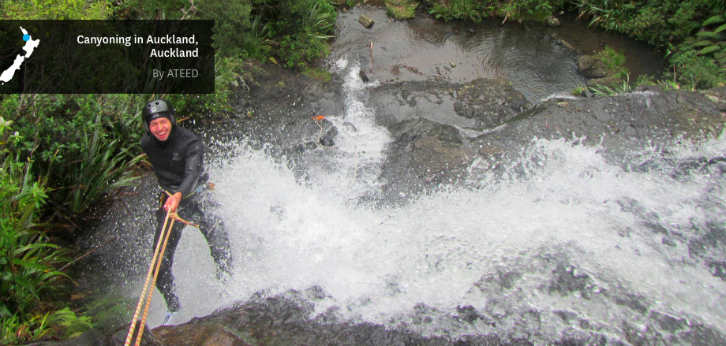
Adventure tourism New Zealand
https://www.newzealand.com/us/feature/new-zealand-must-do-top-10-adventure-experiences/
Seeking thrills and extreme sports in New Zealand: http://www.bbc.co.uk/programmes/p02kw1ks

Slide 13
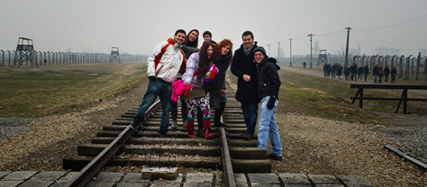
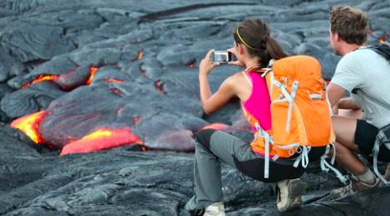
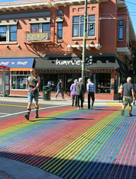
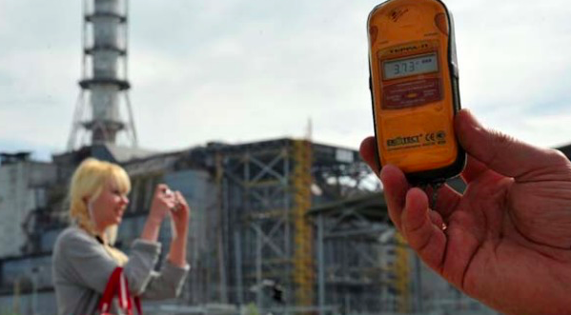
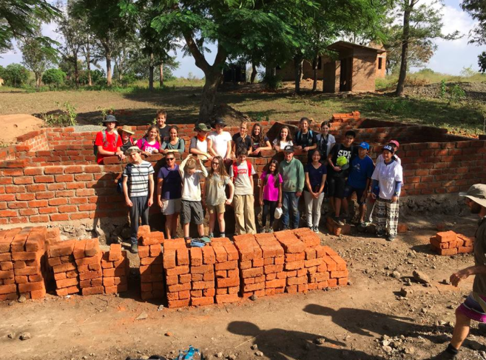
Tasks
List other types of niche tourism- in which locations may these occur?
Giving examples, why may niche tourism have a global sphere of influence.

