Slide 1
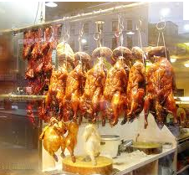
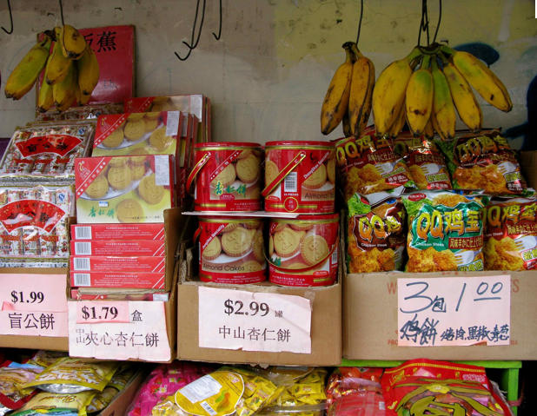
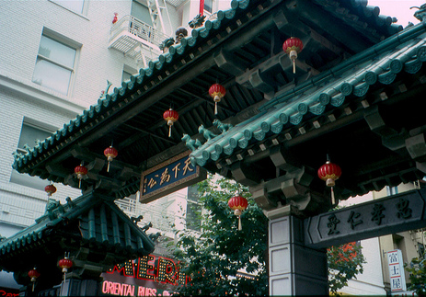
China Town, San Francisco
Cultural diasporas

Slide 2
IB LO: How diasporas influence cultural diversity and identity at both global and local scales
Aims of the lesson
To have knowledge and understanding of how diasporas influence cultural diversity and identity at both global and local scales.
To have knowledge and understanding of overseas Chinese or Indians as a case study of a global diaspora population and their cultures.

Slide 3
Who are 'diasporas'?
A population of a country who have migrated abroad and keep strong identity ties with the homeland.
A permanently displaced and relocated collective.

Slide 4
Diaspora – Not just migration but the widespread scattering and dispersal of a nation or group of people.
Example diaspora source nations – Jewish, Polish, Palestinian, Irish, Italian, Chinese, Scottish,
Example diaspora host countries – USA, UK, Australia

Slide 5
According to the United Nations' 2015 migration report, India has the largest diaspora with 16 million Indians living abroad, followed closely by Mexico with 12 million. However, India’s diaspora population is just over 1% of its total population, whereas Mexico’s is 10%.

Slide 6
What has caused this?
Migration- the worldwide scattering or dispersal of the population.
Jewish Diaspora: accelerated after AD 70 when the Jewish population was forced to spread following the Roman conquest of Palestine
The new Polish Diaspora: 1-3 million people left Poland when it joined the EU in 2004.
Chinese Diaspora: Indonesia, Thailand, Malaysia and other SE Asian Countries along with far flung countries such as UK have Chinese districts- China Town.

Slide 7
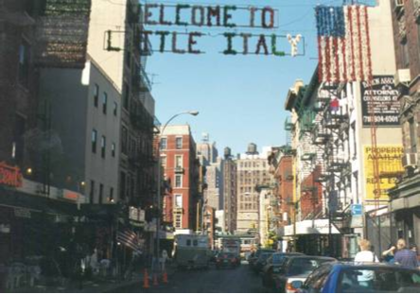
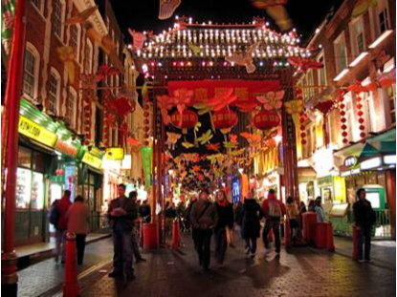
Within host nations and cities areas of high concentrations of a particular ethnic group or nation can develop as people tend to want to live together in a community. “Little Italy” “China towns”.

Slide 8
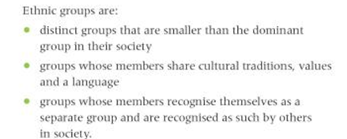

Slide 9
The slow decline of American Chinatowns
http://www.bbc.com/news/magazine-25920980
Chinatowns are a feature of many US cities, but some of the best known are succumbing to gentrification, campaigners say. Even one of the largest and most vibrant, in Manhattan, is slowly being invaded by luxury shops and apartment buildings. "Chinatowns are turning into a sanitised ethnic playground for the rich to satisfy their exotic appetite for a dim sum and fortune cookie fix"
Link to Urban environments and gentrification

Slide 10
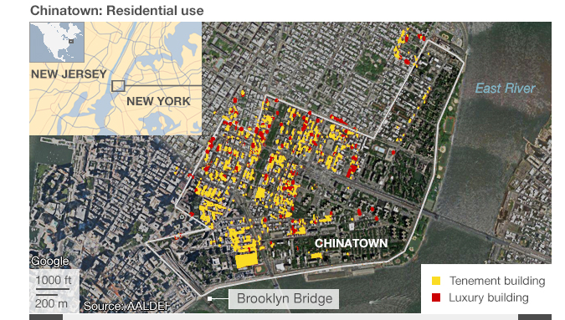
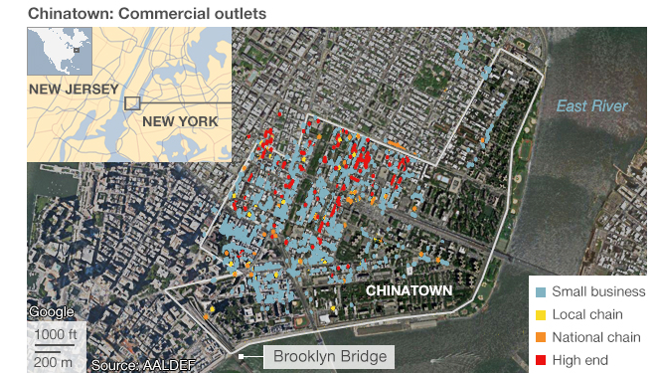

Slide 11
Case studies: Chinese or Indian Diaspora

Slide 14
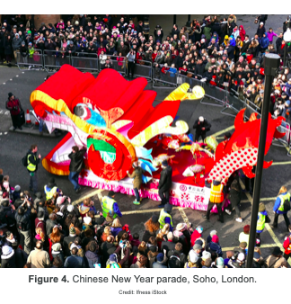
Chinese diaspora case study
Read Kognity: 5.2.6 Diasporas and their influence on cultural diversity and identity and the resources on the weebly
Make notes on:
The history of Chinese migration
How do the Chinese maintain their culture in the UK and/ or Malaysia?
To what extent have the British adopted the cultural traits of the Chinese migrants?

Slide 15
The Indian diaspora case study
Read Kognity: 5.2.6 Diasporas and their influence on cultural diversity and identity and embedded sheet on weebly
Make notes on:
The history of Indian migration
The distribution of Indian migration in the USA
How do Indians maintain their culture in the USA?

Slide 16
Essay
Using examples, analyse how diasporas influence cultural diversity and identity at both global and local scales. [12]

Slide 17
12 mark question

Slide 18
