Slide 1
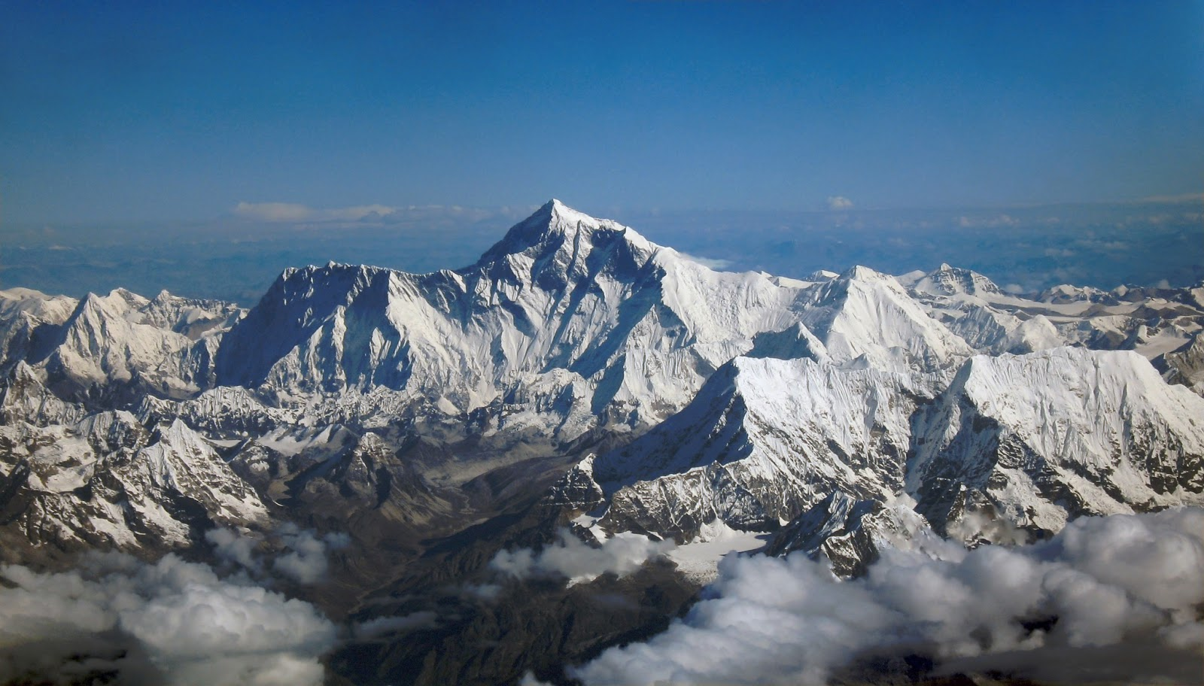
Write down 3 adjectives to describe this environment.

Slide 2
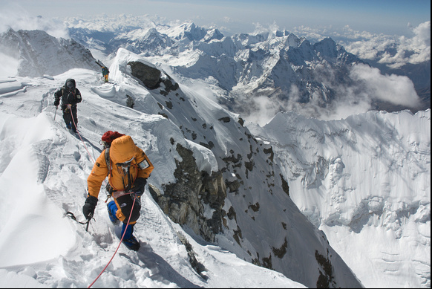
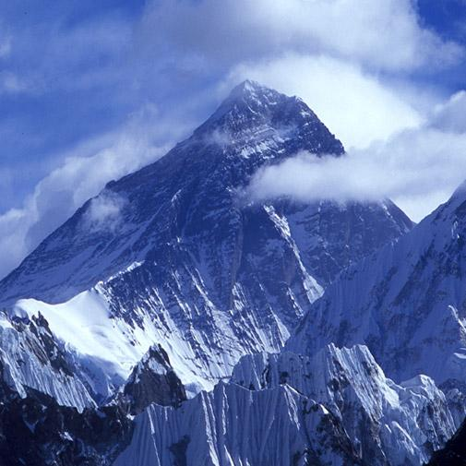
Green boots
Use the statements to answer the following questions.
Who is Green boots?
What happened to Green boots?
Where is Green boots today and why?

Slide 3
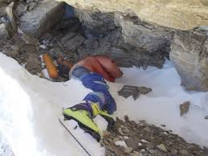
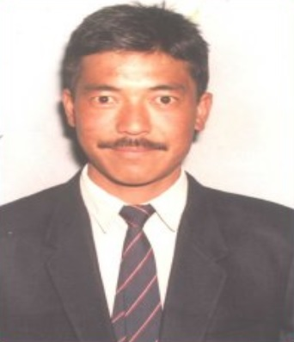
The highest Geography on Earth
8850

Slide 4
Green boots
Green Boots is among many corpses remaining on Everest.
Over the years it became a common term, as all the expeditions from the north side encounter the body of the Indian climber curled up in the limestone alcove cave.
The cave is located at 27,890 feet (8 500 m), and is littered with spent oxygen bottles.
Extra information: Read the BBC article about Green boots
Add this to the profile

Slide 5
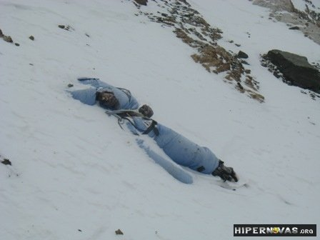
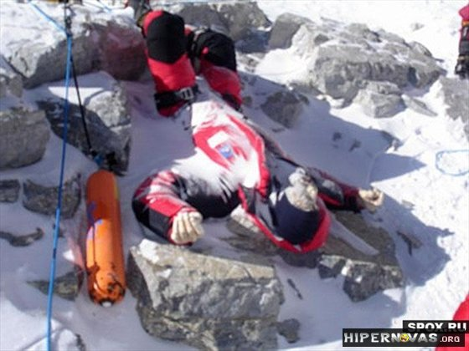
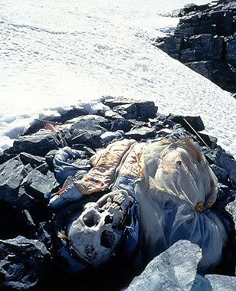
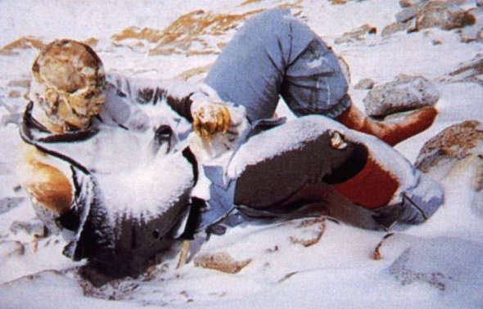
He is not alone.....
200

Slide 6
Mystery:
Why was Green Boots in the same place until 2014 when he mysteriously disappeared and then reappeared and is back in 2017?

Slide 7
The Death Zone relates to any area of a mountain that is above 8000 metres in altitude. Seemingly fit and healthy climbers and mountaineers can suddenly drop dead or start suffering from a number of illnesses above 8000 metres. There is no of knowing how your body will react until you are there.

Slide 9
Complete the worksheet- the death zone

Slide 10
What questions could we ask Kenton Cool about climbing Everest?

