Slide 1
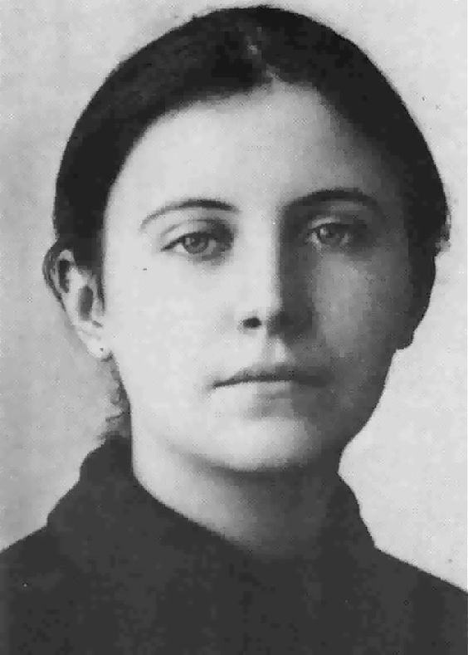
Changemaker – Mother Teresa

Slide 2
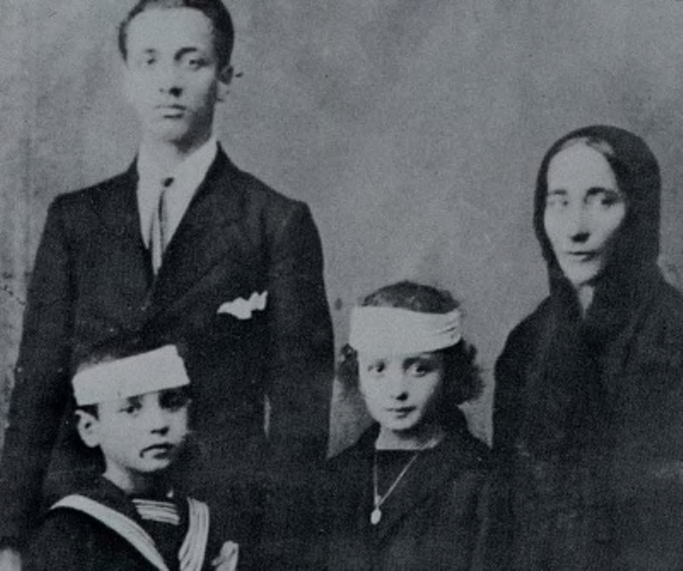
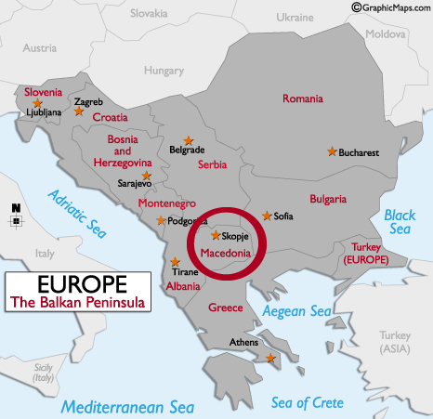
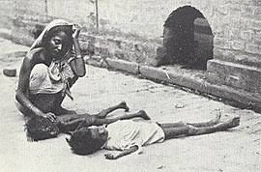
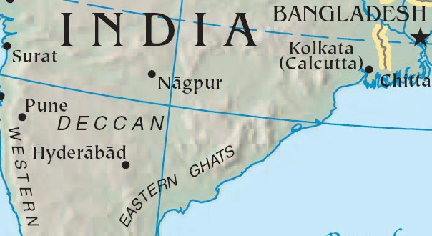
Anjezë Gonxhe Bojaxhiu was born on 26 August 1910 in Skopje, Ottoman Empire.
She was the youngest child of Nikollë and Dranafile Bojaxhiu. Her father, who was involved in Albanian-community politics in Ottoman Macedonia, died in 1919 when she was eight years old.
Teresa was in her early years when she was fascinated by stories of the lives of missionaries and their service in Bengal; by age 12, she was convinced that she should commit herself to religious life.
She left home in 1928 at age 18 to join the Sisters of Loreto at Loreto Abbey in Rathfarnham, Ireland, to learn English with the view of becoming a missionary; English was the language of instruction of the Sisters of Loreto in India. She never saw her mother or her sister again.
She arrived in India in 1929 and began her training in the lower Himalayas, where she learned Bengali and taught at St. Teresa's School near her convent. Teresa took her first religious vows on 24 May 1931. She chose to be named after Thérèse de Lisieux, the patron saint of missionaries;, she opted for its Spanish spelling (Teresa).
Teresa took her solemn vows on 14 May 1937 while she was a teacher at the Loreto convent school in Calcutta. She served there for nearly twenty years and was appointed its headmistress in 1944. Although Teresa enjoyed teaching at the school, she was increasingly disturbed by the poverty surrounding her in Calcutta. The Bengal famine of 1943 brought misery and death to the city.

Slide 3
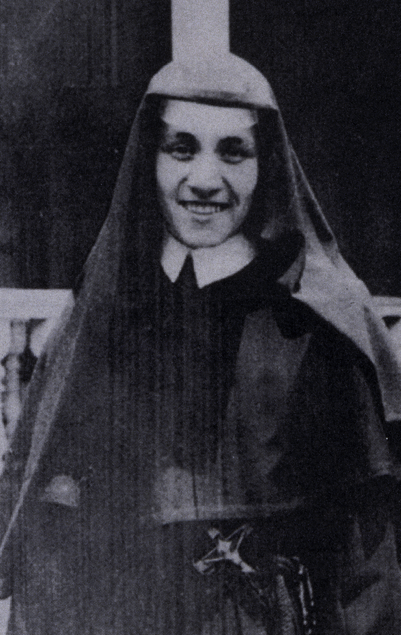
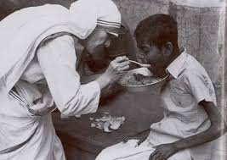
On 10 September 1946, Teresa experienced what she later described as "the call within the call" when she traveled by train to the Loreto convent for her annual retreat.
She began missionary work with the poor in 1948,replacing her traditional Loreto habit with a simple, white cotton sari with a blue border. Teresa adopted Indian citizenship, spent several months in Patna to receive basic medical training and ventured into the slums.
"I was to leave the convent and help the poor while living among them. It was an order. To fail would have been to break the faith."
She founded a school in Kolkata, before she began tending to the poor and hungry. At the beginning of 1949 Teresa was joined in her effort by a group of young women, and she laid the foundation for a new religious community helping the "poorest among the poor".
Her efforts quickly caught the attention of Indian officials, including the prime minister. Teresa wrote in her diary that her first year was fraught with difficulty. With no income, she begged for food and supplies and experienced doubt, loneliness and the temptation to return to the comfort of convent life during these early months:
“Today, I learned a good lesson. The poverty of the poor must be so hard for them. While looking for a home I walked and walked till my arms and legs ached. I thought how much they must ache in body and soul, looking for a home, food and health.”

Slide 4
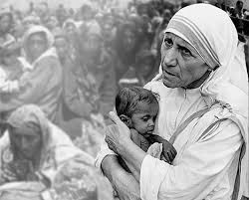
On 7 October 1950, Teresa received Vatican permission for the Missionaries of Charity. In her words, it would care for;
"the hungry, the naked, the homeless, the crippled, the blind, the lepers, all those people who feel unwanted, unloved, uncared for throughout society, people that have become a burden to the society and are shunned by everyone".
In 1952, Teresa opened her first hospice. She converted an abandoned Hindu temple into the Kalighat Home for the Dying, free for the poor, and renamed it Kalighat, the Home of the Pure Heart. Those brought to the home received medical attention and the opportunity to die with dignity in accordance with their faith: Muslims were read the Quran, Hindus received water from the Ganges, and Catholics received extreme unction. "A beautiful death", Teresa said, "is for people who lived like animals to die like angels—loved and wanted."
She opened a hospice for those with leprosy, calling it Shanti Nagar (City of Peace). The Missionaries of Charity established leprosy-outreach clinics throughout Calcutta, providing medication, dressings and food.
The Missionaries of Charity took in an increasing number of homeless children; in 1955 Teresa opened Nirmala Shishu Bhavan, the Children's Home of the Immaculate Heart, as a haven for orphans and homeless youth.

Slide 5
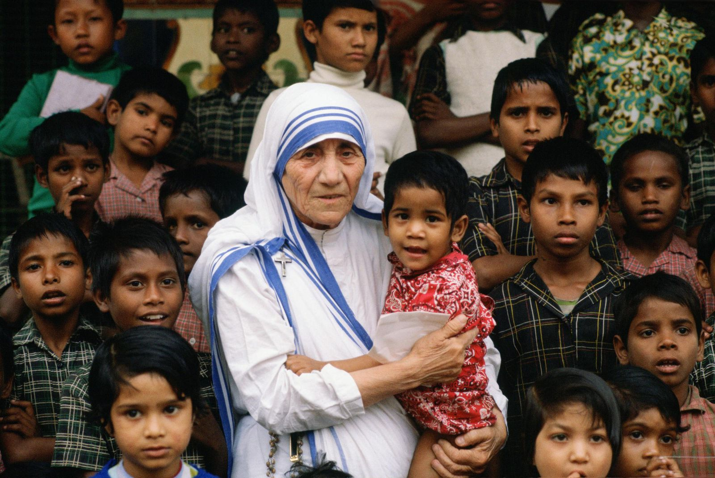
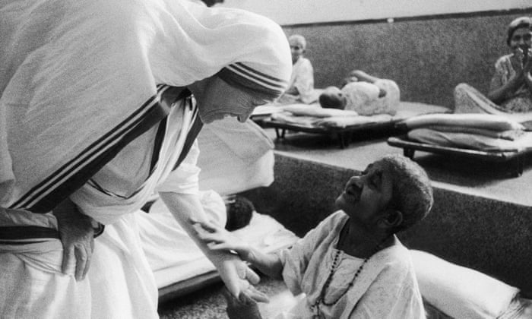
The congregation began to attract recruits and donations, and by the 1960s it had opened hospices, orphanages and leper houses throughout India.
Teresa then expanded the congregation abroad, opening a house in Venezuela in 1965 with five sisters. Houses followed in Italy (Rome), Tanzania and Austria in 1968, and during the 1970s the congregation opened houses and foundations in the United States and dozens of countries in Asia, Africa and Europe.
By 1997, the 13-member Calcutta congregation had grown to more than 4,000 sisters who managed orphanages, AIDS hospices and charity centers worldwide, caring for refugees, the blind, disabled, aged, alcoholics, the poor and homeless and victims of floods, epidemics and famine. By 2007, the Missionaries of Charity numbered about 450 brothers and 5,000 sisters worldwide, operating 600 missions, schools and shelters in 120 countries.
Fluent in five languages – Bengali, Albanian, Serbian, English and Hindi – she made occasional trips outside India for humanitarian reasons.
At the height of the Siege of Beirut in 1982, Teresa rescued 37 children trapped in a front-line hospital by brokering a temporary cease-fire between the Israeli army and Palestinian guerrillas. Accompanied by Red Cross workers, she travelled through the war zone to the hospital to evacuate the young patients.
In the late 1980s, Teresa expanded her efforts to Communist countries which had rejected the Missionaries of Charity. She began dozens of projects, undeterred by criticism of her stands against abortion and divorce She visited Armenia after the 1988 earthquake and travelled to assist the hungry in Ethiopia, radiation victims at Chernobyl and In 1991 she returned to Albania for the first time, opening a Missionaries of Charity Brothers home in Tirana.

Slide 6
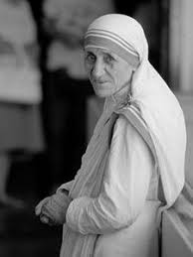
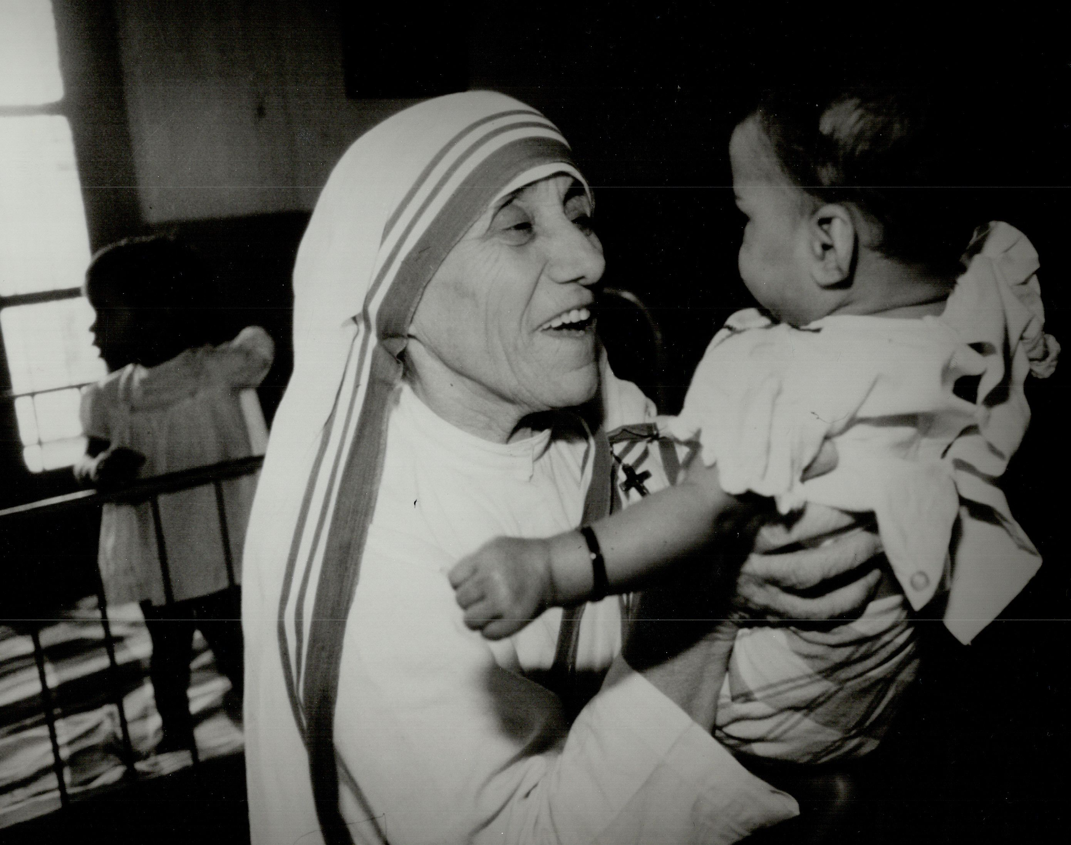
By 1996, Teresa operated 517 missions in over 100 countries. Her Missionaries of Charity grew from twelve to thousands, serving the "poorest of the poor" in 450 centres worldwide.
Teresa had a heart attack in Rome in 1983 while she was visiting Pope John Paul II. Following a second attack in 1989, she received an artificial pacemaker. In 1991, after a bout of pneumonia in Mexico, she had additional heart problems.
"By blood, I am Albanian. By citizenship, an Indian. By faith, I am a Catholic nun. As to my calling, I belong to the world. As to my heart, I belong entirely to the Heart of Jesus.”
In April 1996 she fell, breaking her collarbone, and four months later she had malaria and heart failure. Although Teresa had heart surgery, her health was clearly declining.
On 13 March 1997 Teresa resigned as head of the Missionaries of Charity, and she died on 5 September. At the time of her death, the Missionaries of Charity had over 4,000 sisters and an associated brotherhood of 300 members operating 610 missions in 123 countries. These included hospices and homes for people with HIV/AIDS, leprosy and tuberculosis, soup kitchens, children's-and family-counselling programmes, orphanages and schools. The Missionaries of Charity were aided by co-workers numbering over one million by the 1990s.
Teresa lay in an open casket in St Thomas, Calcutta, for a week before her funeral. She received a state funeral from the Indian government in gratitude for her service to the poor of all religions in the country. Teresa's death was mourned in the secular and religious communities.
Her life-long devotion to the care of the poor, the sick, and the disadvantaged was one of the highest examples of service to our humanity.” According to former U.N. Secretary-General Javier Pérez de Cuéllar, "She is the United Nations. She is peace in the world.”

Slide 7
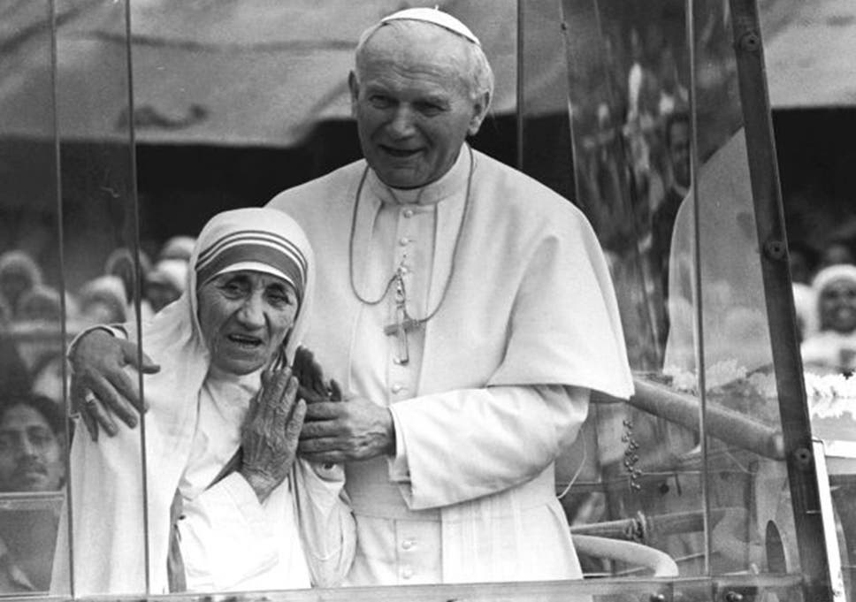
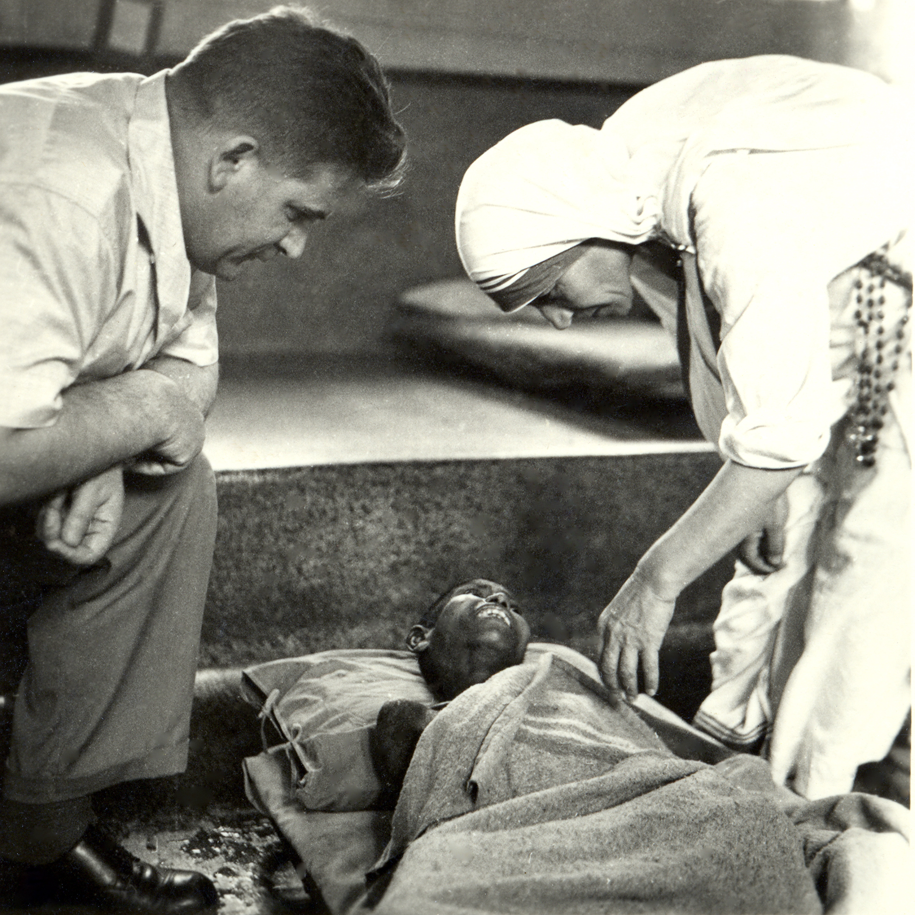
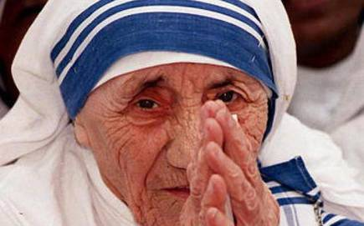
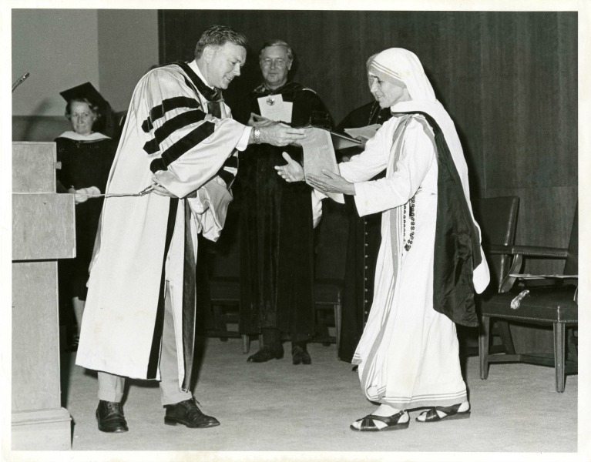
Around this time, the Catholic world began to honour Teresa publicly. Pope Paul VI gave her the inaugural Pope John XXIII Peace Prize in 1971, commending her work with the poor, display of Christian charity and efforts for peace. After her death, Teresa progressed rapidly on the road to sainthood.
To commemorate the 100th anniversary of her birth, the government of India issued a special ₹5 coin (the amount of money Teresa had when she arrived in India).
During her lifetime, Teresa was among the top 10 women in the annual Gallup's most admired man and woman poll 18 times.
In 1999 she headed Gallup's List of Most Widely Admired People of the 20th Century,
"Clad in a white sari with a blue border, she and the sisters of Missionaries of Charity became a symbol of hope to many – the aged, the destitute, the unemployed, the diseased, the terminally ill, and those abandoned by their families."
28 August 2010. President Pratibha Patil

Slide 8
She was honoured by governments and civilian organisations, and appointed an honorary Companion of the Order of Australia in 1982 "for service to the community of Australia and humanity at large". The United Kingdom and the United States bestowed a number of awards, culminating in the Order of Merit in 1983 and honorary citizenship of the United States on 16 November 1996. Teresa's Albanian homeland gave her the Golden Honour of the Nation in 1994. Universities in India and the West granted her honorary degrees. Other civilian awards included the Balzan Prize for promoting humanity, peace and brotherhood among peoples (1978) and the Albert Schweitzer International Prize (1975).
"Around the world, not only in the poor countries, but I found the poverty of the West so much more difficult to remove. When I pick up a person from the street, hungry, I give him a plate of rice, a piece of bread, I have satisfied. I have removed that hunger. But a person that is shut out, that feels unwanted, unloved, terrified, the person that has been thrown out from society – that poverty is so hurtable [sic] and so much, and I find that very difficult.”
In 1979, Teresa received the Nobel Peace Prize "for work undertaken in the struggle to overcome poverty and distress, which also constitutes a threat to peace". She refused the conventional ceremonial banquet for laureates, asking that its $192,000 cost be given to the poor in India and saying that earthly rewards were important only if they helped her to help the world's needy.
When Teresa received the prize she was asked, "What can we do to promote world peace?" She answered, "Go home and love your family.”

