Slide 1
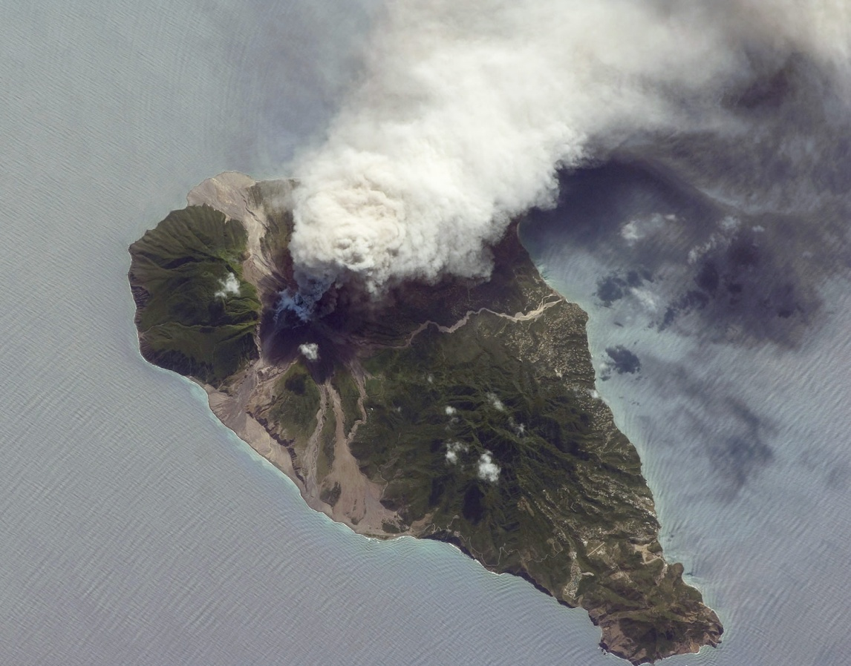
Montserrat volcanic eruption
LO: to produce a case study of the causes, effects (long and short term) and responses to the eruption

Slide 2
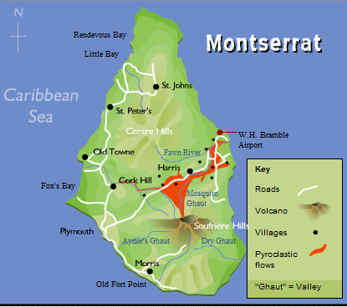
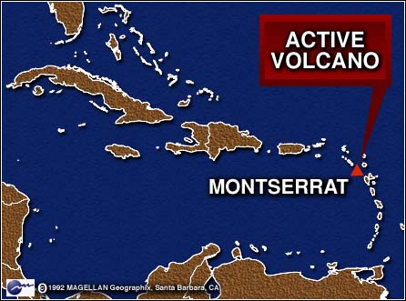
Location of Montserrat
Use the map provide write a detailed description of the location of Montserrat and the volcano.

Slide 4
Overview of the eruption….
The Soufriere Hills volcano began to erupt in 1995 following a long period of inactivity (hadn't erupted for 350 years).
The eruptions forced the evacuation of the capital Plymouth and the part of the island that was actually the most densely population - and for good reason as it had the best advantages for settlement.
Pyroclastic flows killed some of the people who returned against advice, and have also created an area of new land as the debris has been deposited off the coast.

Slide 5
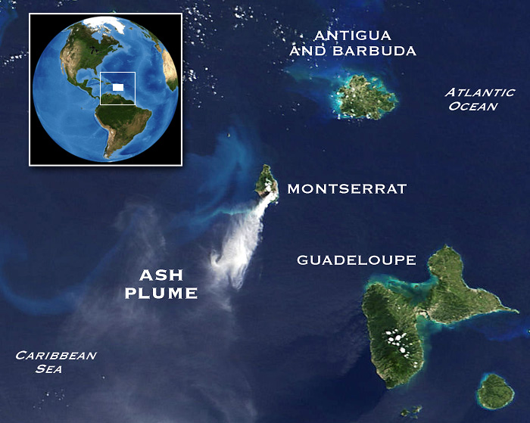

Slide 6
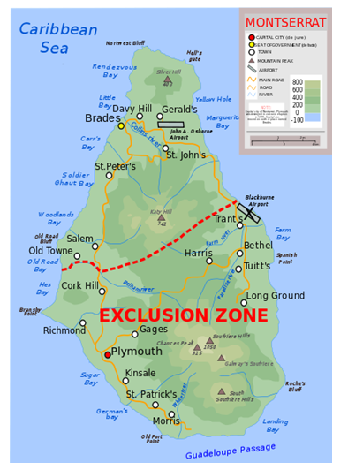

Slide 7
DVD notes

Slide 8
Cause of the eruption…
Destructive plate boundary (convergent)
North American Plate is being forced (subducted) under the Caribbean plate
Convection currents pull the plate into the mantle causing the rock to melt.
The molten rock is lighter than the surrounding rock which causes it to rise through the cracks towards the earths surface

Slide 9
Cause of the eruption
The volcanic eruption was so deadly because the volcano produced sticky andesitic lava (thick lava).
The lava is so thick it created a dome on the side of the Chances Peak volcano.
As the dome collapsed a huge ash cloud was formed.
Also the dome collapse caused hot rocks, gases and ash- a pyroclastic flow.

Slide 10
Exam question- January 2011

Slide 11
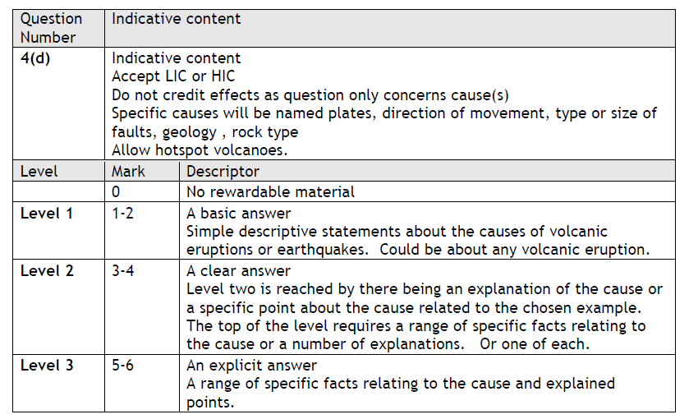

Slide 12
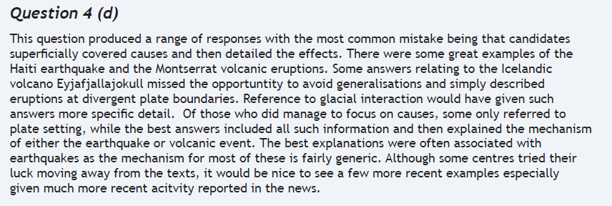

Slide 13
Monitoring of the volcano from the MVO

Slide 14
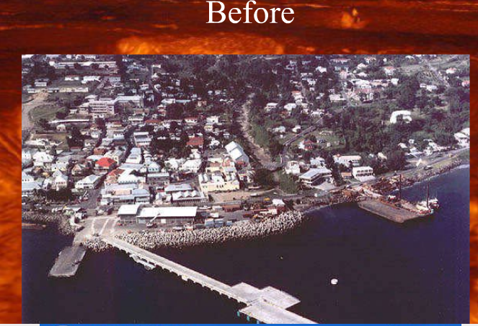
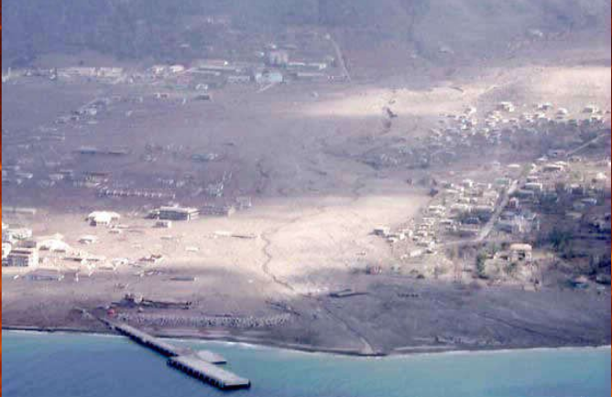

Slide 16
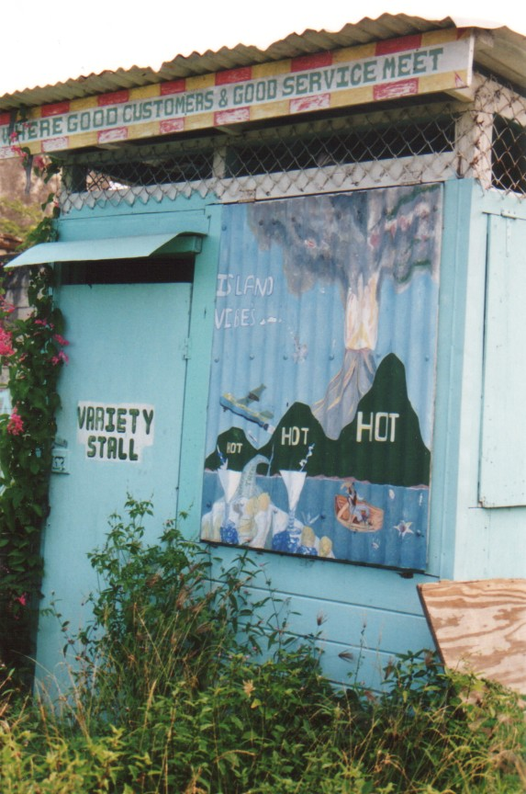
"Hot, hot, hot" the Soca anthem by Montserratian Arrow, now takes on a new meaning.....
Photograph by Adam Goss http://people.cornell.edu/pages/arg32/watson/montserrat.html and used with permission

Slide 17
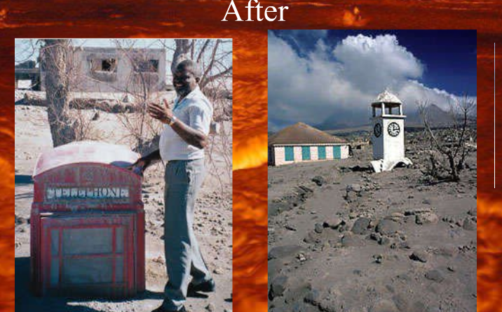

Slide 18
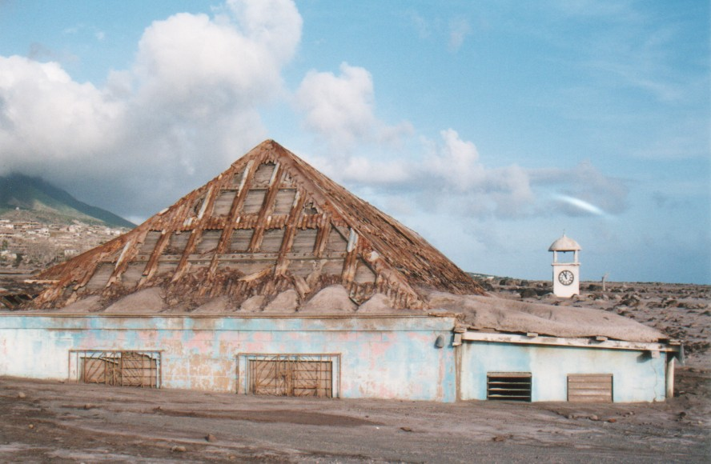
In August of 1997, a series of pyroclastic flows and lahars (mudflows) destroyed the capital city of Plymouth
Photograph by Adam Goss http://people.cornell.edu/pages/arg32/watson/montserrat.html and used with permission

Slide 19
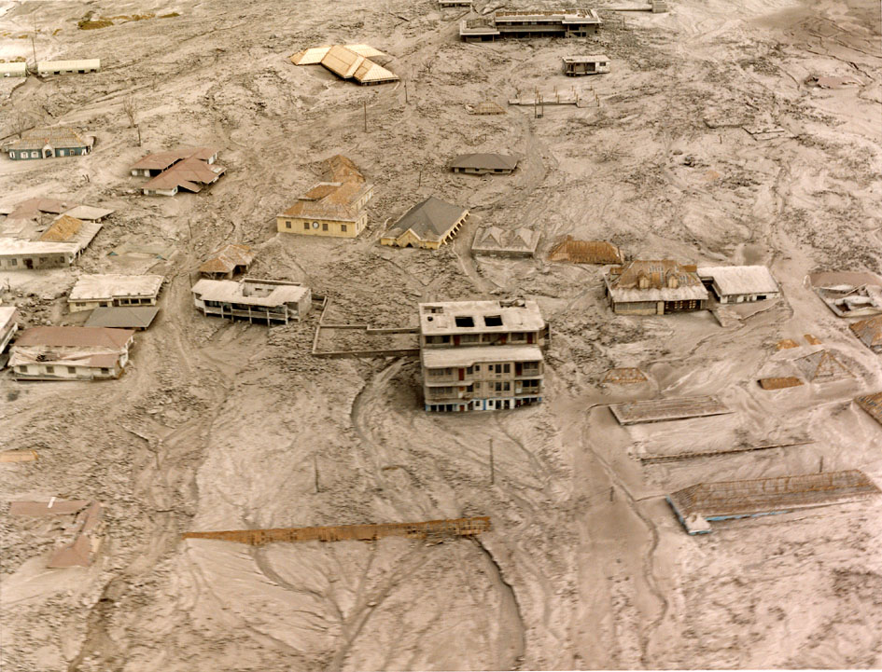
Nearly 8,000 people out of a total population of 12,000 left the island for nearby Antigua, some went to the USA and Britain.
Photograph from MVO http://www.mvo.ms/ and used with permission

Slide 20
What is the future for Montserrat?
Photograph by Adam Goss http://people.cornell.edu/pages/arg32/watson/montserrat.html and used with permission

Slide 21
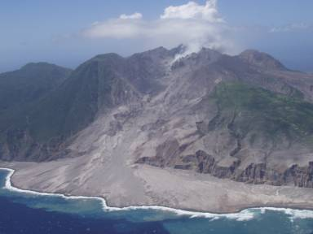
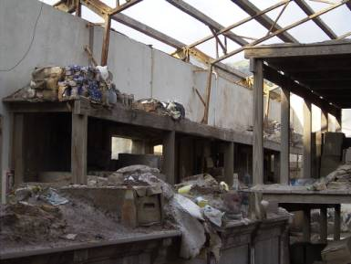
Coral reefs have been damaged and fish stocks affected
Most of the islands small businesses have been forced to close
Photographs from MVO http://www.mvo.ms/ and used with permission

Slide 22
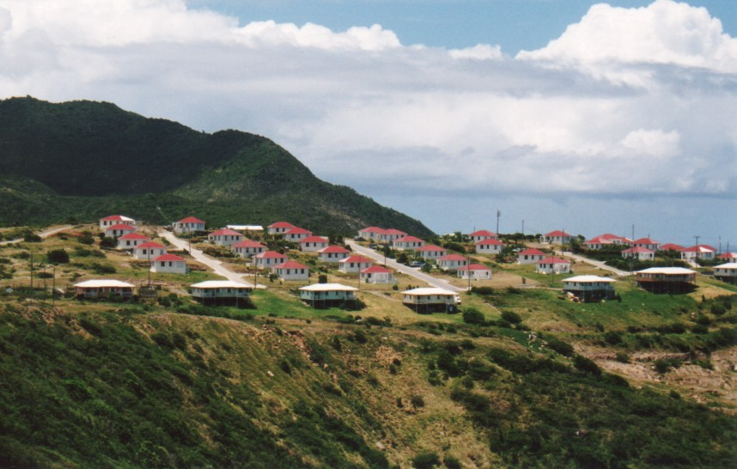
Today, Montserratians are rebuilding their country with help from the British Government. Slowly, people are moving out of the shelters or back from abroad to resettle in developments constructed in the North.
Photograph by Adam Goss http://people.cornell.edu/pages/arg32/watson/montserrat.html and used with permission

Slide 23
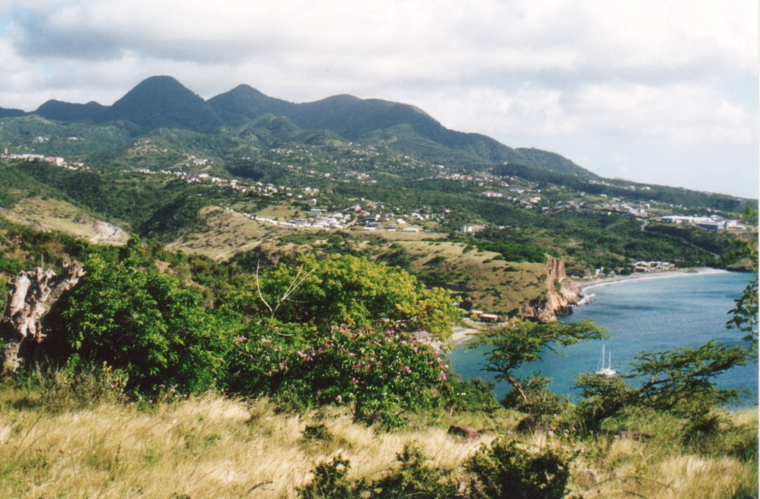
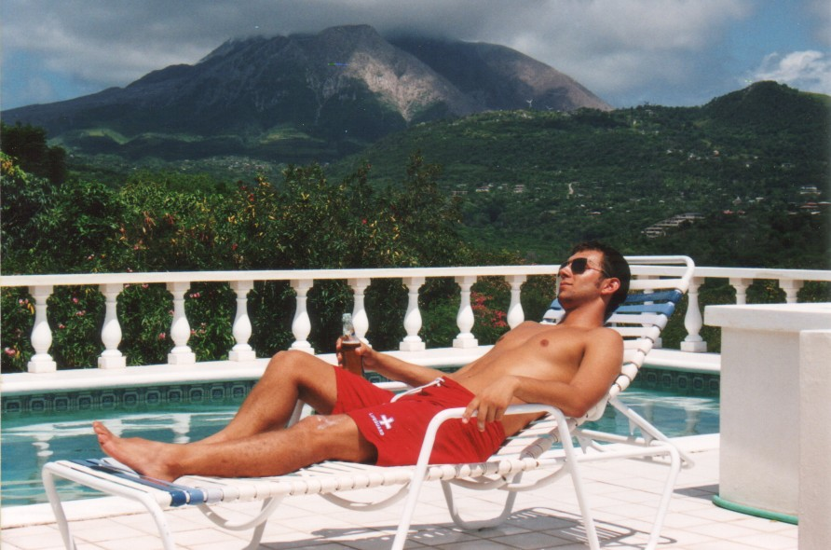
The north of the island remains untouched by the volcano.
Photograph by Adam Goss http://people.cornell.edu/pages/arg32/watson/montserrat.html and used with permission

Slide 24
Exam question June 2011

Slide 25
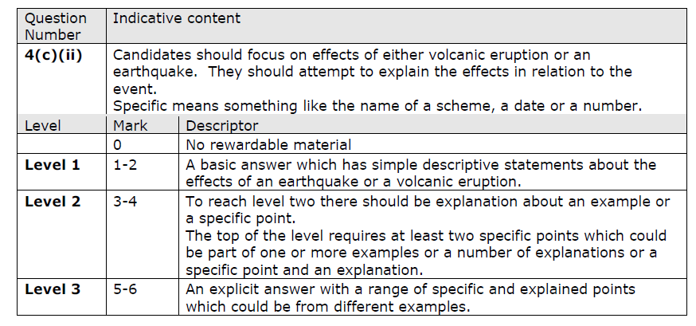

Slide 27
KEY FACTS
Think of these as 'bullet points' - a useful REVISION technique is to try to reduce any topic down to just 10 bullet points which contain the main aspects of what it is you want to get across....

