Slide 1
Monopoly

Slide 2
Assumptions/Characteristics
Single firm
No close substitutes
High barriers to entry, because….
Large Economies of Scale (EofS)
Legal patents or copyrights
Aggressive tactics
Control of necessary resources
Branding
Natural monopoly

Slide 3
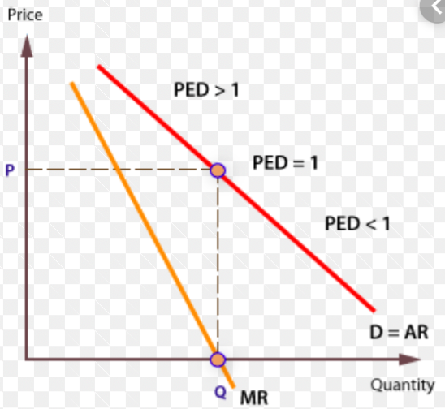
The monopolist’s demand and revenue in relation to PED
While we tend to draw the demand curve relatively steeply in Paper 1, it is important to remember the relationships between PED, MR and the demand curve.
We know that we draw a downward sloping demand curve because prices and quantity demanded have an inverse relationship.
Where prices fall proportionally less than quantity demanded increases, we know that total revenue will increase.
This will occur along the demand curve as long as MR remains positive. After all, MR is the rate of change of TR (in fact, it is the gradient of TR) and positive MR means that TR is growing.
Looking back at figure 3, we can see that the profit-maximising level of output MR=MC will always be where MR and MC are positive values.
That must mean that the monopolist will only ever produce where PED is greater than 1.

Slide 4
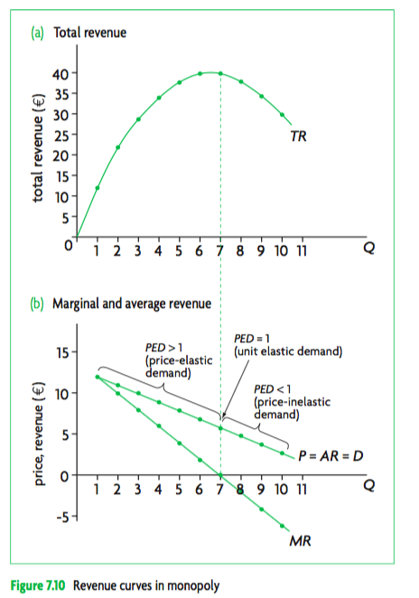
The monopolist’s demand and revenue in relation to PED
While we tend to draw the demand curve relatively steeply in Paper 1, it is important to remember the relationships between PED, MR and the demand curve.
We know that we draw a downward sloping demand curve because prices and quantity demanded have an inverse relationship.
Where prices fall proportionally less than quantity demanded increases, we know that total revenue will increase.
This will occur along the demand curve as long as MR remains positive. After all, MR is the rate of change of TR (in fact, it is the gradient of TR) and positive MR means that TR is growing.
Looking back at figure 3, we can see that the profit-maximising level of output MR=MC will always be where MR and MC are positive values.
That must mean that the monopolist will only ever produce where PED is greater than 1.

Slide 5
A MONOPOLY IS ABLE TO EARN LARGE ABNORMAL PROFITS

Slide 6
COMPARING REVENUE MAXIMISATION WITH PROFIT MAXIMISATION FOR A MONOPOLY

Slide 7
A MONOPOLIST IS NOT ALLOCATIVELY EFFICIENT

Slide 8
A MONOPOLIST IS NOT PRODUCTIVELY EFFICIENT

Slide 9
MONOPOLY CREATES A WELFARE LOSS

Slide 10
COMPARING MONOPOLY WITH PERFECT COMPETITION

Slide 11
A MONOPOLY CAN ACHIEVE EOFS

Slide 12
OUTCOMES OF A NATURAL MONOPOLY

Slide 13
Evaluating Policies to regulate monopoly REGULATIONS:
Most countries…
Evaluate
Do not permit formation of monopolies (exc. Nat. Monop.)
Do not permit collusion in oligopoly
Regulate mergers
Legislation is essential for greater competition benefits consumers and society
However vague laws allow for broad interpretation
There are differences on how much power is desirable from one country to another
There are different degrees of enforcement of laws
Problems of finding evidence of collusion in oligopoly

Slide 14
Evaluating Policies to regulate monopoly Nationalization:
Most countries…
Evaluate
Have some nationalized monopolies e.g. mail, trains, central banking
Lower prices and increased quantities to consumers
Higher ATC’s because of x-inefficiencies and a lack of dynamism
Lack of incentives to cut costs

Slide 15
Evaluating Policies to regulate monopoly Trade Liberalization:
Some countries…
Evaluate
Have opened up national markets to trade liberalization and competition from abroad
Imports create competition and domestic monopolies will be forced to lower prices reducing monopoly power
Inefficient domestic firms may go out of business

