Slide 1
Can you master monetary policy?

Slide 2
The aim of the simulation is for the central bank to conduct monetary policy and maintain a healthy degree of economic growth (AD) whilst keeping inflation under control
The actors in the game are:
1 central bank (2 players)
3 commercial banks (3 players)
Households and firms an even split of each (rest of the players)
The aims of each actor are:
central bank - maintain economic growth (AD) and keep inflation under control
Commercial banks – make loans, maximize the interest rate
Households and firms – Use a portion of income for consumption or investment and save the rest at the highest rate of interest (at the end of 5 rounds have the most wealth)

Slide 3
Central Bank
You are in control of monetary policy. You may create as much money supply or as little money supply as meets your objectives. You two main tools for doing so in the economy are:
The setting of the overnight lending rate to commercial banks
Changing the regulations for the reserve ratio
The sale or purchase of government bonds/treasury notes

Slide 4
Commercial Banks
Your main role in the economy is to allow and encourage savings deposits to households and firms in order to make loans to other households and firms.
You should seek out to maximize the greatest volume of savings/deposits so that you can make the greatest volume of loans to households/firms
You will make profit by paying the least amount of interest on savings whilst charging the highest amount on loans made
You must abide by the regulations vis-à-vis the reserve ratio
You may buy government/treasury bonds as and when sold by the Central Bank

Slide 5
Households and firms
Your main role is to maximise consumption (C) or Investment (I) depending on whether you are a household or a firm.
At the beginning of each round you will receive $100 which will represent incomes from either wages (W) or profits (P). You must decide what to do with this money, you may either spend it on goods and services or on factors of production or save it. You can of course take loans too.
You income will go directly into your commercial bank account as savings and can be loaned out to other households.
You may buy government bonds/treasury notes as and when they are released

Slide 6
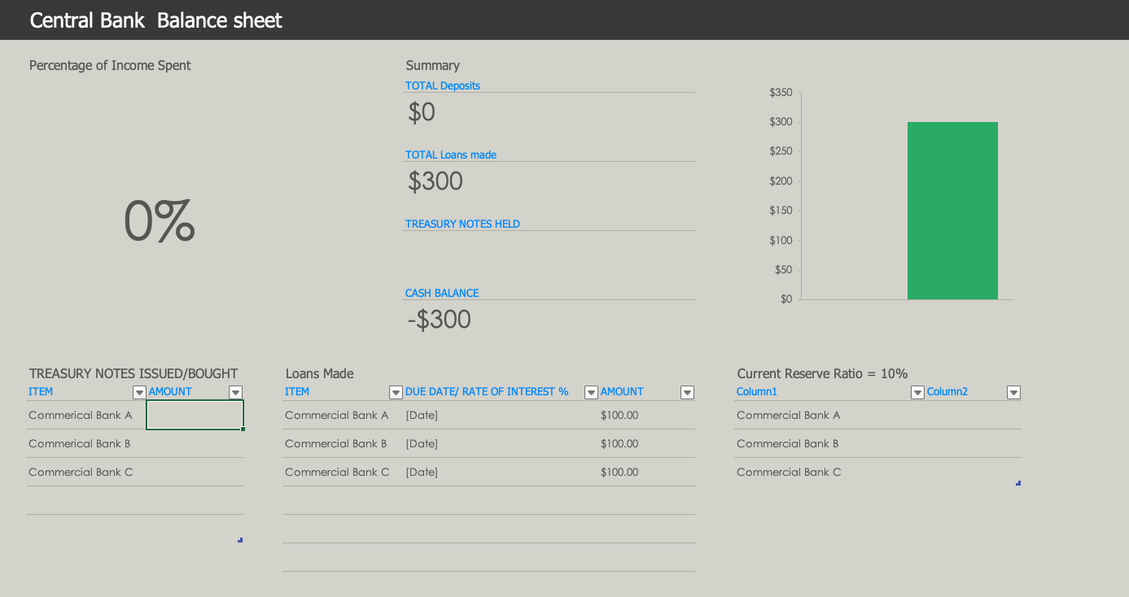
Central Bank Balance Balance Sheet

Slide 7
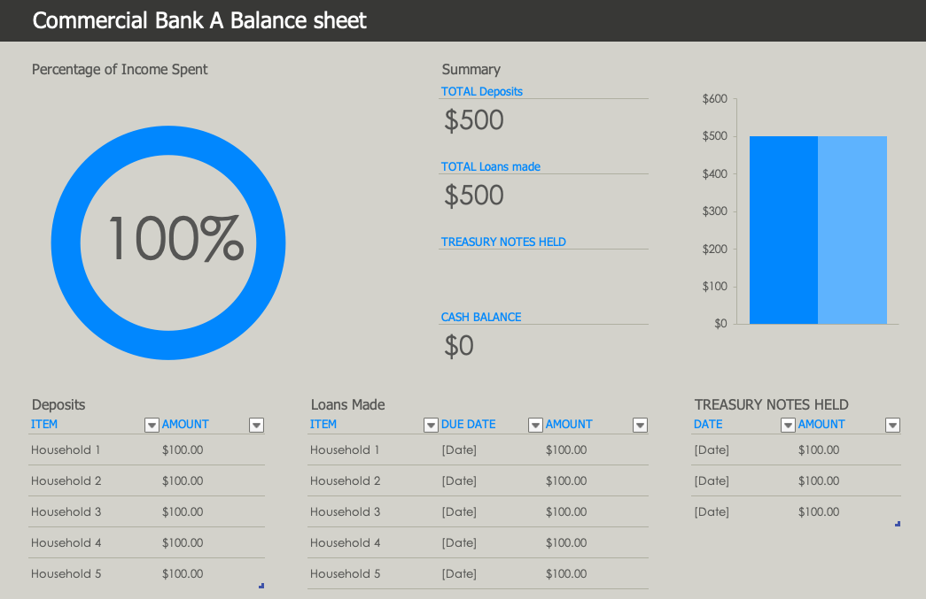
Commercial Bank Balance Balance Sheet

Slide 8
Households Balance Sheet

Slide 9
Economic Overview (Example: Group 3 2021)
 | Month 1 | Month 2 | Month 3 | Month 4 | Month 5 | Month 6
Reserve Ratio | 10% | 5% | 15% | 40% | 50% | 60%
Central Bank Base Rate | 10% | 5 | 5% | 5% | 10% | 15%
Treasury Note interest rate | 5% | 0 | 5% | 10% | 15% | 15%
Savings Ratio Ave Households | 65% | 53% | 58% | 68% | 63% | 22%
CPI % | $20 | $15 (-25%) | $20 (33%) | $20 (0%) | 25$ (20%) | $110
Output sold | 11/15 | 15/15 | 15/15 | 15/15 | 15/15 | 15/15

