Slide 1
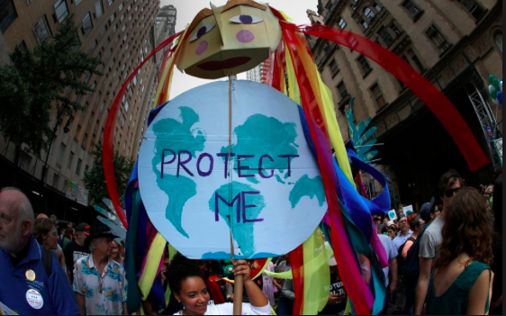
ADAPTATION AND MITIGATION STRATEGIES

Slide 2
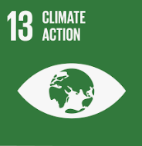
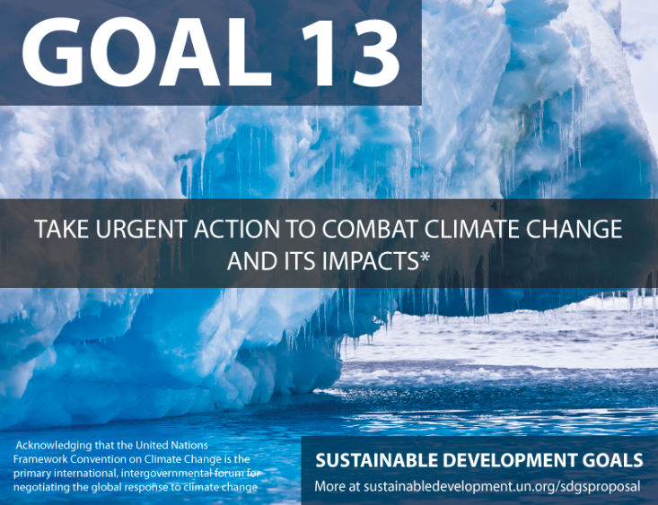
What: Climate change mitigation and adaption strategies
Why: To evaluate the different ways in which we can deal with the cause and impacts of climate change
How:
Distinguish between mitigation and adaptation
Research some different adaptation strategies
Make predictions about what life may be like in 2045

Slide 3
Mitigation Vs Adaptation
Mitigation – Reducing the effects of climate change by reducing emissions.
Adaptation – Changing our lifestyle in response to the impacts caused by climate change.
Task: Write 2 mitigation and 2 adaptation strategies for climate change in comments box.

Slide 4
Organise the following into ‘adaption’ and ‘mitigation’
Water and energy conservation
Insulate buildings
Health Programmes
Sustainable transportation, improved fuel efficiency
Renewable energy
Upgrades of buildings and infrastructure
Capture and use of landfill and digester gas
Carbon sinks and storage
Fish and shellfish
Training programmes and education
Change in land use, relocation
Energy conservation and efficiency
Green Infrastructure
Business community planning

Slide 6
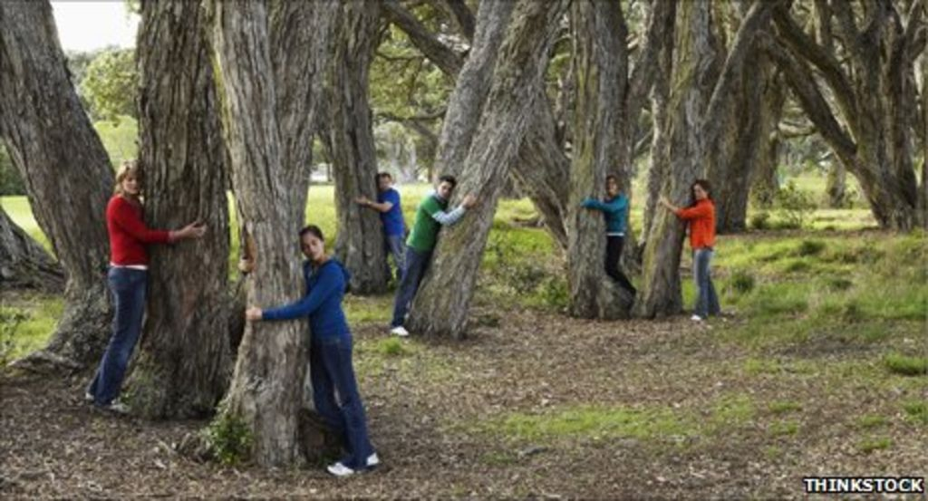
Mitigation strategy: Planting trees

Slide 7
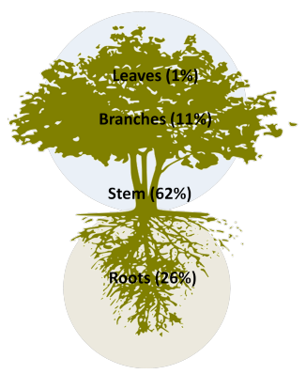
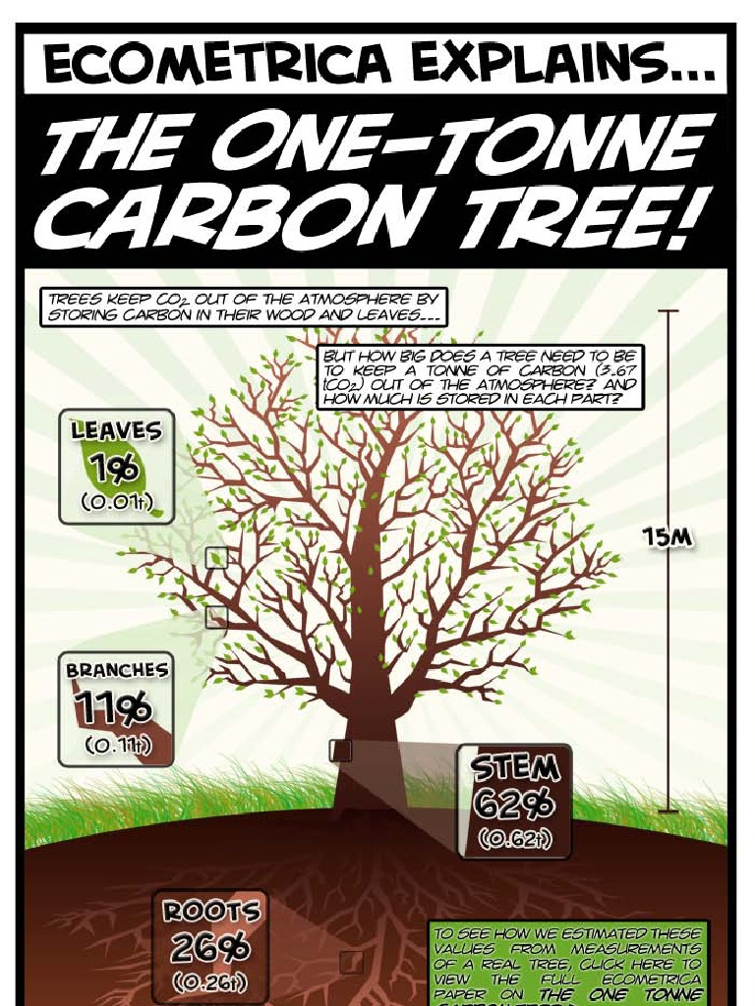
Task: Write a 100 word summary of how trees will reduce the amount of carbon in the atmosphere
Extension: How could trees also be seem as an adaption strategy?

Slide 8
What do we need to adapt?
There are 3 key adaptations that need to be made globally:
Adapting our agricultural systems to reduce water demand
Sustainably managing our water supply
Responding to sea level rise

Slide 9
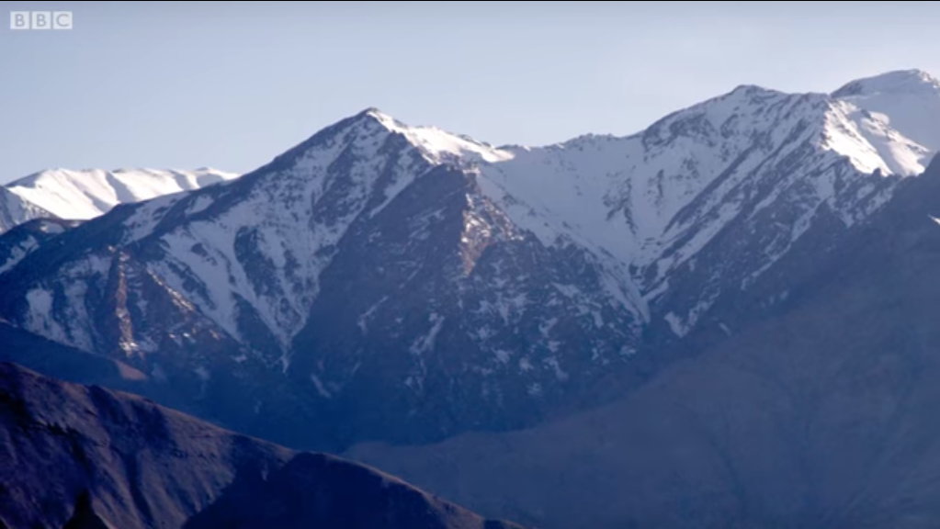
How is water supply managed in the Himalayas?
Task: Watch the following video and make notes on…
Why does water supply need to be managed in the Himalayas?
How is water supply being managed in the Himalayas?
This is an example of appropriate technology:
Appropriate technology makes use of skills and technology that are available in a local community to supply basic human needs, such as gas and electricity, water, food, and waste disposal.
Notes:
https://www.youtube.com/watch?v=kptgonELj00 (Link on picture)

Slide 10
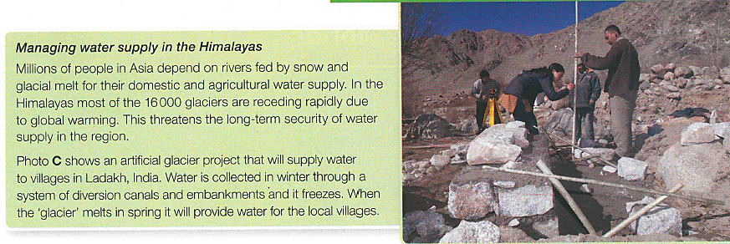
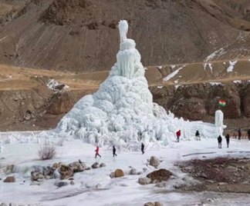
How is water supply managed in the Himalayas?
Task: How effective do you think the artificial glacier project will be? Why?
Think about:
What is the scale of the project?
What are the benefits?
What are the limitations (problems)?

Slide 11
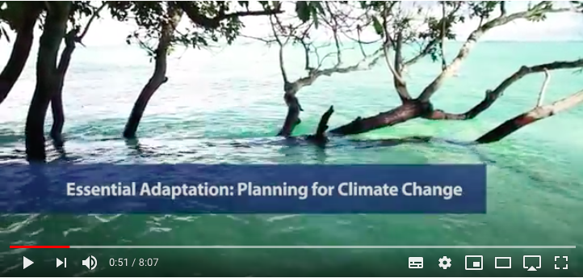
Sea level rise: Crisis in Tuvalu
Restoration of coastal mangrove forests – the tangled roots trap sediment and offer protection from storm waves.
Introduction of fish farms
Construction of sea walls – a 3m sea wall is being constructed around the capital, male with sandbags used elsewhere.
The entire population may need to be relocated to New Zealand or Australia
Watch this video for more detail:
Building houses that are raised off the ground on stilts.
Task: Choose any 2 of the above strategies.
Explain how it will help the population of Tuvalu?
Evaluate its effectiveness. How much will it help? What are the issues?

