Slide 1
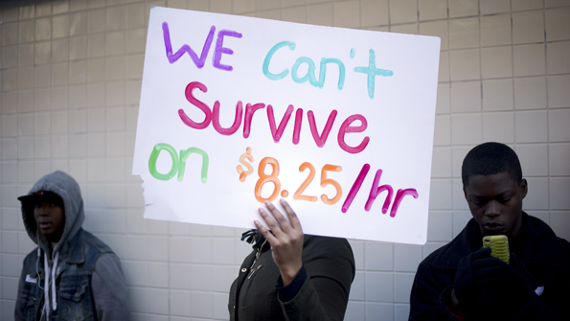
Minimum Wages

Slide 2
Conceptual Lens: Transfer and Fairness
Benefits | Conflict | Losers
Exploitation | Costs | Resistance
Winners | Difference | Fairness

Slide 3
Arguments For Minimum Wages | Arguments Against Minimum Wages
http://www.economist.com/search/gcs?ss=minimum%20wages#masthead&gsc.tab=0&gsc.q=minimum%20wages&gsc.page=1
Login: dan.bish@bishouston.org
Password: british1

Slide 4
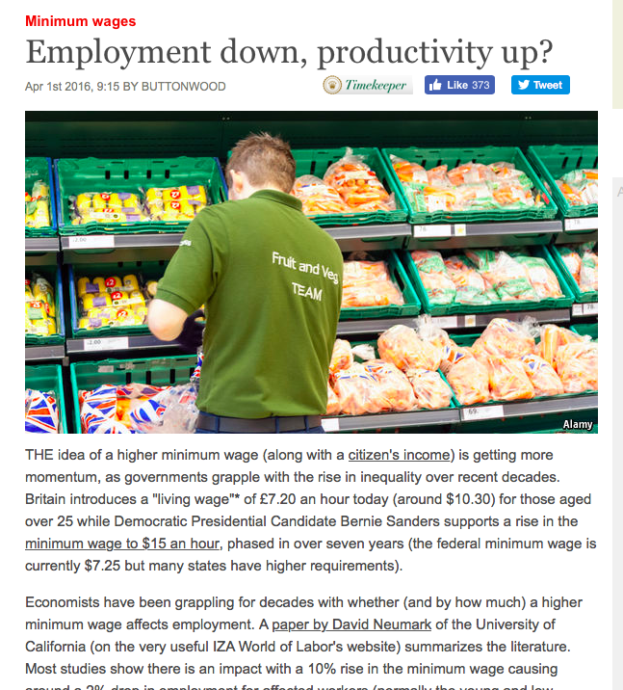
Introducing Evidence from Articles/Journals…
In the article … (Title and the source),
it describes how .... (state evidence)
This shows that…(explain how it supports your argument)

Slide 5
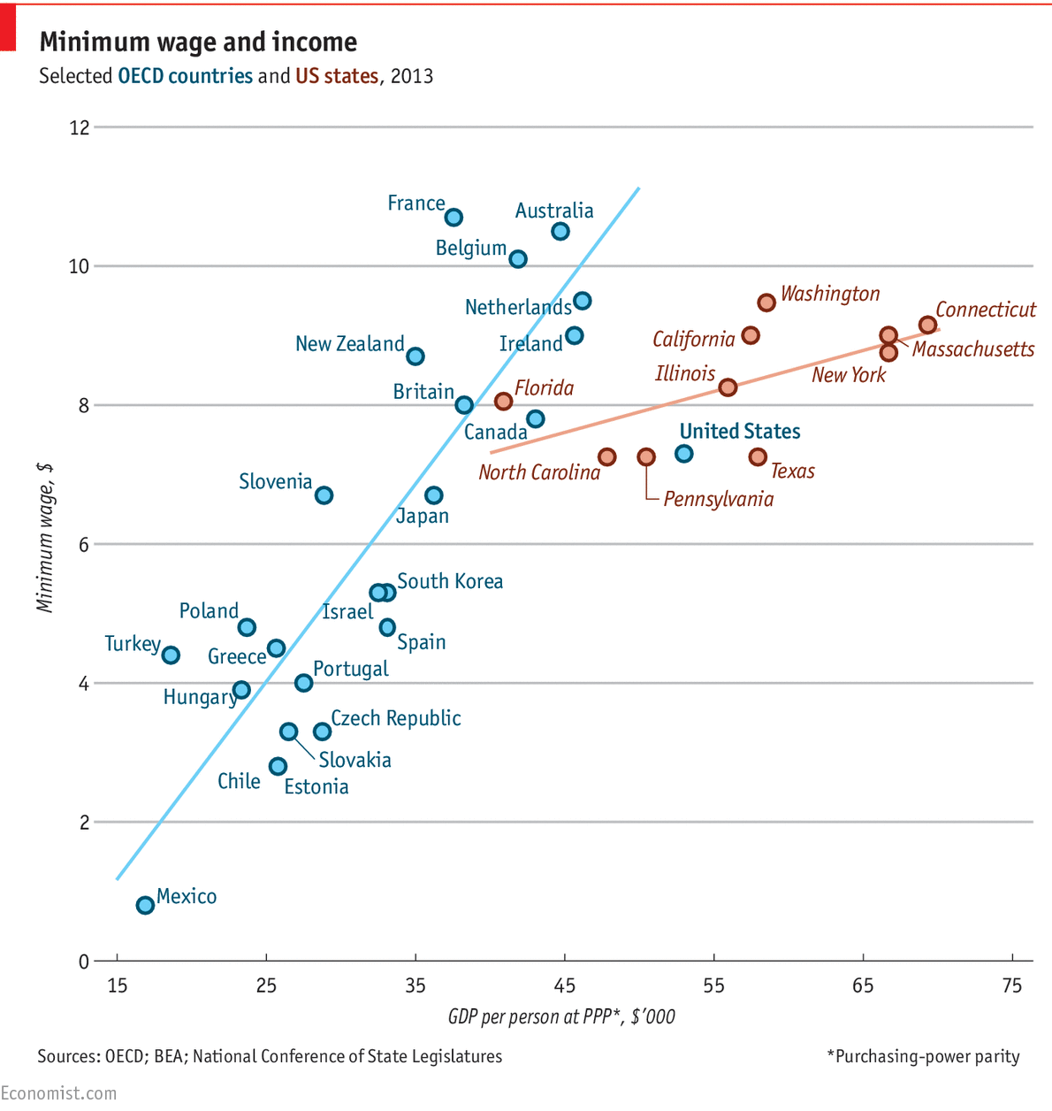
Introducing Data/Statistics…
In one study… (quote the source),
it was found that .... (state evidence)
This shows that…(explain how it supports your argument)

