Slide 1
“What are the consequences of Migration to the USA?”
Key enquiry question:
What may we need to find out to answer this question?

Slide 2
1.A nation of immigrants
What: Understanding how important migration has been and continues to be in the history of the USA
Why: To understand contemporary issues in the USA
How: Analyzing data and following several stories of migrants.
Notes:
If time allows

Slide 3
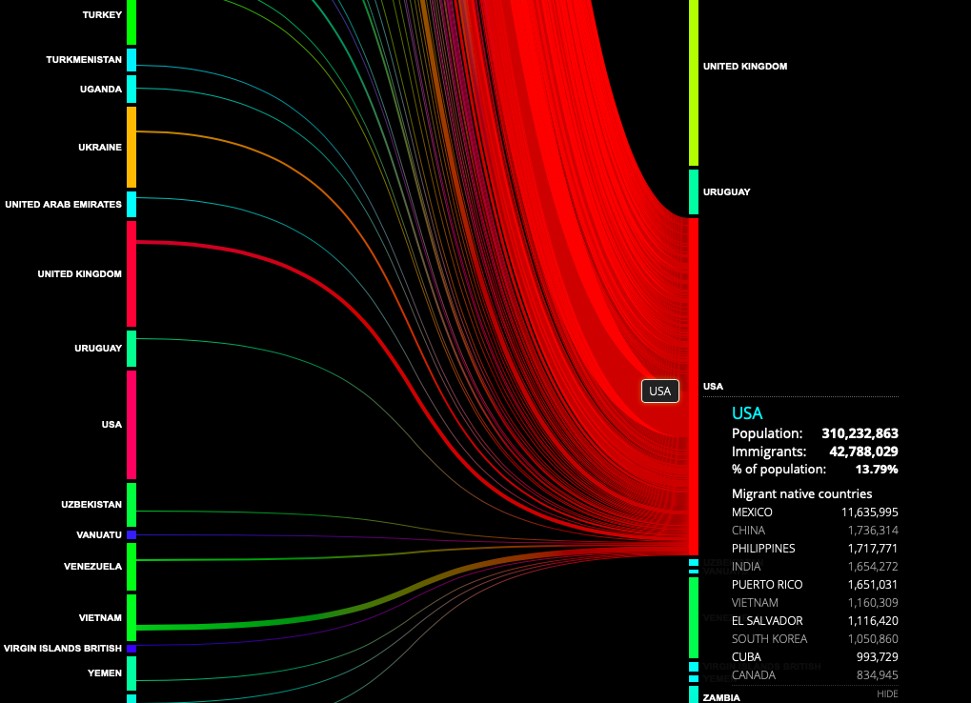
Global migration patterns
Where do people move from and to?
http://peoplemov.in/#f_DZ
Task
Click on the USA and list the top five groups of migrants who arrive there.
Why is there this pattern?
Are the countries the same as the findings we found in our class survey? Why/ why not?
Choose another country from the resource. Describe how the migration flows vary for this country and the USA. Why is the pattern the same or different?

Slide 4
What? Why? Where?
Give me your tired, your poor, Your huddled masses yearning to breathe free, The wretched refuse of your teeming shore. Send these, the homeless, tempest-tossed to me, I lift my lamp beside the golden door!
Watch the following video. How does it make you feel? Can you note down words to describe how you feel?
https://www.youtube.com/watch?v=5rredHTyKaQ
Notes:
Poem is from statute of liberty. Why is it important? What does it mean?

Slide 5
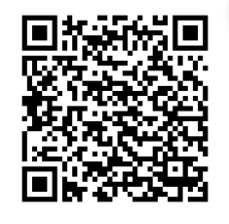
Notes:
Study and discuss all of the information then answer questions on it – QR code tasks students directly to web page to save flipping between pages

Slide 6
The journey to Ellis Island
Answer the following questions:
How many Americans are descended from immigrants from Ellis Island?
How many Americans is that in total?
How many people in total passed through Ellis Island?
How did the conditions for first and second class passengers vary?
Why was the registry room at Ellis Island upstairs?
How many questions did they ask to check their identity?

Slide 7
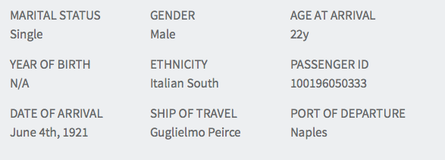
What was the journey to America like?
Notes:
Note – you can do as yourself if you want, free to register https://www.libertyellisfoundation.org/passenger

Slide 8
Immigrants to the USA
Read both of the accounts. Make a list of 5 questions you would ask each of the immigrants if you could interview them today. What do you think the answers would be?
Notes:
Read both of the accounts. Make a list of 5 questions you would ask each of the immigrants if you could interview them today. What do you think the answers would be?

Slide 9
Moving to America
You are writing your memoirs about moving to the USA. Using the information provided try to make this as accurate as possible;
Explain why you left Toritto (where is it – what do you think life was like there)
Conditions onboard the ship and what the journey was like (how long did it take?)
Explain the process of arriving at Ellis Island (use your information from the previous lessons)
What you are doing 40 years on; in 1961 (did you stay in NYC?)
You should have a historically accurate and detailed paragraph for each

Slide 10
Task 1: How has the source of migrants to the USA changed over time?
http://metrocosm.com/animated-immigration-map/
Watch the amination the whole way through.
Watch a second time and for each 10 year period use the information to complete the table
Year | Total number | Top 3 donor countries
1820-1829 | 128,502 | Ireland UK Germany

Slide 11
http://teacher.scholastic.com/activities/immigration/immigration_data/periods-and-region.htm

Slide 13
Notes:
Can answer questions in groups

Slide 14
Migration to the USA today

Slide 15
2. Push and Pull factors
What: Discovering what push and pull factors are and how they influence decisions to move
Why: To understand the reasons why people migrate.
How: Using GIS to display my findings.

Slide 16
On the post it notes list as many Push and Pull factors as you can think of.
You should have post it per note (one color for push and one color for pull).
Stick them on the world map on the country or countries you think they apply to.
They can be anywhere in the world.
Remember
Push factors are reasons why people leave
Pull factors are factors attracting people to a new destination.
Once you have completed this task, use the table on the next slide to summarize your findings.
Notes:
Can do on big world map in neighbourhood, use the window or the blank canvas wall

Slide 17
Push Factors | Pull Factors
Can you categorize these into social , economic , political and environmental ? Give an example for each – you must have at least 10 in each column!

Slide 18
Push Factors of Mexico | Pull factors of California
Low standard of living | High standard of living
High unemployment (70%) | Low unemployment (6%) – unskilled jobs available
Poor medical services – 20,000 people/doctor | Highly developed medical services – 5,000 people/doctor
Low wages ($15/week) | High wages ($150/week for a migrant)
Low standard of education – 54% children attend school | High standard of education – 97% children attend school

Slide 19
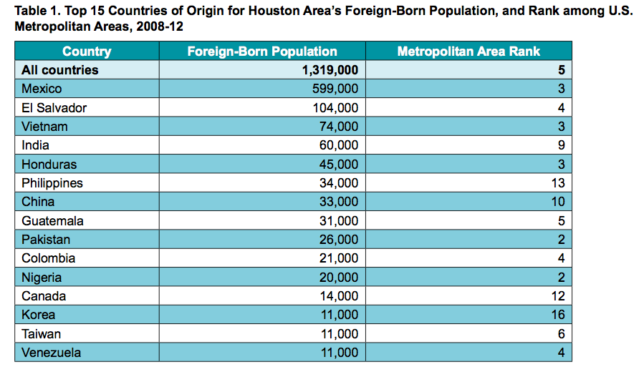

Slide 20
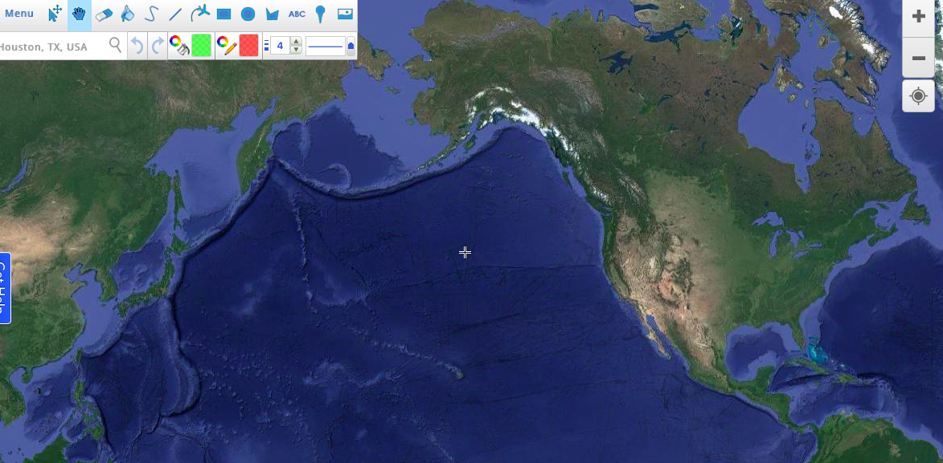
Using the information provided draw a proportional line map to show the origin of the number
of foreign born population in Houston
1. Go to scribblemaps.com
2. Zoom out so your map looks like this
3. Place a marker for the location of Houston
4. Draw lines from the country of origin to Houston. In order to
do this use the key from the table
5. Take a screen shot of your map
6. Comment on and explain the trends shown.
Number | Thickness
0-25,000 | 2
25,001-50,000 | 4
50,001-100,000 | 6
100,0001-150,000 | 8
150,000 + | 10
Notes:
You might to play around with this first. Quite user friendly

Slide 21
What are the impacts of migration on the host and donor countries?
What: The impacts migration has
on the host and donor country
Why: To appreciate and better
understand the complexities of the
issues surrounding migration
How: Developing a case study
and role playing an immigration
official.

Slide 22
Notes:
How do you think these pictures are related to migration on both the host and door country?

Slide 23
In groups of 4-5 investigate the following (with examples);
You can display this as a collaborative mind map
The positive and negative effects of migrants leaving the donor country
The positive and negative effects of migrants arriving in the host country
Think about economic, social and environmental impacts.
Notes:
Students may want to use the Mexicans to USA help sheet

Slide 24
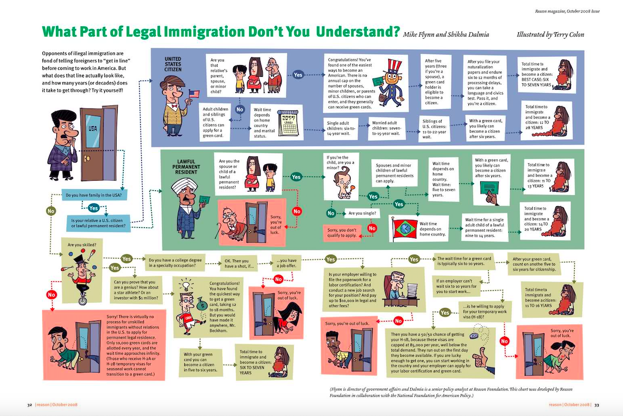

Slide 25
Who would you choose?
You work for the American Immigration Office.
You are only allowed to choose 5 people to give visas to.
You can choose 2 of those 5 that you can give a green card to.
In groups, you have 5 minutes to decide who you’re allowing in and why.
Empathy | I understand how other people are feeling. | I consider other people’s feelings. | I show empathy for others in the way I act.
Notes:
Use the infographic to help make the correct decision

Slide 26
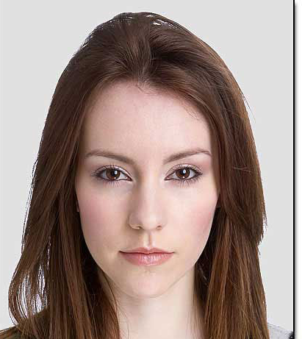
Name: John Smith
Country of birth: UK
Job: Scientist
Family: Widower, no children.
Extra: Specialises in cancer research
Name: Agneskia Janowski
Country of birth: Poland
Job: Unemployed
Family: Husband is a US Citizen.
Extra: 1st class degree in Physics
Name: Ankur Kabat
Country of birth: India
Job: Food tester
Family: wife and child (11) who live in India.
Extra: Has been offered a job for coca-cola.
Name: Henrietta Jones
Country of birth: Canada
Job: Teacher
Family: Divorced, 2 children aged 19 and 17.
Extra: Got arrested for assault in 1992.
Name: Merrion Stein
Country of birth: Germany
Job: Unemployed (obviously)
Family: Mother has a green card, Father does not.
Extra: Has no grandparents.
Name: Steven Gerrard
Country of birth: United Kingdom
Job: Athlete
Family: Wife and 2 children (5 and 2).
Extra: Has been offered a job in Los Angeles.

Slide 27
Name: Linda Li
Country of birth: France
Job: Student
Family: Parents in France, 1 brother studying in USA and 1 brother studying in UK.
Name: Maisie Broomhaugh
Country of birth: UK
Job: Singer
Family: Mother is a US Citizen
Extra: Arrested on drug charges in 2014
Name: Juan Diego
Country of birth: Spain
Job: Artist
Family: None
Extra: Wants to move to New York to paint.
Name: Santiago Alvez
Country of birth: Mexico
Job: Mechanic
Family: Wife, 4 children (all aged below 18) who live in Mexico.
Extra: Will do any work, needs the money.

Slide 28
Asylum seekers to the USA

Slide 30
What is it like for ‘TPS’ migrants in the USA?
Read the article ‘Will ginger get to stay’
Watch the video: https://www.youtube.com/watch?v=YTdHOBNW3OE
Complete the worksheet
Link to main enquiry question: What impact do these TPS migrants have on the USA?

Slide 31
Stacey Dooley Investigates
What are the push factors from Mexico?
What are the pull factors to the USA?
What are conditions like for the migrants on the journey?
What are the impacts for the USA of the migration?
What are the impacts on Mexico of the migration?
Notes:
https://www.youtube.com/watch?v=KiQdFqtZqu0
BBC3 investigation on illegal immigration from Mexico to the USA.
Students to take notes – stop to discuss

Slide 32
4. Should borders be open?
What: Should borders be open
to encourage more migration?
Why: To appreciate what can be
done to address issues surrounding
migration
How: Analysis of a range of
information from different viewpoints
leading to a debate

Slide 33
“What’s in the news?”
Notes:
Read worksheet and complete tasks

Slide 34
4. Should borders be open?
In this activity, you are going to debate the question:
‘Should borders be open?’
The class will be split into 8 different groups, and each group will be given one of the statements from an article on the BBC News website to read. The statement gives the views of the person your group will represent in the debate.
Decide whether the person agrees or disagrees with the question ‘Should borders be open?’ and pull out 3 points from the text which support their reasoning.
Nominate one person from the group to be the spokesperson. Each spokesperson should read out what their person thinks on this question.
Once each person has had a chance to speak, the question can be opened to
the floor to discuss the question. You must stay in character.
⇨What do you think? ⇨Who do you agree with? ⇨Why?

Slide 35
5. Migration murder mystery
Notes:
Fun activity lesson if time allows fun activity

Slide 36
Assessment:
“What are the consequences of Migration to the USA?”
Task: Produce a balanced report detailing the issues surrounding migration in the USA.
Your report should include:
A brief intro into the history of migration and how it has changed throughout the years.
An explanation of push and pull factors and examples, these need to be specific to Mexico and the USA.
Why people cross the border illegally
The positive and negative impacts of migration for the source and host country
Solutions to the issues which benefit all involved (think about the host and source countries).

