Slide 1
CASE STUDY OF A VOLUNTARY MIGRATION

Slide 2
Objectives:
What: The causes and impacts of population migration
Why: So that we can understand the positive and negative consequences that migration can bring
How:
Consider the reasons for a range of migration using the concept of push and pull
Study the impacts of the Mexico to USA voluntary migration case study - on both host and source country

Slide 3
Management
Positive and negative effects on host country
Positive and negative effects on source country
Causes of migration (Push/pull factors)
Location of source country:
Location of host country:

Slide 4
Case Study of Voluntary Migration – Mexico to the USA
In groups, create a presentation about one of the following:
What is the situation? What are the causes of migration? Include push and pull factors
Lukeman, Robert Crichton, Libby
What are the positive impacts of the migration for the source country (Mexico)?
Tom B, Alex, Ben, Kai
What are the negative impacts of the migration for the source country (Mexico)?
Robert Harrison, Jack, Robert Hill, Idenya
What are the positive impacts of the migration for the host country (USA)?
Juan Diego, Jennifer, Marisa, Juan
What are the negative impacts of the migration for the host country (USA)?
Diego, Caimin, Owen, Stephanie
How is Mexico to US migration managed?
Kate, Gus, Griffen, Isaac

Slide 5
CAUSES
What is the situation? What are the causes of migration? Include push and pull factors
http://www.emigration.link/push-pull-factors-mexican-migration.htm
http://www.sln.org.uk/geography/schools/blythebridge/GCSECSMigrationMexicoUSA.htm
https://geographyas.info/population/mexico-to-usa-migration/
http://www.pewresearch.org/fact-tank/2016/02/11/mexico-and-immigration-to-us/

Slide 6
POSITIVE IMPACTS FOR SOURCE
What are the positive impacts of the migration for the source country (Mexico)?
http://www.sln.org.uk/geography/schools/blythebridge/gcsecsmigrationmexicousa.htm
https://www.bbc.co.uk/education/guides/z8g334j/revision/2
http://www.bbc.com/news/world-radio-and-tv-17190679
https://geographyas.info/population/mexico-to-usa-migration/

Slide 7
NEGATIVE IMPACTS FOR SOURCE
What are the negative impacts of the migration for the source country (Mexico)?
http://www.sln.org.uk/geography/schools/blythebridge/gcsecsmigrationmexicousa.htm
https://www.bbc.co.uk/education/guides/z8g334j/revision/2
http://www.bbc.com/news/world-radio-and-tv-17190679
https://geographyas.info/population/mexico-to-usa-migration/

Slide 8
POSITIVE IMPACTS FOR HOST
What are the positive impacts of the migration for the host country (USA)?
http://www.sln.org.uk/geography/schools/blythebridge/gcsecsmigrationmexicousa.htm
http://www.bbc.com/news/world-radio-and-tv-17190679
https://geographyas.info/population/mexico-to-usa-migration/

Slide 9
NEGATIVE IMPACTS FOR HOST
What are the negative impacts of the migration for the host country (USA)?
http://www.sln.org.uk/geography/schools/blythebridge/gcsecsmigrationmexicousa.htm
http://www.bbc.com/news/world-radio-and-tv-17190679
https://geographyas.info/population/mexico-to-usa-migration/

Slide 10
MANAGEMENT
How is Mexico to US migration managed?
http://www.siue.edu/GEOGRAPHY/ONLINE/Vogeler/US-MexciodBorder.htm
https://www.nationalgeographic.org/media/tijuana-border-fence/
https://news.nationalgeographic.com/2016/03/160304-us-mexico-border-fence-wall-photos-immigration/
https://www.migrationpolicy.org/article/us-mexico-border
http://abc13.com/politics/heres-what-the-trump-border-wall-might-look-like/1953404/
https://www.nytimes.com/interactive/2017/09/05/us/politics/who-are-the-dreamers.html
https://www.nytimes.com/2016/10/26/business/economy/if-immigration-cant-be-stopped-maybe-it-can-be-managed.html
http://www.pewresearch.org/fact-tank/2016/02/11/mexico-and-immigration-to-us/

Slide 11
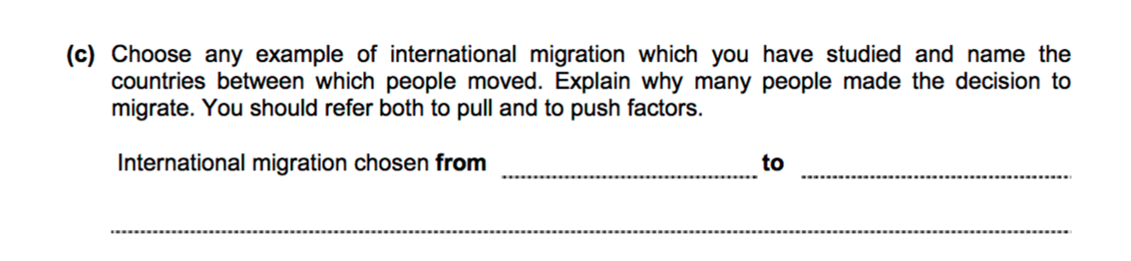
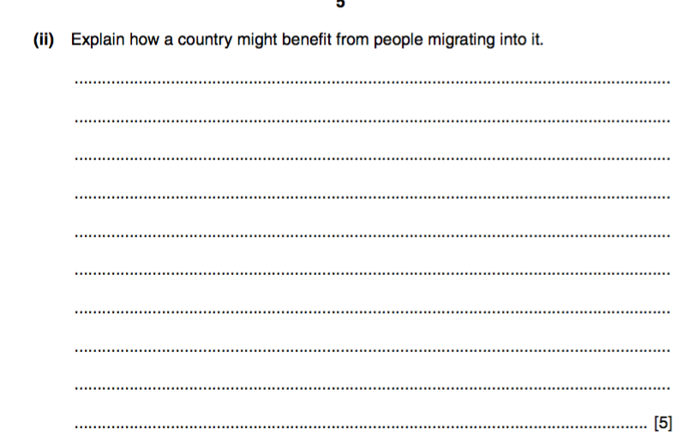
Sample exam questions

