Slide 1
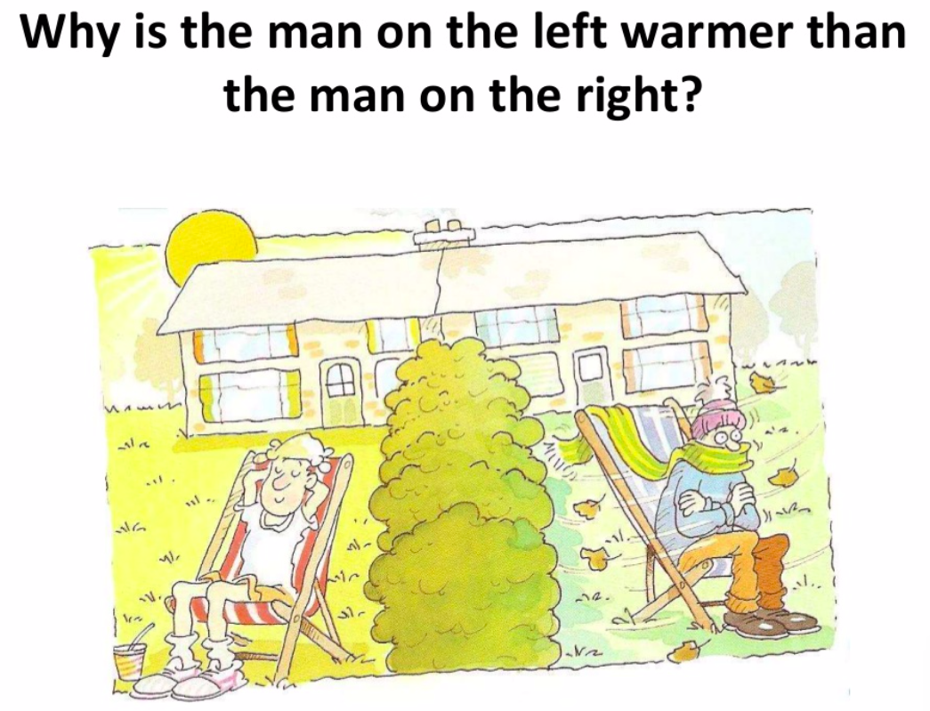

Slide 2
Microclimate
The climate of a very small or restricted area, especially when this differs from the climate of the surrounding area.

Slide 3
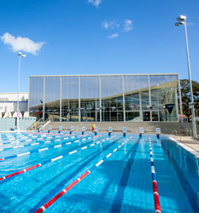
Key enquiry question: What is the best site for an outdoor swimming pool on the BISH campus?
Aim of this study: To plan and carry out a microclimate investigation to find a suitable site for the new BISH outdoor swimming pool.
Why are we doing this? To practice the skill of undertaking a fieldwork enquiry.
How you will find out information:
By finding out what microclimates are
By planning and undertaking fieldwork around the school

Slide 4
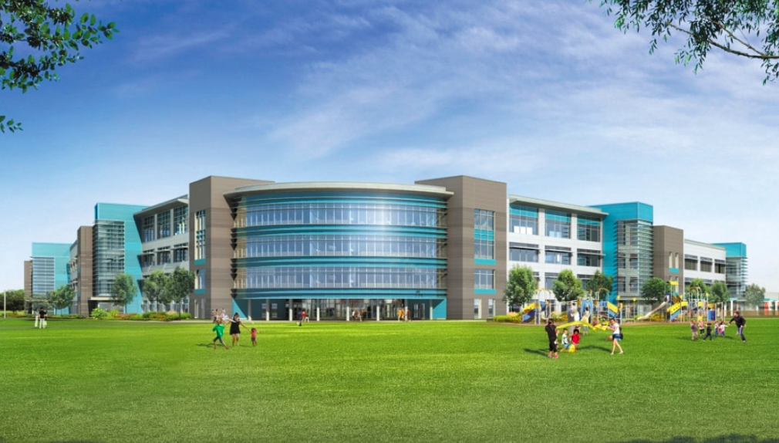
Situation 2019:
Mr Derry has agreed to allow a 25 metre outdoor pool to be installed in the school grounds. This will allow students the chance to improve their swimming skills and provide a refreshing alternative to the indoor pool. Mr Derry would like to utilize the help of Year 8 to present his ideas for the location of the pool to the Board of Directors. He has one chance to get this right and so your help is crucial.

Slide 5
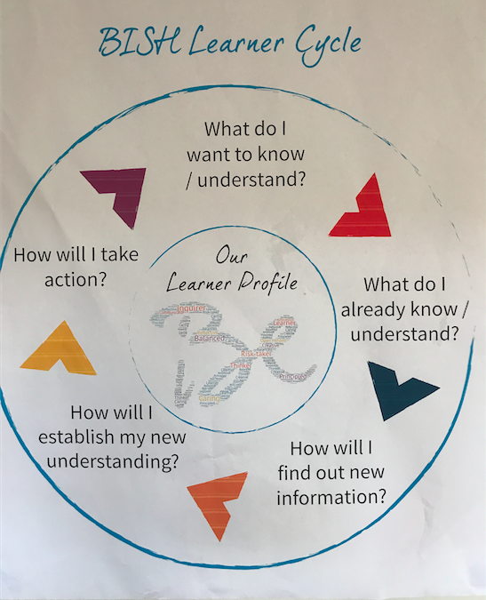
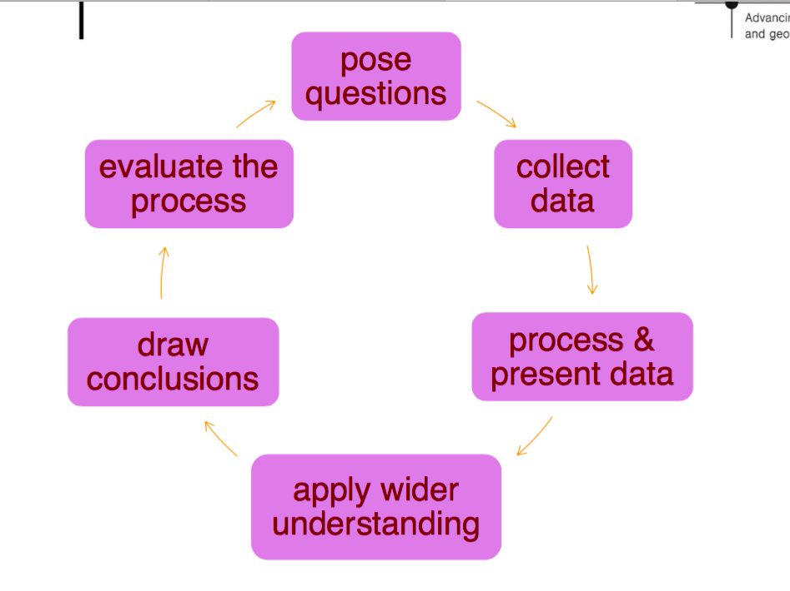
The route to enquiry
Key enquiry question: What is the best site for an outdoor swimming pool on the BISH campus?

Slide 7
What is a microclimate?
Key enquiry question: What is the best site for an outdoor swimming pool on the BISH campus?
Task: The theory/ background knowledge
What is a good definition of microclimates?
List factors that affect the local weather conditions. For each explain how it will affect it and why.
Why are microclimates important for human activity?

Slide 8
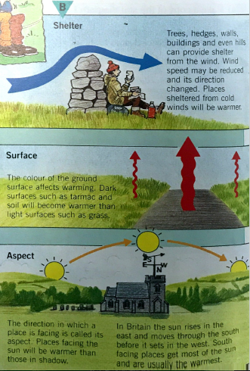

Slide 9
Key enquiry question: What is the best site for an outdoor swimming pool on the BISH campus?
Examine the context of your investigation - what factors will affect microclimate? Why would we expect to find microclimates in school?

Slide 10
Key enquiry question: What is the best site for an outdoor swimming pool on the BISH campus?
Will these conditions exist at BISH?

Slide 11
BISH Microclimate
Examine the context of your investigation - what factors will affect microclimate? Why would we expect to find microclimates in school?
Label our school building and grounds using the image above and the 'five causes' as a guideline. You will need a compass to work out the prevailing wind direction.
Prevailing Wind Information - Katy In Katy, the main prevailing wind direction is from the south (Feb-Nov). From Dec-Jan is is typically from the north. Using a compass (or Google Earth), can you add: 1. The north direction arrow 2. Both the prevailing wind direction arrows Path of the sun. The sun rises in the east and sets in the west. From your own experiences, can you label the classrooms that are particularly hot in the morning and those that are hot in the afternoon?

Slide 12
Your fieldwork research
Key enquiry question: What is the best site for an outdoor swimming pool on the BISH campus?
How you will find out information: By undertaking fieldwork around the school. The field work should include (success criteria):
A collection of weather data that might vary over a local area e.g. air temperature and wind speed and wind speed using anemometer.
A measurement of the aspect of the 4 different sites
A measurement of water temperature
Field sketches, photographs
Other possible techniques could include: questionnaires, EQS, interviews e.g. with the BISH architect (Mr. Schmidt) or Mr. Derry.

Slide 13
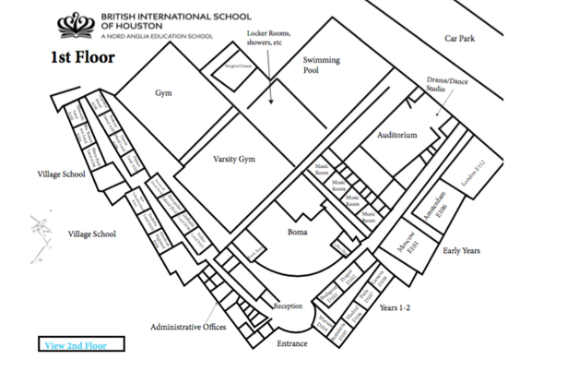
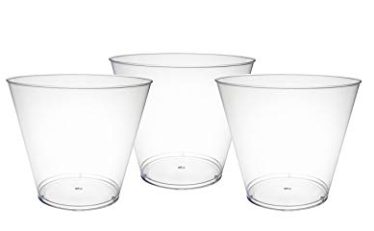
Equipment
Map- with 4 sites identified
Anemometer: measures wind speed and wind chill in addition to temperature, barometric pressure, relative and absolute humidity, and dew point.
Download: SPARKvue app to ipads to view/ download the data
Plastic cups filled with water

Slide 14
Before you start your fieldwork
Key enquiry question: What is the best site for an outdoor swimming pool on the BISH campus?

Slide 15
Before you start your fieldwork: checklist
What are your 4 sites?
When are you going to collect your data?
Can you use your anemometer?
How are you going to record your data?
How are you going to stay safe? What is your risk assessment?

