Slide 1
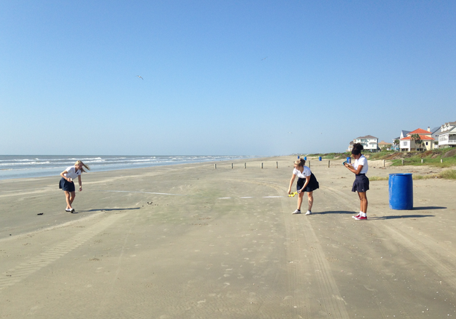
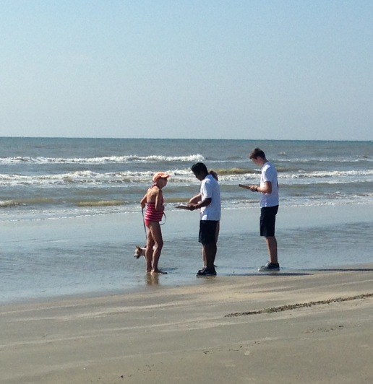
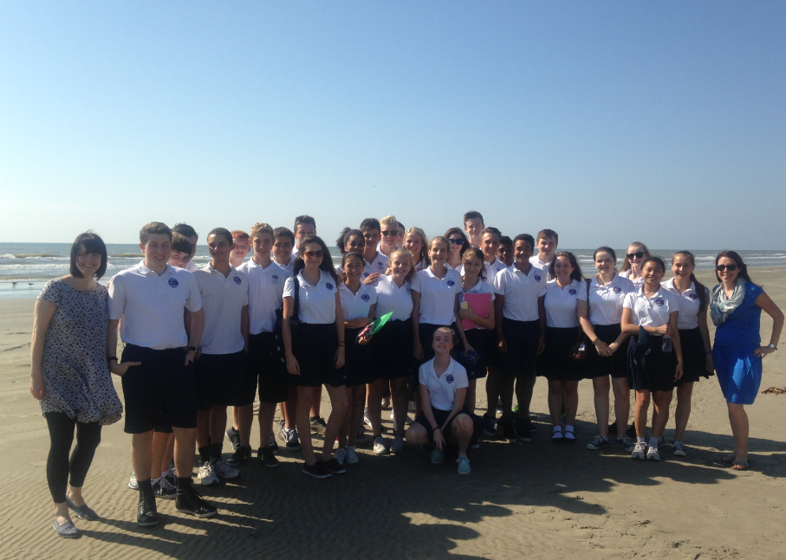
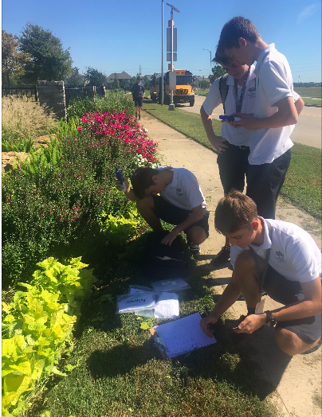
Planning data collection
Has tourism had both positive and negative environmental impacts on Seawall Boulevard in Galveston, TX?

Slide 2
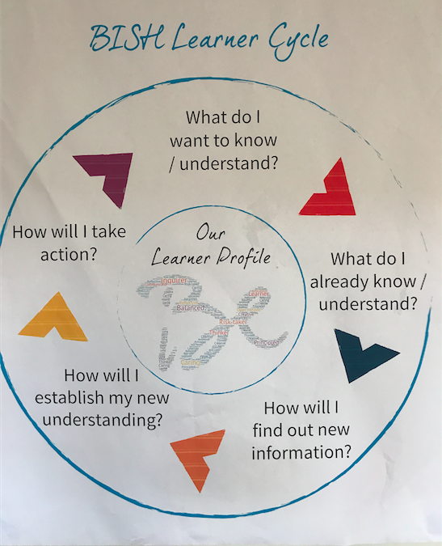
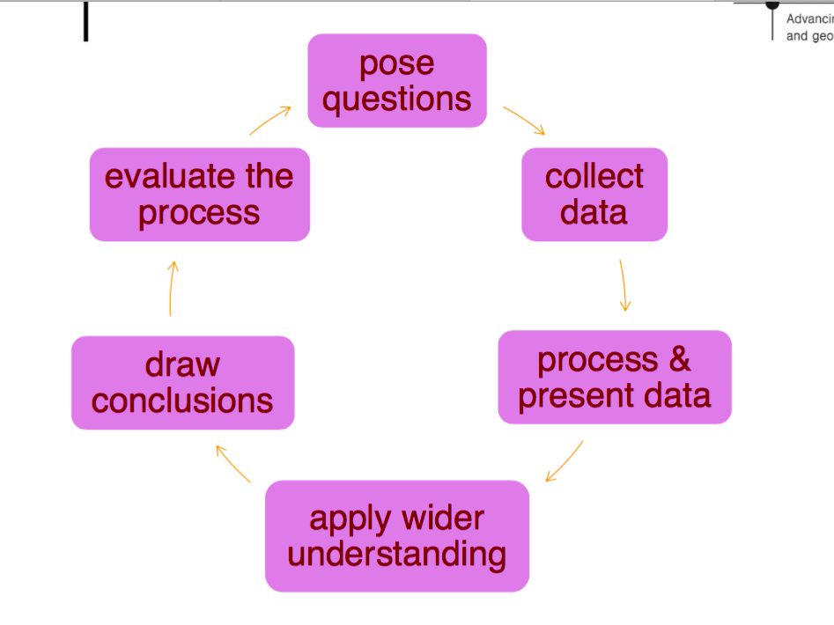
The route to enquiry

Slide 3
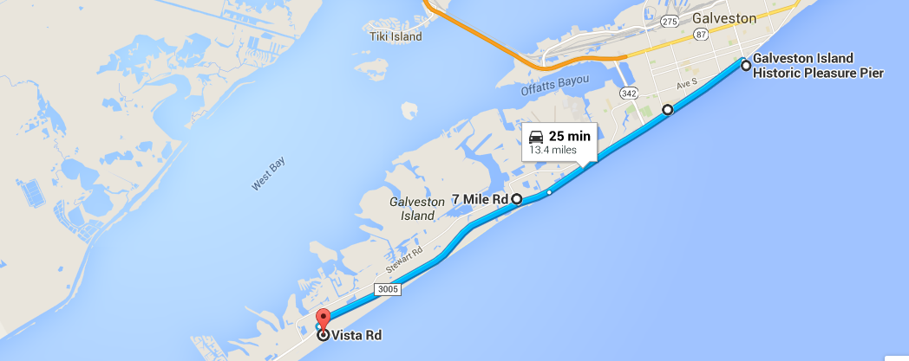
Location of study sites
Site 1: Pleasure pier
Site 2: conference Centre
Site 3: 7 Mile Road
Site 4: Galveston state park

Slide 4
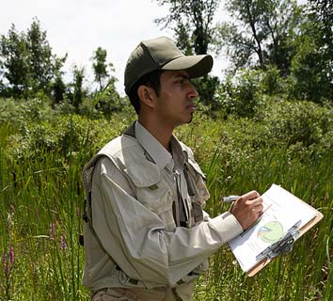
Creating a hypothesis
A hypothesis is an idea which can be investigated and found to be true or false.
Research is the way geographers gather information to prove or disprove a hypothesis or a set of hypotheses.
Example hypotheses:
A river gets wider as you move downstream.
The school building produces its own microclimate.
Land use in the town centre is mostly commercial.
What data could you collect to prove or disprove each hypothesis?
Notes:
Teacher’s notes: Possible data to collect for each hypothesis could include:
1. The river gets wider as you move downstream. Taking measurements of the width of a stream at various points from the source to the mouth.
2. Most people visiting a site of special scientific interest travelled there by car. Asking a sample of visitors to the site how they arrived there. Groups could be positioned at major entry points to the site.
3. Pedestrian numbers vary with the time of day. Counting the number of pedestrians passing a number of fixed points at three different times during a day.
Photo credit: ©2008 JupiterImages Corporation

Slide 5
Types of data- primary and secondary
Primary data may be defined as: data collected that are original and collected for the first time, eg fieldwork data.
Secondary data may be defined as: data collected by using already available sources, eg published materials.

Slide 6
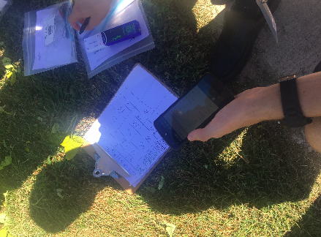
Discuss in a group….
What ideas for primary data do you have
How would these be carried out?
How would this help us test our question?
What equipment would be needed?
Are there any limitations to this method?
Is there any secondary data collection that could be done?

Slide 7
Mrs Bennett’s ideas
Primary
Secondary
Land use survey
Amenities survey
Photos
Questionnaire
Car park survey- where have cars come from
People count
Basket of goods
Shopping quality survey
Environmental quality survey
Walk score
Accessibility

Slide 8
Primary data collection sample surveys

Slide 9
Annotated photos Fig 3.8 Annotated photo to show leisure and environmental quality in site 7, West Gray shopping centre
Palm trees and landscaping planted to try and improve environmental quality
Range of leisure facilities such as shops, restaurants and cinema
High order, exclusive shops for wealth residential population
Large amounts of free parking in front of shops for convenience
Bike rack to improve accessibility

Slide 10
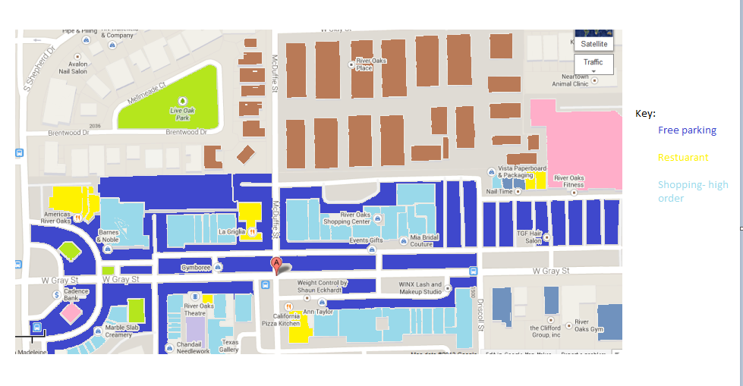
Land use mapping
Use a key:
The key could be split into different types of land-use e.g.
residential
parkland
parking
derelict land
High order goods
Low order goods
Restaurants
lesiure
promenade

Slide 13
Writing a questionnaire
yes or no answers
Closed (categories)- possibly a few open questions
not too many questions
easy to read lay out
Able to collect all answers on one sheet
Need information on:
Where people have travelled from
What type of good are they buying?

Slide 14
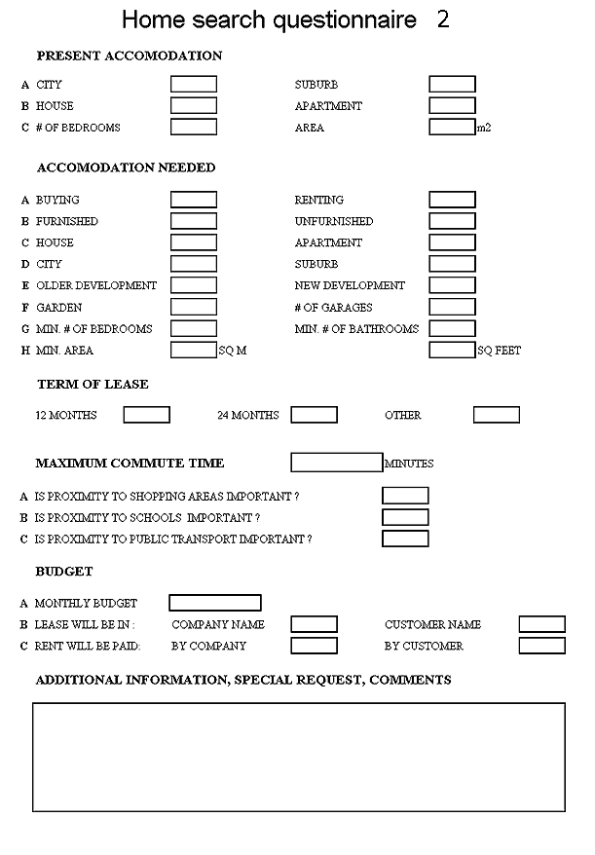
Clear set out
Boxes to tick or cross
Headings in bold to make it clear
Large title

Slide 15
To much writing to fill in.
Will take too long and people won’t want to fill it in.
To much information to read in the introduction
Not obvious what questions are asking

Slide 16
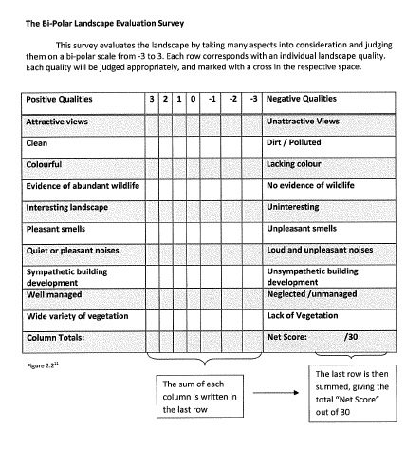

Slide 17
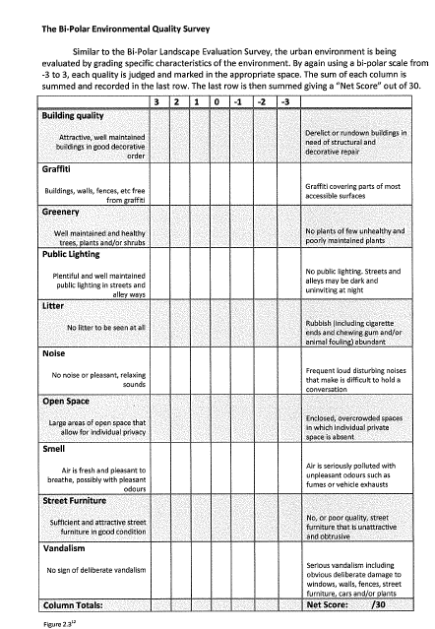

Slide 18
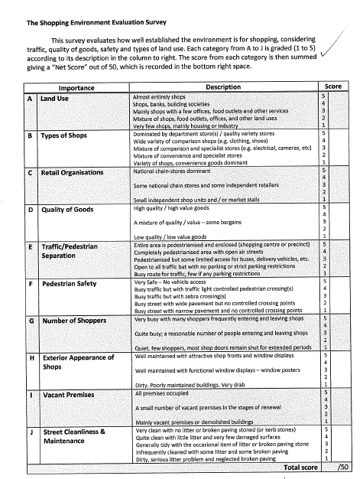

Slide 19
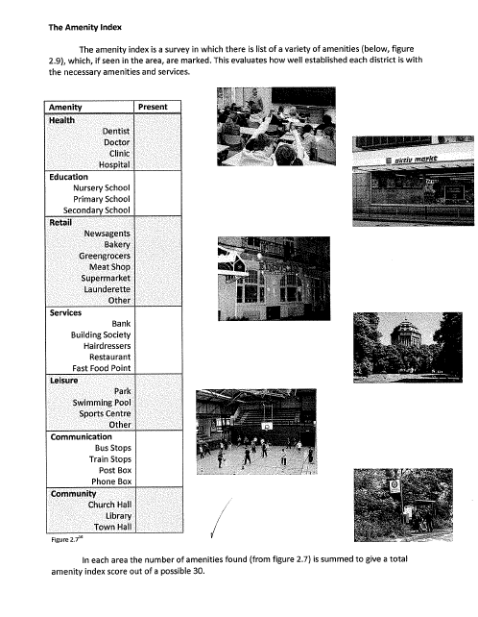

Slide 20
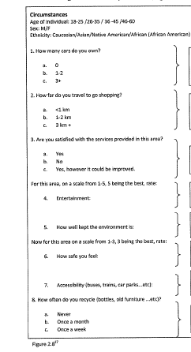

Slide 21
Basket of goods survey
Goods: | Stop 1: | Stop 2: | Stop 3: | Stop 4: | Stop 5: | Stop 6: | Stop 7:
500ml bottle of water | $0.59 | $2.15 | $1.97 | $1.49 | $1.59 | $1.69 | $1.99
500ml bottle of Coke | $0.89 | $2.17 | $1.74 | $1.69 | $1.79 | $1.69 | $2.79
Packet of Crisps | $5.29 | $1.50 | $1.49 | $1.49 | $1.09 | $1.49 | $3.49
2 pack of sandwiches | $4.39 | $5.79 |  | $2.69 |  | $2.79 | $4.99
Trident layers gum |  |  | $1.57 | $1.49 | $1.59 | $1.59
Hershey’s milk chocolate | $1.69 | $5.00 | $2.17 | $1.69 | $2.79 | $0.89
Bottle of suncream |  |  | $12.99 |  | $11.49 | $9.49 | $12.99

Slide 22
Do now
Decide which data collection method you would like to collect on September 13th
Design an effective way of collecting this data

