Slide 1
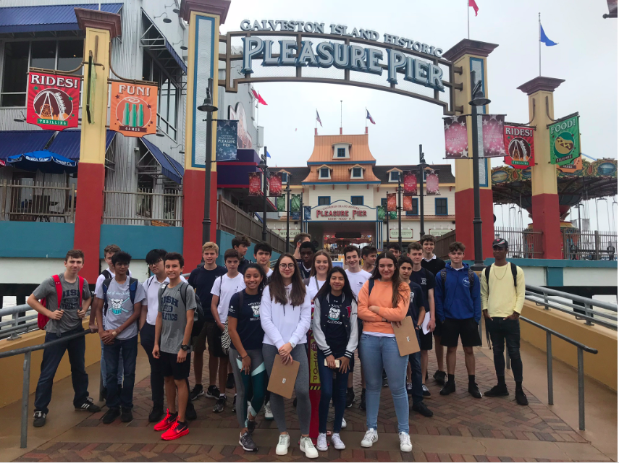
Galveston fieldwork method
LO: to learn how to write up our controlled assessment method

Slide 2
Markscheme

Slide 3
Method needs to include….
Sampling Method - how and why ?
(Line intercept sampling : 11 mile transect along coastline with sites roughly every 2.5 miles)
Group work- why?
Clearly explain how the data was actually collected- include annotated data collections tables etc
Use of GIS in planning- how was it used and how was this beneficial?
Show links to hypothesis- justify methods
Secondary data collected

Slide 4
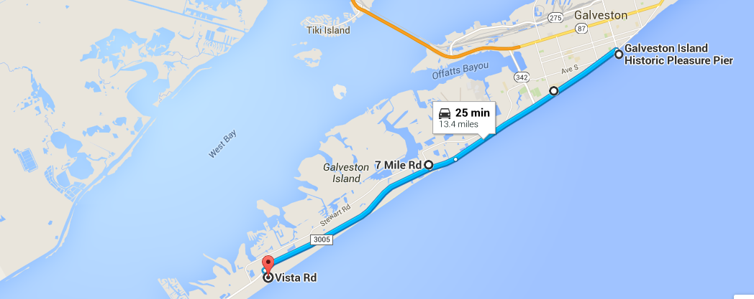
Location of study sites
Site 1: Pleasure pier
Site 2: conference Centre
Site 3: 7 Dellanera RV park
Site 4: Galveston State park

Slide 5
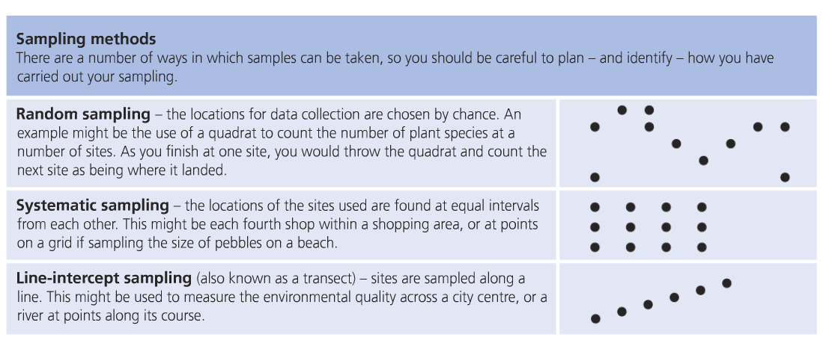
Sampling (which did you use and why?)

Slide 6
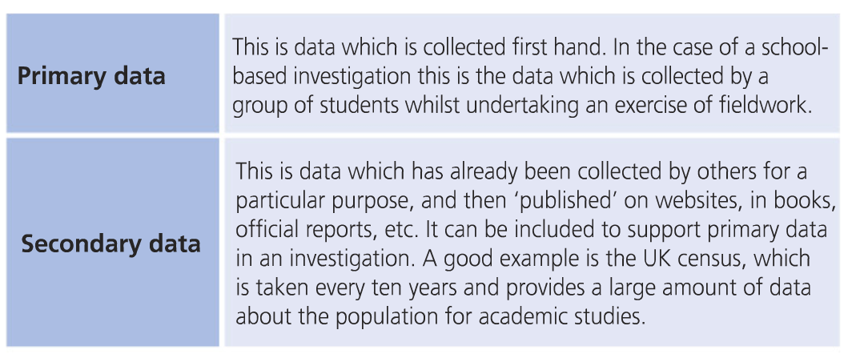

Slide 7
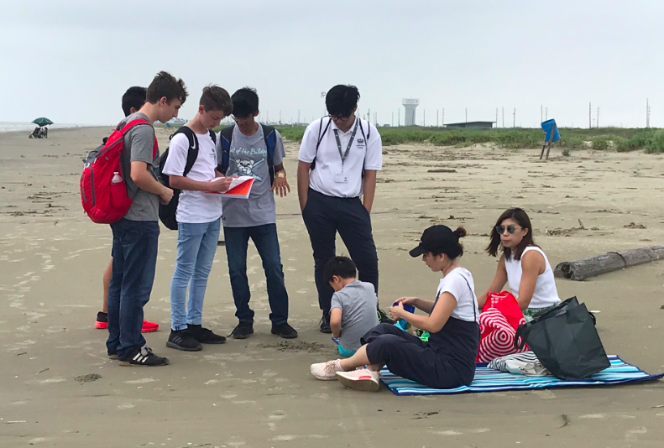
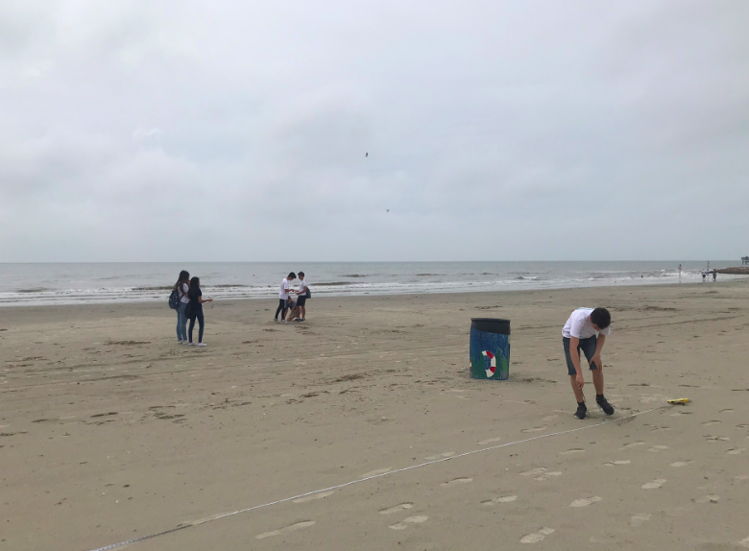
You need to write up how each data collection you will use was collected……
Fully explain methods :-
How was it carried out
Why was it selected
Justify why it was done this way- link to hypothesis

Slide 8
Example of some work…..

Slide 9
Homework
Write a draft method including….
Sampling Method - how and why ?
(Line intercept sampling : 11 mile transect along coastline with sites roughly every 2.5 miles). You should include a map of the sites (or refer to one from introduction)
Group work- why and which part of the work were you responsible for
Clearly explain how the data was actually collected- include annotated data collections tables etc
Use of GIS in planning- how was it used and how was this beneficial?
Show links to hypothesis- justify methods
Secondary data collected

