Slide 1
The growth of megacities
What: Causes and consequences of the growth of megacities
Why: To understand the issues surrounding the current and future sustainability of life in cities
How: Develop a megacity case study – example Mumbai, India

Slide 2
IB Objectives
Factors affecting the pattern of urban economic activities (retail, commercial, industrial), including physical factors, land values, proximity to a central business district (CBD) and planning
The incidence of poverty, deprivation and informal activity (housing and industry) in urban areas at varying stages of development
Urbanization, natural increase and centripetal population movements, including rural–urban migration in industrializing cities, and inner city gentrification in post- industrial cities
Centrifugal population movements, including suburbanization and counter- urbanization

Slide 3
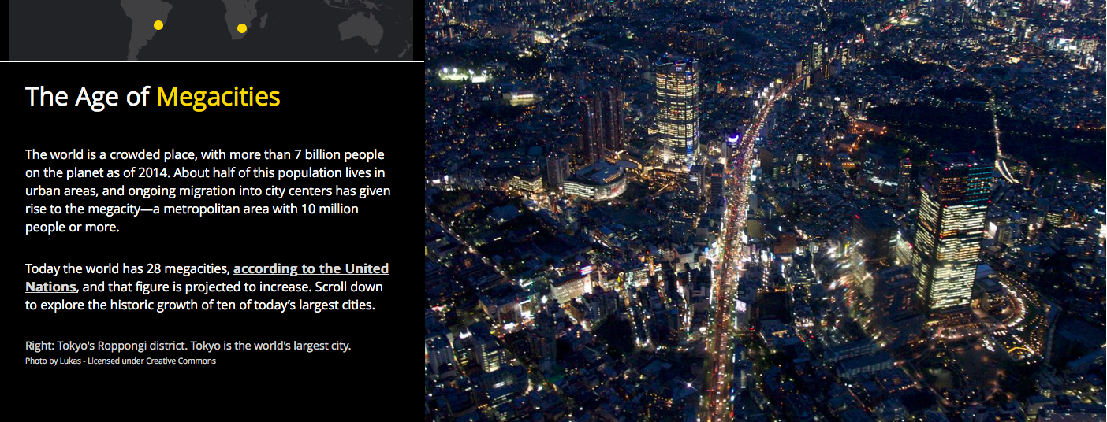
Megacities
Spend a little time exploring the Esri Story Map.
Pay particular attention to the increase in size of spread of the megacities in the study.

Slide 4
Watch the video and take notes of the global patterns and trends associated with historical and future growth of megacities globally. Don't forget to make sure you know the reasons for growth.

Slide 5
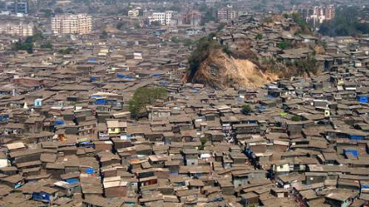
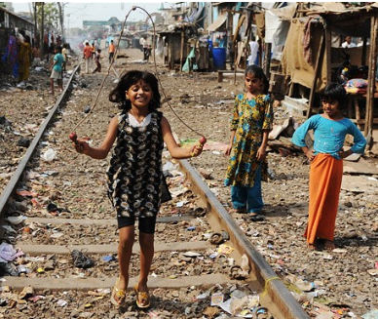
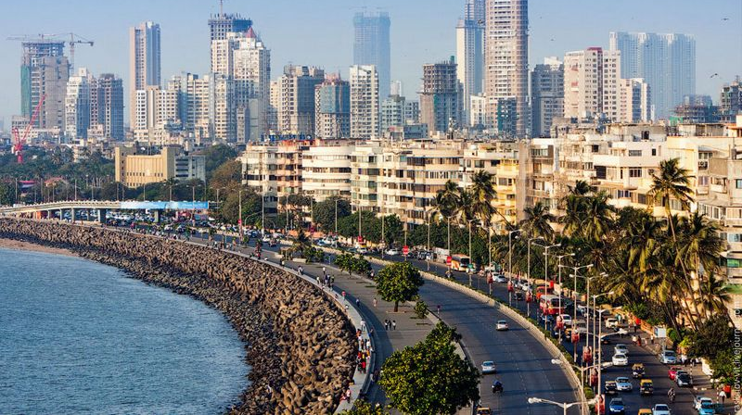
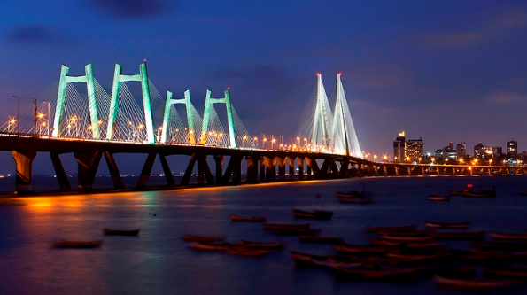
Mumbai – a mega city

Slide 6
Mumbai megacity case study: what do you know?
Case Study - need to know:
Background information (e.g. location, history etc)
Reasons for growth (including natural increase and inward migration)
Patterns of growth e.g. urbanization, suburbanization and counter-urbanisation
Consequences of growth (positives and negatives/use SEEP)
Work – informal and formal sector of the economy – including features and location
Urban Redevelopment – what are the plans? Is it sustainable?

Slide 7
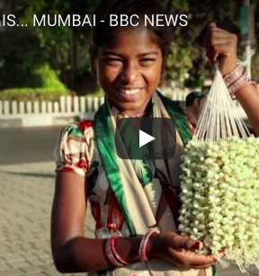
Watch the video to get an idea of why the city has grown so quickly (note link to colonisation by the Portuguese) as well as modern day functions of industry, commerce and Bollywood.
Megacity Case Study: Mumbai India

Slide 8
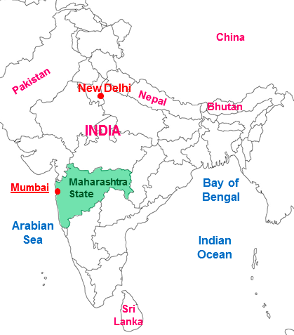
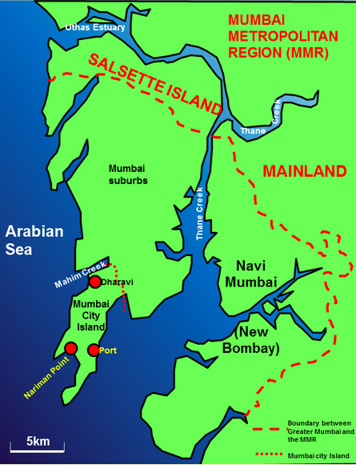
Mumbai is a megacity and a World city, it has grown enormously since the 1950’s and gives a great case study of urbanization and its issues within a developing country.
Where is Mumbai located?

Slide 9
Mumbai’s location
Mumbai is located on a peninsular on the Western coast of Maharashtra state in western India, bordering the Arabian Sea.
It is a thriving megacity that has had an economic boom in recent years.

Slide 10
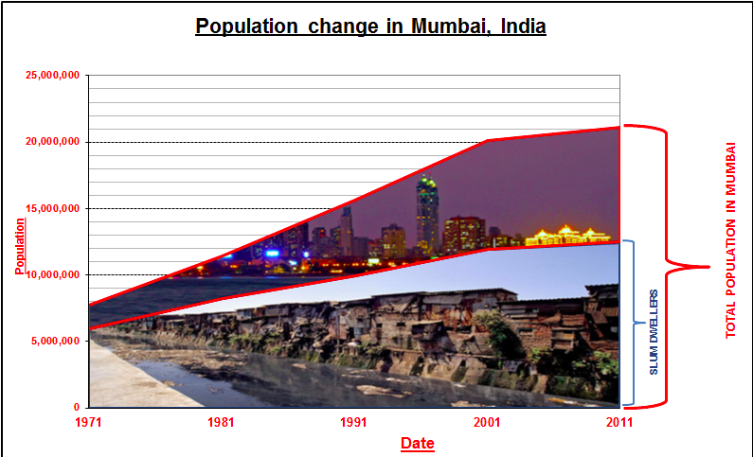
Describe Mumbai’s population growth
Use this website to learn more about Mumbai’s growth:
http://worldpopulationreview.com/world-cities/mumbai-population/
How and why has Mumbai grown?
What challenges does it face?

Slide 11
Since 1971, the graph shows the inexorable rise in the population of Mumbai, from 8 million in 1971 to 21 million today.
The other significant factor to note is that slum dwellers make up an ever increasing proportion of the population, creating numerous problems for people and planners.

Slide 12
Mumbai’s slums/informal economy
SEEP = Social, economic, environmental and political consequences
Watch the documentary "Slumming It" showing life in Mumbai's largest slum (Dharavi).
What can you learn about life in slums (categorize your findings using SEEP)?
Describe and explain the pattern of informal activity in the city of Mumbai
Homework: Watch Part 2 of the documentary

Slide 13
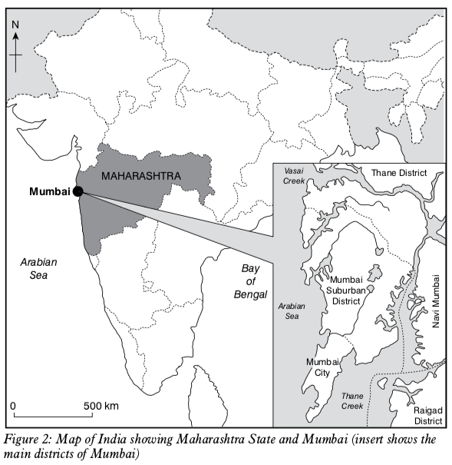
Open up GeoFile 696* (September 2013) - Mumbai: Case Study of a Megacity - use the geofile to add to your case study notes.

Slide 14
Urban trends – including urbanisation, suburbanisation and counter-urbanisation

Slide 15
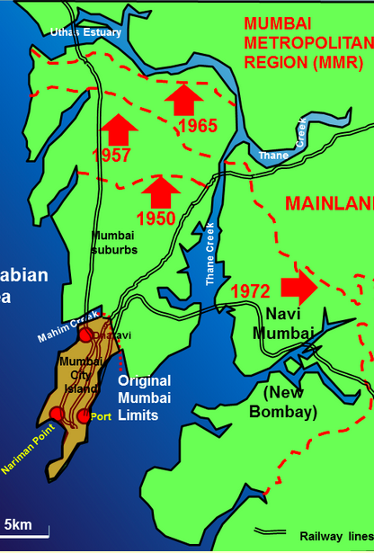
Suburbanisation in Mumbai (centrifugal movement)
Mumbai now has a long history of suburbanization.
Mumbai initially grew in a Northwards direction along major transport routes such as roads and rail links, and has now also expanded in an easterly direction.
This suburbanisation has involved not just the growth of residential areas but also the relocation and growth of new industrial areas.
As with other major cities, other towns and villages have been swallowed up by Mumbai in the process of suburbanisation. In the last decade, Thane, Vashi and Belapur have become extended suburbs despite being planned as individual towns.

Slide 16
Consequences of suburbanisation
People are economically segregated into those that can afford better housing and those that cannot, rather than historical caste, religious or linguistic segregations
Less than a third of the population of Mumbai lives in the `island' city.
The centre of density of population has shifted from the island city well into suburban Salsette.
The commuter traffic has changed. Rather than being just one way into the Central Business District (CBD) in the south of the city in the mornings there is an increasing movement of people in the opposite direction. Increasing industrialisation of the suburbs is increasing this movement.

Slide 17
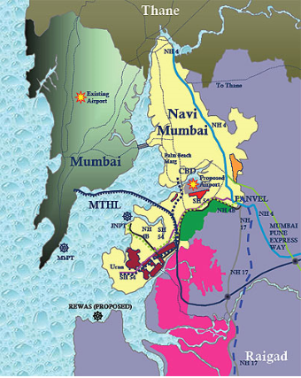
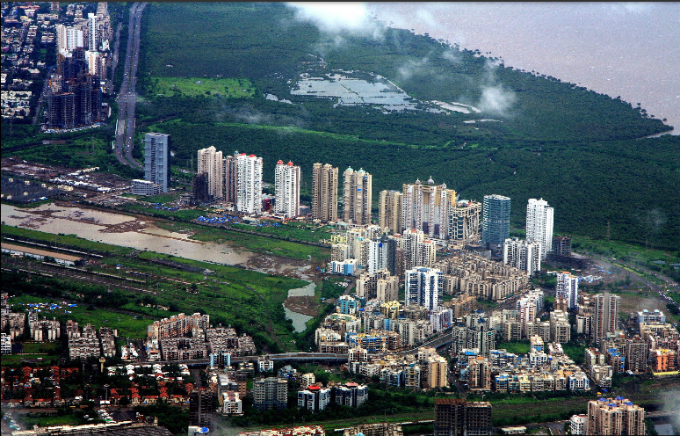
Navi Mumbai: a new town
https://www.youtube.com/watch?v=YH-STykTgC4

Slide 18
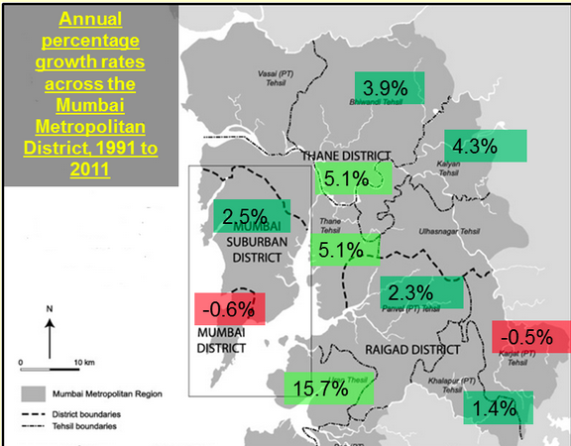
Counter-urbanisation in Mumbai (centrifugal movement)
The map shows that some of the population of Mumbai is also counterurbanising, with a decline in population over a 20 year period within the original heart of the city in Mumbai district.
The largest growth is in those districts directly to the East of Salsette Island, and even districts 50 or more kilometres from Mumbai are growing.
One such phenomenon fuelling this growth is that of planned towns (new towns in the UK.
Navi Mumbai is a planned township directly to the East of Mumbai and was designated in 1972. It is the largest new town in the world.
The town was developed to reduce congestion and population densities in Mumbai, which itself was restricted by its physical geography.
The new town now has a population of 1,111,000 people, is linked to Mumbai by road and rail bridges and an international airport.
It also has an extensive bus network, an international airport and many IT and software firms in areas such as the International Infotech Park at Vashi and the New Millennium City near Mahape.

Slide 19
The location of Mumbai’s economic activity
Fill in the table to describe the locations of Mumbai’s economic activities and the reasons for the locations
Type of activity/ example | Formal or informal? | Details | Location(s) | Reason for location
https://www.marieclaire.com/culture/g20993287/bollywood-movies-2018/

Slide 20
How could we answer this essay question?
Referring to examples, compare the patterns formal and informal economic activities in urban areas (10)
-Use the IB essay writing guide to help you plan out this response

Slide 21
Now that we have looked at the case study…
Debate: “To the local population, megacities have more advantages than disadvantages.” Discuss this statement.

Slide 22
Debate Resources
Mumbai case study notes and geofile
https://www.iol.co.za/news/south-africa/the-pros-and-cons-of-mega-cities-281152
https://longitudes.ups.com/megacities-provide-new-benefits-to-humanity-and-pose-unique-challenges/
https://futurism.com/how-to-ensure-smart-cities-benefit-us-all/
https://www.theguardian.com/cities/2016/jul/12/urban-sprawl-how-cities-grow-change-sustainability-urban-age
https://www.telegraph.co.uk/men/thinking-man/11406410/Is-it-really-better-for-your-career-if-you-work-in-London.html
https://www.theguardian.com/commentisfree/2017/mar/13/warning-living-city-seriously-damage-health
https://www.theguardian.com/cities/2014/aug/19/an-urbanists-guide-to-dhaka-an-unplanned-urban-sprawl
https://www.bbc.co.uk/news/world-africa-18870511
https://business.inquirer.net/172201/rapid-urbanization-threatens-overcrowded-cities-like-manila

