Slide 1
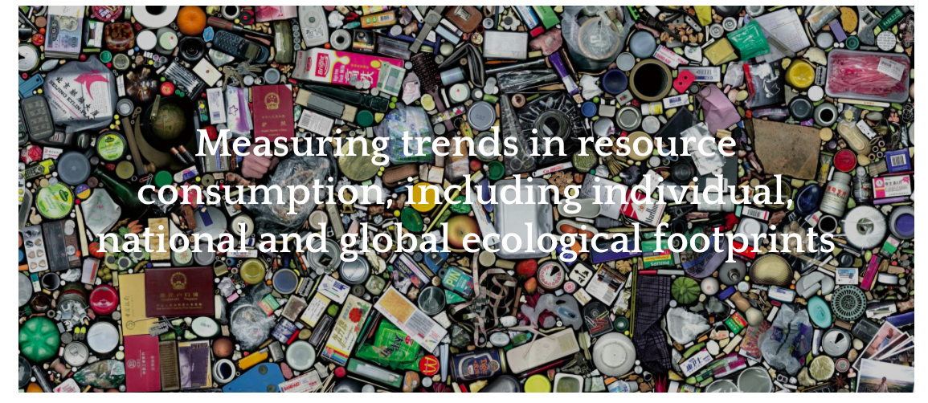
Subject Guide
​Measuring trends in resource consumption, including individual, national and global ecological footprints

Slide 3
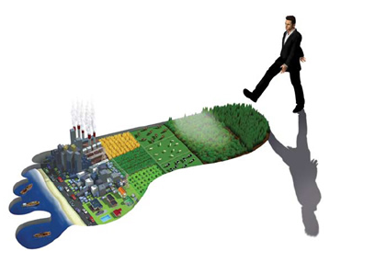
Ecological Footprint: IB definition
The theoretical measurement of the amount of land and water a population requires to produce the resources it consumes (1 mark) and to absorb its waste, under prevailing technology (1 mark).
https://www.youtube.com/watch?time_continue=5&v=fACkb2u1ULY

Slide 4
Components of the Ecological Footprint (six human activities that require space)
Growing Crops (arable land)
Grazing Animals (pasture land)
Harvesting Timber (forests)
Catching Fish (oceans)
Accommodating Infrastructure (housing, transportation systems, industry, built up land…)
Carbon footprint: Absorbing Carbon Dioxide Emissions (burning fossil fuels)

Slide 5
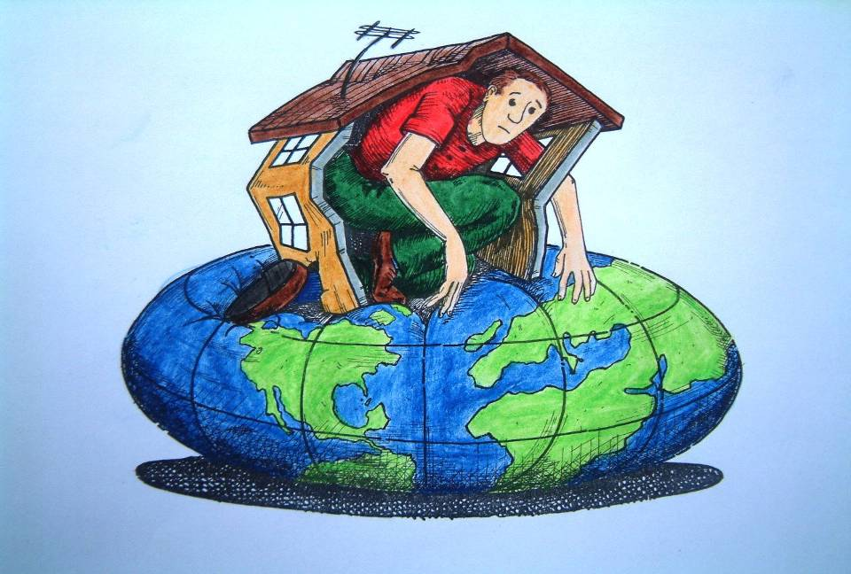
House
Are we getting too big for our house?
Notes:
Eco-footprint helps us to understand that the impact of the human population on the planet is becoming increasingly large, or as the cartoon shows we are getting bigger and the planet is getting smaller! We are getting too big for our own house.
Question for students
Identify places on a world map where there is minimal evidence of human occupation? These are hard to find – some answers might include parts of Antarctica, the Arctic but even these most inhospitable parts of the globe have some human occupation.

Slide 6
Key terms
Global Hectare: The measurement of biocapacity and ecological footprint. There were 12 billion hectares of biologically productive land and water on Earth in 2013. Dividing by the number of people alive in that year (7 billion) gives 1.72 global hectares per person.
Ecological Debtor: Country's whole ecological footprint is higher than their biocapacity.
Ecological Creditor: Country's whose ecological footprint is lower than their biocapacity.
Biocapacity: is the capacity of an area to provide resources and absorb wastes. When the area's ecological footprint exceeds its biocapacity, an ecological deficit occurs.

Slide 7
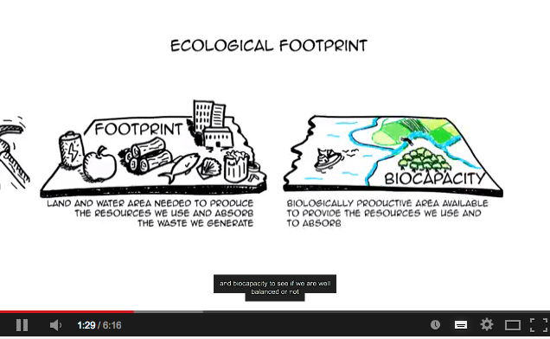
What does our ecological footprint mean?
https://www.youtube.com/watch?v=g_aguo7V0Q4

Slide 8
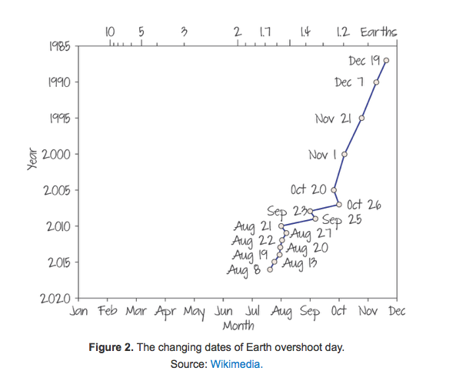
Ecological Overshoot
In the mid 1980s humankind’s ecological footprint had reached Earth’s biocapacity.
Since then humanity has been in ecological overshoot, with annual demand on resources each year exceeding the Earth’s regenerative capacity.
Figure 2 shows how ‘Earth Overshoot Day' comes earlier and earlier each year.
Earth overshoot day is the day when human demand for ecological resources and services exceeds the Earth's capacity to regenerate them in a whole year.
So as humanity becomes more developed we are using up our annual budget of resources faster every year.
https://www.youtube.com/watch?time_continue=18&v=DtpKsgKLaH4

Slide 9
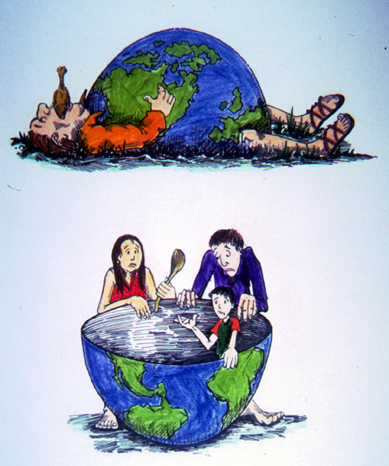
Global equity
Who is getting what?
Notes:
Eco-footprint also helps us understand that a small proportion of the population is consuming a large amount of the resources.
Approximately 20% of the global population consumes 80% of resources.
Australia fits into the high-consuming category.
Question for students: Can you identify 5 countries on a world map that each picture is referring to?
Top picture: USA, Canada, Australia, New Zealand, United Kingdom.
Bottom Picture: Mozambique, India, Ethiopia, Vietnam, Uganda

Slide 10
Calculating ecological footprint
Take the Footprint calculator test to work out your individual impact on the planet. Where you have the option to 'add more detail', please do so. Take a note of your score as well as a screen shot of your further details and your overshoot day.
How did you do?
What features caused your footprint to be bigger or smaller than your peers in the class?
Who reaches the overshoot threshold the quickest?? ​

Slide 11
Global trends in ecological footprint
On a global scale the human population became unsustainable in 1970.
It was at that point that the total EF exceeded the biocapacity for the first time and we moved from ecological surplus to ecological deficit.
The demands being placed on the planet cannot be met in the long term.
Over time the biocapacity of the Earth has increased slightly from approximately 9.5 billion gha in 1961 to 12.25 gha in 2013. This can be attributed to human ingenuity and our ability to exploit areas of land previously inaccessible to us, such as mountainous areas.
In addition to that, we are now able to farm land that was previously unproductive, for instance by irrigation of semi-desert areas.
Also, as a race, humans have become aware of the need for action. Afforestation is taking place, which improves the planet's ability to absorb the carbon dioxide waste from the combustion of fossil fuels.

Slide 12
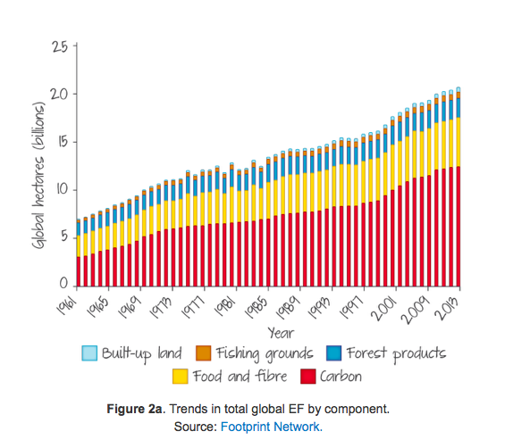
Global trends
The carbon component takes up the largest proportion of the EF and it has quadrupled in 52 years.
The carbon element of the EF will come from many areas including energy production, transport, manufacturing, agriculture and deforestation.
Food and fibre have also shown a significant increase, having more than doubled in the given time period. As the global population increases and diets become more meat and dairy based this component of the EF will increases.
Forest shows the lowest percentage increase (approximately 50%), which is probably due to the fact that many HICs are now starting re-afforestation programmes that will counteract increases in paper and timber products.
The EF of fishing grounds has increased by over 100%. As our diets change and the population grows, more fish are needed to meet demand. Also, fish farming is increasing, being seen as a way to improve protein intake in MICs such as the Philippines and India.
Built-up land includes actual buildings and infrastructure such as communication networks and power-generation plants.

Slide 13
Global variations in ecological footprint
Why is UAE’s so high? https://www.youtube.com/watch?v=nP1nzCqoT9g

Slide 14
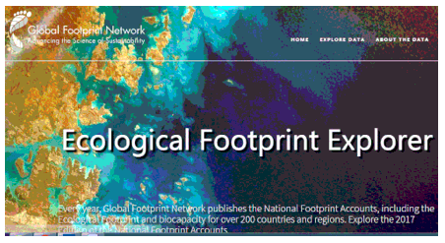
Comparing the ecological footprints of countries
The Open Data section of the Ecological Footprint website (http://data.footprintnetwork.org/#/) allows us to investigate global patterns of ecological footprints on a national scale.
Use the website to compare a range of countries.
You should include: Indonesia, Niger, China, USA, Kiribati, the "home" countries of everyone in the room plus one or two other countries of your choice.
Examine the patterns.
Compare Ecological Footprint total with Ecological Footprint per person - why the contrasts?
Now look at ALL countries: Which countries have the highest ecological footprints per person? Why?
Which countries have the lowest? Why?
What about ecological footprint per person?

Slide 15
Describe the distribution of countries with large and small ecological footprints (4)
Why is there this pattern? (p472-473 will help)

Slide 16
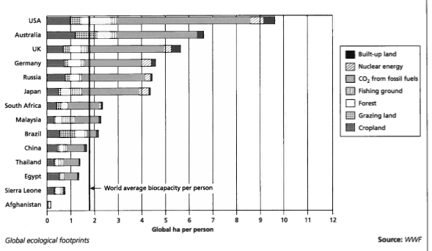
Refer to the graph of global ecological footprints.
Describe the pattern shown, how does this vary by area and by what resources they are using? (4)

Slide 17
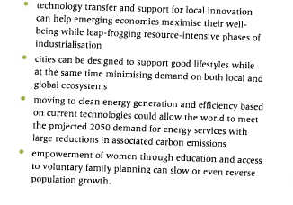
Things that could be done to reduce the global footprint

Slide 18
Summary notes – ecological footprints
IB OBJECTIVE:
Measuring trends in resource consumption, including individual, national and global ecological footprints
Make sure you know:
What an ecological footprint is
How ecological footprint is measured
What the components of the ecological footprint are and their varied contributions to the total ecological footprint
Global and national patterns and trends in ecological footprints
How ecological footprints vary globally (including differences between HICs and LICs – p474. Also mini case study on Peru in Kognity)
Reasons for the differences in ecological footprints
Ways to reduce ecological footprint
Resources – Ib textbook P471-475 and Kognity
Finally, answer this exam question:
To what extent is a future global increase in ecological footprint inevitable due to a rapid growth of the Middle Class? (5)

Slide 19
Exam practice To what extent is a future global increase in ecological footprint inevitable due to a rapid growth of the Middle Class? (5) Tip: Try to use key terms covered in your answer.

