Slide 1
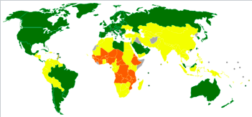
The multidimensional process of human development and ways to measure it

Slide 2
What: The multidimensional process of human development and ways to measure it
Why: To understand how actions to support human development involve spatial interactions from local to global scales
How: By considering validity and reliability of development indicators and indices, including the human development index (HDI) and gender inequality index (GII)

Slide 3
The multidimensional process of human development
What is human development?
Why do we need to develop sustainably?

Slide 7
Measuring human development
Development refers to an improvement in the quality of life. How is quality of life measured and what factors make up our quality of life? A range of physical, economic, social and psychological factors comprise our quality of life. Many people consider income to be most important factor but education, health, climate, happiness, job security, access to food and water all impact on our quality of life. Some indicators of development are relatively easy to measure (e.g. income) whereas others, such as happiness, are much more subjective.

Slide 8
Task: Measuring human development
Construct a spreadsheet that displays the 5 indicators for a range of countries.
Evaluate the 5 indicators as 'development indicators'.

Slide 9
The validity and reliability of indicators

Slide 10
Measuring Economic Development
All these are indicators of income
Gross Domestic Product
GDP – total value of goods and services produced in a country (US$)
Gross National Product/Income
GNP/GNI – Including income from investments abroad (US$)
GDP/GNP/GNI per capita
Total value divided by the total population
Purchasing Power Parity
PPP – Takes into account local cost of living and is usually expressed per capita (US$)

Slide 11
Example of PPP

Slide 12
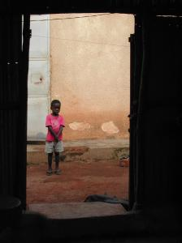
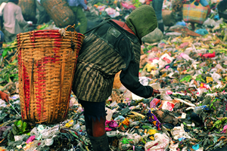
Economic Growth
Using measures of economic growth can give distorted pictures of the level of income in a country – the income distribution is not taken into account.
A small proportion of the population can own a large amount of the wealth in a country. The level of human welfare for the majority could therefore be very limited.

Slide 13
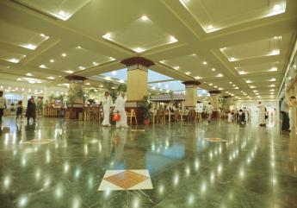
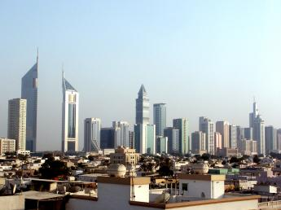
Economic Growth
High economic growth fuelled through capital spending can hide a number of underlying economic problems – how is the income and wealth distributed? Who is doing the spending and will it ‘trickle down’ to the poor?

Slide 14
Problems of using economic indicators such as GDP/GNP/GNI/PPP to measure development
Currency fluctuations
Prices of goods and services (PPP)
Distribution of Wealth
Dependency on one industry (skills, location, fluctuations)
Tax and govt spending on public goods
Informal economy and unpaid work eg child care and subsistence farming, bartering
Monetary value of goods traded can fluctuate, especially agriculture
Remittances from migrant workers are not included

Slide 15
Problems of using economic indicators such as GDP/GNP/GNI/PPP to measure development
Negative externalities of economic growth are not included (eg pollution, environmental damage)
Environmental services such as the benefits derived from standing forest are not included.
Basically it is only a measure of the economic value of what is produced and paid for. Does not take into account what was produced, the environmental and social costs, how the wealth is distributed, who spends it and what it is spent on.

Slide 16
Social indicators
In one minute list as many social indicators of development as you can.

Slide 17
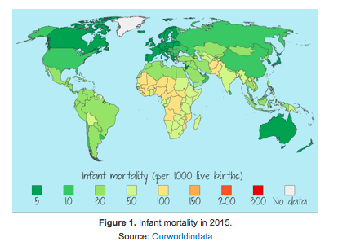
Social indicators
Infant mortality rate: the number of deaths of children under 1 year of age per 1000 live births in a country. This is considered to be an important measure as it is affected by the people's knowledge of health, availability of resources and health technology.

Slide 18
Child mortality rate: the number of deaths of children under 5 years of age per 1000 live births in a country.
Life expectancy: the average number of years a person born today can expect to live.
Health-adjusted life expectancy (HALE): the number of years a person is expected to live in full health.
Daily calorie intake: the amount of energy a person consumes in a 24-hour period.
Adult literacy rate: the percentage of the adults in a country with basic reading and writing skills.
Percentage of children enroled in schools (including primary, secondary and tertiary education).
Average number of years in full-time education.
Percentage of children enroled in schools (including primary, secondary and tertiary education).
Average number of years in full-time education.
Access to safe water: this measures the percentage of the population that can access adequate safe drinking water within a convenient distance of their home
Video: How do we measure life expectancy?

Slide 19
Evaluating social indicators

Slide 20
Human Development Index
The Human Development Index (HDI) is a composite measure of development. This means that it covers different components of development. The HDI measures the development of a country in social and economic terms. The statistical measurement is based on three components: health, education and wealth. The scores for the three are combined and converted into an index with a maximum value of 1.0. The closer to 1.0, the higher the level of human development of the country. The HDI comprises:
life expectancy at birth
mean years of schooling received by people aged 25 and over and expected years of schooling
GNI per capita (PPP* USD).

Slide 23
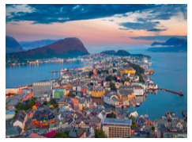
Norway ranks number one for HDI with a score of 0.944.
It ranks highly on all three indicators with a life expectancy of 81.6 years, 17.5 years of expected schooling, 12.6 years of mean schooling and a high GNI PPP per capita of $64,992. Norway has held the top position for the last 12 years. Norway’s position is perhaps not surprising, being the second wealthiest country in the world. Norway's wealth is mainly attributed to oil; it is the fifth largest exporter of oil in the world. Due to the country's wealth it can afford to invest in providing good services for its citizens. The government invests heavily in the health care system and health is free for all, after a small initial charge. Another factor contributing to longevity is the quality of the environment: air pollution in Norway is almost the lowest in Europe. Similarly, education is free for all, including tuition for university-level students. Norway’s egalitarian values have also resulted in only a small gap between rich and poor

Slide 24
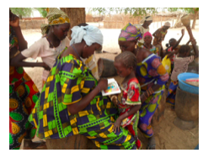
Niger is bottom of the list with an HDI of 0.348.
Life expectancy is low at only 61.4 years, 5.4 years of expected schooling, 1.5 years of mean schooling and a low GNI PPP per capita of only $908. Niger is one of the poorest countries with two thirds of the population living below the poverty line. The government has little money to invest in the education or the health of its citizens. Literacy rates are low and it is traditional for girls to stay at home rather than attend primary school. Medical care is poor and clinics lack basic equipment and medicine. Many people suffer from infectious and parasitic diseases. Malaria is responsible for 20% of deaths in children under 5 years. Women often choose not to seek medical help and it is common for people visit local healers who rely on natural remedies and rituals. Niger has frequent droughts, resulting in crop failure and food shortages. Malnutrition is common, resulting in stunted growth for over half of the children.

Slide 25
The Gender Inequality Index
Like the HDI the GII is a composite measure based on three components: female reproductive health, female empowerment and labour market These three components are measured by:
Female reproductive health: maternal mortality ratio and adolescent birth rates. Maternal mortality is a measure of the number of deaths due to pregnancy-related causes per 100,000 live births. Adolescent birth rates are the number of births to 15–19-year-olds per 1000 women aged 15–19.
Female empowerment: measured by the share of parliamentary seats occupied by females and also the percentage of females compared to males aged over 25 years with some secondary education.
Labour market participation: measured by the percentage of females and males (aged 15 years and older) in the labour market.

Slide 27
Read the information on kognity (5.1.2
Indicators of development)
to :
1. compare why Slovenia and Yemen score differently on the GII
2. evaluate the GII as a measure of development

Slide 28
The happiness index
The Gross National Happiness Index considers a number of components including GDP (PPP) per capita and healthy life expectancy (how many years a person might live in a healthy state). It also looks at people’s willingness to donate money to charity, their freedom to make life choices, perception of corruption and available social support, along with laughter and feelings of worry and sadness. In 2016 Denmark was ranked as the happiest country, followed by Switzerland, Iceland and Norway. The unhappiest county was Burundi, closely followed by Syria, Togo and Afghanistan.

Slide 29
The happiness index: watch….

Slide 30
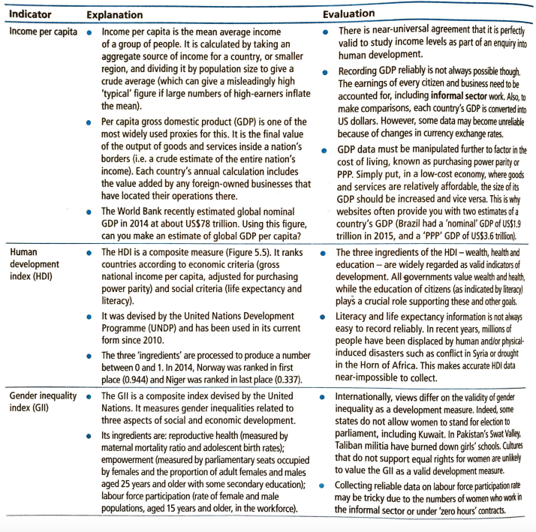

Slide 31
Exam question
‘People in developed countries live longer than those in less developed countries. Improving human development is about helping a population to live longer’. Discuss this statement. [16]

