Slide 1

Section 3
Section 3:
Economic development

Slide 2
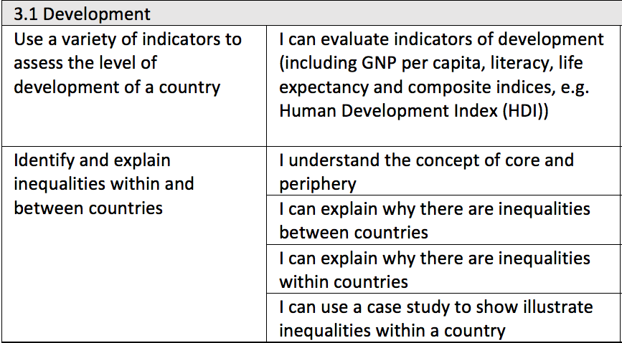

Slide 3

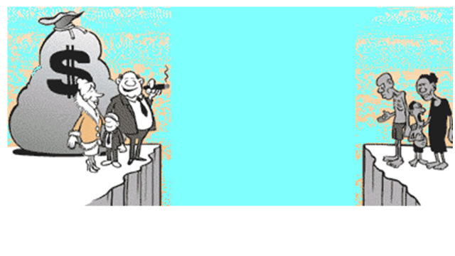
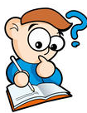
Learning Objective
To look at how we classify development across the world
What is development?
Starter
What is this cartoon saying?

Slide 4





What is development?
CAN YOU CREATE A DEFINITION FOR WHAT DEVELOPMENT MEANS?
Improvement
Change
Advancement
Progress
Growth

Slide 5
Thinking:
Here you can see a range of different countries. List as many words as you can to describe/classify these countries

Slide 6
Thinking:
What kind of words have you listed?
Poor and Rich
fIRST WORLD & Third world
Developed &
Underdeveloped
MORE DEVELOPED & less developed
Can you think of any problems with using these words?
High income & Low income

Slide 7
Realising
The Gap Instinct
Rich
Poor
MORE DEVELOPED
Less DEVELOPED
We have an almost irresistible temptation to divide all things into 2 distinct and often conflicting groups with an imagined gap in-between: rich and poor, developed and underdeveloped, us and them. It completely distorts our worldview…
High income
Low income
Developed
Underdeveloped
fIRST WORLD
US
Third world
Them

Slide 8
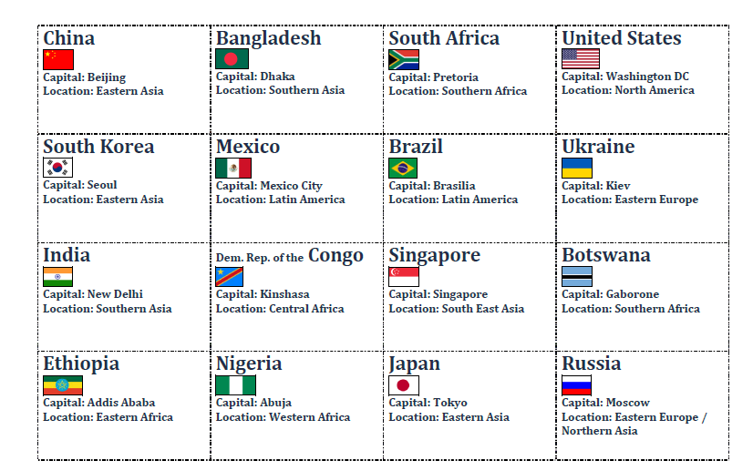
Put these countries in order of development…..

Slide 9
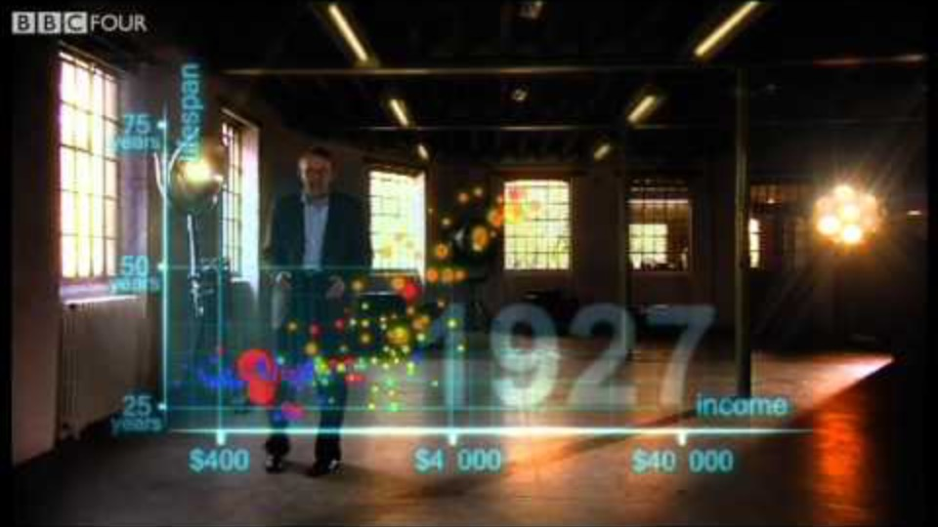
Realising
200 countries over 200 years
Hans Rosling presents a much clearer way of thinking about different countries around the world. Hans makes an important point that ‘poor developing’ countries do not exist as a distinct group anymore. Today, most people around the world (75%) live in middle-income countries. Not poor, not rich, but somewhere in the middle.
https://www.youtube.com/watch?v=jbkSRLYSojo&feature=emb_logo

Slide 10
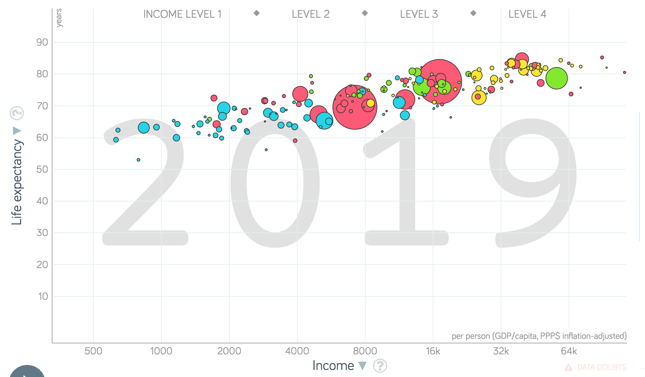
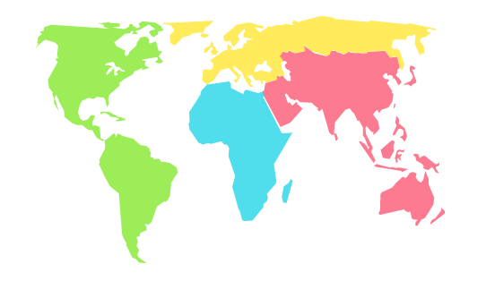
Realising
This data proves why we should no longer refer to ‘rich’ and ‘poor’ countries.
What patterns and trends can you take from this graph?
He also created a great tool for helping us to better understand this…
https://www.gapminder.org/tools/#$chart-type=bubbles

Slide 11
How do we measure development?
Gross National Income (GNI) per head
Birth rate
Death rate
Infant mortality rate
Life expectancy
People per doctor
Literacy rate
Access to safe water
Human Development Index (HDI)
Quality of life
Tasks
Match the definitions
2. Colour code them into social and economic measures of development
3. What are the advantages and limitations of each of these indicators?
4. Which do you think is better to measure development and why?

Slide 12


What is GNI (Gross National Income)?
A country’s level of development is shown firstly by the average wealth of its citizens. One way of finding this out is to use a measurement called gross national income (GNI). This is calculated by adding together:
The total value of all the goods and services produced by its population
The income earned from the investments that is people and businesses have made overseas.
To compare the level of economic development for different countries, the GNI is:
Divided by the population of the country to produce a per capita (per person) figure.
This is then converted into US dollars the comparison clearer.
Finally, each figure can be adjusted for each country based on its income. In LICs, goods often cost less, meaning that wages go further than might be expected in a HIC.
Countries are classified into three main categories based on GNI; lower income countries (LICs), higher income countries (HICs) and newly emerging economies (NEEs).
Describe the meaning of Gross National Income (GNI) (4 marks).
Structure
Paragraph structure:
A definition of what Gross National Income is.
An detailed description of how Gross National Income is calculated.
Description of how the Gross National Income is adjusted depending on a countries income.
Literacy
Can you use these key terms:
Wealth
Development
Standard of living
Per capita
HIC
LIC
NEE
Success criteria:
You recognise in your description how the GNI might need to be adjusted depending on the income.
Notes:
What are the limitations of just using GNI?

Slide 13
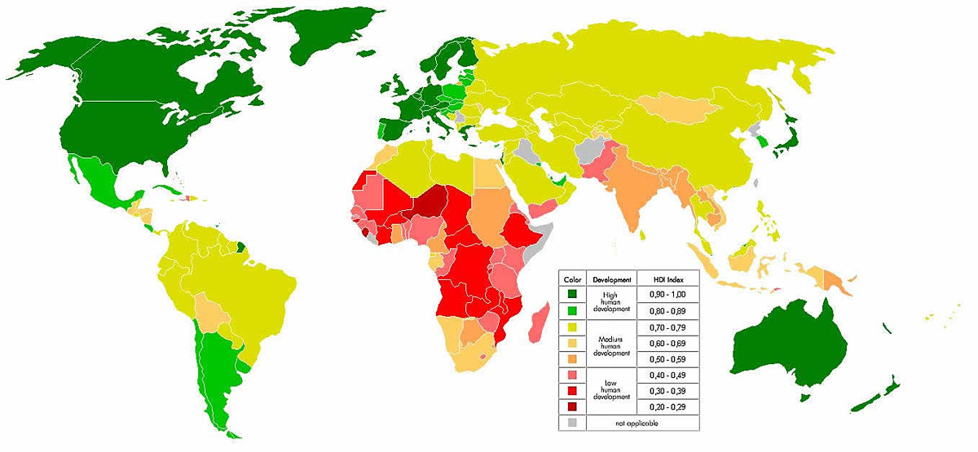
Human Development Index
What is HDI – why it is more useful than any other methods?

Slide 14



What is the HDI?
The human development index uses three different indicators to make it more accurate (a composite indicator) . They are:
Life expectancy
Education attainment (how well people do in their exams)
GDP (how much money on average a person earns)
It measures all three indicators and gives each country a number between 0 and 1. The UK is currently rated 0.8

Slide 15


What are the different social measures of development?
Development is about more than just money! The concept of development is linked with the idea of progress and civilisation.
Indicator of development | Definition | What does it indicate about the social development? | What are the limitations? | How does the measure vary globally?
Literacy rate
People per doctor
Access to safe water
Use the information to complete the table about the features of the different social indicators of development.
Extension
Consider the following:
Which indicator is the most reliable? Why?
Which indicator is the least reliable? Why?
Which indictors could be added to the HDI to make the measure of development more reliable?
Literacy
Can you use these key terms:
Economic stability
Services and facilities
Conflict zones
Healthcare
Infrastructure
Education
Developed
Reliable
Grades Below C
You can define and describe the features of the different measures of development using some key terms.
Grades B-C
You can explain what the indicator shows about the development of different countries using contrasting examples.
Grade A*-A
You can explain the limitations of the different indicators of development and evaluate their reliability.

Slide 16
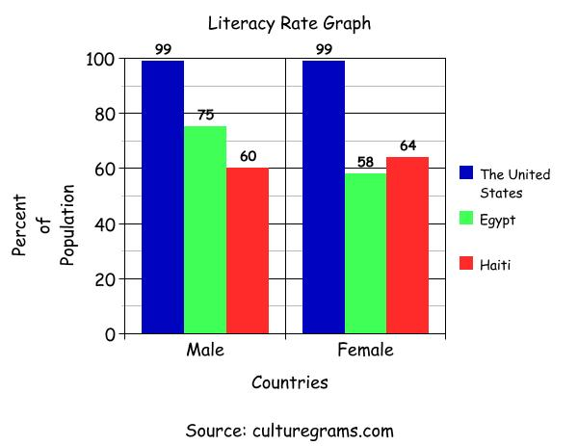
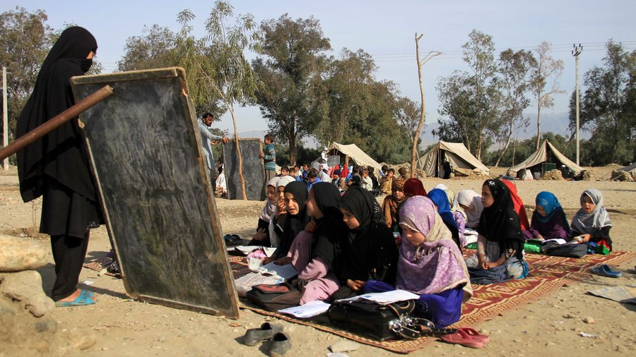
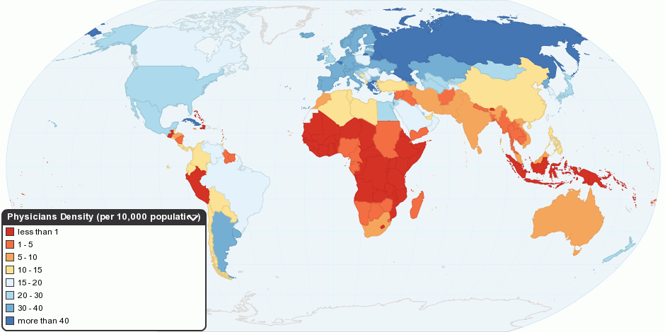
Literacy rate
Literacy rate is the percentage of people with basic reading and writing skills within a country. Most EU countries have a literacy rate of 99 per cent. Whereas, in some LICs, the figure is as low as 40-50 per cent. The literacy rate of a country can be a good at showing the difference between the quality of life of different sexes in some countries. Literacy rate is also closely linked to GNI as the more economically stable a country is the more likely they are to be able to afford to build the infrastructure required for education. However, carrying out surveys to determine literacy in rural populations, especially in conflict zones or squatter settlements in LICs is difficult.
People per doctor
People per doctor is the number of people who depend on a single doctor for their health care needs. The number of people per doctor is closely linked to the GNI and literacy rates of a country. A better education enables more doctors to be trained and a good economy allows more hospitals and healthcare centres to be constructed.
However, just because the people per doctor figure is high does not mean that people are not receiving healthcare advice. In India and other NEEs, people in rural areas are now using their mobile phones to get healthcare advice. This is not taken into account by the people per doctor measurement.

Slide 17
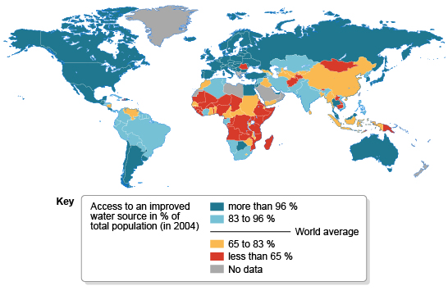
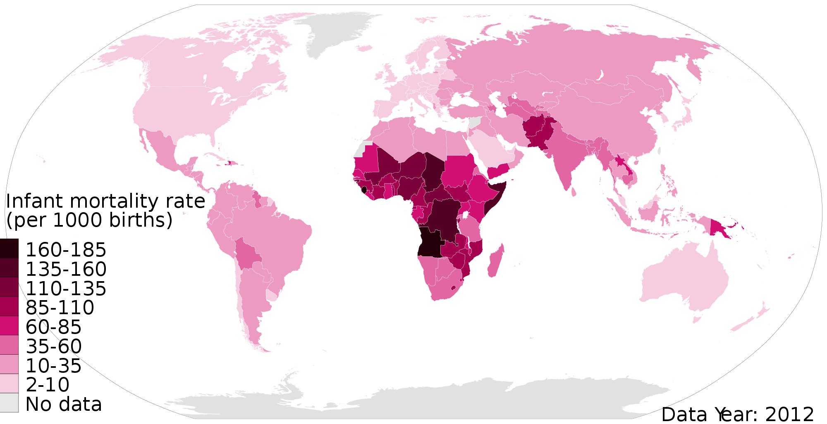
Access to safe water
Access to safe water is the percentage of people who have access to water that does not carry health risks such as cholera. This measure is also linked to GNI as safe water supplies require good infrastructure such as sewage networks.
All EU citizens must have access to safe water by law. However, in rural Angola, just 34% of people have access to safe water. However, other factors can affect the water quality of a country. For example water quality can decline due to flooding or poor maintenance of pipes. The rising cost of water in cities sometimes forces poor people to start using unsafe sources. Official data may underestimate these problems.
Infant mortality rate
Infant mortality rate is the number of deaths of children under one year of age per 1,000 live births. This rate is closely linked to people per doctor, access to safe water and the GNI. If the infant mortality of rate is high this suggests that the country does not have the facilities and services such as post-natal care. The UK figure is just 4 deaths per year but Somalia has over 100.
However data for the worlds poorest countries for IMF is often inaccurate as not all infant deaths are recorded. Sadly, many children are buried in unmarked graves. Therefore official data may be underestimated.

Slide 18
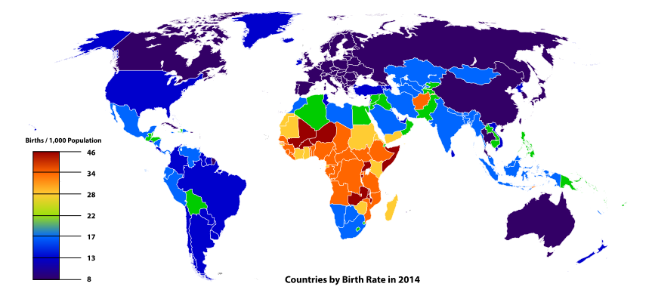
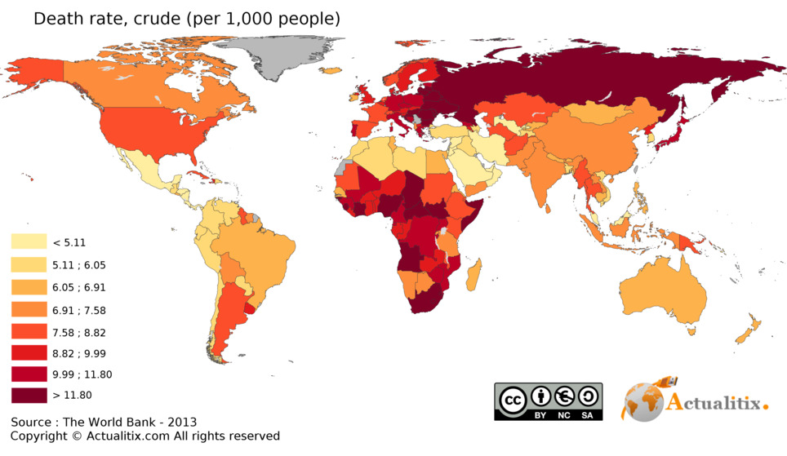
Birth rate
The birth rate is considered a reliable measure. It is the number of live babies born per 1000 per year. As a country develops, women are likely to become educated and want a career rather than staying at home. They marry later and have fewer children. As a result the birth rate is closely related to the literacy rate. It is also closely related to the infant mortality rate; when this is high women tend to have more children.
Mali has a birth rate of 42.9 per 1000 per year whereas,
the UK has a rate of 11.9 per 1000 per year.
Death rate
The death rate is the number of deaths per 1000 per year. It is considered a less reliable measure. Developed countries such as the such as the UK, Germany and Japan tend to have older populations and death rates will therefore be high. Whereas in LICs such as Bangladesh, death rates may be lower because there are proportionally more young people.
The death rate can give an indication on the availability of healthcare in a country. In Afghanistan the death rate is 8 per 1000 per year, whereas in France the death rate is 7 per 1000 per year.

Slide 19
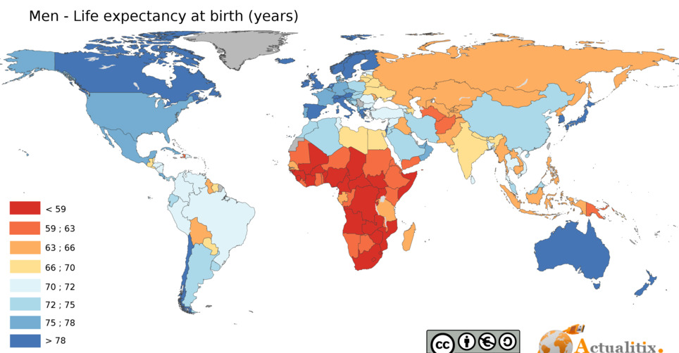
Life expectancy
Life expectancy is the average number of year a person can be expected to live to. Most NEEs now have a high life expectancy of 65-75 years or more. In LICs, a figure of 55 (as in Chad) is more typical. In HICs this is usually 75+.
Life expectancy is closely related to access to safe water and people per doctor. The life expectancy of a country shows the level of access to healthcare and even diet and nutritional standards. In countries where the infant mortality rate is high, the life expectancy of those who survive childhood is actually far higher than the mean life expectancy suggests.
Human development Index
Income
The HDI uses a measure of wealth derived from the estimated per capita GNI of a country.
All measures of development should be factored in to calculate a countries overall level of development. Many people would also argue that other factors such as human rights and happiness should also be included. With so many factors to consider composite measures are used which combine several development measures into one formula, such as the HDI. The three ingredients are processed to produce a number between 0 and 1. The closer to 1 the more developed a country is.
Life expectancy
This is the numbers of years that a person can be expected to live from birth. Women generally live longest in any society.
HDI
Education
The HDI uses an education index based on the average number of years of schooling for people in a country

Slide 20

What are the relationships between different indicators?
Complete the line of best fit for figure 2 below. What is the correlation?
Figure 3: World HDI
USA
UK
Japan
Zimbabwe
Brazil
Turkey
China
Nigeria
Bangladesh
Ivory coast
Extension
Literacy
Compare and contrast the figure 2 with figure 3 which shows the distribution of HDI values across the world.
Interpolate the number of doctors for 1000 people if the GNI per capita is 30,000
Extrapolate the number of doctors per 1000 people if the GNI per capita is 60,000
Can you use these key terms:
Dispersed
Clustered
Varied
Positive relationship
Increases
Northern hemisphere
Southern hemisphere
Success criteria:
You can explain the relationship and also explain the links with the choropleth HDI map.

Slide 21
What are the relationships between different indicators?
Figure 3: World HDI
USA
UK
Japan
Zimbabwe
Brazil
Turkey
China
Nigeria
Bangladesh
Ivory coast
________________________________________________________________________________________________________________________________________________________________________________________________________________________________________________________________________________________________________________________________________________________________________________________________________________________________________________________________________________________________________________________________________________________________________________________________________________

Slide 22
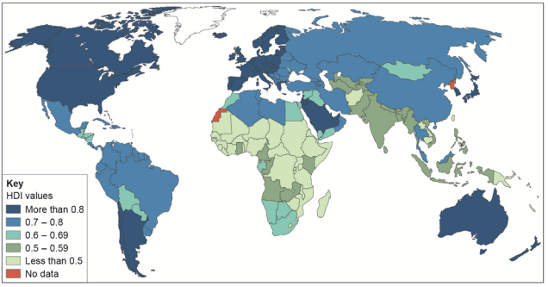
Exam question
Study Figure 4, a world map showing the global distribution of Human Development Index (HDI) values.
HDI combines data on life expectancy, educational levels and income, with values ranging from 0 (worst) to 1 (best).
Using Figure 4, compare HDI values in Africa and South America. (4 marks)
Responses should focus on differences in HDI values between Africa
and South America. Expect statements backed up by data from the map, e.g.
• HDI values in South America are generally higher than in Africa (1)
• the vast majority of countries in South America have values above 0.7, whereas most countries in Africa show HDI values under 0.6 (1)
• the highest figures for HDI are in the extreme north and south of Africa showing values exceeding 0.6 (1). The highest in South America are in the southern part, with values above 0.8 (1).
Success criteria:
You can develop the comparisons between Africa and South America’s HDI values using specific values.

Slide 23
Exam question
Study Figure 4, a world map showing the global distribution of Human Development Index (HDI) values.
HDI combines data on life expectancy, educational levels and income, with values ranging from 0 (worst) to 1 (best).
Using Figure 4, compare HDI values in Africa and South America. (4 marks)
_________________________________________________________________________________________________________________________________________________________________________________________________________________________________
________________________________________________________________________________________________________________________________________________________________________________________________________________________________________________________________________________________________________________________________________________________________________________________________________________________________________________________________________________________________________________________________________________________________________________________________________________

Slide 24
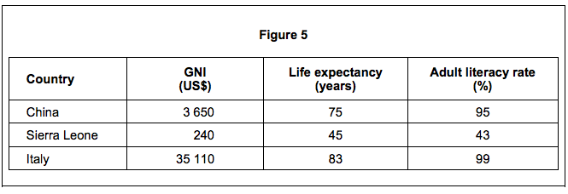
Exam question
Study Figure 5, a table showing indicators of development for three countries.
Literacy
Can you use these key terms:
War
Disease
Disasters
Life expectancy
Living standards
Economic stability
Education
Job security
Developed
Nutrition
Healthcare
Diet
Explain how one of the indicators of development in Figure 5 shows the differences in the quality of life between the three countries. (4 marks)
Structure
Level 1 (basic) 1-2 marks
Shows limited understanding of one relevant measure of development.
Demonstrates limited application of knowledge and understanding in interpreting how one indicator of development shows differences in quality of life.
Level 2 (clear) 3-4 marks
Shows sound understanding of one relevant measure of development.
Demonstrates sound application of knowledge and understanding in interpreting how one indicator of development shows differences in quality of life.
Paragraph structure:
Give a definition of the indicator you have chosen.
Describe the factors that could affect your chosen indicator.
Describe the relationship between your chosen indicator and quality of life.
Give country examples from figure 5 and explain what the life expectancy suggests about the quality of life in the country.

Slide 25
Exam question
Study Figure 5, a table showing indicators of development for three countries.
_______________________________________________________________________________________________________________________
________________________________________________________________________________________________________________________________________________________________________________________________________________________________________________________________________________________________________________________________________________________________________________________________________________________________________________________________________________________________________________________________________________________________________________________________________________________________________________________________________________________________________________________________________________________________________________________________________________________________________________________________________________________________________________________

Slide 26
Exam question
Discuss the disadvantages of using a single measure of development such as income. (4 marks)
Birth rate is an excellent measure of development. In rich industrialising countries, women achieve high levels of education and career prospects. As it is difficult to pursue a high flying career and bring up several children, having children is often sacrificed for success in the working world. Some countries such as France have tried to encourage career women to have children using tax advantages an benefits.
Death rate is a poor indicator of development. Almost all countries have low death rates today. The more economically developed the country, the higher is the death rate, as improved health care increases the amount of elderly people.
Some measures of development can give a narrow or confusing picture. GNI per capita is only an economic measure of development so gives no clear indication of people’s personal living standards. They do not tell us what people earn or how much that buys. Nor do they touch directly on how educated people are and the cultural quality of their lives.
All indicators of development are averages across a country. Within any society there are extremes of wealth and opportunity, which a single figure hides. Relying on one indicator increases this problem. The solution is to use a number of indicators together, giving a much broader view of economic and social development as well as living standards. One such measure that uses multiple indicators is the human development index (HDI).

Slide 27
What are the three main global groups?
Countries are classified into three main categories based on GNI; lower income countries (LICs), higher income countries (HICs) and newly emerging economies (NEEs).
Category of development | Average GNI ($) | Main industry | Characteristics | Examples
Lower-income countries
Newly emerging economies
High income countries
Use the information to complete the table about the features of each category of development.
Extension
Literacy
Can you describe the distribution of HICs, NEEs and LICs across the world.
Use PDA (pattern, data and anomaly)
Consider which continents each category is mainly found in. Is this continent in the northern or southern hemisphere?
Can you use these key terms:
Per capita
Primary
Secondary
Tertiary
BRIC
Transnational corporations
Word Bank
Economies
Success criteria
You can explain the distribution of HICs, NEEs and LICs across the world based on your knowledge.

Slide 28
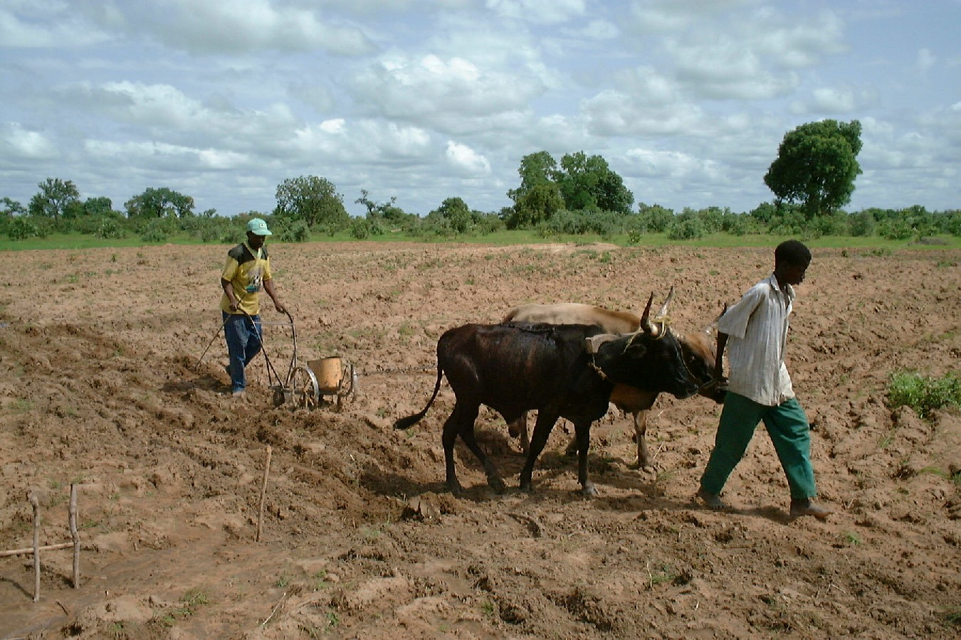
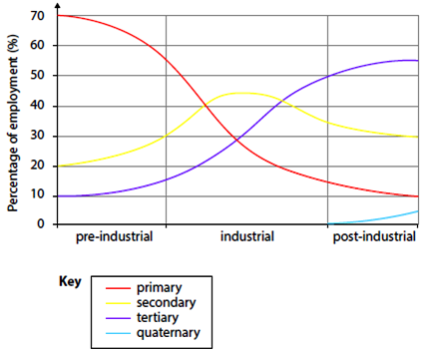
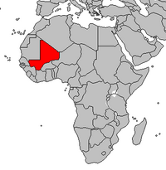
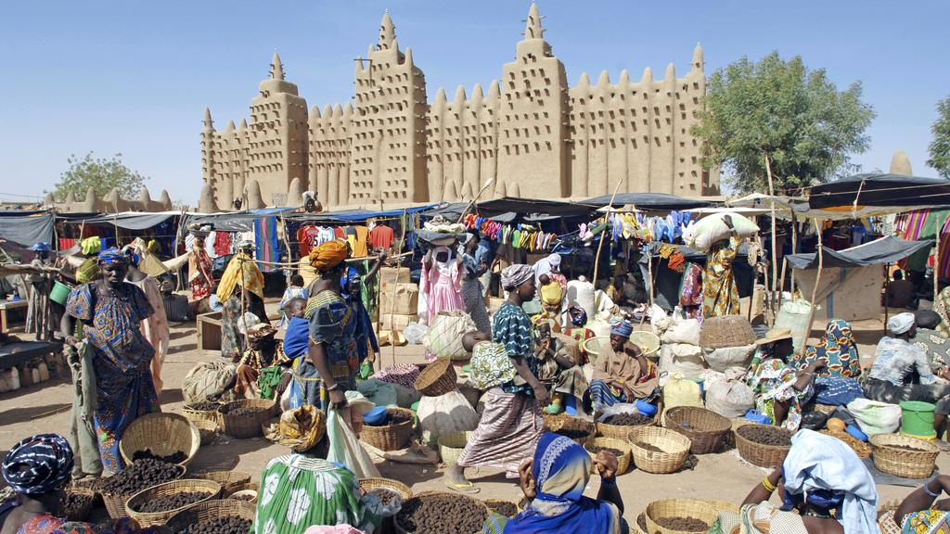

Lower income countries (LICs)
This group of around 30 countries is classified by the World Bank as having low average incomes (GNI per capita) of US$1,045 or below (2015 values). Agriculture still plays an important role in the their economies. As a result these countries are especially vulnerable to natural hazards such as flooding . It will often take them longer to recover as they do not have the economic support within their country. Many of these countries can be found in the continent of Africa and include Mali, Niger and Chad.
Mali
GNI: US$2040

Slide 29
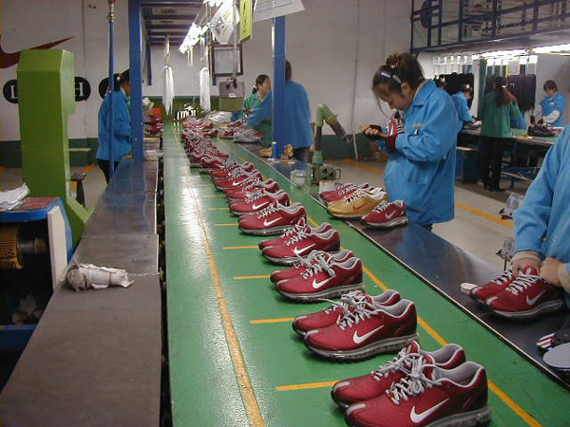
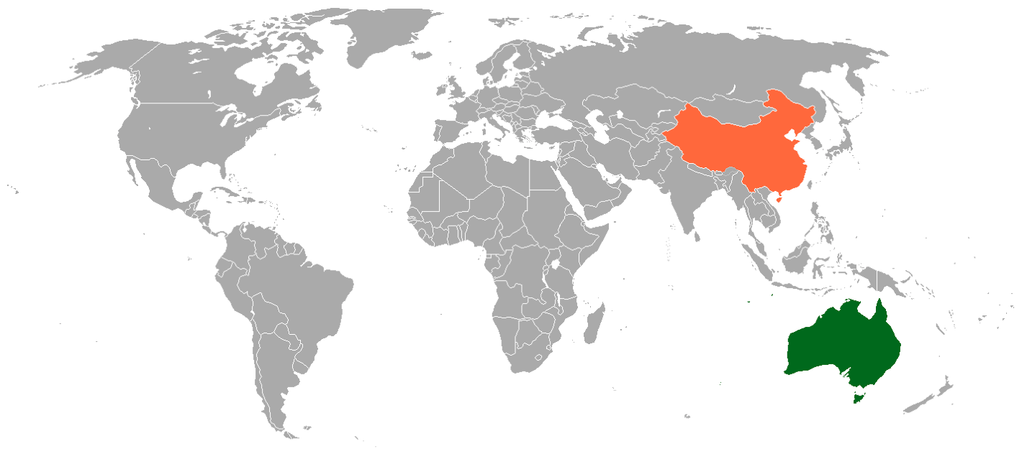
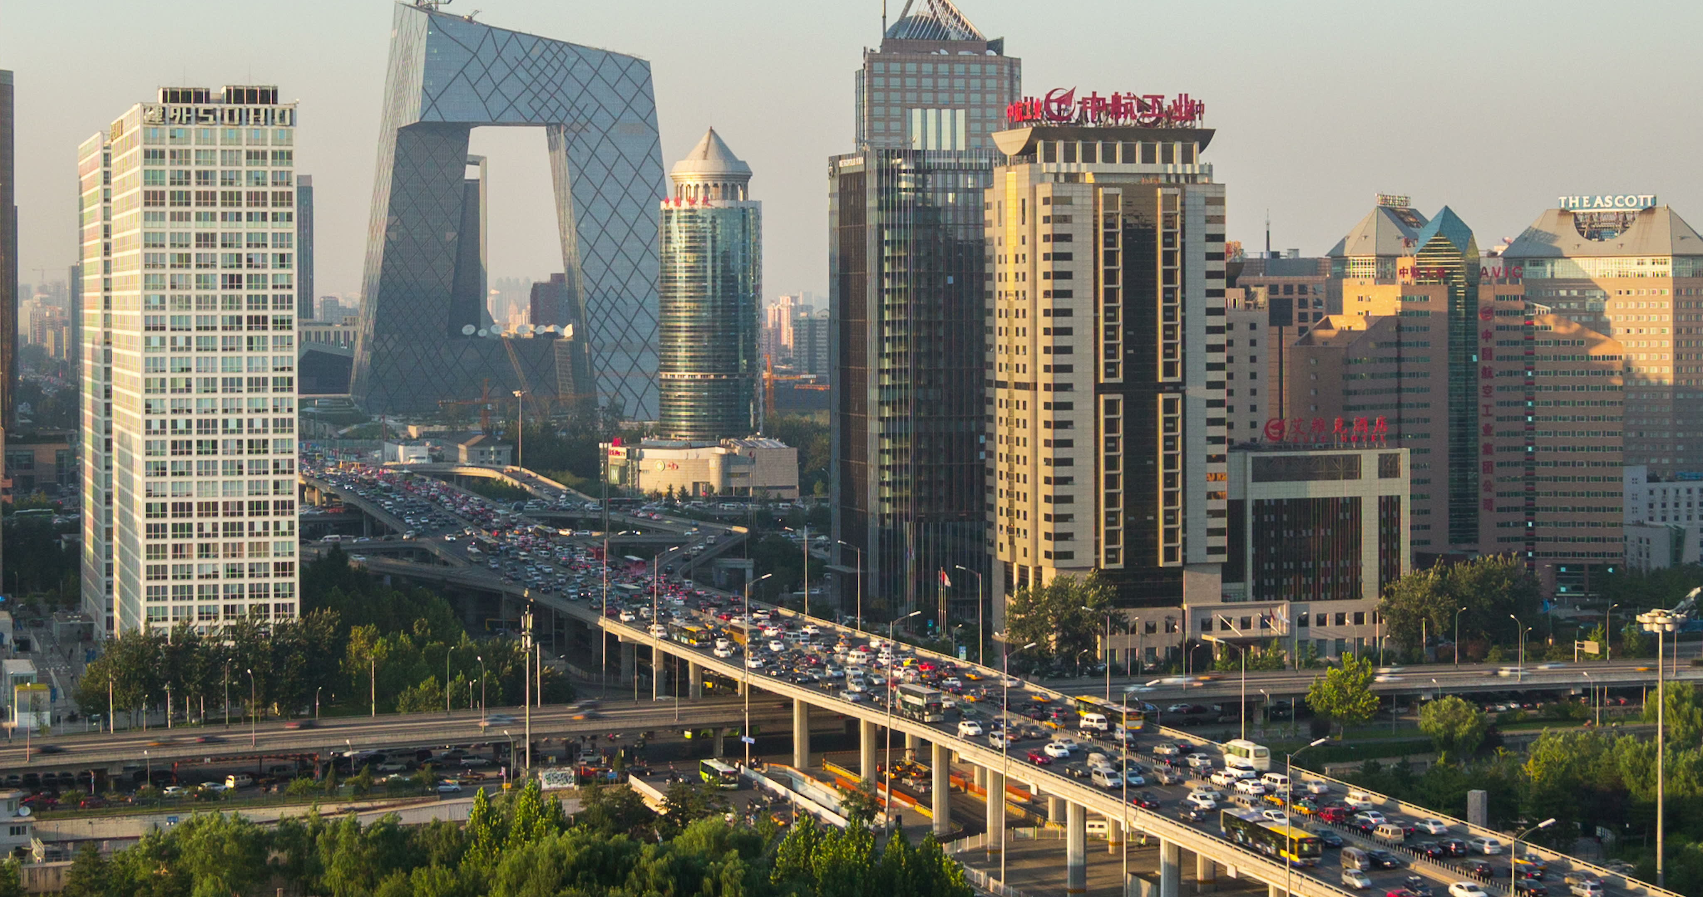
Newly emerging economies (NEEs)
These are around 80 countries that have begun to experience higher rates of economic growth, usually due to rapid factory expansion and industrialisation. Transnational corporations (TNCs) invest in these NEEs, which have sub-groups like BRICs and MINTs. The NEEs roughly correspond with the World Banks ‘middle-income’ group of countries. The average income of these countries is between US$1046-12735 per capita. The number of NEEs has increased rapidly in recent decades: this is linked to the spread of globalisation.
As a result their economies are largely reliant on secondary industries such as working in factories. However, agricultural production is still part of their economy. Good examples of NEEs are Russia and China.
China
GNI: US$15,500

Slide 30


High income countries (HICs)
This group of around 80 countries is classified by the World Bank as having high average incomes (GNI per capita) of US$12,736 or above (2015 values). Around half are sometimes called ‘developed’ countries. These are states where office work has overtaken factory employment, creating a post industrial economy where employment is mainly in the tertiary industry. Examples include the UK and Australia.
There are also around 40 smaller high income countries (of roughly 1 million people or less), including Bahrain, Qatar, Liechtenstein and the Cayman Islands.
Australia
GNI: US$45,970

