Slide 1
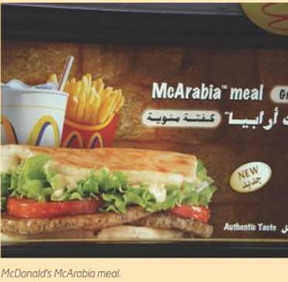
McDonalds TNC case stud

Slide 2
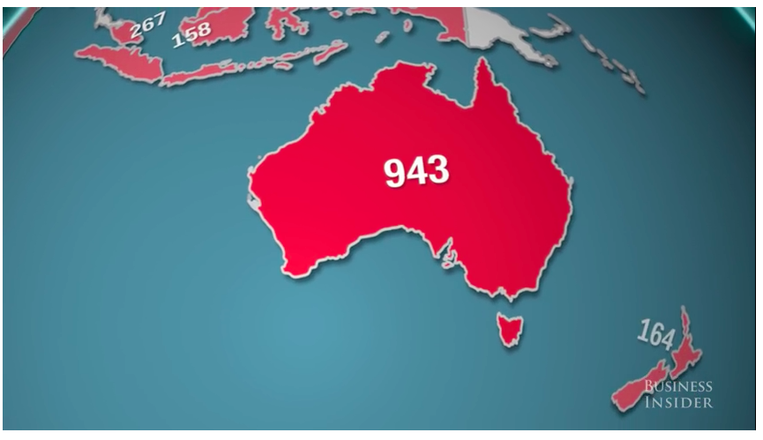
Where are the McDonalds?
Which countries have a lot?
Which have none?
WHY?

Slide 3
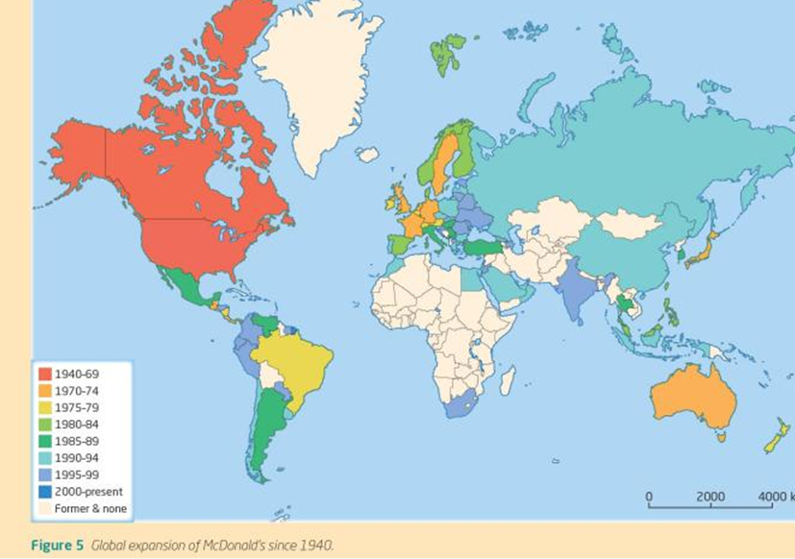
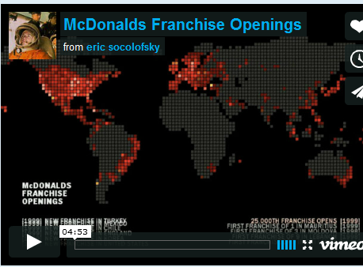

Slide 4
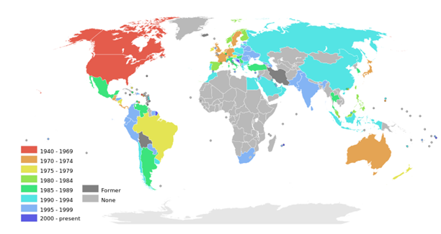
The global spread of McDonalds

Slide 5
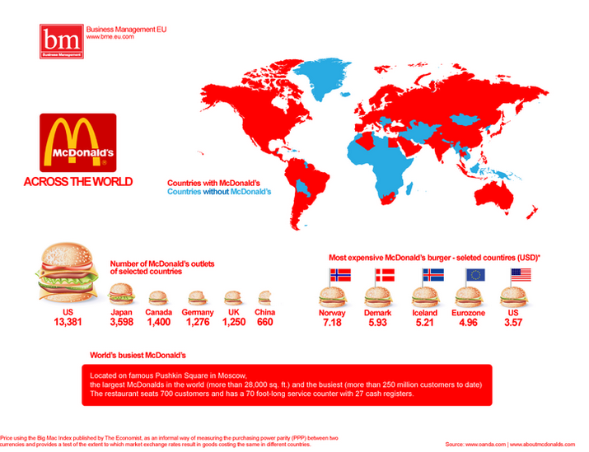
What may be barriers to globalization?
List at least 3 with your partner

Slide 6
iv. Read the article to the right hand side and this BBC article then explain why McDonald's a Coca Cola have consistently maintained their brand value and loyalty. What has been the key to their success? Are there any areas that have been hard to reach?

Slide 7
McDonalds facts

Slide 8
McDonalds global expansion
On average 30 million customers are served in one of the 31,000 McDonalds restaurants in one of more than 100 countries.
First located in USA and Canada, then spread to Europe, Australia and Japan in 1970s.
1980s spread to Mexico, S America and SE Asia
1990s the restaurant spread to China, Russia and the Arab World

Slide 9
Why did McDonalds go global?
The company initially had rapid growth (between 1961 and 1991 it was 24 % annually)
Growth based on innovative marketing and high standards of quality and marketing
BUT competition grew stiffer in USA so they had to expand
In 1991 was the first time McDonalds had more outlets overseas than in the USA
In 1996 the peak year of expansion McDonalds opened 200 restaurants globally

Slide 10
What are the impacts of McDonalds global spread?

Slide 11
Impacts of McDonalds-social
Spread of Western culture-The introduction of another culture can result in the loss of some traditions. In this example, the introduction of fast food made lead to loss of traditional foods. However McDonald's does vary its Menu from country to country to take into account national tastes called Glocalisation.
Could be an increase in the obesity rate of these countries
McDonald's has also tried to create a positive image the idea ofcorporate responsibility such as the Ronald McDonald house charities that offer help and support to families with sick children through independent charities supported by McDonald's. Through the money donated they have made 400 rooms for families every night of the year.

Slide 12
Impacts of McDonalds-economic/ environmental
Employs more then 1.7 million people, and train their employees in the U.K they offer employees the chance to gains qualifications from apprenticeships up to foundation degrees.
One environmental impacts that sticks in peoples brains is the allegation that McDonald's fuels that deforestation of the Amazon. In 2006 Greenpeace published a report called "Eating Up the Amazon" this traced soya beans grown in illegally deforested areas to McDonald's used as chicken feed and then served up as Chicken McNuggets.

Slide 13
What is Glocalisation?

Slide 14
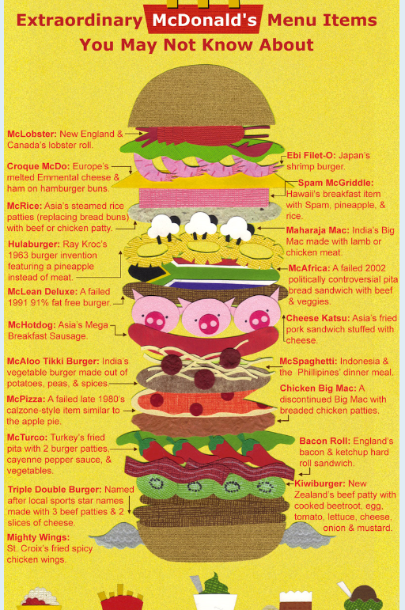

Slide 15
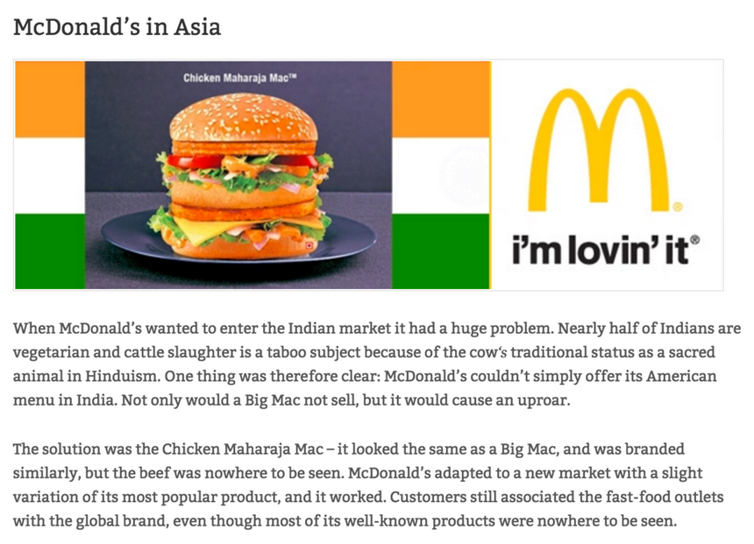

Slide 16
Questions
For a global company you have studied explain its global reach (7)
For a named TNC you have studied explain the impacts in LEDCs (7)

