Slide 1
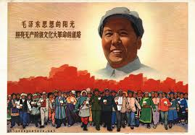
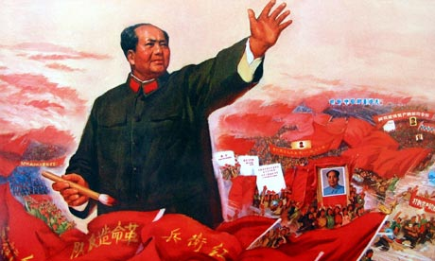
To what extent were Mao’s Domestic Policies a Success?
L/O – To evaluate the successes and failures of Mao’s domestic policies

Slide 2
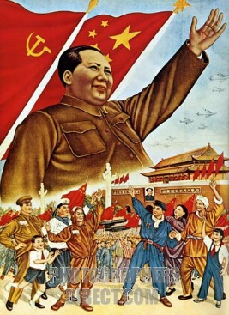
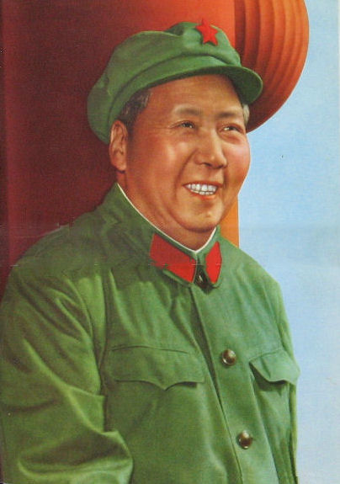
Building a New World
Mao believed that he could turn China into a world superpower by enforcing his Chinese version of Marxism – Maoism.
However his ideological commitments and inflexibility actually made his domestic aims of a strong and stable China difficult to achieve.
Whilst he had huge success in reshaping the culture and lives of many Chinese people, his economic policies were huge failures and were eventually reversed by Deng Xiaoping after 1979.

Slide 3
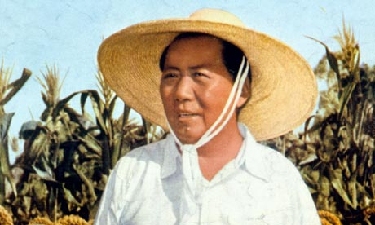
To what extent were Mao’s agricultural policies a success?
L/O – To analyse the impact of Mao’s agricultural policies and evaluate their successes and failures

Slide 4
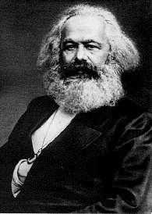
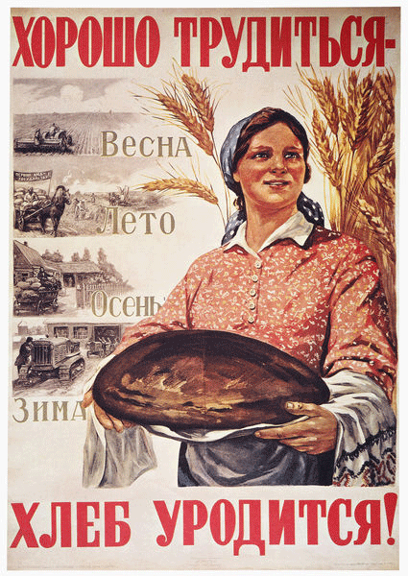
The CCP and Agriculture
As a Marxist organisation, the CCP was committed to ‘building socialism’ in China. This required China to become an industrialised nation.
According to Marx, this also required the ‘collective ownership of the means of production’. i.e. the government needed to control industry and agriculture in order to ‘build’ socialism.
In farming, this would mean ‘collectivisation’ – abolishing private land ownership so that the government controlled all farming land. Rising food production would then ‘kick-start’ industrialisation.

Slide 5
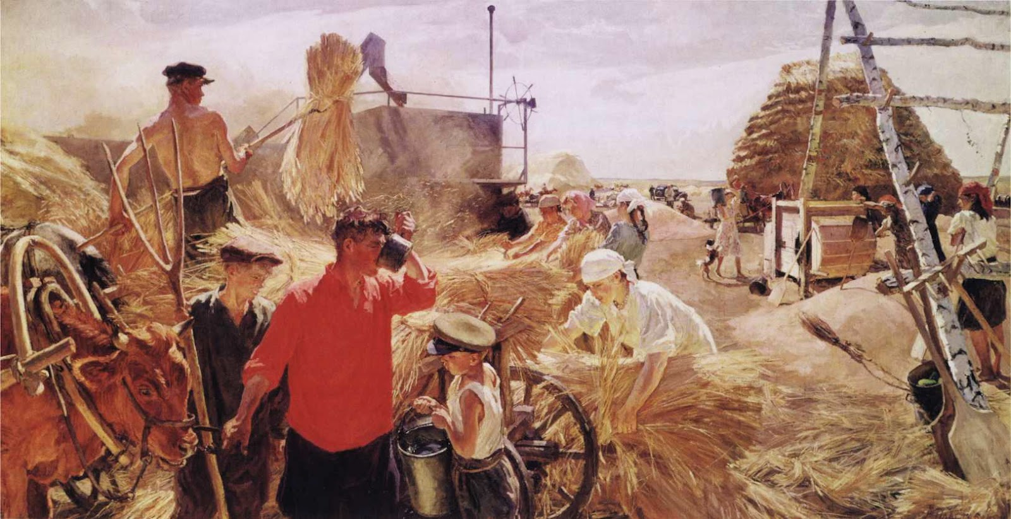

Slide 6
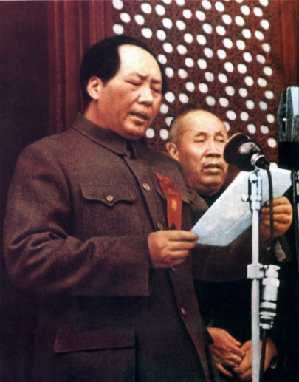
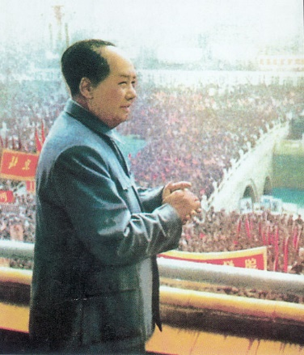
The CCP and Agriculture
As early as September 1949, the Chinese People’s Political Consultative Committee published it’s ‘Common Programme for China’.
Article 3 – ‘the PRC…must systematically transform the feudal and semi-feudal land ownership system into a system of peasant land ownership.’
Article 27 – ‘…agrarian reform is the necessary condition for the development of the nation’s productive power and for its industrialisation.’

Slide 7
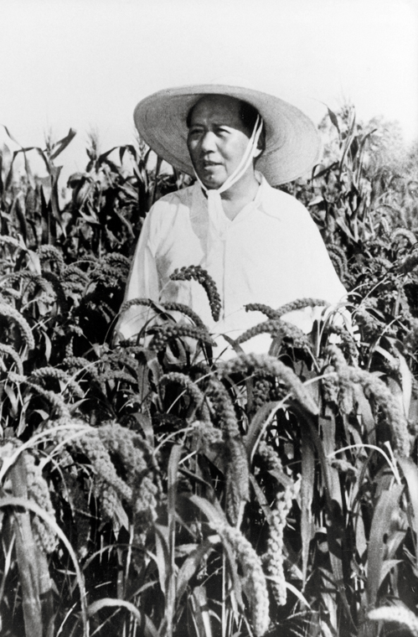
Debates over Agricultural Policy
All members of the CCP agreed with Mao that collectivisation and boosting production were the key aims for agricultural policy.
However the key debate within the CCP during Mao’s rule (1949-1976) was over the pace of change and how best to boost production.
Mao believed that China should try to collectivise as rapidly as possible using mass campaigns and propaganda. Others favoured a slower, measured and bureaucratic approach with financial incentives.

Slide 8
Changes in Policy over Time
Agricultural policies therefore fluctuated between periods of rapid change and rapid reversal. The main periods of change:
1950-1953: Initial land reforms
  1950 Agrarian Reform Law and 1951 Mutual Aid Teams
1953-1955: First attempts at greater collectivisation
  First Five Year Plan and Agricultural Producer’s Co-operatives (APCs)
1955-1957: Rapid growth of collectivisation
  1955 Higher Stage APCs
1958-1961: Drive to full collectivisation
  The Great Leap Forward and People’s Communes
1961-1966: Reversal and Decline of Collectivisation
  Breakup of Communes and Rural Capitalism

Slide 9
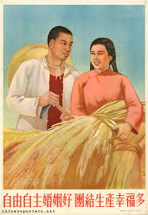
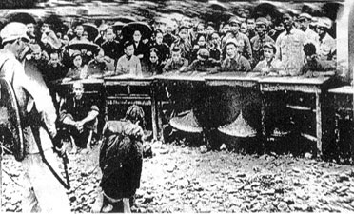
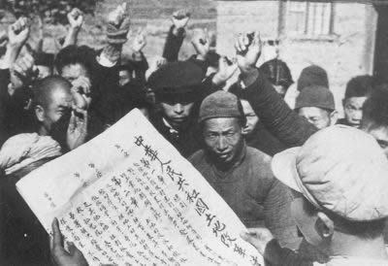
1. Land Reform 1950-1953
The policy of destroying the elite landlord class and redistributing land to the peasants was a key source of support for the CCP before 1949.
The 1950 Agrarian Reform Law called for the ‘abolition of the land ownership system of feudal exploitation.’
It was implemented by teams of 30-40 Party Cadres who would go to each village and organised ‘accusation meetings’. Peasants were encouraged to denunciate and attack landlords and some rich peasants.

Slide 10
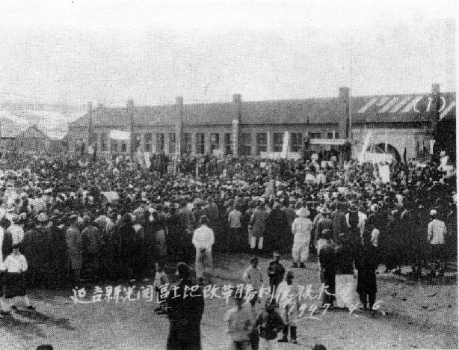

Slide 11
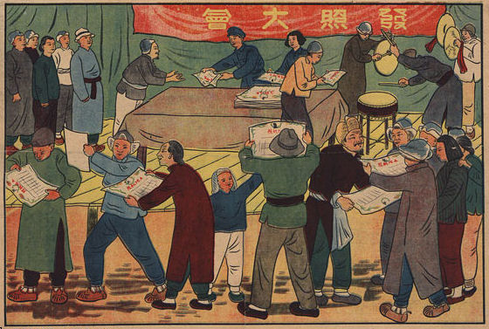

Slide 12
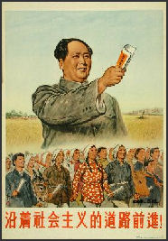
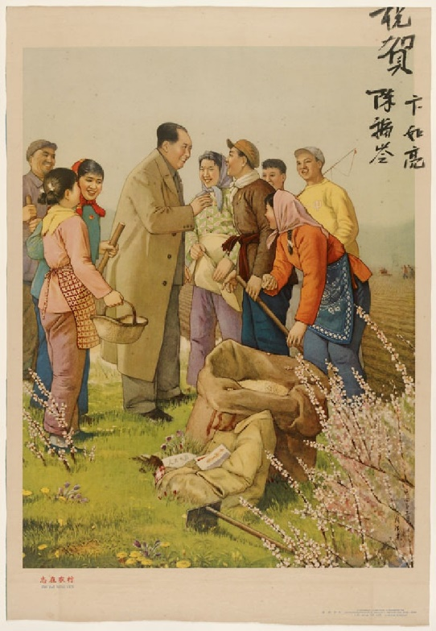
1. Land Reform 1950-1953
Violence was encouraged as it ‘cemented’ the relationship between the peasants and the communist revolution. Between 700,000 – 3 million landlords were killed as a result.
By the end of 1952, land reform was complete. The landlord class were destroyed. 700 million ‘mou’ (1/6 acre) was re-distributed to over 300 million peasants – success?
However land reform did nothing about collectivisation. It left the land in private hands. Mao claimed that peasants showed a ‘spontaneous tendency towards capitalism’.

Slide 13
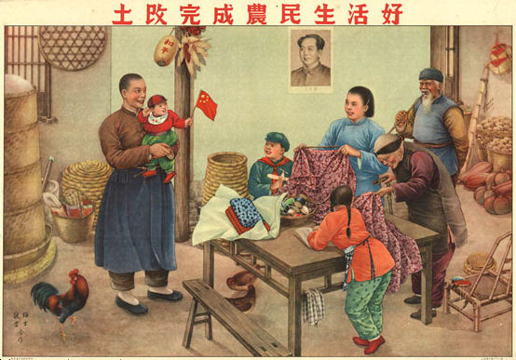

Slide 14
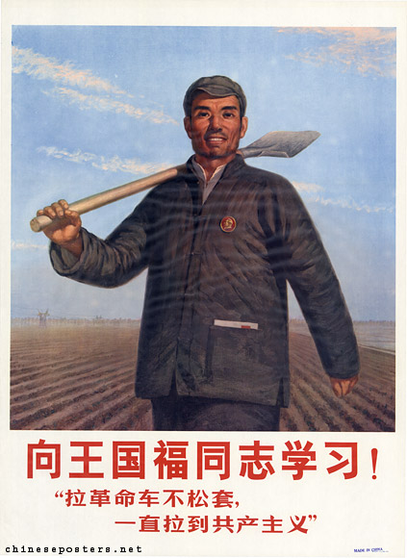
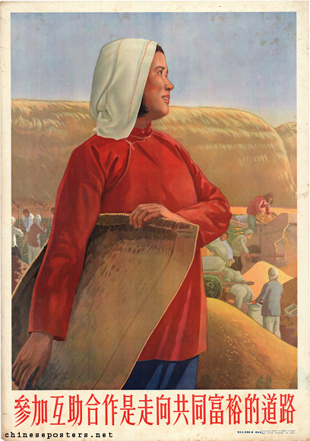
1. Land Reform 1950-1953
Many in the CCP agreed that in 1952-53, China was not ready for rapid collectivisation.
The Party feared taking away land from the peasants who had just received it! Over 70% of CCP members came from a rural background.
The CCP began in 1951 by encouraging peasants to co-operate and form ‘Mutual Aid Teams’ of 10 families who would pool their labour, knowledge and equipment.

Slide 15
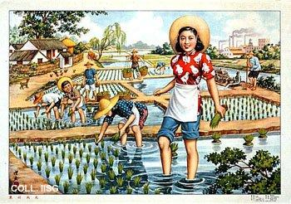
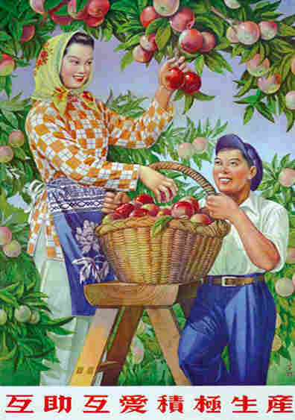
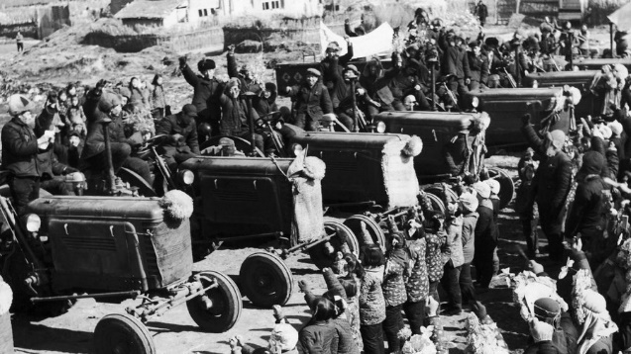
2. Agricultural Co-operatives 1953-1955
In 1953, collectivisation was slowly sped up with the introduction of Agricultural Producer’s Co-operatives (APCs) which grouped 30-50 households together.
Households ‘pooled’ their land together as well as helping each other work the land. Peasants still retained ownership and profits were shared out amongst members.
APCs boosted production as they enabled villages to end strip farming, create larger plots, cut travel times and share the costs of new farming machinery and equipment.

Slide 16
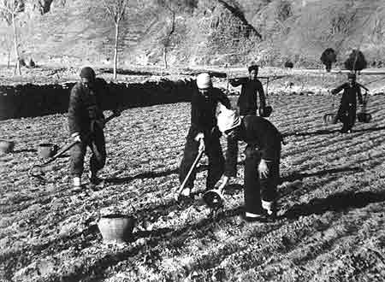
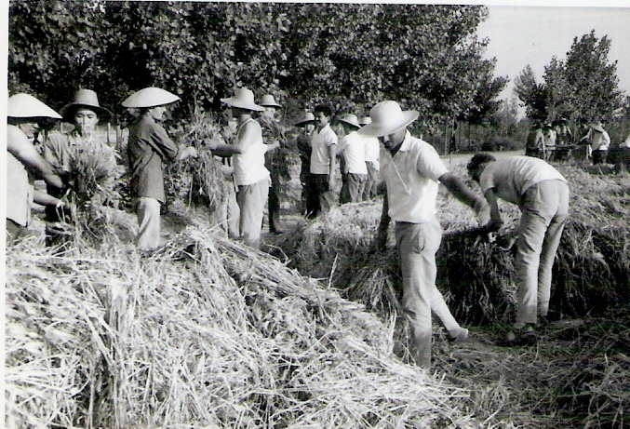
2. Agricultural Co-operatives 1953-1955
Despite the introduction of APCs, the move towards greater collectivisation slowed between 1953-55.
Many APCs were inefficiently run by eager but inexperienced Party Cadres. Many got into debt. In Spring 1953 Mao cautioned against ‘rash advance’.
The halt in collectivisation only encouraged wealthy peasants to prosper. In 1955 Mao campaigned against ‘rash retreat’ and sped up the introduction of APCs.

Slide 17
3. Higher Stage APCs 1955-1957
With the economy growing, Mao pushed towards collectivisation by merging APCs into ‘Higher-stage’ APCs of 200-300 households.
Peasants could still own their land but all land was ‘pooled’. Profits were distributed according to time worked. The government enforced the move by withholding loans to farms who didn’t join the higher-stage APCs.
In 1955, only 17 million households in APCs. By January 1956 this leapt to 75 million. By December 1956, only 3% of all land was in private ownership.

Slide 18
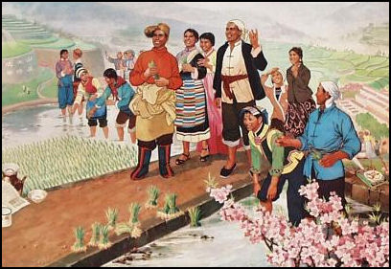

Slide 19
3. Higher Stage APCs 1955-1957
In 1957, Mao proclaimed that ‘collectivisation is 15 years ahead of schedule’. Collectivisation seemed to be boosting production. It also strengthened the CCPs control over the countryside.
Agricultural production on rose on average by 3% between 1953-1957 however Mao began to believe that anything was possible!
Spence (1990) argued that peasants were better fed in 1957 than in 1950. However Chang & Halliday (2006) argued that peasants experienced severe hardships during collectivisation.

Slide 20
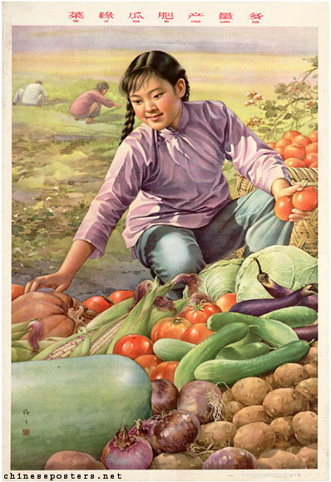
4. People’s Communes and the GLF
In 1958 Mao launched the Second Five Year Plan or ‘Great Leap Forward’. He believed the communist society was within reach if only China sped-up industrialisation and collectivisation.
He argued that this could be achieved by ‘de-centralising’ control of the economy to local Party Cadres and Co-operatives, rather than by the centralised bureaucracy of government.
He confidently declared in 1958 that China could catch up with the West within 15 years!

Slide 21
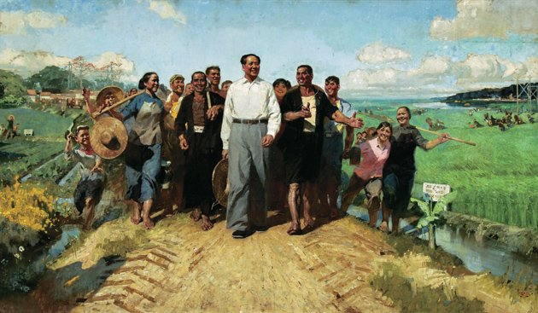

Slide 22
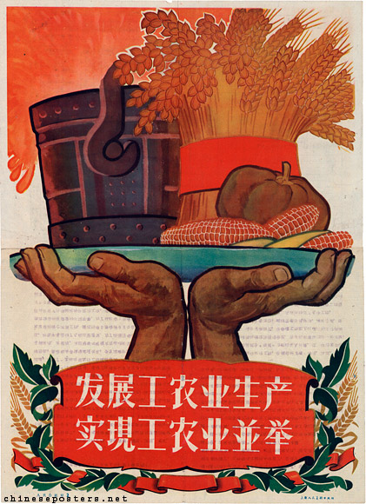
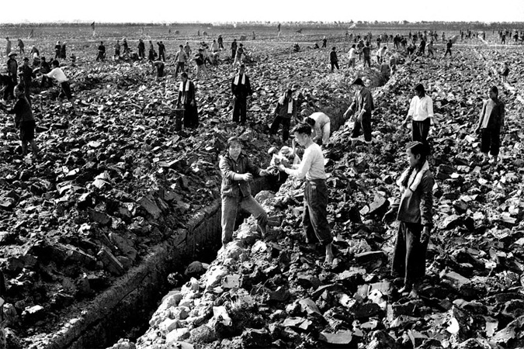
4. People’s Communes and the GLF
The Great Leap Forward was driven by Mao’s over-confidence. He bravely declared in December 1958 that Grain Production in 1959 could reach 430 million tonnes. This was double what had ever been produced!
Mao introduced further collectivisation to achieve this with the ‘People’s Communes’. These became the basic unit of rural society and took on the functions of local government and military units.

Slide 23
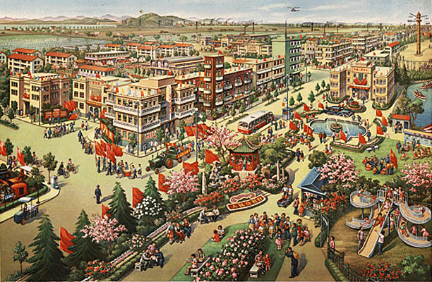

Slide 24
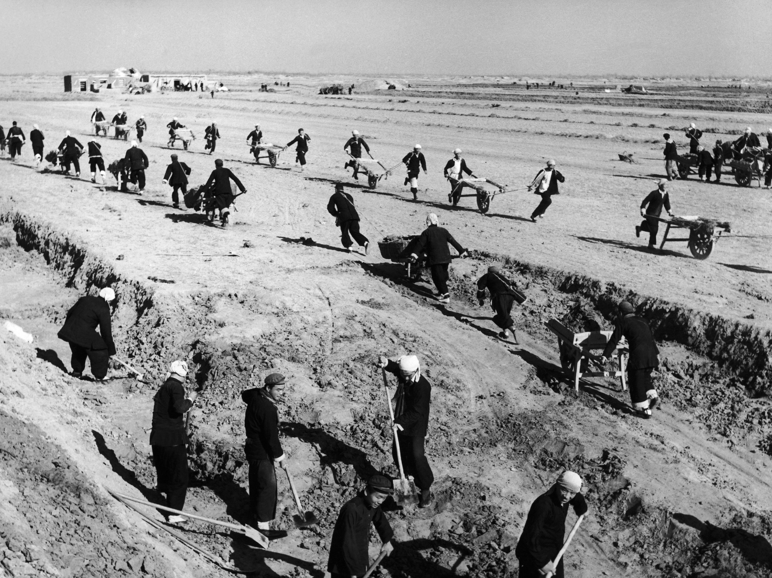

Slide 25
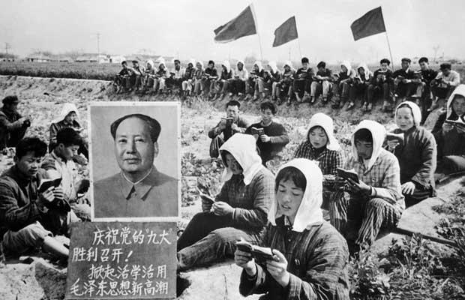
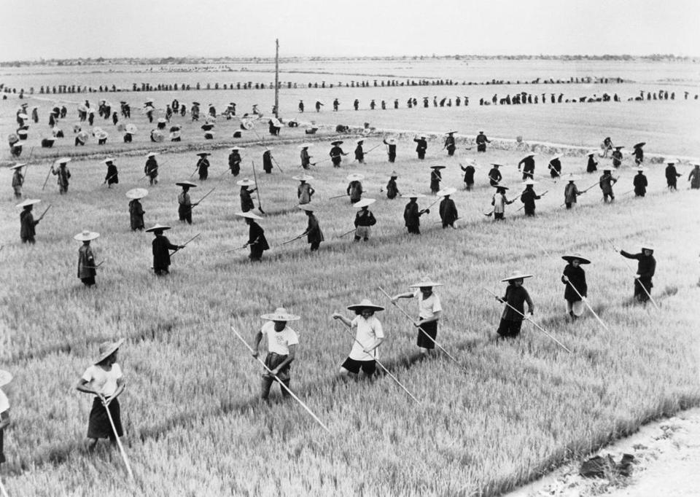
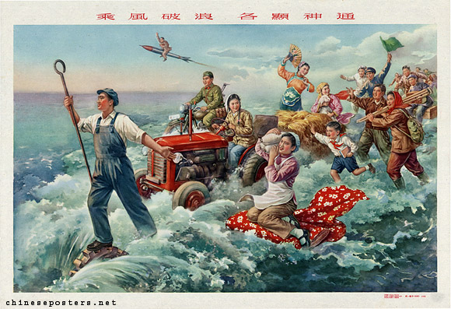
4. People’s Communes and the GLF
By the early 1960s there were about 70,000 Communes in China. Each Commune contained 25,000 people or 30 APCs or 5000 households.
Communes completely abolished private land ownership and were organised on military principles. Private family life was effectively destroyed.
Children were placed in kindergartens enabling women to work and old people lived in ‘happiness homes’.

Slide 26
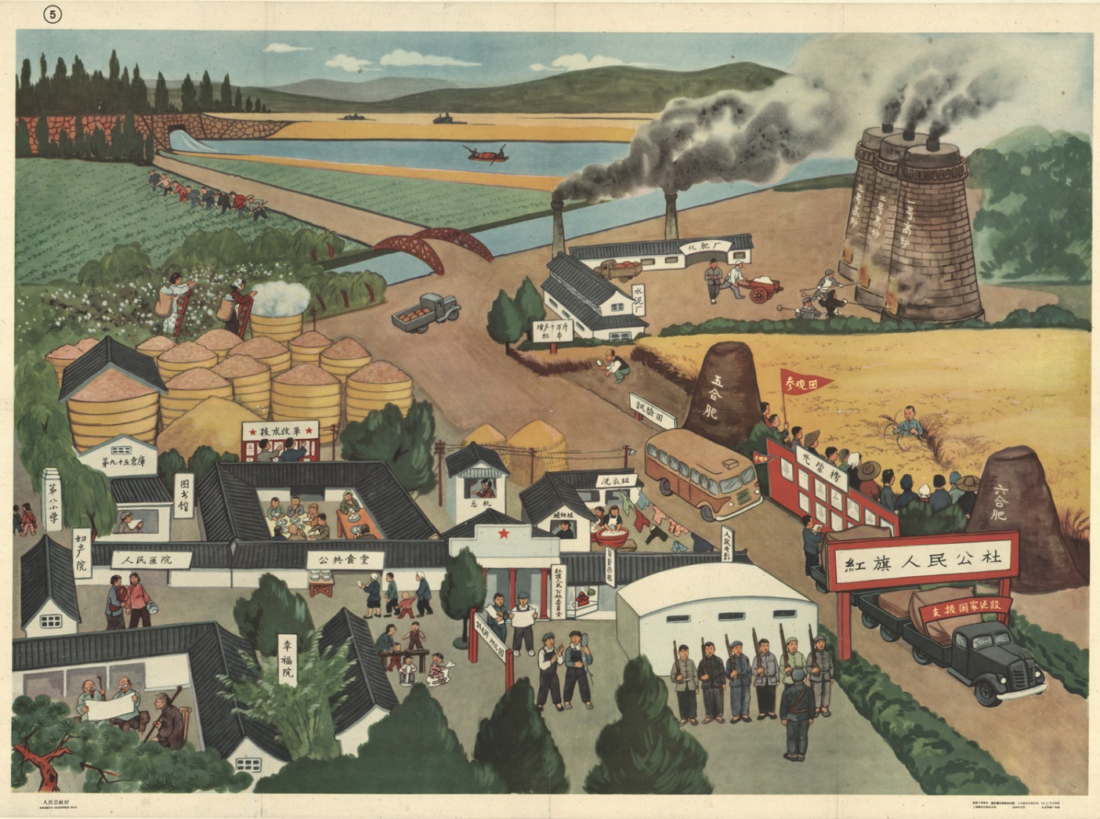

Slide 27
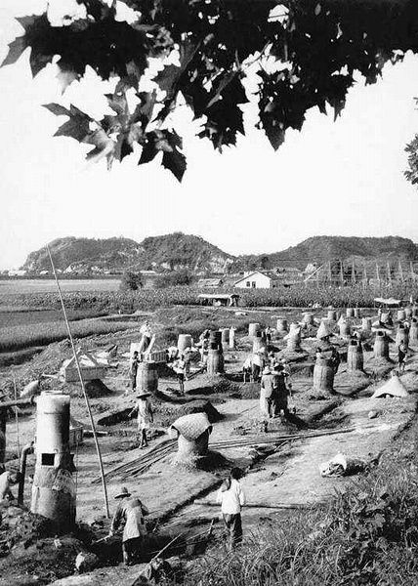
4. People’s Communes and the GLF
Communes were divided into Brigades of 1,000 people and then Production Teams of around 150 people.
Peasants were forced to eat in communal canteens and had to take part in industrial work as well.
Farming life was dictated by the Communes leaders who were often inexperienced Party Cadres.

Slide 28
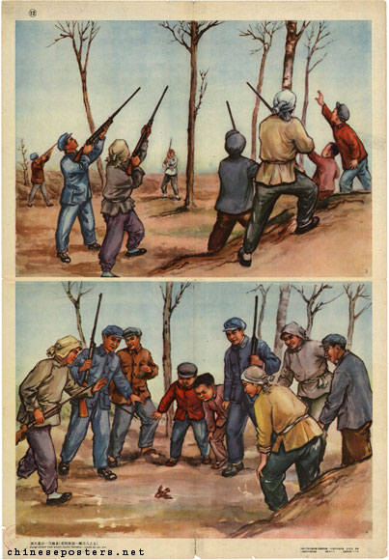
4. People’s Communes and the GLF
In 1958 an ‘8-Point Agricultural Constitution’ was published which was based on the fraudulent theories of Soviet ‘scientist’ Lysenko – ‘Lysenkoism’
The government even told each Commune when, where and how to farm. In one case, the gov. encouraged the mass killing of sparrows and other pests. This only encouraged others pests to destroy crops!
Communes were told to plant crops closer together and plough deeper. These policies failed to boost production.

Slide 29
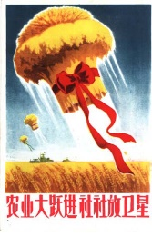
4. People’s Communes and the GLF
The Great Leap Forward began with success in 1958. Mao claimed 375 million tonnes of grain had been produced. He set the target for 1959 at 430 million tonnes!
In 1959 only 170 million had been produced due to a bad harvest. In 1960 this dropped to 143 million.
Despite this, production figures continued to be inflated by Communes eager to please Mao and seeking to avoid missing quotas.

Slide 30
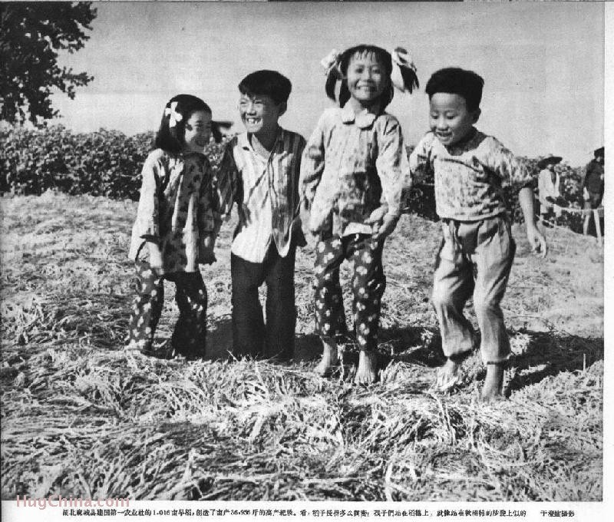
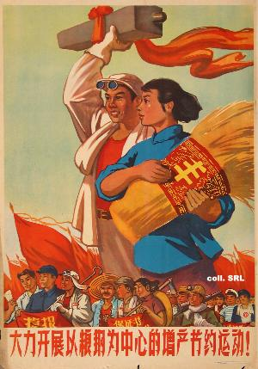
4. People’s Communes and the GLF
This just encouraged the government to requisition even more grain from the Communes.
Propaganda even encouraged peasants to keep consuming food as apparently there was plenty!
Despite falling production, China kept exporting food to the USSR to payback loans.

Slide 31
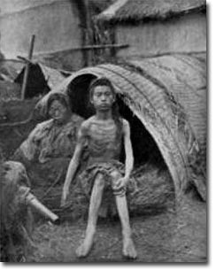
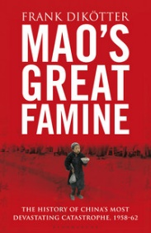
4. People’s Communes and the GLF
By 1959, food began to run-out. It was clear that the Commune system was not producing enough food.
Peasants resented being forced to work on shared land. There was no incentive to work hard and many just hoarded grain.
Between 1959-1962 a nationwide-famine struck. Over 20 million people died in the famine. The Great Leap Forward and collectivisation was a disaster.

Slide 32
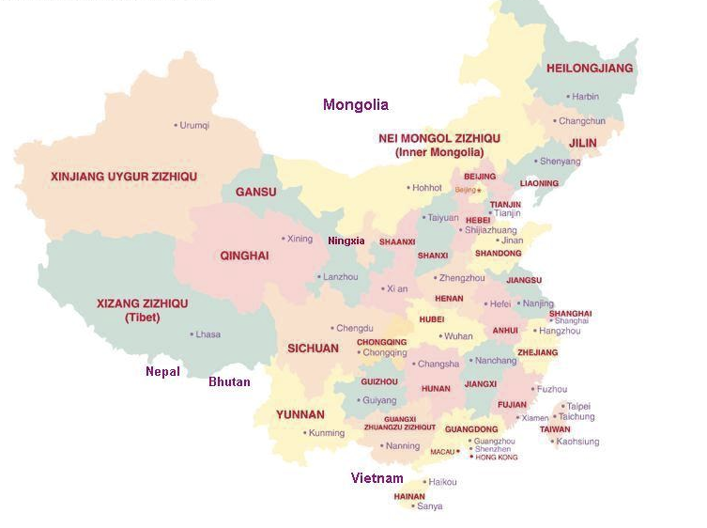
Provinces with the highest death tolls
7.5 mill.
7.8 mill.
8 mill.
1 mill.
9 mill.
1 mill.

Slide 33
Impact of the Great Famine
“arc of misery”
Social disruption
Causes
Collectivization
Lysenkoism
Bad Weather
Deliberate Policy
Why was it so severe?
Disorientation of the peasants
Lushan conference suppressed the truth
Refusal of officials to admit scale of hunger
Mao’s refusal to face facts
A conspiracy of silence
Deliberate genocide

Slide 34
5. Reversal of Collectivisation
As a result of the famine, Mao stepped down as Chairman of the PRC (not the CCP).
From 1961, the government began to reverse Mao’s Commune Policies. Peasants were allowed private land again and communes were broken down in size.
Financial incentives were given to encourage more food production and rural markets began to open again.

Slide 35
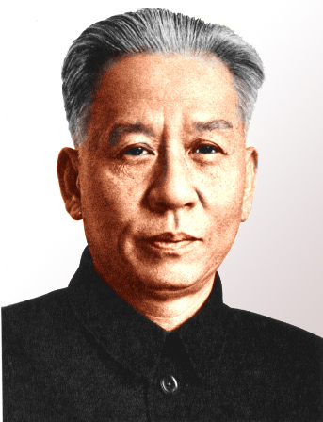
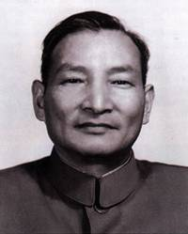
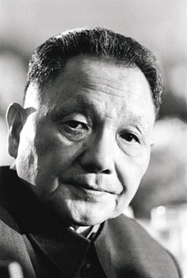
5. Reversal of Collectivisation
The Third Five Year Plan of 1962-1966 restored Central Bureaucratic control over agriculture.
The government began to review production targets and by 1965, agricultural production had returned to 1957 levels.
CCP leaders like Liu Shaoqi, Chen Yun and Deng Xiaoping led these changes. It seemed to prove that Mao’s agricultural policies didn’t work.

Slide 36
Were Mao’s Agricultural Policies a Success?
Yes!
  He had achieved collectivisation of agriculture by 1956 with only 3% of land remaining in private hands.
  APCs and People’s Communes strengthened government control over the countryside.
  The landlord class had been destroyed, land re-distributed.
  Increasing production in 1950s helped to pay for industrialisation.
No!
  Despite initial successes, the GLF showed that the Communes were not an efficient way to boost production – too big and unmanageable.
  Changes after 1961 proved that rural capitalism was a better way to boost production – collectivisation gave no incentive to work.
  The Great Famine of 1959-62 killed over 20 million people!
  Many were murdered during land reform.
  State went back on its word to peasants about re-distributing land.

Slide 38
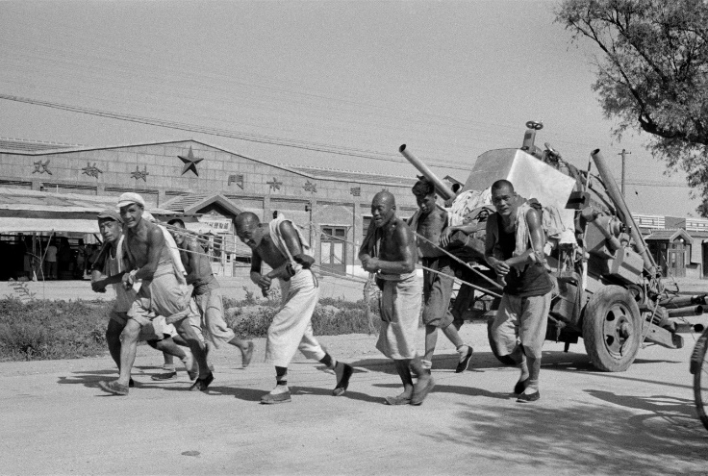
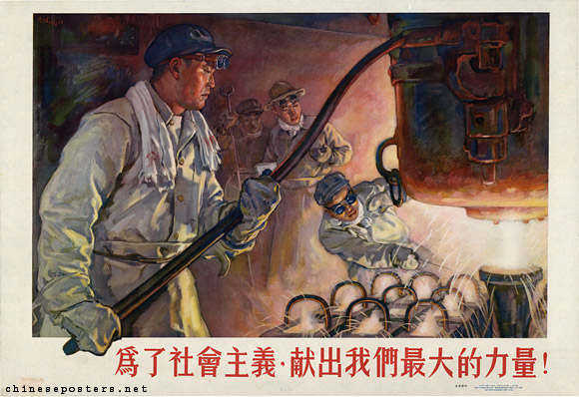
To what extent were Mao’s industrial policies a success?
L/O – To analyse the impact of Mao’s industrial policies and evaluate their successes and failures

Slide 39
The CCP and Industry
As a Marxist organisation, the CCP was committed to ‘building socialism’ in China. This required China to become an industrialised nation.
According to Marx, this also required the ‘collective ownership of the means of production’. i.e. the government needed to control industry and agriculture in order to ‘build’ socialism.
The key focus for Mao in the 1950s was therefore to rapidly develop heavy industry. Lenin had once famously said, ‘there is only one real foundation for a socialist society, and it is large industry.’

Slide 40

The CCP and Industry
As early as September 1949, the Chinese People’s Political Consultative Committee published it’s ‘Common Programme for China’.
Article 3 – ‘the PRC…must steadily transform the country from an agricultural into an industrial one.’
Article 48 – ‘State-owned economy is of a Socialist nature. All enterprises… shall be under the unified operation of the state.’
Article 35 – ‘…the central point of industrial work shall be the planned, systematic rehabilitation and development of heavy industry such as mining…’

Slide 41


Post-War Reconstruction
China was devastated by the Sino-Japanese and Civil War and the CCP embarked on a period of reconstruction after 1949.
The industrial economy was inefficient and 3/5 of manufacturing workers were still self-employed (i.e. private businesses). Under KMT rule, the economy had relied on foreign imports and was constantly in debt.
CCP Cadres also didn’t have much experience in industry. Luckily, over 200,000 employees and engineers of the KMT’s ‘National Resources Commission’ remained in China after 1949.

Slide 42


Post-War Reconstruction
From 1950-1953, the PRC moved quickly to nationalise foreign-owned businesses and reduced foreign trade to an absolute minimum.
A new currency, the renminbi, was introduced to reduce inflation and the government curbed spending and reorganised the tax system by raising rates for urban dwellers.
Government bonds were also sold to raise funds, and consumer goods kept in deliberately short supply to encourage bank savings.
By 1952, inflation had been reduced to 3% (from 70% in 1949) and industrial production had returned to pre-war levels.

Slide 43


Socialist Transformation
For Mao, once in government, he was focused on ‘building socialism’ in China just like the USSR had done in the 1930s.
The ‘Soviet Model’ of development called for rapid industrialisation of heavy industry through ‘Five Year Plans’.
By 1952, the economy had recovered and Mao believed China was ready for Socialist transformation. He believed full industrialisation would only take 15 years!
The ‘First Five Year Plan’ was announced for the years 1953-1957, however plans were not put into practice until 1955 due to planning delays.

Slide 44


The First Five Year Plan - 五年计划
The focus of the Plan was on developing heavy industry like iron and steel, coal, machine-making, chemicals, electricity generation and transport.
Over 25 billion Yuan was invested in 694 industrial projects, 156 of which would be built with Soviet help. 10,000 Soviet specialists were sent to China and 28,000 Chinese received training in the USSR.
These projects would help to double production by 1957 and targets were set for all industrial sectors.

Slide 45

Results of the First Five Year Plan
In many ways the First Five Year Plan was a success. Most production targets were met by 1956 and over fulfilled by 17% on average.
National income grew 8.9% on average and urban workers’ wages grew by 1/3. The urban population rose from 57 million in 1949 to 100 million by 1957.
By January 1956, all private businesses in China had been converted into state-private enterprises, realising the CCP goal of collective ownership over the means of production.

Slide 46


Slide 47


Slide 48
Results of the First Five Year Plan
However there were some problems. In the rush to boost production, quantity over quality was emphasised. Many factories were not efficient.
Serious bureaucratic delays emerged as state planners struggled to plan for growing production, distribution and supply.
Many new workers were illiterate and unqualified, resulting in machinery breakdowns and production delays.
Competition for scarce resources emerged between industries, resulting in supply delays.

Slide 49
Production Data of First Five Year Plan
Industrial Sector | 1952 (actual) | 1957 (target) | 1957 (actual) | 1957 (actual as % of target)
Coal (millions of metric tonnes) | 68.50 | 113.00 | 130.00 | 115%
Steel (millions of metric tonnes) | 1.35 | 4.12 | 5.35 | 129.8%
Cement (millions of metric tonnes) | 2.86 | 6.00 | 6.86 | 114.3%
Electrical Power (billions of kWh) | 7.26 | 15.90 | 19.34 | 121.6%
Locomotives (units) | 20 | 200 | 167 | 83.5%
Trucks (units) | 0 | 4,000 | 7,500 | 187.5%
Insecticide (tonnes) | 600 | 70,000 | 61,000 | 87.1%
Machine Tools (units) | 13,734 | 12,720 | 28,000 | 220.1%
Bicycles (thousands) | 80 | 555 | 1,174 | 211.5%
Merchant Ships (tdwt) | 21.5 | 179.1 | 54.0 | 30.2%

Slide 50
Capital Invested by the State 1952-57
Economic Sector | 1952 | 1955 | 1957
Industry | 38.8% | 46.2% | 52.3%
Construction | 2.1 | 3.9 | 3.3
Prospecting for Natural Resources | 1.6 | 3.2 | 2.2
Agriculture, Forestry, Water | 13.8 | 6.7 | 8.6
Transport and Communication | 17.5 | 19.0 | 15.0
Trade | 2.8 | 3.7 | 2.7
Culture, Education and Research | 6.4 | 6.3 | 6.7
Public Health and Welfare | 1.3 | 1.1 | 0.9
Urban Public Utilities | 3.9 | 2.4 | 2.8
Government Administration | 0.4 | 1.5 | 1.3
Other | 11.4 | 6.9 | 4.2
Total in percentage | 100.0 | 100.0 | 100.0
Total in million yuan | 4,360 | 9,300 | 13,830

Slide 51
Distribution of Gov. Budget 1950-57
Expenditure Category | 1950 | 1952 | 1957
Economic Construction | 25.5% | 45.4% | 51.4%
Social, Cultural and Education | 11.1 | 13.6 | 16.0
National Defence | 41.5 | 26.0 | 19.0
Government Administration | 19.3 | 10.3 | 7.8
Other | 2.6 | 4.7 | 5.8
Total in percentage | 100.0 | 100.0 | 100.0
Total in million yuan | 6,810 | 16,790 | 29,020

Slide 52


The Great Leap Forward
By 1957, State economic planners were busy working on the Second Five Year Plan for the years 1958-1962. However Mao forced through his vision for the SFYP.
In January 1958 Mao confidently announced the ‘Great Leap Forward’ – China will be transformed and catch up with Britain within 15 years.
Mao announced that there should be a 75% increase in industry and agricultural production by 1962. National income would increase by 50%.

Slide 53


Reasons for the Great Leap Forward
Mao was unhappy with the pace of change of the FFYP. Agricultural production had only increased 3.8%.
This was holding back further industrialisation as cities needed more food and more workers. Food was also a key export commodity for China.
Bureaucratic delays led Mao to question whether the central government should be involved with economic planning at all.

Slide 54



Reasons for the Great Leap Forward
Caught up by the euphoria of his own rhetoric, Mao believed that the revolution could be continued and accelerated by mobilising the masses to spearhead economic development.
Facing a lack of opposition from within the Party due to the 1958 Anti-Rightist campaign, Mao began to declare wildly unrealistic production targets for the Great Leap Forward.
State economic policies thus became distorted by Mao’s ideological and political aims.

Slide 55

Aims of the Great Leap Forward
To boost agriculture and ‘build socialism’, Mao called for the creation of ‘People’s Communes.’ These consolidated Higher-State Cooperatives into huge agricultural communes of over 20,000 people.
Under his policy of ‘Walking on Two Legs’, each commune was to become a centre of industry as well as agriculture. By 1958 over 600,000 ‘back-yard’ furnaces were setup all over China to produce steel.
Industrial growth was therefore decentralised and power over economic planning giving to local CCP Cadres, rather than the Central Government.

Slide 57


Slide 58


Slide 59


Slide 60



Aims of the Great Leap Forward
The people would be mobilised by the thousands to construct large-scale engineering projects like dams, bridges, canals and irrigation channels.
The whole economic plan of the Great Leap Forward took on the nature of a military ‘mass campaign’.
Crazy production targets were announced by Mao and local Party Cadres in each commune would exaggerate production figures to please their superiors. This in turn resulted in even higher targets.

Slide 61


Results of the Great Leap Forward
There were some successes. Large-scale dike building, irrigation channels and land reclamation projects sprung up all over China.
The collectivisation of agriculture was complete with over 74,000 communes by the early 1960s.
Initial production figures in 1958 were positive with coal and steel production doubled, electricity generation up 40% and machine tool production trebled.

Slide 62


Results of the Great Leap Forward
Despite this, the GLF was catastrophe overall. The majority of steel produced in backyard furnaces was deemed unsuitable for use. Only 9 million tons was acceptable.
Production and supply delays became disastrous as central government was unable to coordinate resources.
The focus on steel production in the communes resulted in agriculture production declining. This contributed to the famine of 1959-60 in which over 20 million people died.

Slide 63
Agricultural Production Statistics 54-66
Year | Grain Output (million tons) | Grain Procurement (million tons) | Retained Grain per Capita (kg/person) | Rural Labour (millions) | Size of Production Units (households) | Steel and Iron Output (10k tons)
1954 | 170 | 51 | 228 | 182 | 22 | 7.9
1955 | 184 | 48 | 256 | 186 | 33 | 10.2
1956 | 193 | 40 | 284 | 185 | 162 | 16.0
1957 | 195 | 46 | 273 | 193 | 179 | 19.1
1958 | 200 | 52 | 268 | 155 | 2675 | 30.4
1959 | 170 | 64 | 193 | 163 | 1696 | 46.9
1960 | 143 | 47 | 182 | 170 | 1751 | 62.6
1961 | 148 | 37 | 209 | 197 | 354 | 31.0
1962 | 160 | 32 | 229 | 213 | 41 | 23.8
1963 | 170 | 37 | 231 | 220 | 30 | 27.2
1964 | 188 | 40 | 256 | 228 | 31 | 34.4
1965 | 195 | 39 | 261 | 234 | 33 | 43.7
1966 | 214 | 41 | 282 | 243 | 31 | 54.7

Slide 64

Results of the Great Leap Forward
The huge increases in production expected by Mao didn’t materialise. China had to rely on food imports of over 6 million tons a year until the 1970s. This halted industrial growth.
The decentralisation of economic planning was seen as a disaster. Mao himself stepped down as State Chairman in December 1958 and was replaced by Liu Shaoqi.
By 1961 the Great Leap Forward was abandoned and moves were made to reverse Mao’s policies.

Slide 65



The Third Five Year Plan 1962-1966
Initially envisaged as the final stage of socialist construction by Mao, the Third Five Year Plan was marked by a return to the bureaucratic planning of the FFYP and more pragmatic policies.
The return to the ‘capitalist road’ was led by Liu Shaoqi (Chairman of the PRC), Deng Xiaoping (Secretary General of the Secretariat), Zhou Enlai (Premier of the PRC), Chen Yun (Vice Chairman of CCP and Vice Premier of the PRC), and Bo Yibo (Vice Premier of the PRC).
Their economic policies were cautiously implemented to avoid clashing with Mao. After the Lushan Conference of July 1959 in which Defence Minister Peng Dehuai was purged for criticising the GLF, many feared openly criticising Mao.

Slide 66


The Third Five Year Plan 1962-1966
Chen Yun was the key economic thinker of the Plan and his policies were referred to as Chen’s ‘bird-cage’ theories.
The bird represented the free market and the cage a central plan.
Chen proposed a balance should be sought between ‘setting the bird free’ and choking the bird with a central plan that was too restrictive.

Slide 67


The Third Five Year Plan 1962-1966
In reality, the Plan ended the decentralised approach of the GLF. Communal canteens were abandoned, and peasants were allowed to cultivate private plots with financial incentives added.
Rural markets were permitted and communes broken up into smaller units. ‘Supply and Demand’ economics were re-introduced at local levels.
Over 25,000 inefficient industrial enterprises were closed and production targets were more realistically reviewed every year. Financial incentives were given to industrial workers.

Slide 68


The Third Five Year Plan 1962-1966
By 1965 agricultural production had returned to 1957 levels.
Output of light industry expanded by 27% and heavy industry production by 17%. Oil production increased by 1000% and natural gas by 4000%.
This new pragmatic approach to industrial development is best summed up by Deng Xiaoping’s comment in June 1962: ‘It doesn’t matter if the cat is black or white; so long as it catches the mouse, it is a good cat.’

Slide 69


Ideological Difference over the TFYP
Despite the clear successes of the TFYP, Mao’s prestige had clearly suffered as it illustrated that the GLF was wrong.
Mao increasingly attacked the ‘revisionists’ within the Party at Party Conferences throughout 1962-64. In 1964 Mao tried to regain control by launching the ‘Socialist Education Movement.’
It was another mass campaign which called for ‘four clean-ups’ – over 10,000 Party Cadres were sent to rural areas to remove ‘corruption’. Thousands were subjected to struggle sessions and executed.
Despite the campaign, the ideological divisions within the CCP would only grow, culminating in the Cultural Revolution in 1966.

Slide 70


Slide 71
To what extent were Mao’s industrial policies a success? – What other evidence can you find?
Successes
Failures
FFYP achieved 17% increase in industrial production, 8.9% GNP growth, 1/3 urban wage growth, near complete nationalisation of industries, 129% in Steel.
GLF – thousands of large-scale civil engineering projects – irrigation, dams, bridges
GLF – industrial production up 65% by 1958, oil 50%, elec. 40%
GLF – communes completed Mao’s socialisation of production
Expanded government control of labour to achieve targets
Overall GNP growth 1952-1970 = 4-4.5%
Mao allowed capitalist reforms of Deng and Liu in 1960s?
FFYP – Major supply and distribution delays
GLF – 3m/11m tonnes of steel unfit in 1959, backyard furnaces a failure, led to loss of 10% China’s forests
GLF – Agricultural exports declined, industrial production slowed, less credit for industrialisation
GLF – led to split with USSR, removal of Soviet expertise and funding
TFYP – reversed most of Mao’s policies
Failure of GLF led to divisions within CCP over form of economic development – lead to Cultural Revolution

Slide 72

To what extent were Mao’s social policies a success?
L/O – To analyse the impact of Mao’s social policies and evaluate their successes and failures

Slide 73
The CCP and Society
As a Marxist organisation, the CCP was committed to ‘building socialism’ in China. This required Chinese society to undergo ‘socialist transformation’.
Based at first on the reforms of the Soviet Union, the CCP wanted to change all aspects of traditional ‘Confucian’ society in order to build a new ‘socialist’ China.
This required changes to women’s rights, education, healthcare, arts and culture and religion.

Slide 74
Women’s Rights
As early as September 1949, the Chinese People’s Political Consultative Committee published it’s ‘Common Programme for China’.
Article 6 – ‘The PRC shall abolish the feudal system which holds women in bondage. Women shall enjoy equal rights with men in political, economic, cultural, educational and social life. Freedom of marriage for men and women shall be put into effect.’
It is clear from the outset that the CCP was a firm believer in women’s rights and equality.

Slide 75


Mao and Women’s Rights
Mao had personally campaigned for female equality for many years. In 1907 at the age of 14, he had defied his father by refusing his arranged marriage to a girl aged 21.
In 1919 he wrote a series of articles calling arranged marriage ‘indirect rape’. He was inspired by the suicide of a woman in Changsha who didn’t want to get married.
He once said ‘women hold up half the sky’ and believed that genuine equality was necessary for ‘socialist transformation’.

Slide 76



Mao and Women’s Rights
However many have criticised Mao’s views on women’s rights. In his later years, Mao kept his own personal PLA ‘Dance Troop’ which in reality acted like his own imperial concubines.
Despite outlawing footbinding, arranged marriages and dowries and making divorce easier in the Jiangxi Soviet and Yanan Base Area in the 1930s and 40s, discrimination still existed.
Ding Ling, China’s leading feminist writer in the 1940s/50s, described Mao and the CCP as ‘hypocrites’ after witnessing their treatment of women at Yanan.

Slide 77


Traditional Role of Women in China
Despite CCP promises, it was hard to break the pattern of tradition that held women in servitude.
China was traditionally a very ‘patriarchal’ society. Based on the teachings of Confucius, daughters owed obedience to their fathers, wives to their husbands, and widows to their eldest sons.
Arranged marriages, dowries, foot-binding, concubinage and a lack of education kept women in bondage. Despite advances in women’s rights in the 1920s-40s, many rural areas still treated women in the same traditional way.

Slide 78


1950 New Marriage Law
The CCP issued the New Marriage Law soon after coming to power.
It outlawed arranged marriages, payment of dowries, banned concubinage, and gave unmarried, divorced or widowed women the same right to property as men. It also enabled women to divorce men on equal terms.
These reforms, combined with increasing educational opportunies, created the legal and social framework for women to establish equal rights.

Slide 79


Land Reform and Collectivisation
The land reform campaigns of 1950-1953 also benefitted women. For the first time, many women were granted land titles in their own names. This boosted the economic position of many women.
However this ended as collectivisation was unleashed in 1953-1962, as private land holdings were taken away.
The Great Leap Forward of 1958 also initiated CCP attacks on the family itself as a basic social unit. The role of women as mother’s was attacked.

Slide 80


Land Reform and Collectivisation
The creation of ‘People’s Communes’ during the GLF almost entirely destroyed traditional family life.
Men and women were often forced to sleep in separate quarters. Children were kept in Commune kindergartens so women could work.
Whilst the communal canteens meant that women didn’t have to cook anymore, it totally destroyed their roles as mothers. Equality also meant that women had to undertake heavy manual work at the same pace as men.

Slide 81


The Great Famine 1958-62
As the ‘Mao-made’ famine of the GLF worsened, women were proportionately more effected.
Many mothers found it impossible to feed their children. Instances of child abandonment and cannibalism became common. These orphans became victims of exploitation and sexual abuse.
Divorce rates rose, wife-selling became common and prostitution rose as women struggled to survive and feed themselves.

Slide 82


The Cultural Revolution 1966+
The result of the GLF and the famine was that it disrupted traditional family life, breaking down the role of women as mothers.
To make matters worse, the Cultural Revolution re-emphasised the importance of the individual over the family. Loyalty and worship of Mao came before family.
The traditional ‘nuclear family’ became attacked by Red Guards as one of the ‘four olds’. Children were encouraged to inform on parents and personal love with seen as a ‘bourgeois attachment’.

Slide 83
To what extent were Mao’s policies towards women a success?
Successes
Failures
1950 New Marriage Law achieved legal equality for women – banned concubinage, arranged marriages, dowries, easier divorce, land rights
Educational reforms allowed equal access and career advancement
Female participation in workforce + 8% in 1949 to 32% in 1976
Land reform improved economic position of women, broke male land holding tradition
Communes enabled women to break free of traditional roles
Destruction of family life in GLF/CR increased loyalty to Mao & State
Despite new laws, ingrained prejudice still existed within CCP and in society – boys still favoured over girls
Women only 13% CCP membership, Song Qingling – inequality within CCP
Female members of National People’s Congress only increased from 14% in 1954 to 23% in 1975
Collectivisation took away female land holdings, forced women to do same heavy work as men, took away family life
Great Famine – women disproportionately affected, child abandonment, cannibalism, wife-selling, prostitution
Regional differences – Muslim Xinjiang

Slide 84


To what extent were Mao’s educational policies a success?
L/O – To analyse the impact of Mao’s education policies and evaluate their successes and failures

Slide 85
The CCP and Society
As a Marxist organisation, the CCP was committed to ‘building socialism’ in China. This required Chinese society to undergo ‘socialist transformation’.
The CCP based their reforms on the USSR. Rapid industrialisation was called for but this required a growth in educated technocrats who could design and manage new industrial projects.
The political indoctrination needed to transform society could also only be achieved if the people were literate. Education was therefore a key policy area for the CCP.

Slide 86
The CCP and Education
Article 41 – ‘…education of PRC shall be New Democratic – national, scientific and popular… raise cultural level of people…train personnel for national reconstruction…’
Article 43 – ‘…develop the natural sciences in order to serve industrial, agricultural and national defence…’
Article 44 – ‘…application of scientific-historical viewpoint to the study of history, economic, politics, culture and international affairs.’
Article 46 – ‘…PRC shall reform the old education system, subject matter and teaching methods.’
Article 47 – ‘…universal education shall be carried out, secondary and higher education shall be strengthened, technical education shall be stressed.’

Slide 87


Traditional Education System
For thousands of years, the Chinese education system was based around the ‘imperial examinations’. Only 5% passed per year and the costs of education meant that only the elite classes of Chinese society benefitted.
The curriculum for the imperial exams was based on classical texts and subjects such as poetry.
The education system therefore bred intellectuals that were conservative and accepting of the social order as they benefitted from it.

Slide 88


Post 1911 Changes to Education
The Imperial Examination system was abolished by the late Qing government in 1905. Attempts were made to reform and strengthen the system.
Throughout the 19th century and early 20th century, Western education had grown in China, mainly through missionary institutions.
By 1949 there were 31 British or American schools and over 32 Christian schools, all based on a Western education. Richer Chinese often sent their children overseas to Western universities.

Slide 89


The CCP and Education
The education system the CCP took control of in 1949 was therefore in need of reform. Only 20% of children went to primary school and only 30% of the population was literate.
Despite a growing professional class since 1911, education was non-existent for most peasants.
If the CCP was going to transform society, it needed to raise the basic literacy of the peasants AND rapidly develop higher education in order to produce educated industrial specialists and technocrats.

Slide 90

Mao and Education
Mao’s views on education and his own experience reflected the contradictions within the Chinese education system.
As a Marxist, Mao believed that the traditional Chinese system only served the elites and had to be reformed, yet he himself had read many of the classics!
As a nationalist, Mao opposed Western influences in education as a form of ‘cultural imperialism’.
From his own background as a largely self-taught student and peasant organiser, Mao believed learning should come from direct experience, rather than from formal study of books.

Slide 91



Primary School Education
Upon taking power, the CCP focused its investment into primary schooling, hoping to raise the basic literacy rate. In this regard it was successful.
In 1956 only 50% of 7-16 year olds were in full-time education. This reached 96% by 1976. Literacy rates also increased from around 20% in 1949 to over 70% by 1976.
This was achieved by introducing the ‘pinyin’ simplified form of Mandarin in 1955 which eased the learning process. ‘Minban’ or ‘work-study schools’ were created in each village throughout China to cater for peasant children. These were expanded during the Great Leap Forward.

Slide 92


Higher Education
Despite the increase in basic literacy and primary school provision, China under Mao struggled to increase the quantity and quality of higher education.
To promote the growth of technical specialists, technical education and the natural sciences were promoted. Liberal arts programmes were abolished and 20 new polytechnic colleges and 26 new engineering institutes were setup.
During the Great Leap Forward, over 20,000 students were sent to the USSR for technical training.

Slide 93



Higher Education
Growth in higher education was slow however as the primary school system was producing students of poor quality.
Mao’s de-centralising economic policies during the Great Leap Forward actually took power away from educated specialists and his attitude towards intellectuals during the Anti-Rightist Campaign on 1957-58 resulted in over 300,000 technocrats loosing their jobs.
The failures were telling by 1982. Less than 1% of all workers had degrees, only 11% had post-16 education, only 26% had 12-16 education and only 35% had post-12 education. Only 6% of government politicians had degrees!

Slide 94


Impact of the Cultural Revolution
Between 1966-70, the Cultural Revolution decimated the education system. Over 130 million students stopped attending school!
Education itself was attacked as an ideal with teachers physically assaulted and schools damaged. Technical education was prevented – all learning had to serve the ‘revolution’.
This generation of students became known as the ‘lost generation’ and education was set back in China.

Slide 95


Attitude toward Intellectuals
In many ways, the failures in education were due to CCP disagreements over how to treat intellectuals.
On taking power, in 1950-51, tens of thousands of intellectuals had to undergo ‘thought reform’ and struggle sessions. This made them fearful to speak out when problems within the education system emerged. Yet China needed them!
New members of the CCP after 1949 were often contemptuous of educated cadres and education itself became no barrier to career advancement. Ideological loyalty became more important than educational experience.

Slide 96
To what extent were Mao’s education policies a success?
Successes
Failures
Party achieved almost total primary-age schooling provision by 1976.
Basic literacy amongst the population increased from 20% to over 70% by 1976.
New technical and engineering colleges were established and Soviet education methods became embedded.
Western influences were stamped out and education system was key to enforcing Marxist orthodoxy.
Higher education reforms were a failure – only 1% workers had degrees by 1982.
Cultural Revolution completely destroyed an entire generations’ education.
Village ‘minban’ schools were of poor quality and did nothing to raise the career aspirations of poor peasant families.
‘Key Schools’ formed in each district which attracted the best students and teachers. They became school for CCP families, entrenching corruption and elitism.
Intellectuals were scared into silence due to 100 Flowers Campaign and education became less valued due to the Cultural Revolution.

Slide 97


To what extent were Mao’s healthcare policies a success?
L/O – To analyse the impact of Mao’s healthcare policies and evaluate their successes and failures

Slide 98
The CCP and Society
As a Marxist organisation, the CCP was committed to ‘building socialism’ in China. This required Chinese society to undergo ‘socialist transformation’.
Based at first on the reforms of the Soviet Union, the CCP wanted to change all aspects of traditional ‘Confucian’ society in order to build a new ‘socialist’ China.
This required changes to women’s rights, education, healthcare, arts and culture and religion.

Slide 99
Healthcare
As early as September 1949, the Chinese People’s Political Consultative Committee published it’s ‘Common Programme for China’.
Article 48 – ‘National physical culture shall be promoted… attention shall be paid to the protection of the health of mothers, infants and children.’

Slide 100


CCP and Healthcare
Modern Western medicine had first reached China in the 19th century when Christian missionaries arrived. They built hospitals and medical schools, some of which still survive today.
The 1920s and 1930s under the KMT also witnessed a growth in healthcare provision in China’s biggest cities.
However many rural areas suffered from a lack of modern healthcare. Most peasants still relied on traditional Chinese medicine.

Slide 101


CCP and Healthcare
Lacking funds for healthcare, the CCP relied on preventative rather than curative solutions to health problems.
Through the use of mass campaigns like the ‘Patriotic Health Movements’, street and neighbour committees were mobilised on sanitation projects like building sewers, draining swamps and eradicating pests that carried disease.
Focus were put on clean drinking water and treating human waste correctly.

Slide 102


CCP and Healthcare
In rural areas a 3-tier system developed. At the village level, health centres staffed by paramedics existed.
Townships had bigger wards for in-patients and county hospitals had fully-trained doctors.
Despite attempts at improving health, in 1952 only 1.3% of GDP was spent on healthcare.

Slide 103


The Cultural Revolution
During the Cultural Revolution, even doctors were attacked. They were accused of ‘living off the backs of peasants’. Many were suspicious of their long years of training and study.
There were instances of doctors cancelling operations in order to show solidarity by cleaning toilets!
The ‘Barefoot Doctors’ program was created by Mao during the Revolution to ‘socialise’ healthcare.

Slide 104


The Cultural Revolution
Over 1 million new doctors were trained on short 6 month courses which focused on practical solutions to illness.
These barefoot doctors were then sent into rural areas to provide peasants with free healthcare. The policy was popular and a very visible solution.
However many of these ‘doctors’ had very limited equipment and worked in poor conditions. By 1976, healthcare provision was still poor compared to Western standards.

Slide 105
To what extent were Mao’s healthcare policies a success?
Successes
Failures
Patriotic health movements reduced incidents of endemic diseases like cholera, typhoid and scarlet fever.
Drinking water quality was improved through deep-well construction
Peasant educated boosted awareness of preventative measures.
One million extra ‘barefoot doctors’ were trained.
Healthcare was free for people or at least very subsidised in communes.
Focus on rural areas boosted life expectancy from 32 in 1950 to 69 in 1985.
Great Leap Forward and collectivisation ruined nutrition for many and lead to mass starvation.
Chronic under-investment in modern healthcare and hospitals, only 1.3% of GDP in 1952.
Barefoot doctors well ill-equipped and worked in insanitary conditions.
Rural healthcare programs were short-term solution, economic modernisation and privatisation in 1980s ended rural free healthcare.

