Slide 1
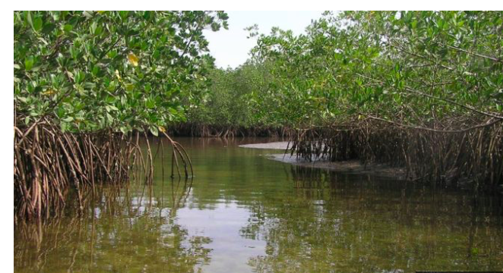
Mangroves
Coasts

Slide 2
Lesson Objectives
Describe coral reefs and mangrove swamps and the conditions required for their development | I can use maps to describe the distribution of Mangrove swamps
 | I understand the conditions the Mangrove swamps need to develop
 | I can distinguish between different types of reef and describe – atoll, fringing and barrier
 | I can give named examples of mangrove swamps and coral reefs
Demonstrate an understanding that coasts present hazards and offer opportunities | I can explain what opportunities are offered by the coast
 | I identify the hazards found on the coast including coastal erosion and tropical storms

Slide 3
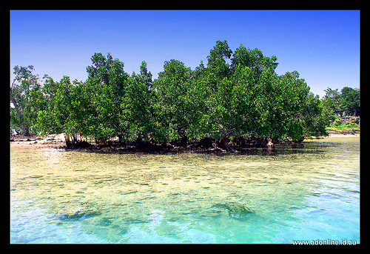
What you need to know
Distribution of ecosystems
Characteristics
Biodiversity
Opportunities and threats

Slide 4
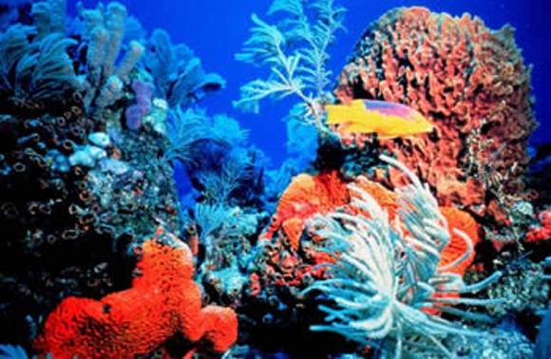
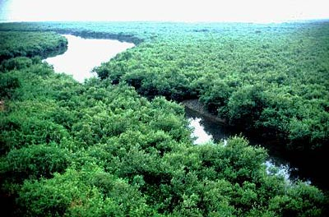
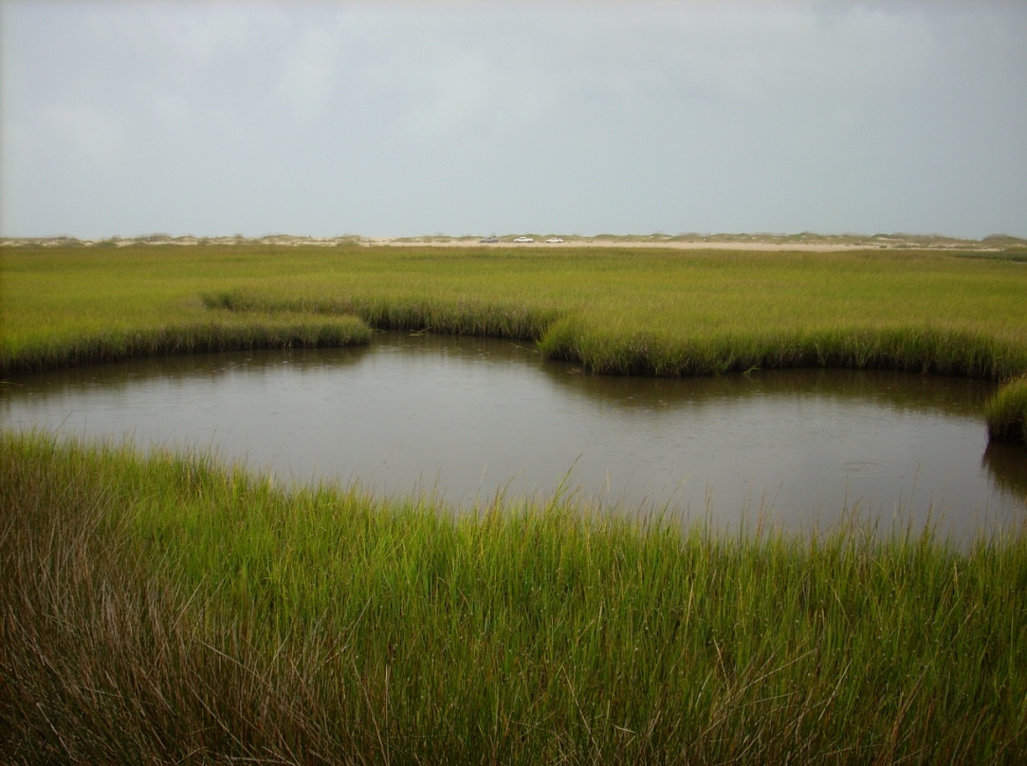
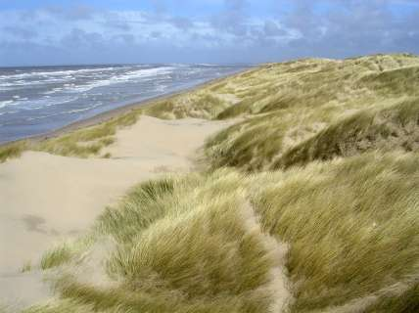
CORAL REEFS
MANGROVES
Coastal Ecosystems
SALT MARSH
SAND DUNES

Slide 5
Use image to describe what a mangrove is like

Slide 6
What are Mangrove forests like?
Mangroves are a tree or shrub which grows in tidal, chiefly tropical, coastal swamps. They have numerous tangled roots that grow above ground and form dense thickets.
It is thought that originate from South-east Asia and then spread across the globe. Because they grow in the intertidal zone, they live in a constantly changing environment.
https://maxwatsongeography.wordpress.com/section-a/coastal-environments/coastal-ecosystems/

Slide 7
Key Definitions
A living community of plant and animals sharing an environment with non-living elements such as climate and soil.
Ecosystem –
Biodiversity -
The number and variety of organisms found within a specified geographic region.

Slide 8
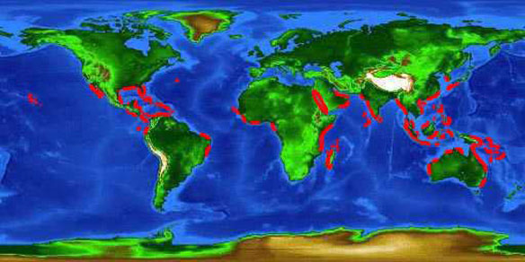
distribution

Slide 9
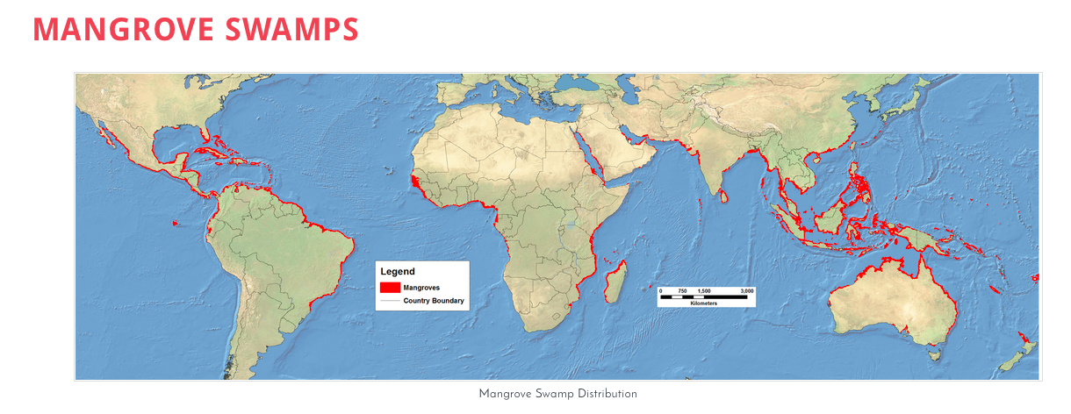
Describe the global distribution of mangrove swamps

Slide 10
Distribution is controlled by the following factors of growth:
Temperatures – Most mangroves grow only 30 degrees latitude of the equator.
Salinity – The water around mangroves has to be of a certain salt content if not the mangrove will suffer, so if fresh water is added to salty water this would be harmful.
Exposure to air – Air is too rich in oxygen and will harm to mangrove if the mangrove is exposed for too long.

Slide 11
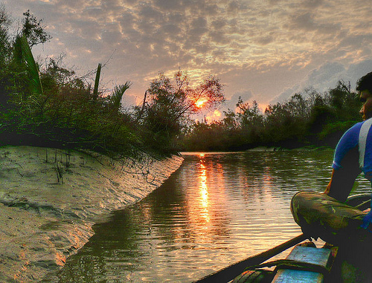
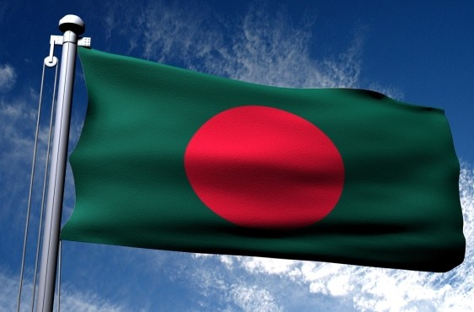
The Sundarbans
Bangladesh

Slide 12
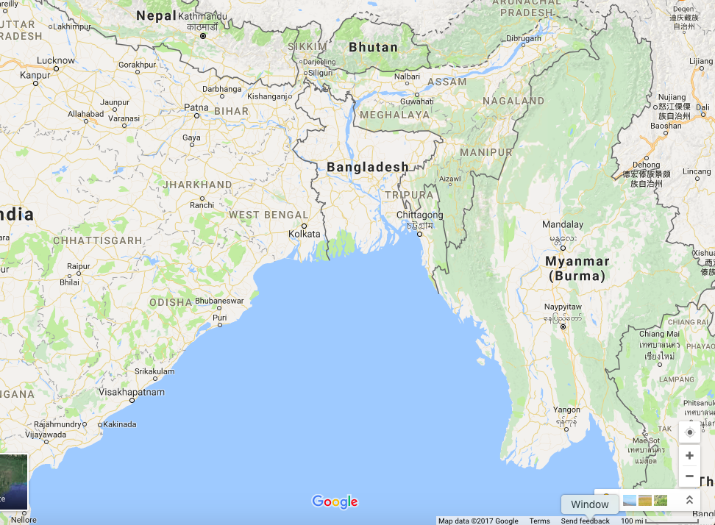
The Sundarbans
The Sundarbans is a natural region in southern Bangladesh and the extreme southern part of the Indian state of West Bengal in the vast river delta on the Bay of Bengal. It is the largest single block of tidal halophytic mangrove forest in the world.
UNESCO world heritage site
http://whc.unesco.org/en/list/798

Slide 13
Task
Watch the Sundarbans DVD. Make notes on:
Location
Characteristics
Threats
Opportunities
Management

Slide 14
Sundarban case study
The Sundarban forest lies in the vast delta on the Bay of Bengal formed by the super confluence of the Ganges, Padma, Brahmaputra and Meghna rivers across southern Bangladesh.
The seasonally flooded Sundarbans freshwater swamp forests lie inland from the mangrove forests on the coastal fringe.
The forest covers 10,000 square kilometres (3,900 sq mi) of which about 6,000 square kilometres (2,300 sq mi) are in Bangladesh.
It became a UNESCO world heritage site in 1997.
The Sundarbans is intersected by a complex network of tidal waterways, mudflats and small islands of salt-tolerant mangrove forests.
The interconnected network of waterways makes almost every corner of the forest accessible by boat. The area is known for the eponymous Royal Bengal tiger, as well as numerous fauna including species of birds, spotted deer, crocodiles and snakes.
The fertile soils of the delta have been subject to intensive human use for centuries, and the Eco-region has been mostly converted to intensive agriculture, with few enclaves of forest remaining.
The remaining forests, taken together with the Sundarbans mangroves, are important habitat for the endangered tiger.
Additionally, the Sundarbans serves a crucial function as a protective barrier for the millions of inhabitants in and around Khulna and Mongla against the floods that result from the cyclones.
The Sundarbans has also been enlisted among the finalists in the New 7 Wonders of Nature.
https://maxwatsongeography.wordpress.com/section-a/coastal-environments/coastal-ecosystems/

Slide 15
The importance of Mangrove forests
http://www.bbc.com/news/science-environment-37386267
Task 1 - Read the above BBC article and use your knowledge from the DVD on the importance of Mangroves as a natural resource and also as flood protection and complete the following tasks.
1. What are mangroves and where do they naturally grow? 2. Explain what 'the roots also act as buffers' mean in terms of protection from flooding and tsunami's 3. What 'death rate comparison' can be made over their effectiveness after the 2004 Asian Tsunami? 4. Outline what is being done to resolve the problem caused by mangrove removal. 5. How is the removal of mangroves also linked to coastal erosion?

Slide 16
Value
Contain Natural Resources – Charcoal, firewood, fish, medicines and other substances can be extracted form mangroves.
Foraging and Living Place for Wildlife – Without mangroves there would be no habitat for animals so there would be no animals.
Reducing Water Pollution – The root systems of mangrove species absorb inorganic substances and reduce water pollution.
Protecting the Coastline – Because the roots of a mangroves act can stabilise the coastlines of the river shores and river mouths. They also protect the coastline from wave erosion.
Flood Prevention – Mangroves can stabilise water capacity of the substratum and on the soil surface, hence steady and retain water to prevent flooding.
Ornamental Value – A mangrove forest is a beautiful environment with a diversity of life that in some peoples eyes is with saving.

Slide 17
Threats
Clearing – Mangrove forests have often been seen as unproductive and smelly, and so cleared to make room for agricultural land, human settlements and infrastructure, and industrial areas.
Overharvesting – While harvesting has taken place for centuries, harvesting of mangroves become unsustainable and threaten their future.
River Changes – Dams and irrigation reduce the amount of water reaching mangrove forests, changing the salinity of water in the forest.
Overfishing – The global overfishing crisis facing the world’s oceans has effects far beyond the directly overfished population. The ecological balance of food chains and mangrove fish communities can also be affected.
Destruction of Coral Reefs – Coral reefs provide the first barrier against currents and strong waves. When they are destroyed, the stronger-than-normal waves and currents reaching the coast can undermine the fine sediment in which the mangroves grow. This can prevent seedlings from taking root and wash away nutrients essential.
Pollution – Fertilizers, pesticides, and other toxic man-made chemicals carried by river systems from sources upstream can kill animals living in mangrove forests.
Climate Change – Mangrove forests require stable sea levels for long-term survival.

