Slide 1
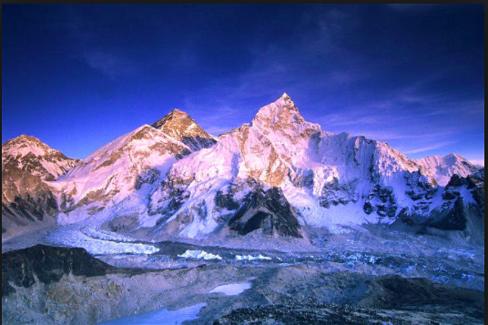
The making of Everest
The making of Everest

Slide 2
The making of Everest
What: To understand how Mt Everest was formed
Why: To understand the geographical processes of tectonics, geology and glaciations
How: Collecting information from a variety of sources and transferring this into an easily understandable cartoon strip

Slide 3
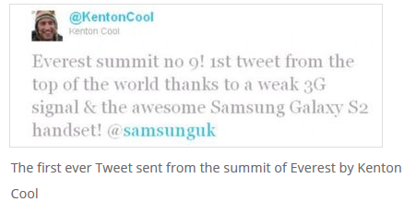
The climber you will see in the video is called Kenton Cool and he holds several Everest records including the one below where he sent the first ever tweet from the summit of Everest.

Slide 4
Objective: To find out how and when Mount Everest (a Fold Mountain) was formed and to see if it is getting taller.
Task 1 - Watch the YouTube video. This is a documentary but you only need to watch up to 10.35. You might find it helpful to make some notes on what you see and hear.
https://www.youtube.com/watch?v=rZNm9_LiyXk&t=628s i. What are the three main layers of rock called that are found on Mount Everest? ii. What were the risks in collecting the samples? iii. What evidence exists to prove that this rock was formed under the oceans?

Slide 5
Pangea
The formation of the Himalyas: https://www.youtube.com/watch?v=PDrMH7RwupQ

Slide 6
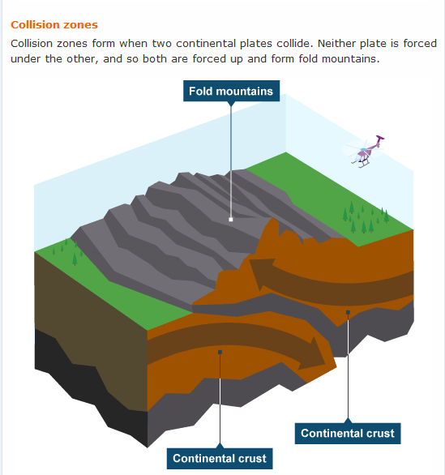
EVEREST - 50 MILLION YEARS IN THE MAKING.
Draw a 4-8 stage cartoon to explain how plate tectonics formed Everest https://www.youtube.com/watch?v=ems9CbXmwNw

Slide 7
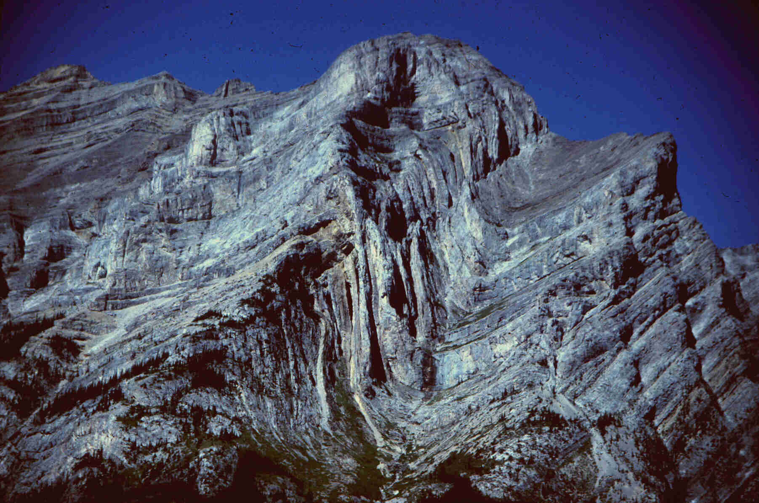

Slide 9
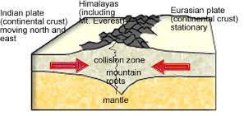

Slide 10
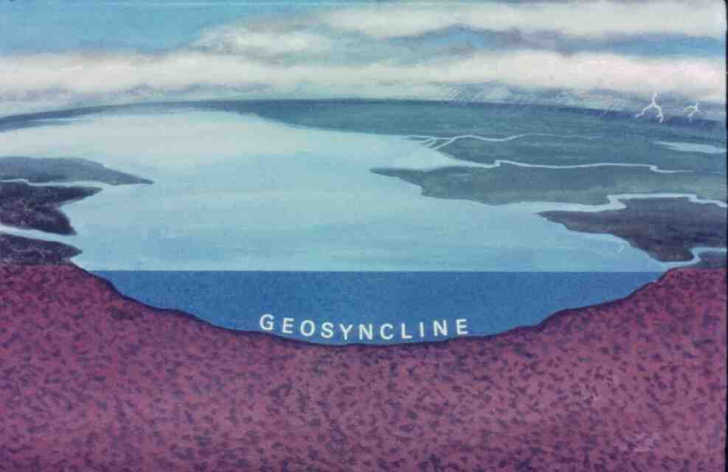

Slide 11
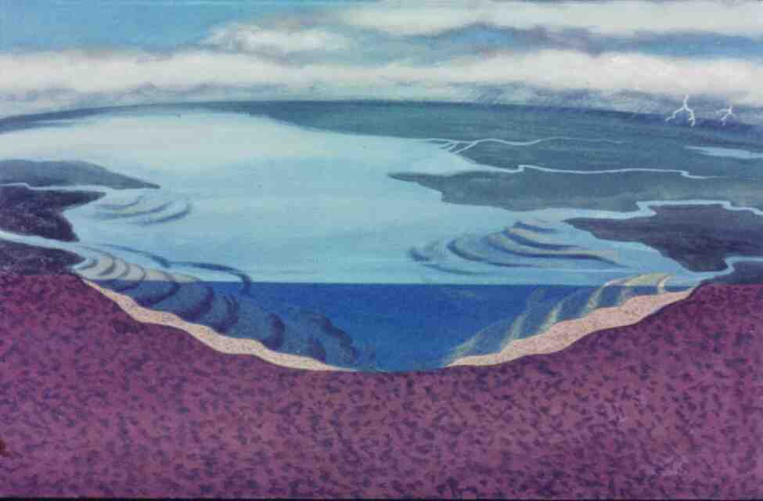
Rivers deposited huge quantities of sediments in depressions called geosynclines

Slide 12
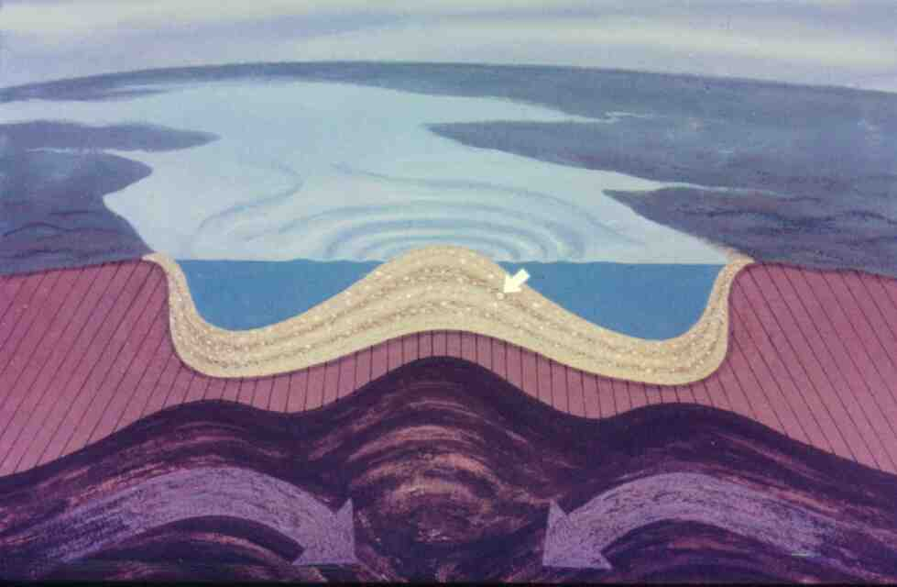
Over millions of years the sediments were compressed into sedimentary rocks such as sandstone and limestone

Slide 13
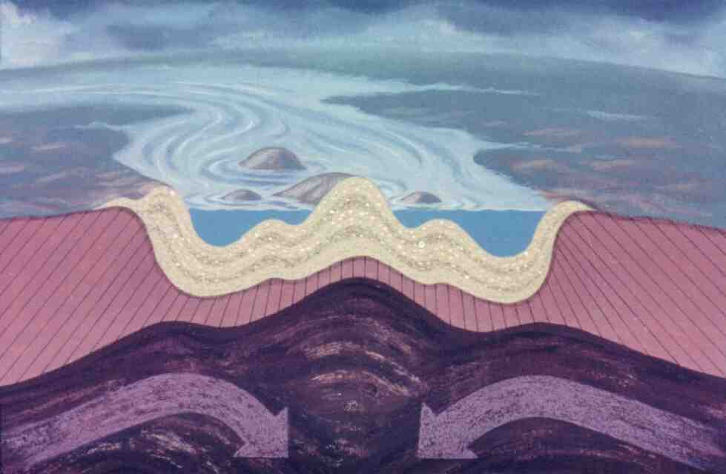
The plates moved together (a compressional boundary) forcing the sedimentary rocks upwards into a series of folds.

Slide 14
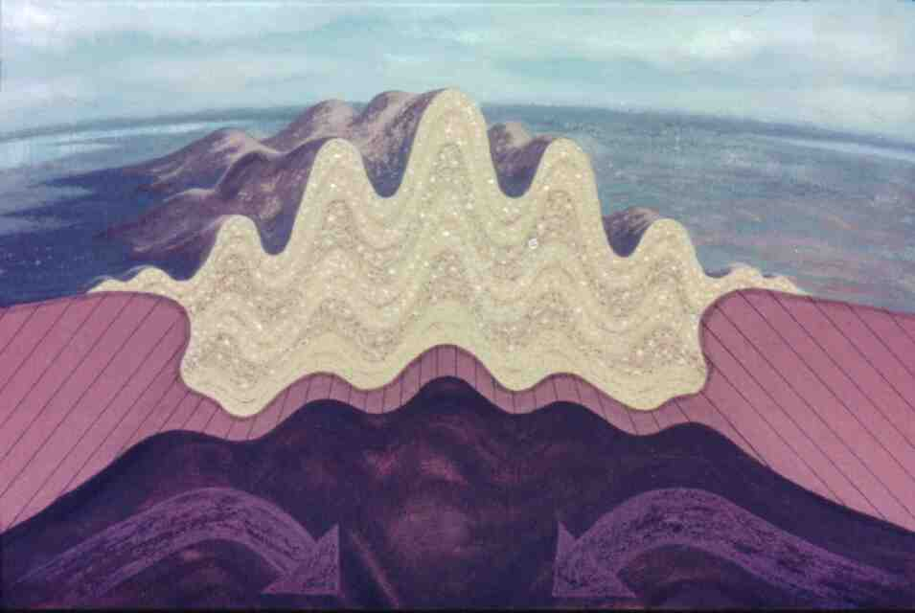

Slide 15
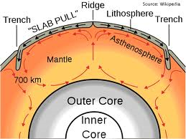
Convection currents

Slide 16
The making of Everest
Indo-Australian plate began moving northwards. About 50 million years ago, the Indian continent (carried by the Indo- Australian plate) started to collide with Eurasia. This began to squash and thicken the edges of the plates and the result of this cataclysmic collision was the buckling up of the land to form the Himalaya. This vast mountain range stretches approximately 2,414 km (1,500 miles) and is home to the world’s highest mountains.
http://www.youtube.com/watch?v=7gXixxYKM80

Slide 17
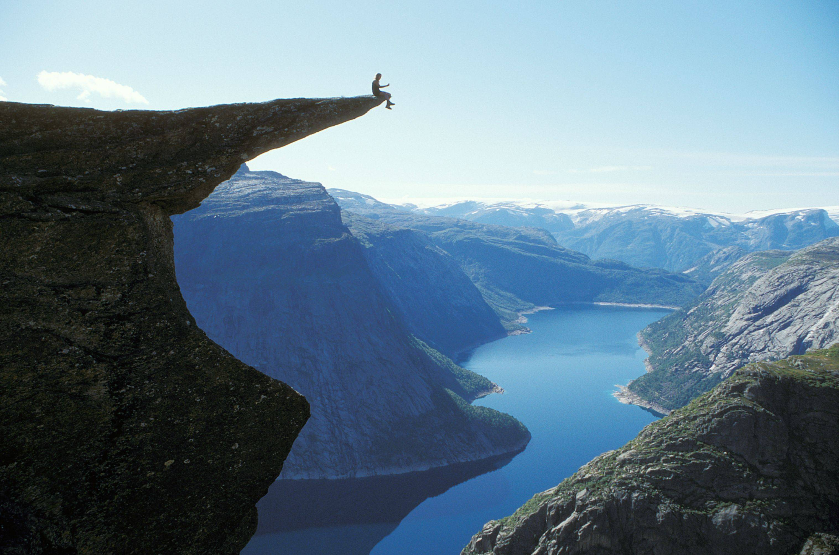
WOW!!!
I wonder how this valley was formed?

Slide 18
An introduction to Glaciation- Why: The shaping of Everest
Key Questions:
What is a glacier
Why study them?
Answers on a post it!

Slide 19
What is a glacier?
A glacier is a huge mass of ice resting on land or floating in the sea next to land, they usually move very slowly. A glacier acts in a similar way to an immense river of ice, often merging with other glaciers in a stream-like manner.
Why are glaciers worth knowing about?

Slide 20
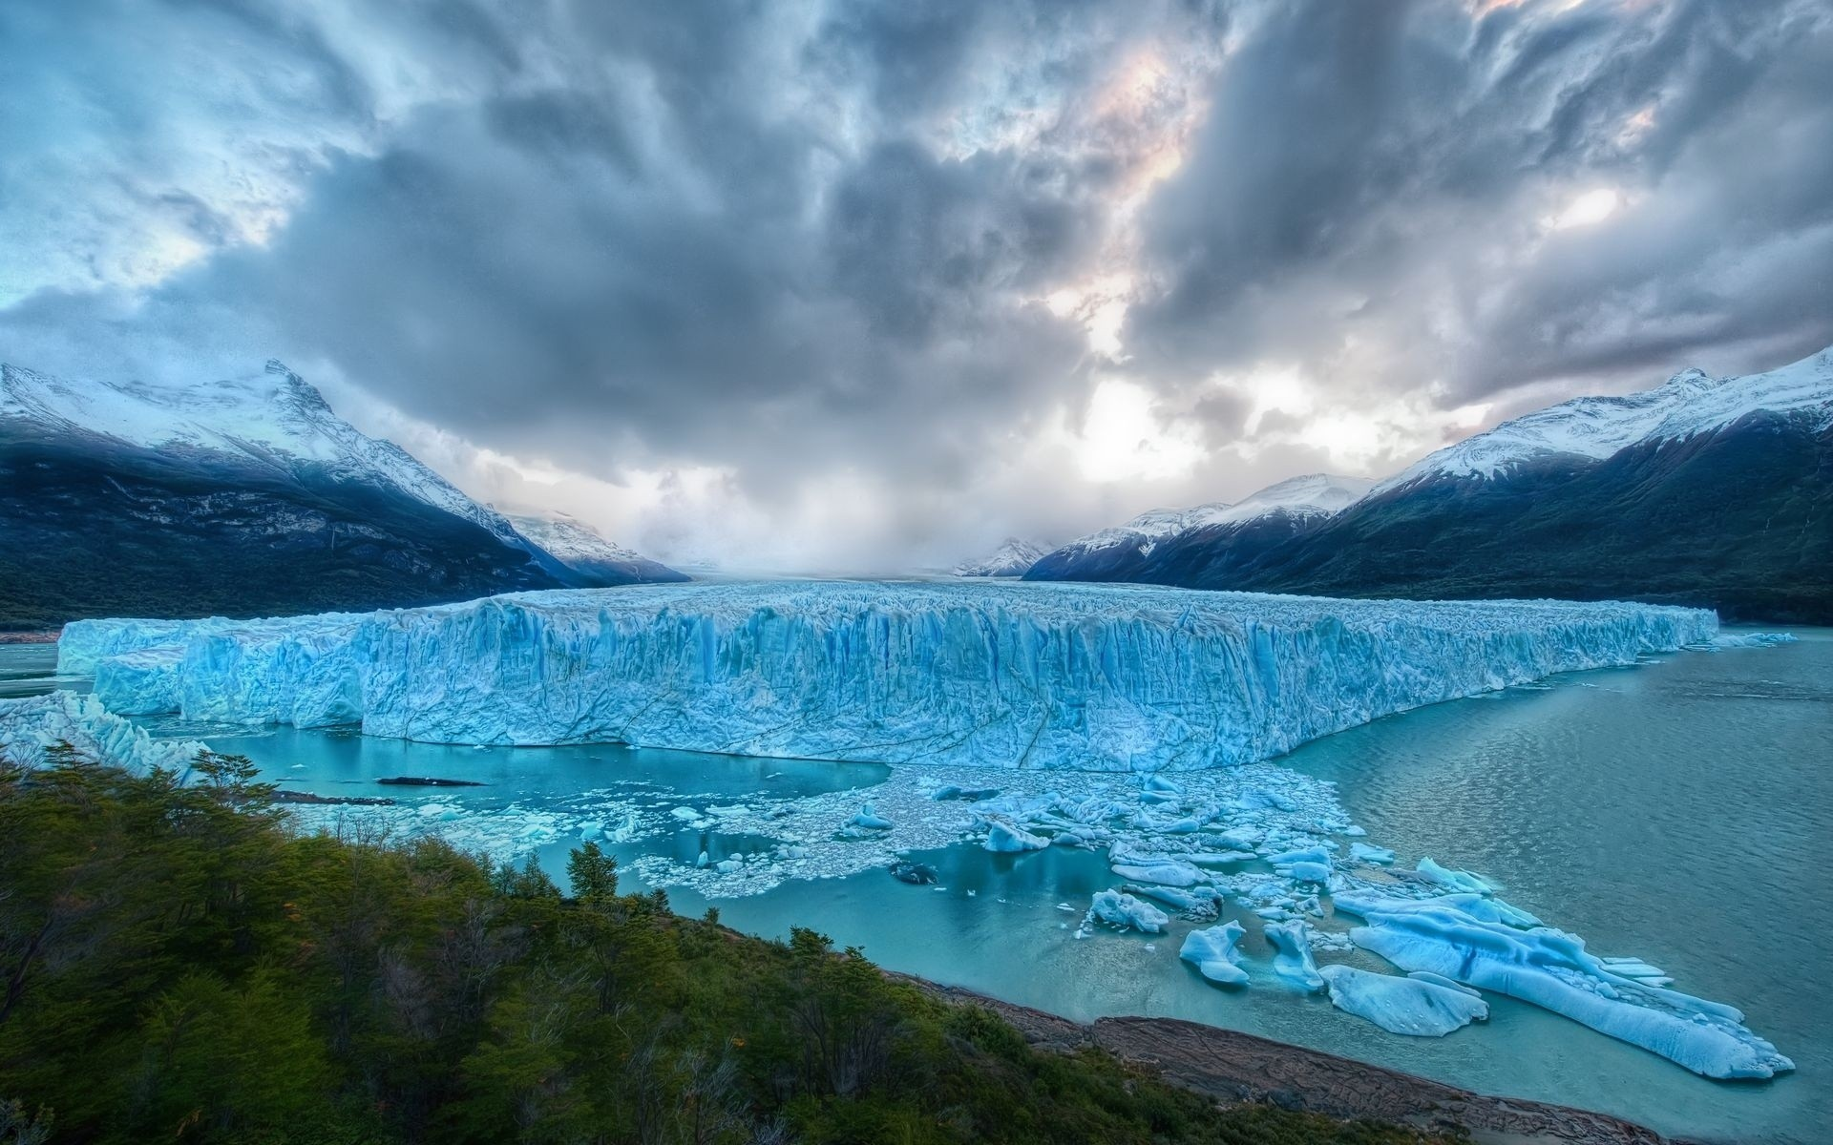
Glaciers are beautiful natural features

Slide 21
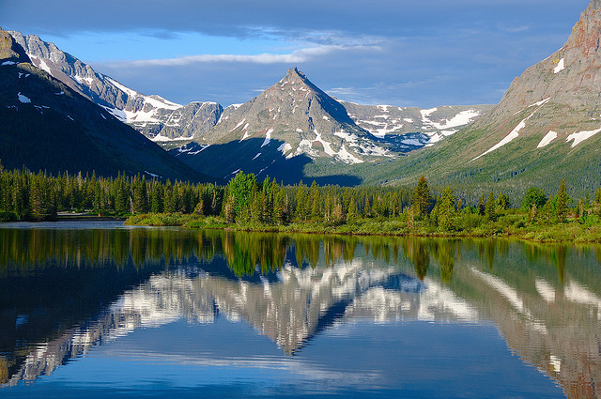
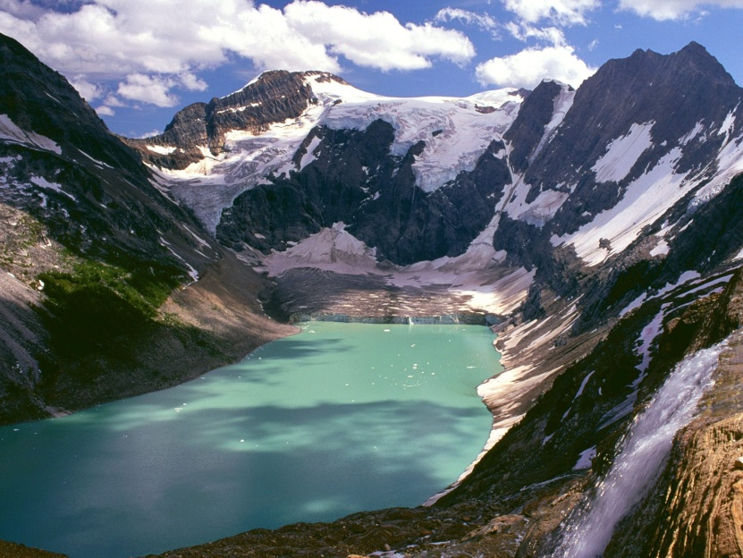
The action of glaciers produces some very distinctive landscape features
Pyramidal peak
arete
Fjord

Slide 22
What is a glacier?
https://www.youtube.com/watch?v=k6gk1b4ACP0

Slide 23
What is the difference between erosion and weathering?

Slide 24
Erosion and weathering
Erosion is the wearing away and removal of material
Weathering is the action of the weather wearing away material in situ (where it is).

Slide 25
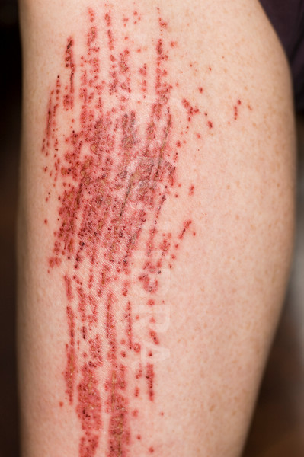
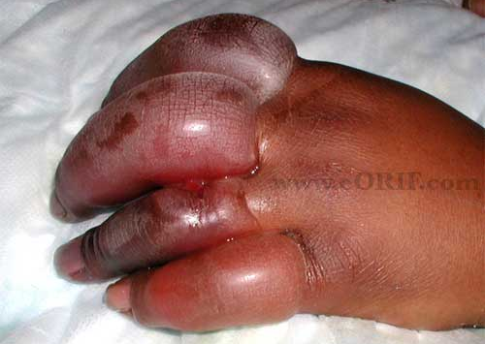
Glacial Weathering/Erosion
There are THREE main types of glacial erosion:
Plucking
Abrasion
Freeze thaw

Slide 26
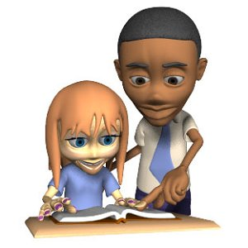
Task
Find a partner and sort yourself into the roles of TEACHER and STUDENT.
2) The TEACHERS will be shown three statements about each erosional pattern for 3mins only.
3) Using the knowledge recently gathered and the image the TEACHER needs to EXPLAIN what's happening with the THREE glacial erosional patterns (abrasion, plucking and freeze thaw) to the STUDENT.

Slide 27
Freeze-thaw is a process of weathering that happens when melt water or rain gets into cracks in the bedrock (usually the back wall). At night the water freezes and expands causing a crack to get larger. Fragments may then fall under gravity.

Slide 28
Plucking is when melt water from a glacier enters cracks in the rock. It then freezes to the glacier and base rocks. When the ice moves downhill, rock is plucked (pulled out) from the back wall and carried a long by the glacier.

Slide 29
Abrasion is a sandpapering action. It happens when rocks in the base and sides of the glacier rub against the valley floor and sides as it moves. This wears away the rock, often leaving them with scratches.

Slide 30
Plucking is when melt water from a glacier enters cracks in the rock. It then freezes to the glacier and base rocks. When the ice moves downhill, rock is plucked (pulled out) from the back wall and carried a long by the glacier.
Abrasion is a sandpapering action. It happens when rocks in the base and sides of the glacier rub against the valley floor and sides as it moves. This wears away the rock, often leaving them with scratches.
Freeze-thaw is a process of weathering that happens when melt water or rain gets into cracks in the bedrock (usually the back wall). At night the water freezes and expands causing a crack to get larger. Fragments may then fall under gravity.

Slide 31
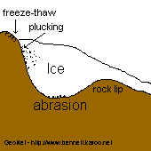

Slide 32
Upland glacial features (erosion) THE FORMATION OF CORRIES, ARETES AND PYRAMIDAL PEAKS
Watch the video of the formation of a corrie and afterwards describe the formation to a partner.

Slide 33
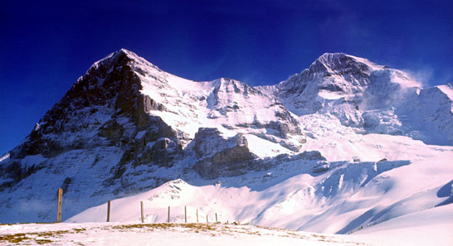
Erosional features: Pyramidal peaks, aretes and corries
http://www.youtube.com/watch?v=uYwGVVK3H2c

Slide 34
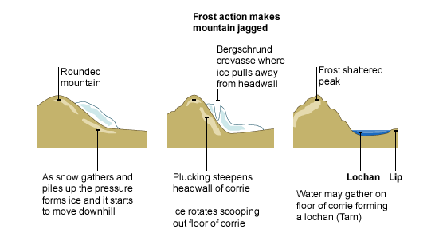

Slide 36
Exam question - recap
Explain the formation of a corrie (4 marks)
A corrie is an arm chair shaped hollow on a hillside. It is formed when snow and ice collect in a hollow.
The snow and ice move downhill under the force of gravity and the back wall of the hollow is plucked out and steepened.
The plucked material is carried by the glacier – it rubs against the base of the hollow and deepens it.
Ice is thinner at the front of the hollow and so there is less erosion – this leads to the development of a rock lip.
When glaciation is over and the snow and ice melt the corrie may fill with water forming a corrie lake (tarn lake)

Slide 37
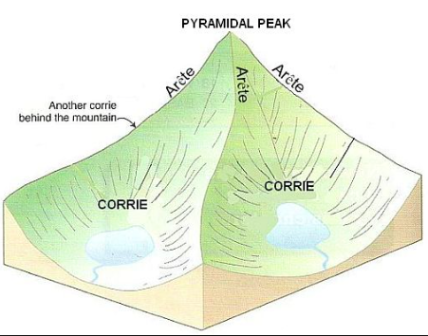
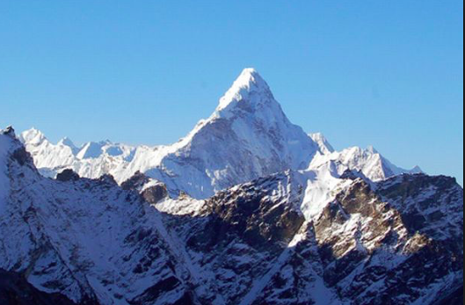
Pyramidal Peak - formed where three or more corries intersect back to back, forming a sharp, pointed hilltop between them

Slide 38
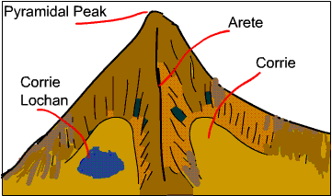

Slide 39
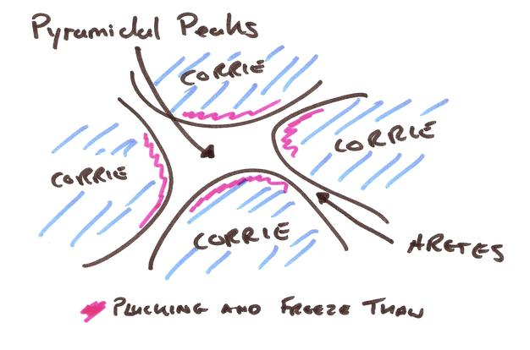

Slide 40
Task: The making of Everest Cartoon strip
Success criteria for cartoon strip
Link to processes:
Include tectonics theory
geology and
glaciation theory
Include a range of appropriate geographical terminology
Include well annotated diagrams
Include the correct processes in a logical order
https://www.youtube.com/watch?v=KnE6S_Mb-mY
Stage 1 - Continental Drift - India on the Move (16:00 - 16:51) Stage 2 - Crashing & Folding (17:15 - 19:46) Stage 3 - Folding & Thrusting (19:46 - 22:30) Stage 4 - Everest in 2013 - Most Famous Mountain in the World Stage 5 - Growing Pains - The Quakes (27:55 - 31:30) Stage 6 - Monsoon & Glaciers - Cutting Everest Down? (31:43 - 34.55) Extension- Is Everest shrinking or growing? (36:55 37:50)
Suggested video timings to help you with cartoon.

