Slide 1
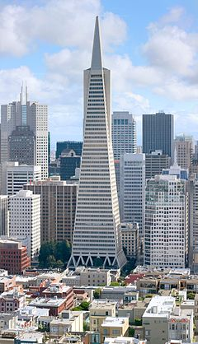
The image on the left shows the Transamerica pyramid in San Francisco.
How is this building different to those around it?
Why do you think its features are different?

Slide 2
What: Designing an Earthquake resistant building
Why: To understand how we can reduce the risks of earthquakes
How: By designing or making an earthquake proof building and explaining the choices made (extension: condsidering how may this be different in an LEDC like Haiti?)
Final essay question: “Was the Haiti 2010 Earthquake a bigger disaster than the Japanese Earthquake of 2011?”

Slide 3
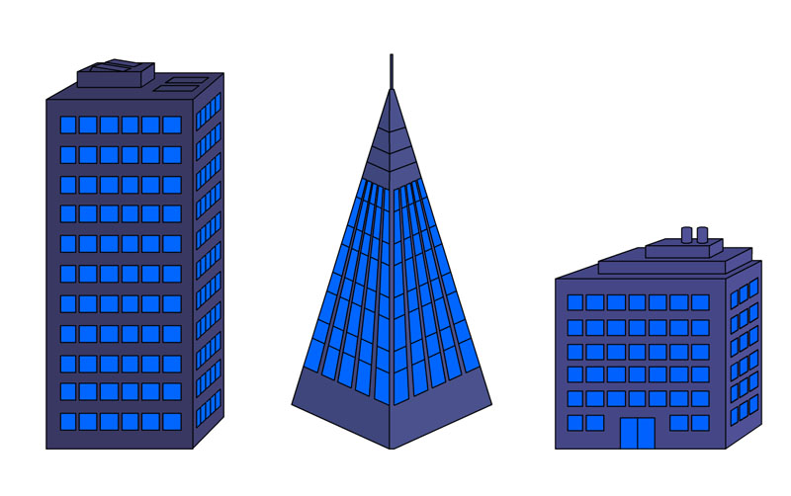
How can we make a building more ‘earthquake-proof?
Wide base
Plenty of support / weight at the base
Thin-pointed top
Cross bracing

Slide 4
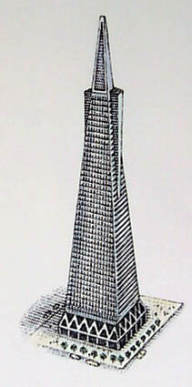
How is this building ‘earthquake proof’?
Counter-weighting: Large weights are placed on top of the building to help counter the effects of sway when the ground shakes.
Steel K-bracing: Steel bracing has been used at the base of the building to help hold the walls together. When the ground shakes the walls are more likely to stay held together by the steel braces, which are light-weight and fairly flexible. The steel bends with the seismic waves and so is less likely to break apart.
Geology: The building is built on a hard rock, through which seismic waves travel slowly, reducing the shaking to a minimum.

Slide 5
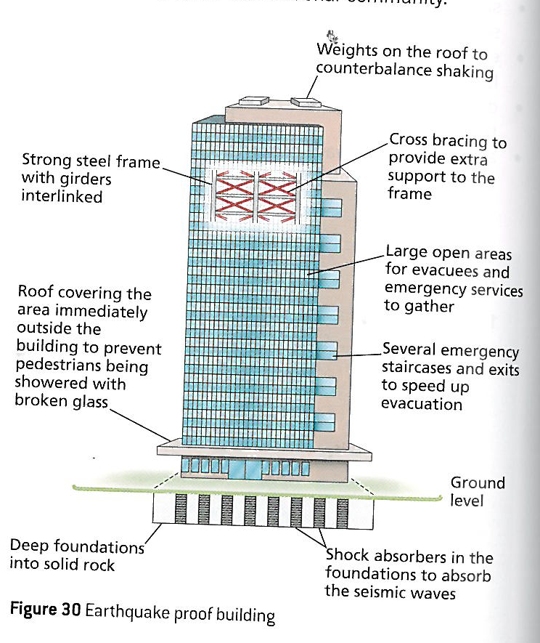
Watch the videos on the weebly to add more understanding of Earthquake resistant building design

Slide 6
Building safe houses in LICs

Slide 7
This week’s Task
Design a earthquake proof building
Your building should take into consideration design, construction and geology
Pick between 5-10 characteristics from the next page
Draw your building at the centre of your page or make a model of the building using resources you find around your home .
Annotate your building to describe the characteristics you’ve chosen and explain why you’ve included them.

Slide 8
Pick between 5-10 characteristics from the list below
Triangular shape | Square shape | Circular shape | X bracing
Short building | Tall building | Base isolators | K bracing
Counter-weights | Shock absorbers | Fixed base | No bracing
Steel | Concrete | Paper | Wood
Glass | Bricks | Plastic | Tiles
Sand | Soft mud | Hard bedrock | Reclaimed land
Steep Slope | Flat land | Near a fault line | Away from a fault

Slide 9
Success criteria 1
You all must:
Write a supporting statement about your design describing the features included, explaining your choices and if you can justifying your decision making.
You may:
Draw your design on A3
Build a 3D model of your design
You could:
Include maps showing where you would build your building
Include photographs of real life buildings to support your decision
Please consider:
DESIGN: What design features will help your building to stay standing in an earthquake? Think about shape and size in particular.
CONSTUCTION: What type of materials are likely to stay strong and stay together in an earthquake? Think about what your building will be made from. How may these vary be different in an LEDC and MEDC?
GEOLOGY: What does your building need to be built upon to help withstand or limit the shaking? Think about rock type and landscape in particular.

Slide 10
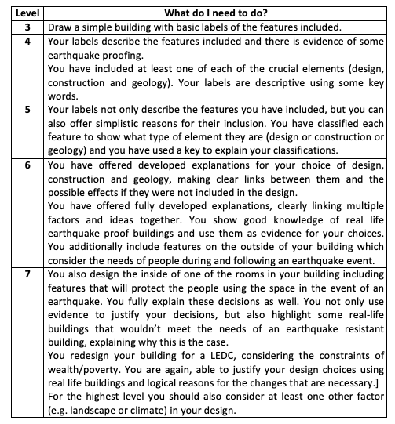
Success criteria 2

