Slide 1
Changing leisure patterns
How do human development processes give rise to leisure activities?

Slide 2
IB Objectives

Slide 3
Add your thoughts to the padlet on the Geog weebly

Slide 4
What do we mean by leisure?

Slide 5
What is leisure?
Leisure: Any freely chosen activity or experience that takes place in non-work time. People use their leisure time in many different ways and these differences are often based on the context of their location and level of economic development.
How do you think leisure might vary depending on location/development?

Slide 6
Categories of leisure
Leisure, as a concept, can be divided into 3 main categories:
Recreation is a leisure-time activity undertaken voluntarily and for enjoyment. It includes individual pursuits, organised outings and events, as well as non-paid (non-professional) sports.
Sports are physical activities that involve using skills in events and competitions at the local, regional, national and international scales. Sport can either be amateur (if participants are unpaid) or professional (if the competitors are paid).
Tourism refers to travel away from home for at least one night for the purpose of leisure; day ripping is not regarded as tourism.

Slide 8
Leisure in different geographical and developmental contexts
An important facet of human well-being is achieving an appropriate work-life balance.
Too little work may prevent people from achieving an adequate income, while working too much may lead to poor health and cause problems in personal life/relationships.
The OECD (Organisation for Economic Co-operation and Development) evaluates work-life balance using international statistics in two areas:
The proportion of employees who usually work for pay for 50 hours per week or more.
The time in a typical day that full-time employed workers devote to leisure and personal care.

Slide 9
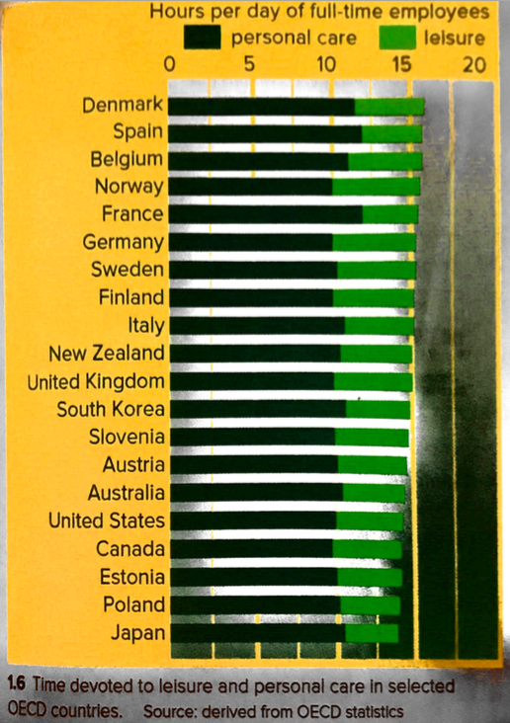
Describe the overall pattern of leisure time (excluding personal care time) for societies in different geographic contexts
Personal care = washing, eating, sleeping etc

Slide 10
Describe the overall pattern of employees working 50 hours per week or more in selected OECD countries

Slide 11
Geographical skills: graphs and statistical analysis
Draw a scatter graph of the data in 1.7. GNP should be on the vertical axis and employees working 50 hours or more on the horizontal axis. Try to draw a line of best fit through the scatter points.
Describe the relationship you have found in the graph.
Calculate a more statistically precise analysis of the data by performing a Spearman’s Rank statistical test. Instructions for how to do this are on the worksheet provided.
Describe the findings of your statistical analysis.

Slide 12
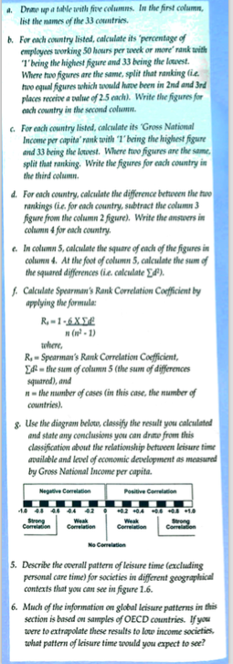
Instructions for conducting a statistical test:
Spearman’s Rank for Correlation Coefficient

