Slide 1
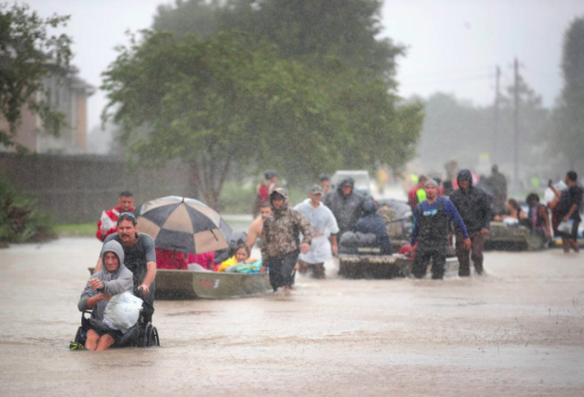
Living graph: Hurricane Harvey

Slide 2
Task
Cut out these statements
Put them into the order you think they occurred in
Place them on the living graph to reflect the emotion that may have been felt at this time
Add your own hurricane Harvey experiences and emotions to the living graph

Slide 3
Living graph: Hurricane Harvey
Aug 24
Aug 26
Aug 28
Aug 30
Sept 1
Sept 3

Slide 4
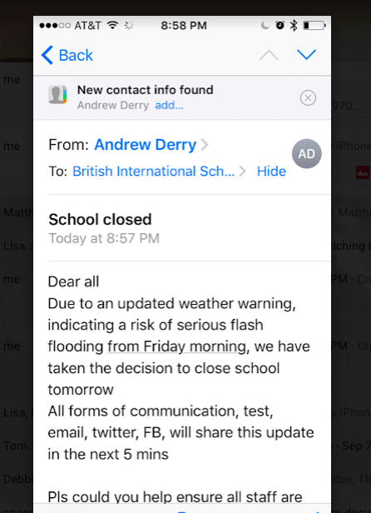

Slide 5
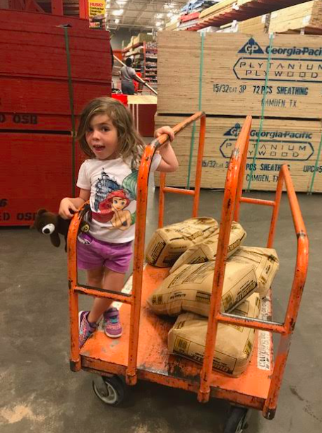
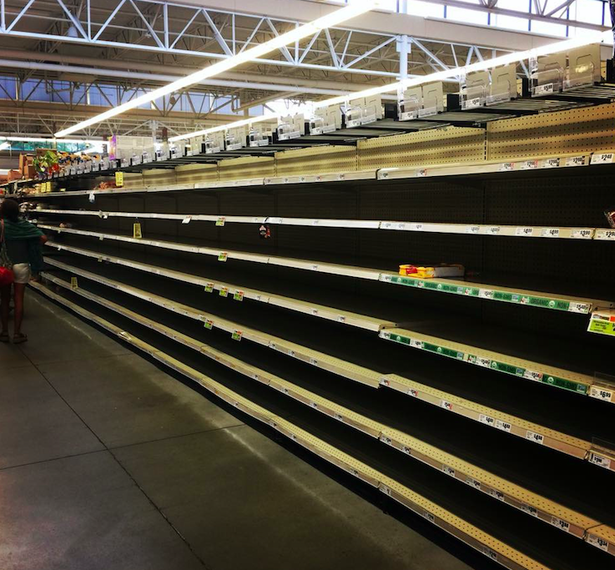

Slide 6
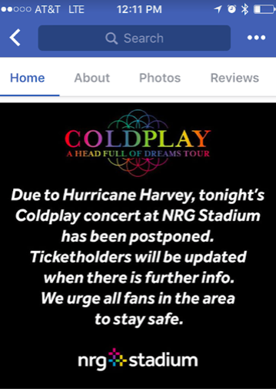

Slide 7
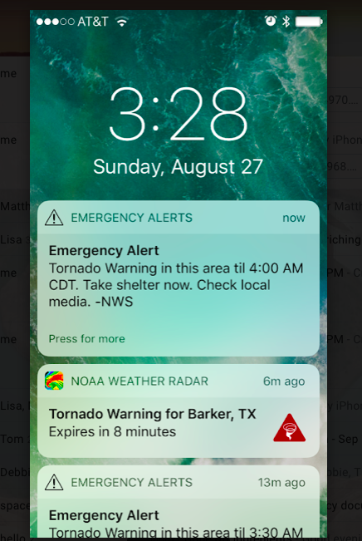

Slide 8
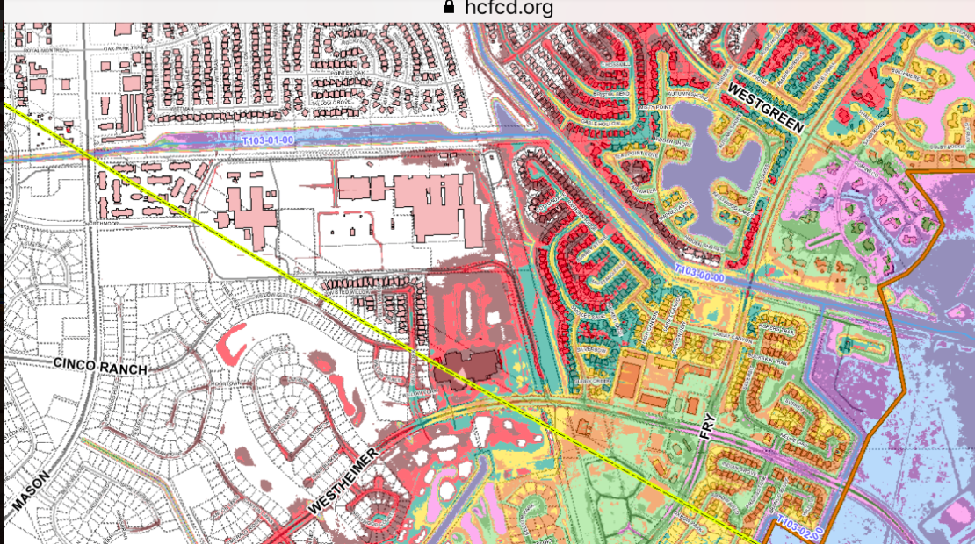
Projected flood map Cinco Ranch

Slide 9
