Slide 1
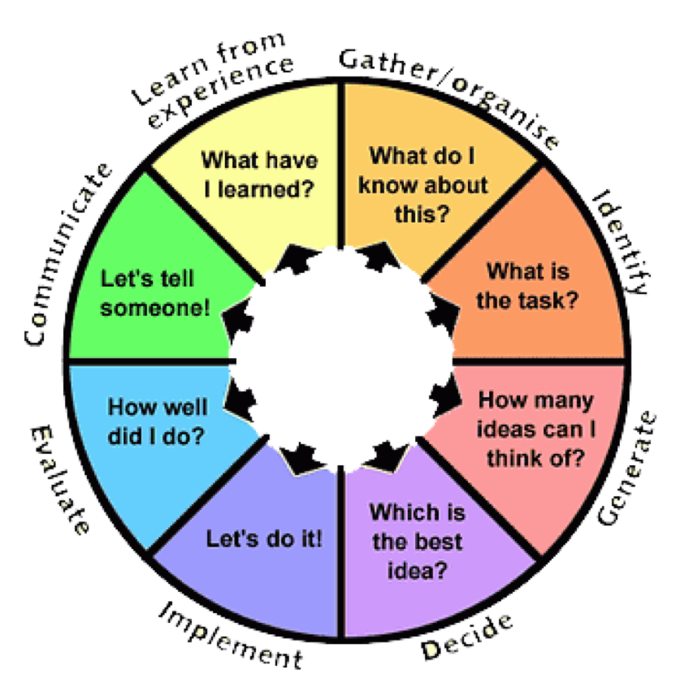
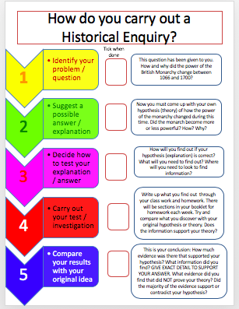
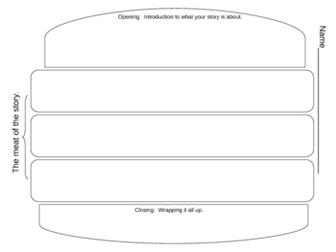
When you need to list things:
Firstly…
Secondly…
Thirdly…
Finally…
When you need to explain both sides of the argument:
On the other hand…
Whereas…
However…
Alternatively…
When you need to highlight similarities
In the same way…
Likewise…
Similarly…
As with…
Compared with…
When you want to add something to what you have written:
Also…
As well as…
Moreover…
In addition…
Furthermore…
When you need to explain why something happened:
Therefore…
Consequently…
One consequence of this was…
This meant that…
Due to…
This caused…
When you want to use evidence:
The evidence suggests…
According to…
The evidence demonstrates…
The evidence contrasts with…
The evidence is useful because…
The evidence illustrates
When you want to give examples:
For example…
For instance…
This can be seen in…
This is shown by…
This can be proven by…
This is revealed by…
When you want to contrast:
However…
On the other hand…
Although…
Despite this…
On the contrary…
Instead…
Whereas…
In contrast…
When you want to prove impact:
This led to…
This resulted in…
As a result of…
This meant that…
When you want to stress something:
Above all…
In particular…
Especially…
Significantly…
Mainly…
Usually
More importantly…
Fundamentally…
Crucially…
When you need to sum up:
In conclusion…
Finally…
On balance…
In summary…
Having considered the evidence…
Overall…
To conclude…
Humanities Enquiry
Humanities
Know how to structure your sentences and paragraphs
to answer questions
Sentence
Paragraph
Make your point – answer the question directly.
The first key feature of the work of Louis Pasteur was his development of the Germ Theory
Explanation of your point – how/why/when/where/who?
In the 1850’s Pasteur became interested in micro-organisms. He was employed by a brewery to investigate why beer was going bad……
Factual development
In order to prove his germ Theory Pasteur conducted an experiment using flasks…..
Paragraph starts and ends
To start:
It appears that....
The evidence suggests....
I believe....
In my opinion...
I infer that....
It would seem that....
I suggest....
The main point…
The most significant….
One way in which……
Answer the question - evaluate significance
Pasteur’s discovery was significant in the development of medicine because…..
To end:
In conclusion....
It is therefore clear....
In summary....
In conclusion...
Overall....
Therefore....
Ultimately....
Point
Evidence
Evaluation
Utility
• Nothing is ever useless; even the most one-sided source full of lies reveals what that author thought.
• Talk most about the ways in which the source is useful.
• Don’t use the word ‘reliable’ here, use ‘trustworthy’
• Look at what the source is telling you and compare it to what you need to know
• An inaccurate source is useful in revealing an author’s opinions BUT not facts
• Compare the source’s strengths and limitations and come to a conclusion
Judgment
• Recount relevant surface/inferred information from the sources.
• Realise that the sources support both sides of the argument., and that you can use the sources and your own knowledge to argue both for and against.
• Weigh the evidence to come down one
way or the other, OR state case and
prove it, discounting contrary evidence
• Refer to the content and utility (content/
accuracy and reliability) of the sources.
• Come to a conclusion - make a judgment…
The Basics
• Highlight key points
• Draw arrows to/circle key points
• Annotate or make small notes
• Discuss with others (where appropriate)
• Think about what type of source it is
• Think about the author of the source
• Think about why it was created
• Avoid the word ‘biased’ use ‘one-sided’
• Answer the question!
• Always back-up your points using the
source - i.e. a quote
.
Inference
• Ignore anything in the source that
doesn’t relate to the question
• Describe what the ‘surface’ information
says…
• Keep it simple and to the point
• Can you 'put two things from the source
together' to deduce something further?
• Is there a message ‘between the lines’?
• Does it tell you further things about the
author or the situation?
• Include 3 inferences
Compare/Contrast(differences)
• How does the content differ?
• Look first for OBVIOUS surface differences of fact, but then study the words/ details to deduce differences in approach, emphasis or tone.
• Why do the sources are differ?
• Compare who wrote them, in what situation, and the motives/ intentions/purpose of the author.
• Make sure you come to a conclusion
Reliability
• Primary sources are immediate and even eyewitness, but they may lack perspective/ objectivity/ may be one-sided.
• Secondary sources can be dispassionate and use a number of primary sources,
but they may be guilty of misinterpreting facts.
• Sometimes the question may ask you about the 'validity' this = accuracy!
• Look at the origin of the source to establish context & purpose
• Does it tell the whole story or miss info out?
• Be specific…use the source.

Slide 2
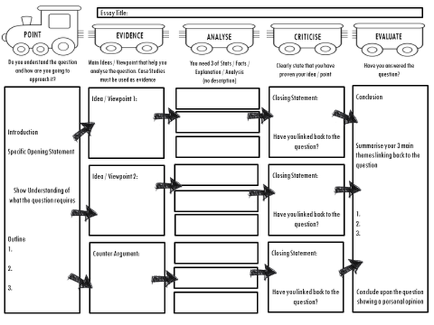
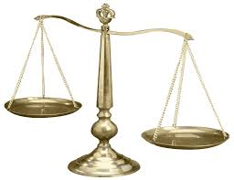
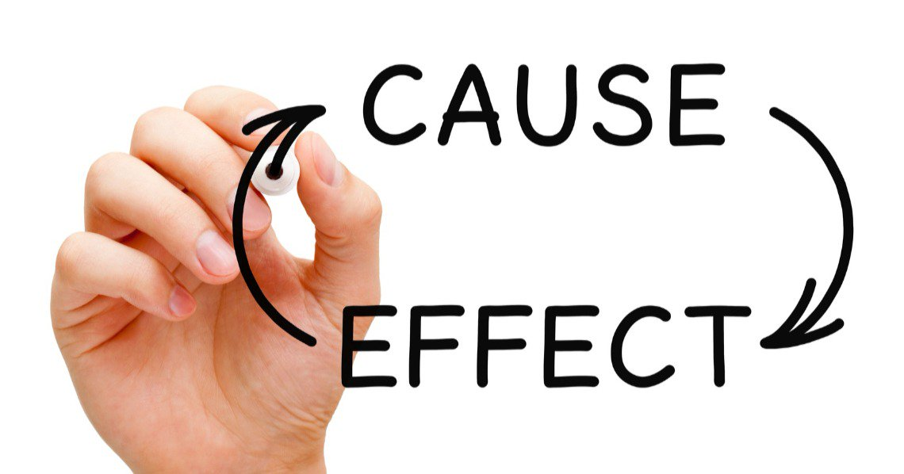
Humanities Literacy Buddy
Essay Planner
Making judgements
On the one hand
How successful…..
Factors – which factor was more important?
How far……..
Key Concepts
Perspectives
Continuity and change
Significance
1
10
Bronze words
- Archive - Autobiography - Aggression - Alliance - Age - Act - allies - Ballot - - Trade - Power - Ballot - Bill - Blockade - boycott - budget - Collective Security - - Cold War - Context - Census - Chancellor - Chronology - Citizen - Civil War - Citizenship - Coalition - Consumer - Colony - Crown - Crusade - Culture - Currency - Curfew - Council - Charter - Conference - cause - century - colonist - Conservative - corruption - Democracy - deadlock - economy - Economic - Election - Empire - Exploration - Government - Historian - Immigrants - Immigration - kingdom - Monarchy - Military - modern - Negotiation - Occupation - parliament – prince/princess - Primary Sources - Reign - rebel - System - slave - settlement – Tax - territory
Silver Words
Amnesty - Anarchy- Appeasement - Armistice - Autocracy - Autonomy - Agrarian - Anarchism - Balance of Power - Bibliography – buffer - Bureaucracy - Colonialism - Communism - Continental -Constitution - Centralised - Consensus - conspiracy - civilization - Dictatorship -Duties - delegate - dictator - Electorate - Emigrants - Emigration - Exploitation - Executive - Famine - Federal - Foreign Policy - Free Trade – hierarchy - Imperialism – Industrial - institution – integrate - Judicial - Labour - Legislation - liberate - Ministry - Nationalism - neutrality – pacify - patriotism – propaganda - Raj - Republic – Revolution - Reforms - Representative - radical - Secondary Sources - Senate – strategic - super-power - Treason – Treasury -Tariff - Terror - Tenant - Vested - Veto
Gold Words
Aristocracy - Autarky – bicameral - Bolshevism - Bull (Papal)- Constituency - Decolonization - Demagogue - Despotic - Divine Right - Excommunication - espionage - Fascism - Feudalism - Fanaticism - Fiduciary - Franchise – Guild - Historiography - Impeachment - jingoism - Laissez-Faire - Legislative - Nazism - Neo-colonialism - Neolithic - Plebiscite - Palaeolithic - partisan - Renaissance – remilitarize - Secularism - Socialism - Syndicalism - Suffrage - Totalitarianism – Temperance - unilateral
Key Words
Chronology sorter
3000bc
2500bc
2000bc
1500bc
1000bc
500bc
1ad
500ad
1000ad
1500ad
2000ad
2500ad

