Slide 1
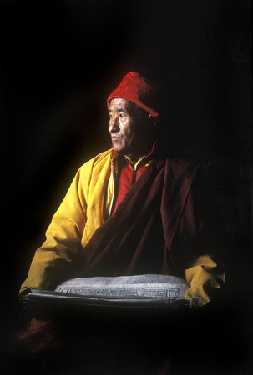
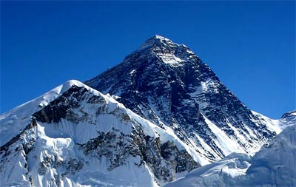
Life In The Mountains!
What does ‘Sherpa’ translate as?
Who where the first to move from Tibet to Nepal?
What was it that brought the Sherpa people to the attention of early European climbers?
Approximately, how many Sherpa's live in
Nepal today?
Where do most Sherpa's live today?
Why do you think they grow their crops on the lower plans while they live in the higher grounds?
Describe how Sherpa's divide their work
Who was Tangzing Norgay? (left)
What has brought wealth to the Everest region of poor Nepal?
What did Sherpa's traditionally work as?
How is Everest regarded in Sherpa homes today?

Slide 2
Life In The Mountains!
Explain the Sherpa religion:
Why was climbing the mountains once thought to be blasphemous?
What does Chomolungma mean?
What is a Puja ceremony? When does it take place?
What are prayer flags? How do they ‘work’?
How have Sherpa's used their fame to benefit themselves?
What is the Sherpa's basic garment called?
What does it look like? (Draw and/or describe)
How has Sherpa's housing changed?
What are the main stables of the Sherpa's diet?
Do Sherpa's eat meat?
Namaste! – Greetings!
What is unusual about the Sherpa language?
Where did the language originate?
How has the language been influences?

